Slide 1
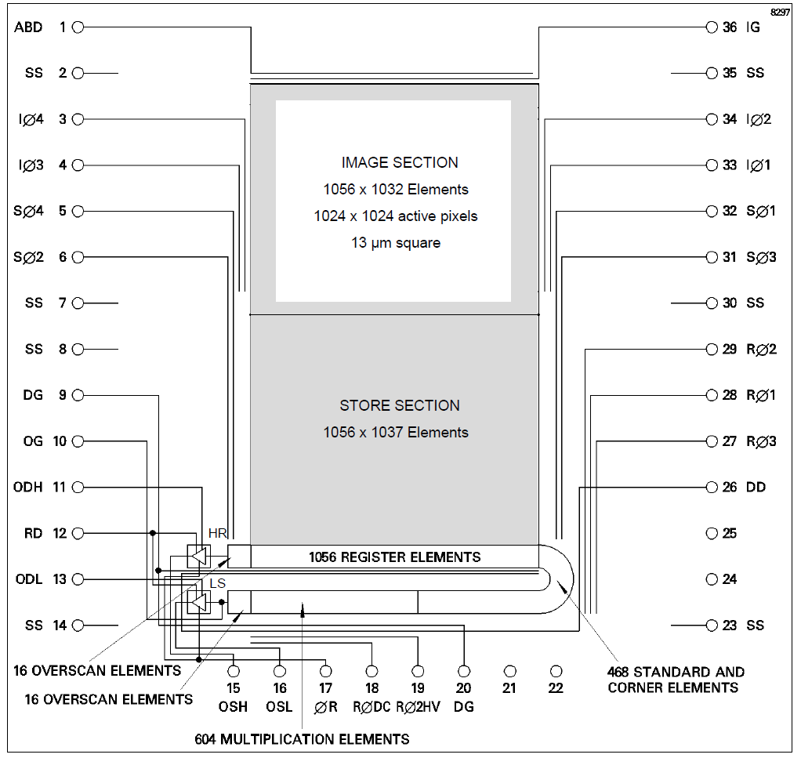
Naming convention for the registers
CGI Image Area
Standard register
corner register
gain register

