Slide 1
EMCCD Frame Geometry
Brian Kern, Sam Miller
2021, Dec 7

Slide 2
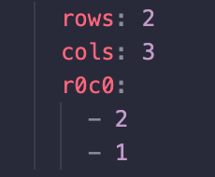
Region Definition Convention
Detector regions are defined in metadata.yaml using the following convention:
rows: number of region rows
cols: number of region columns
r0c0: coordinates (row, col) of the corner closest to (0, 0) of the array
For example, in a 5x5 array of zeros, the following geometry would describe the region of ones, where (0, 0) is defined as the top left of the array:
rows: 2
cols: 3
r0c0: (2, 1)
[[0, 0, 0, 0, 0],
[0, 0, 0, 0, 0],
[0, 1, 1, 1, 0],
[0, 1, 1, 1, 0],
[0, 0, 0, 0, 0]]
How it looks
in metadata.yaml:

Slide 3
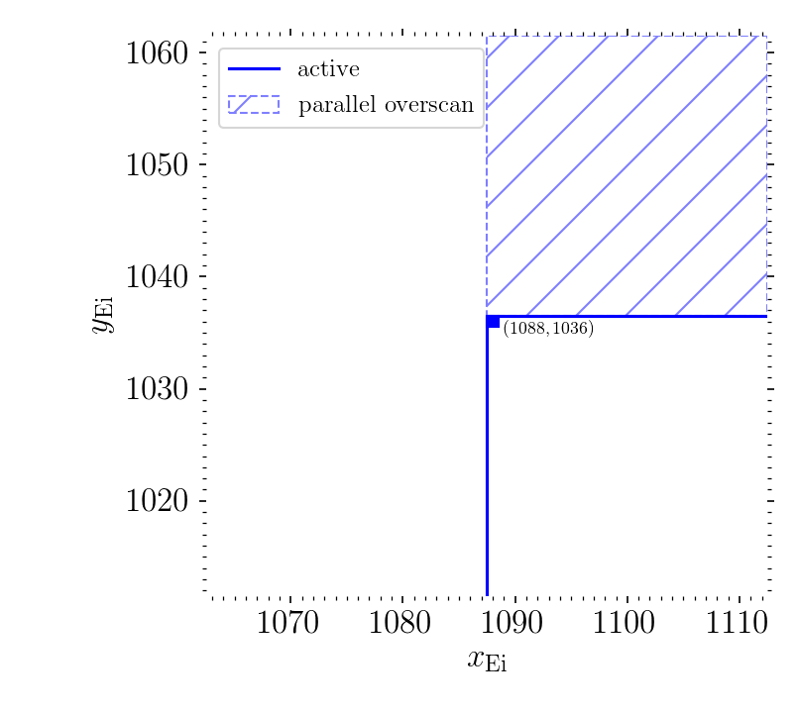
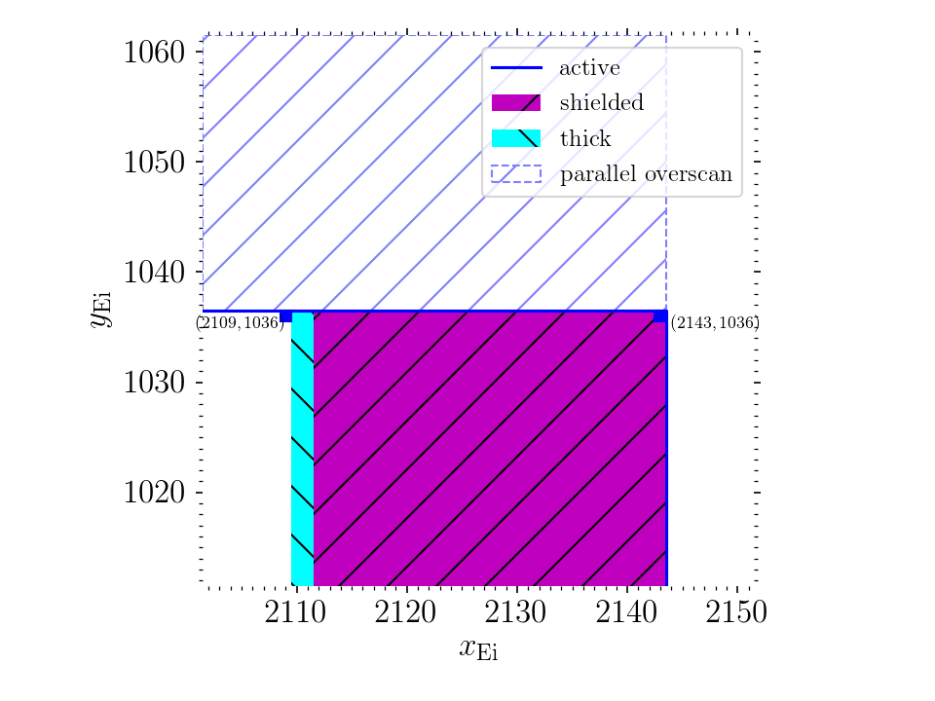
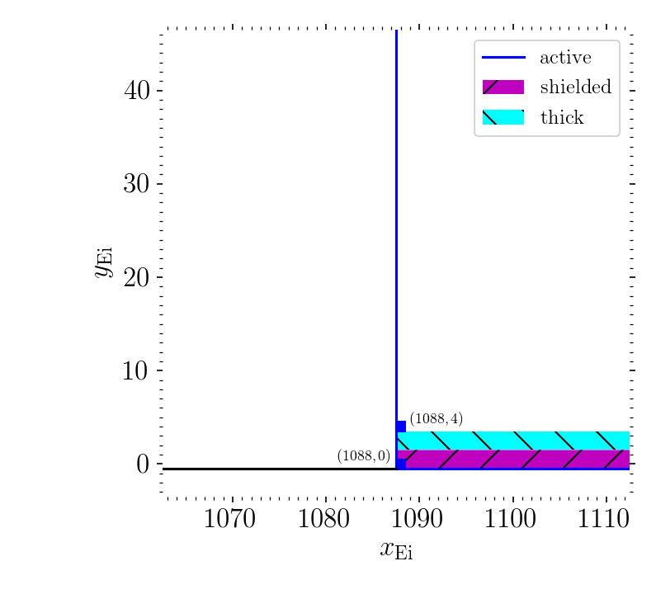
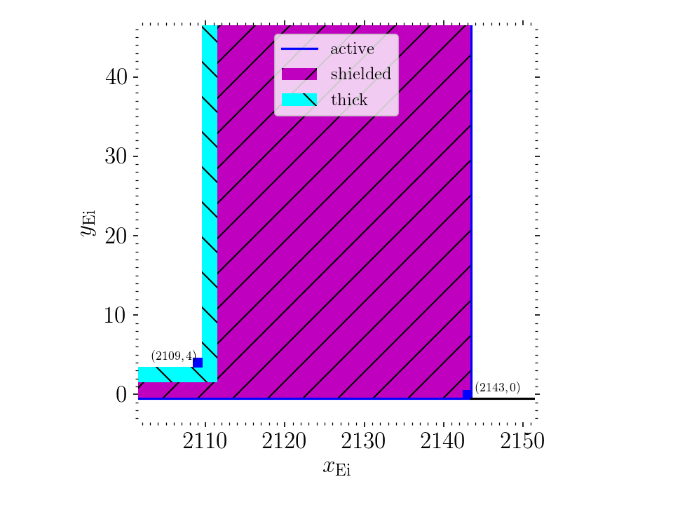
Active Region Corners
Unshielded active region has
the following geometry:
rows: 1033
cols: 1021
r0c0: (4, 1088)
(Note that the image here is
in (x, y) coordinates, so they
are expressed in reverse order
from (row, col) coordinates.)
However, we want an image
region of 1024 by 1024. In
order to achieve this some
of the unshielded rows need
to be excluded and some of
the shielded columns need to
be included.

Slide 4
Image Region Corners
The most logical option is to
keep the upper left corner
where it is. Since it borders the
parallel overscan and prescan,
it is definitely a good pixel
with no transition (unlike the
pixels at near the shielding).
This means that some of the
good rows near the bottom
are trimmed off and some of
the shielded columns on the
right are included.
(2111, 1036)
(1088, 13)
(2111, 13)

Slide 5
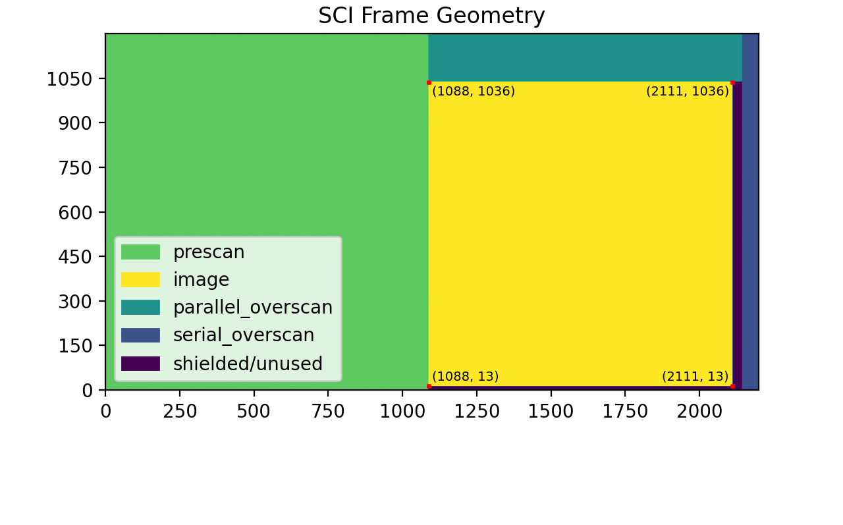
SCI Frame Geometry

