Slide 1
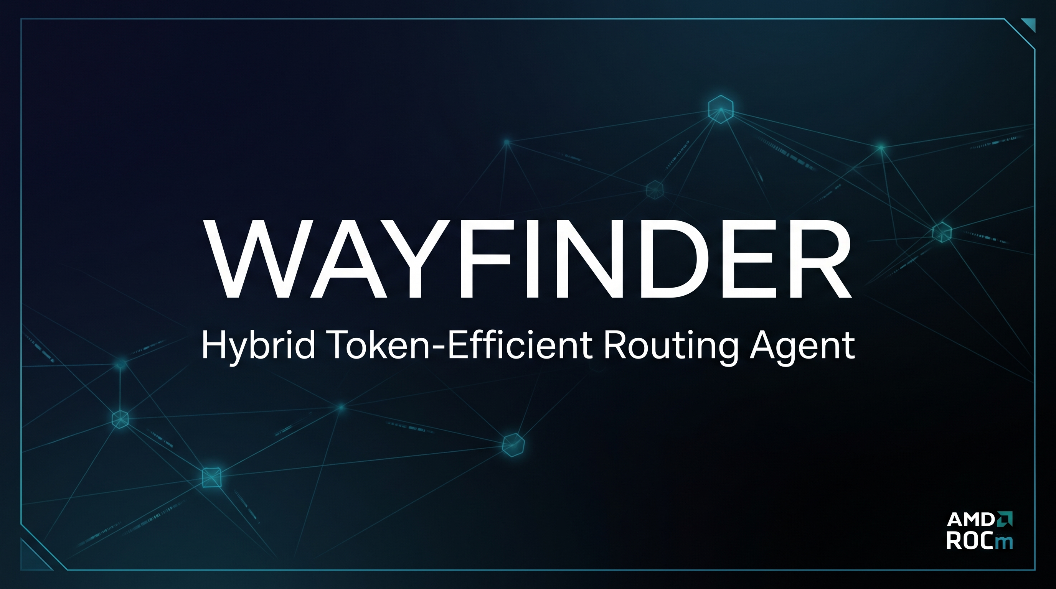
AMD Developer Hackathon ACT II — Track 1
Sebastian Balanta

Slide 2

The Challenge
Accuracy vs Cost Tradeoff
Why It Matters
- No single model excels at every task type
- Token budgets are limited, every call counts
- Premium models cost 10-100x more per token
- Smaller models respond 3-5x faster
- Waste: routing every query to the largest model
- Hackathon constraint: $50 credit must last
- Manual model selection doesn't scale
- Gemma Prize requires efficient routing
- 14 diverse benchmark tasks across 8 categories
- Solution: intelligent task-aware dispatch

Slide 3

Architecture
Classifier -> Selector -> Router -> Evaluator
Gemma 4 26B
Gemma 4 E4B
DeepSeek V4 Pro
GLM 5.2
- Dedicated H200 - Reasoning, Creative
- Local ROCm/llama.cpp - Ranking
- Serverless - Code, Math
- Serverless - Complex reasoning

Slide 4
Routing Flow
Classify
Analyze prompt -> MATH, CODE, REASONING, FACTOID, etc.
Select
Pick optimal model per task + max_tokens
Route
Call model via Fireworks API or local llama.cpp
Evaluate
Score response accuracy, detect failures
Fallback
If score too low, try next model in chain
Return
Package result with model, tokens, cost metadata

Slide 5
Results
73
82%
100%
$0.002
Tests Passing
Coverage
Accuracy
Cost/Run
Coverage Breakdown
Key Achievements
- models.py: 100%
- OpenSpec validated — 77 documented tasks
- tasks.py: 91%
- Gemma 4 routed 9/14 benchmark tasks
- router.py: 86%
- 100% accuracy at $0.002 per run
- 53 source files, 301 statements
- Docker + Streamlit + CLI — 3 delivery modes
- 4 test files, pre-commit QA gate

Slide 6


Tech Stack
Python 3.13+
Streamlit 1.59
uv, pytest, ruff — modern toolchain
Interactive Web UI, forms, dataframes
Fireworks AI
AMD ROCm
Serverless + dedicated H200 inference
Local Gemma 4 E4B via llama.cpp, 48GB VRAM
Docker/Podman
OpenSpec SDD
Containerized with Quadlet systemd
77 documented tasks, CLI-validated specs

Slide 7
Gemma Prize
Gemma 4 Integration
26B
Dedicated H200 deployment (4x NVIDIA H200 141GB, ~$28/hr)
E4B
Local inference via llama.cpp on AMD ROCm GPU (48GB VRAM, $0 cost)
Prize Requirements
Cost Efficiency
- Gemma 4 model used in routing agent
- Dedicated H200: ~$78 total (2.54 GPU hours)
- Task-aware selection demonstrates efficiency
- Local E4B: $0 per inference (free tier)
- Local Gemma 4 E4B for zero-cost ranking
- Serverless: ~$0.002 per benchmark run
- Hybrid: dedicated + local deployment strategy
- Total under $80 for full development + eval

Slide 8
Live Demo
Streamlit Web UI | CLI Interface | Benchmark Evaluation
github.com/PostboxRetinal/amd-hackathon-act2

Slide 9
Thank You
Wayfinder — Hybrid Token-Efficient Routing Agent
Questions?
PostboxRetinal — AMD Hackathon ACT II 2026

