Slide 1
Machine learning -
Facial expression recognition

Slide 2







Datasets
1. CK+
327 facial expressions, divided in 7 categories
Images are 48x48 px grayscale images
Contempt Anger Happy Disgust
Fear Sadness Surprise

Slide 3







Datasets
2. FER2013
28 709 training and 3 589 test instances
Divided into 7 categories
48x48 grayscale images
Angry Disgust Fear Happy
Neutral Sad Surprise

Slide 4
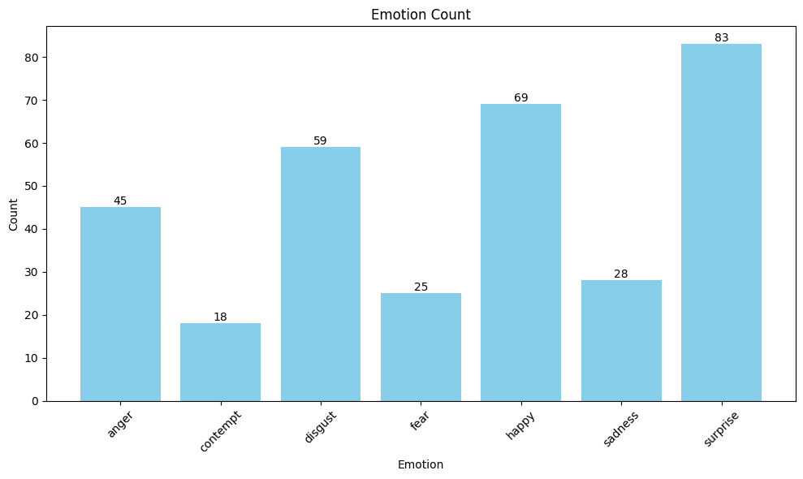
CK+ Preprocessing
The given dataset was unbalanced

Slide 5
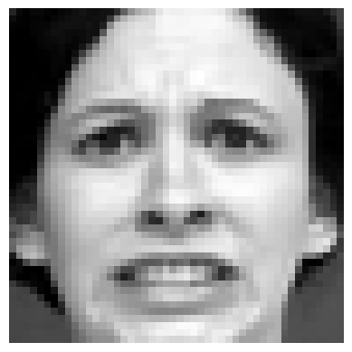
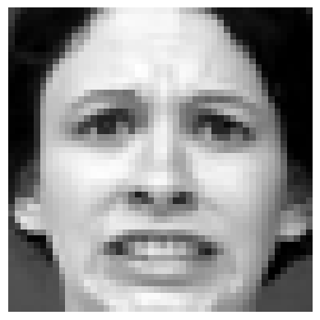
CK+ Preprocessing
One way to add more instances is by adding mirrored images
Original Mirrored

Slide 6
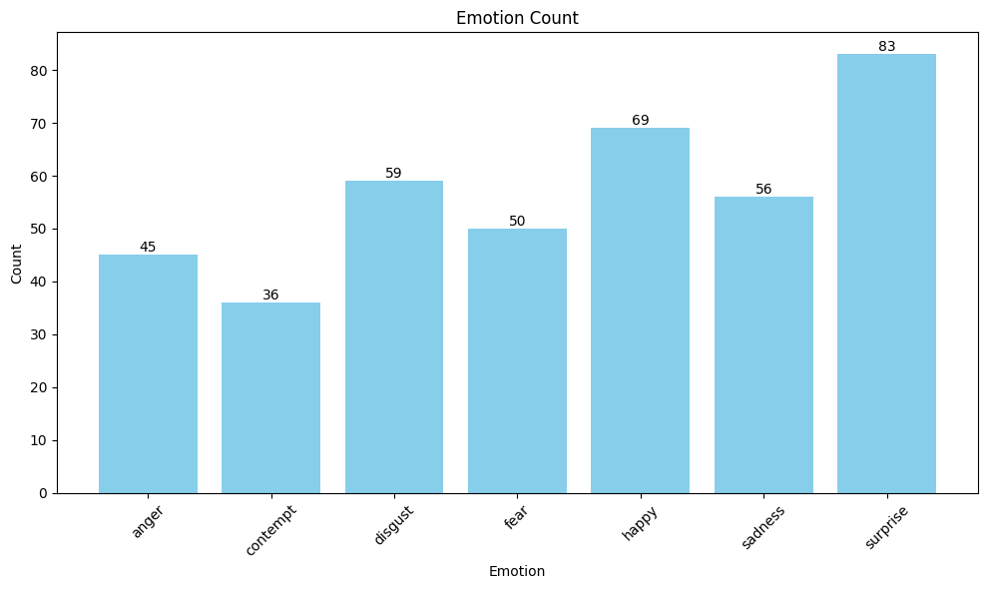
CK+ Preprocessing
After mirroring classes with fewer instances

Slide 7
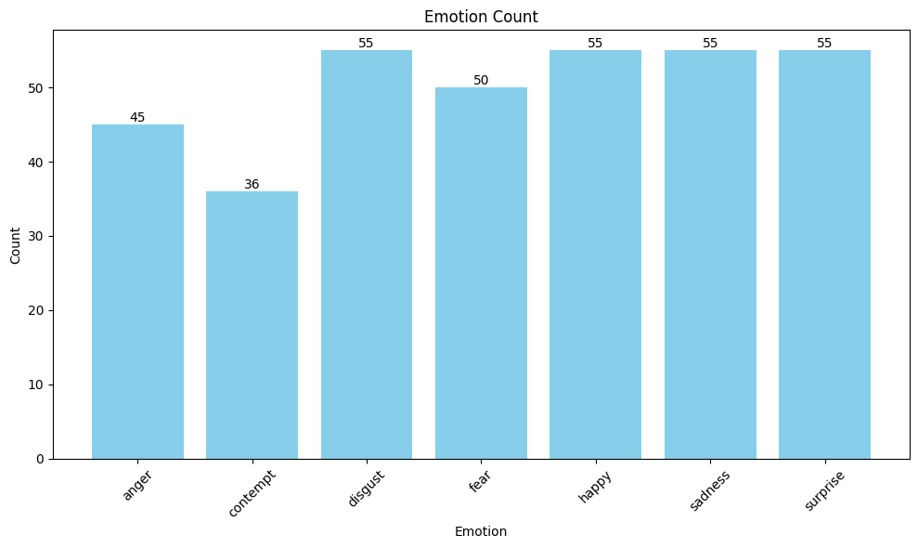
CK+ Preprocessing
After deleting some of the instances from set

Slide 8
CK+ Preprocessing
Now, we divide set into train and test set
Test data is 0.3% of the whole set, stratified by labels, so it contains 106 images.
Train data contains 245 images.
Each image is represented as 48x48 matrix with values between 0 and 255.

Slide 9
CK+ models
Convolutional Neural Networks model
Support Vector Classifier model
Neural networks model

Slide 10
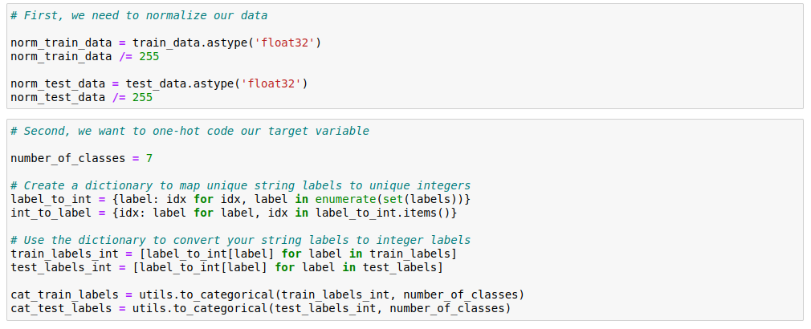
CK+ - CNN model
      First model is convolutional neural network
      In order to perform well, we normalize our images
      and make categorical values using one-hot coding
      for different emotions.

Slide 11

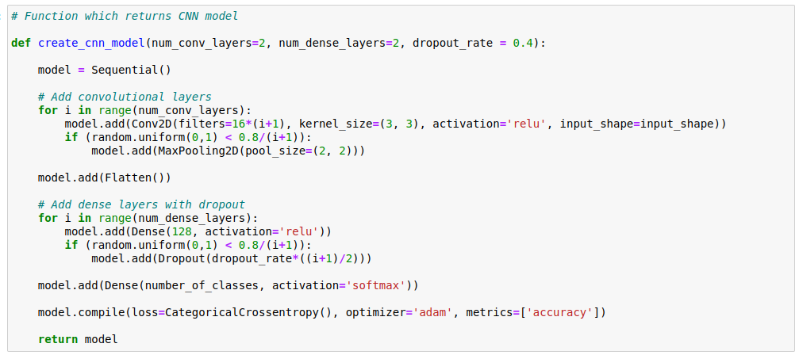
CK+ - CNN model
In order to find best parameters for CNN model, we make more models with different parrameters and test which one performs best.

Slide 12
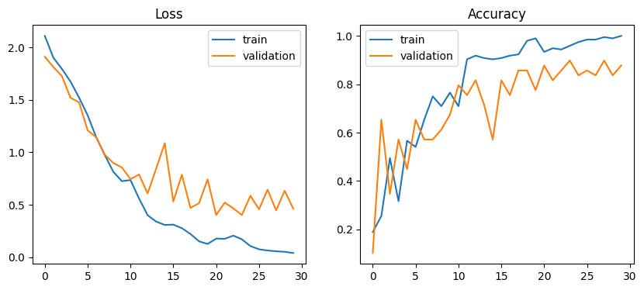
CK+ - CNN model

Slide 13
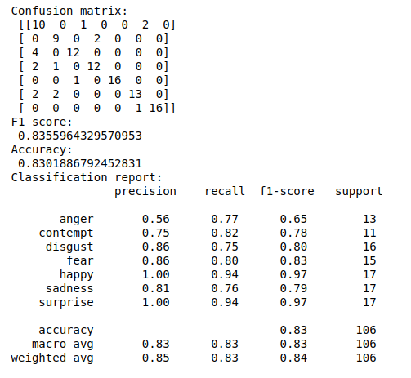
CK+ - CNN model

Slide 14
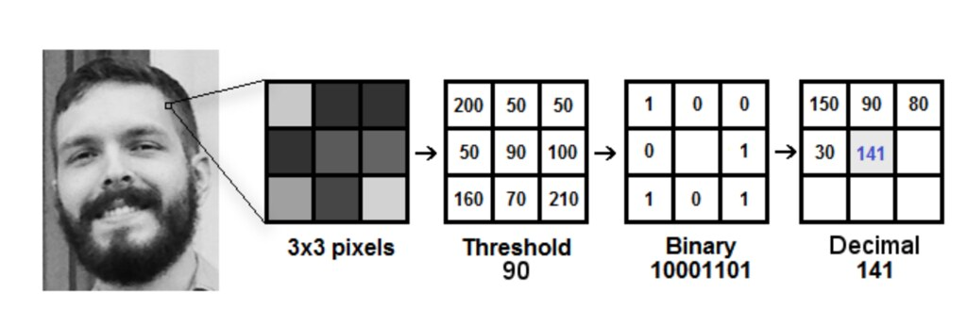
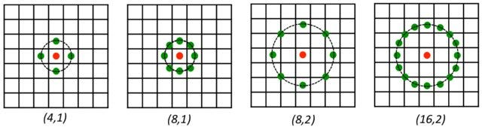
CK+ - LBP preprocessing
(Local Binary Pattern)

Slide 15
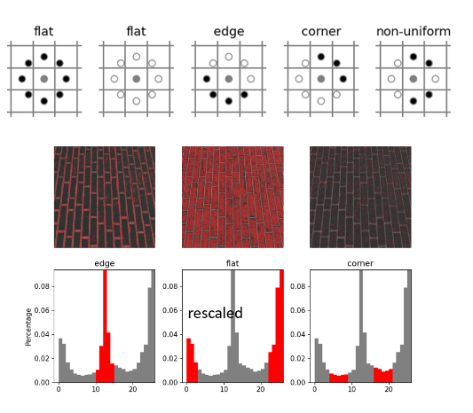
CK+ - LBP preprocessing

Slide 16
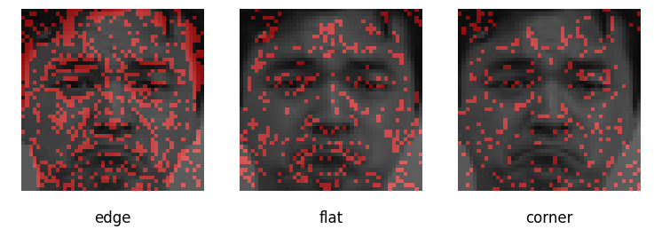
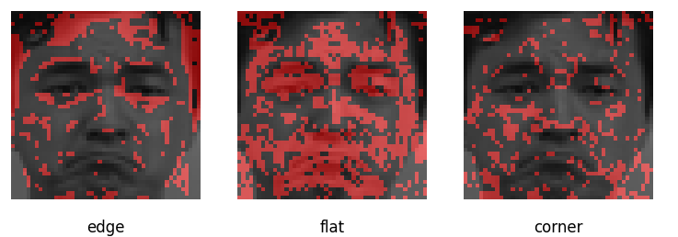
CK+ - LBP preprocessing
R=1, N=8
R=3, N=24

Slide 17
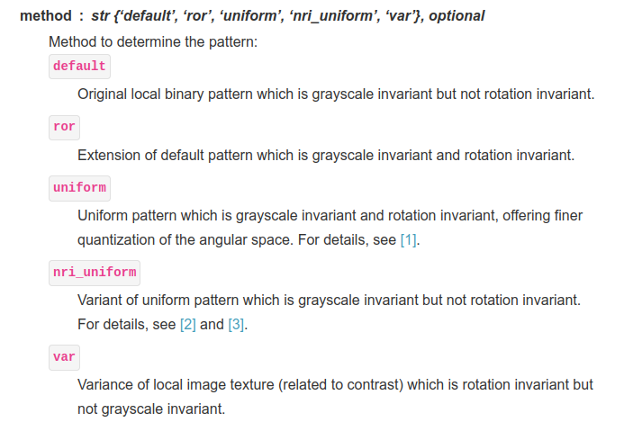
CK+ - LBP preprocessing
In skimage library, built-in function local_binary_pattern(image, n_points, radius, method)
We’ll use nri_uniform

Slide 18
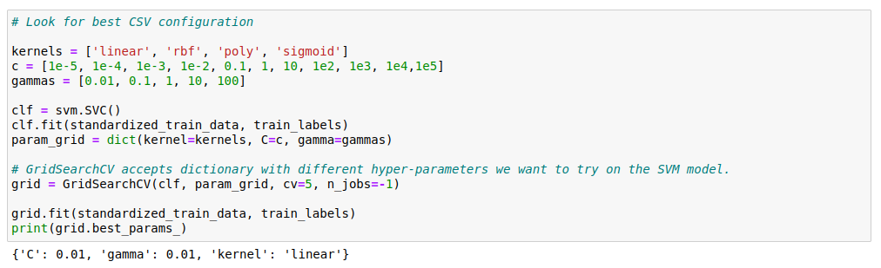
CK+ - SVC model
First, we standardize train set.
Then, using GridSearchCV we search for best params

Slide 19
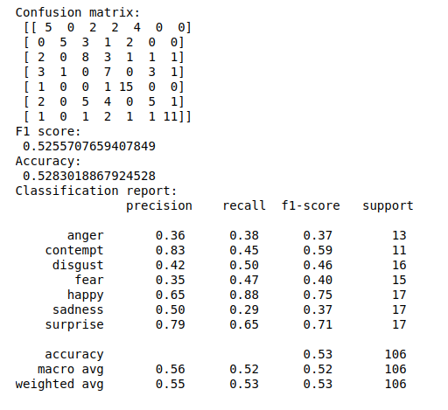
CK+ - SVC model

Slide 20
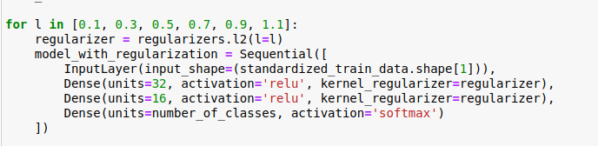
CK+ – NN model
In standard neural network, the biggest problem is overfitting, so we’ll introduce different levels of regularization

Slide 21
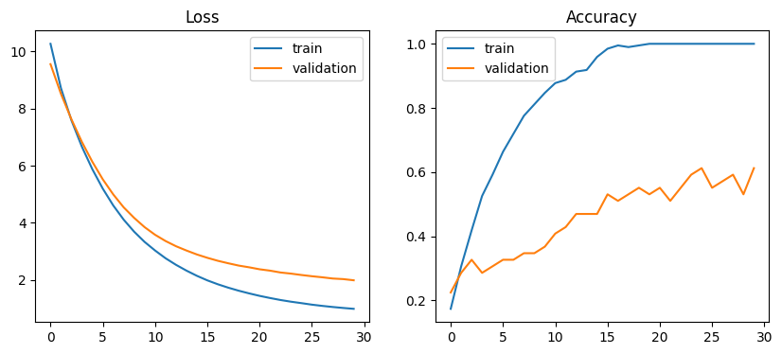
CK+ - NN model
Best results is for l = 1.1

Slide 22
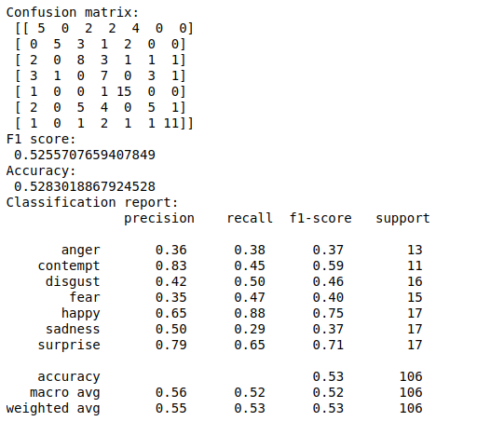
CK+ - NN model

Slide 23
CK+ comparison
CNN SVC NN

Slide 24
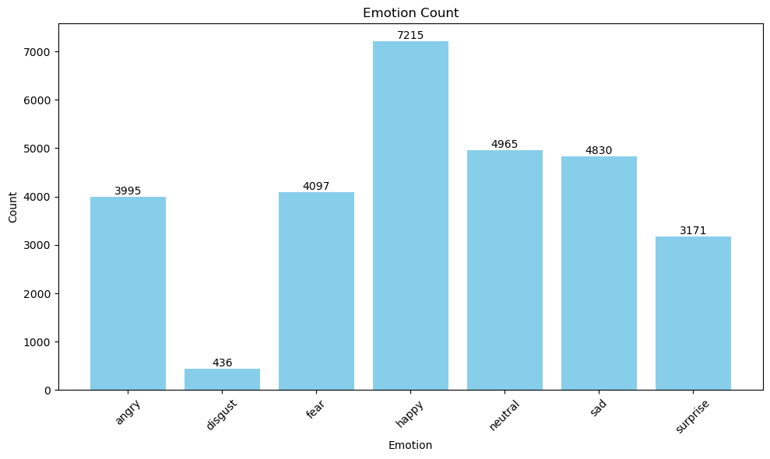
FER2013 Preprocessing
We have unbalanced train set

Slide 25
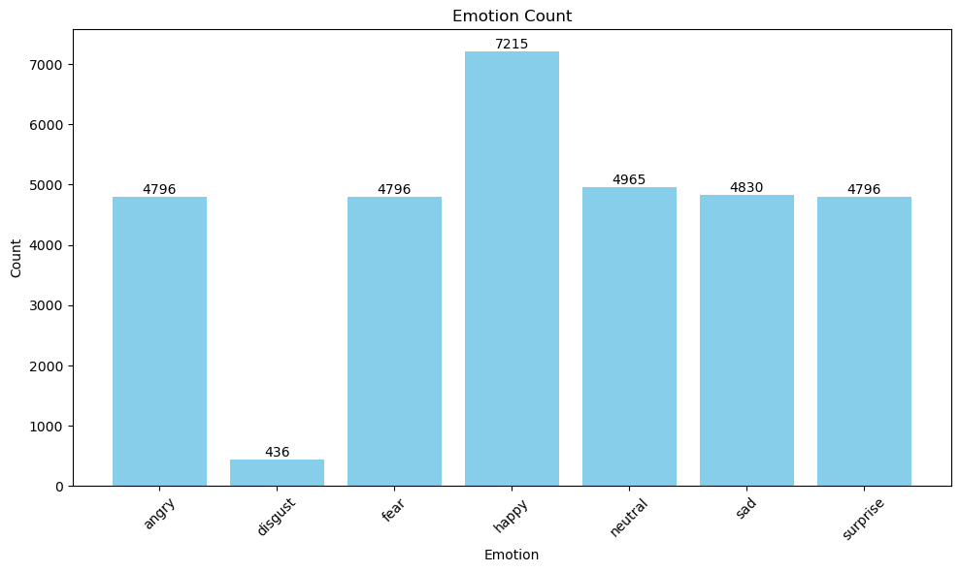
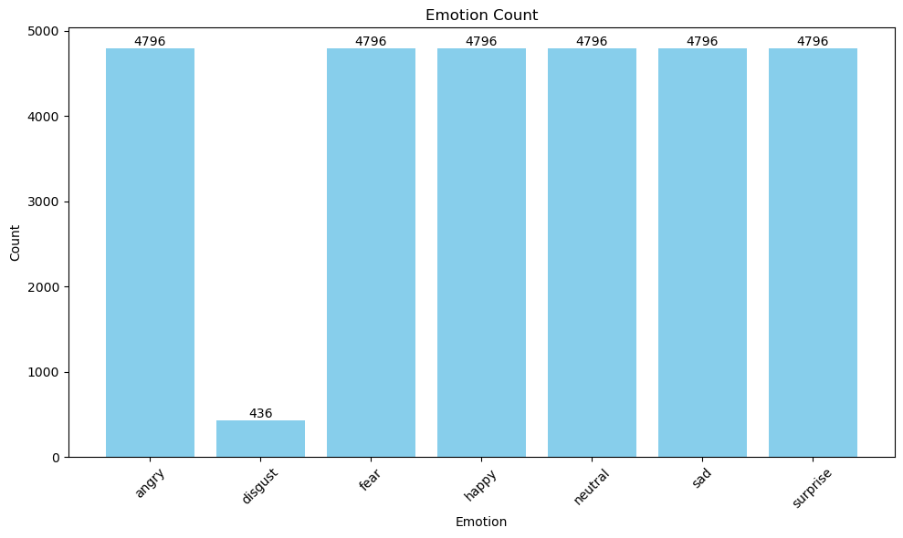
FER2013 Preprocessing
Again, we’ll mirror images from some classes, and then delete images from large classes

Slide 26
FER2013 Preprocessing
We'll make ensemble of length 11. In every instance of ensemble, we'll have the same 436 images of disgust, and different 436 instances from every other class.

Slide 27
FER2013 Ensembles
In our function, we need to pass args x, y, num_ensembles, num_instances, reference_class.
Pseudocode:
Zip x and y
Sort data by reference class.
Get ref_data and delete it from data
For I in num_ensembles:
  add ref_data in list
  For j in (num_classes - 1):
    add data[(j+i)*n_counts:(j+i+1)*n_counts] in list
    in the end, all those lists place in one list

Slide 28
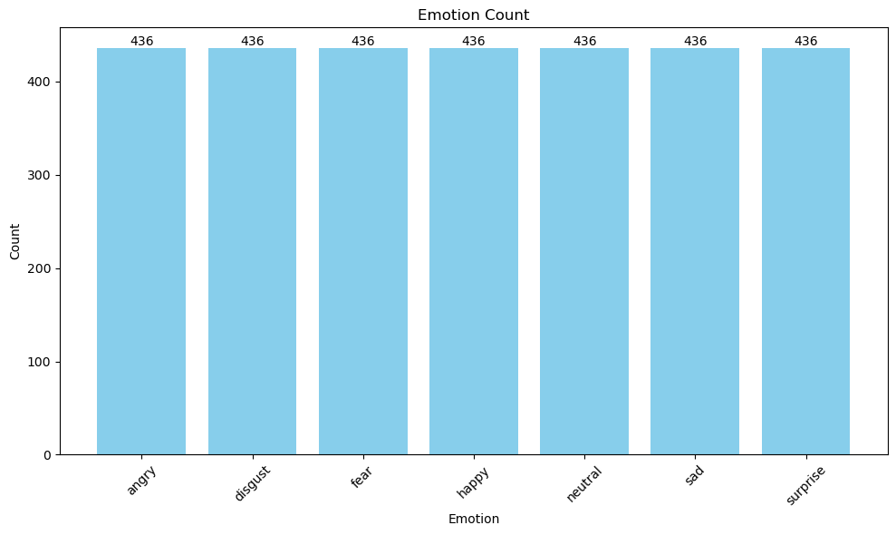
FER2013 Ensembles
Now, each instance of ensemble consists of same amount of images.

Slide 29
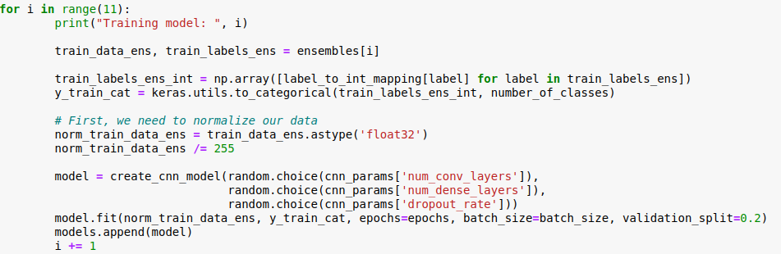
FER2013 – CNN model
We train 11 different CNN models

Slide 30
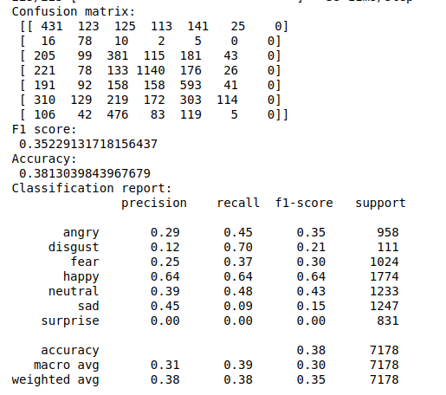
FER2013 – CNN model

Slide 31
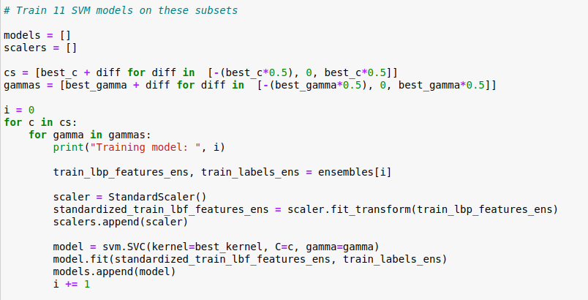
FER2013 – SVC model
We train 11 different SVC models

Slide 32
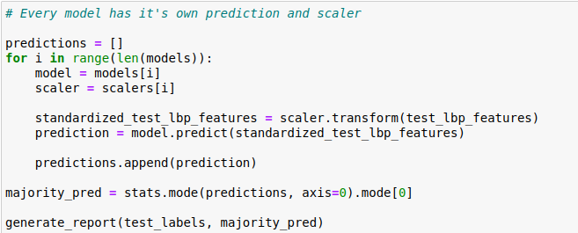
FER2013 – SVC model
Important note is that we need to use different scalers for test set for every ensemble instance

Slide 33
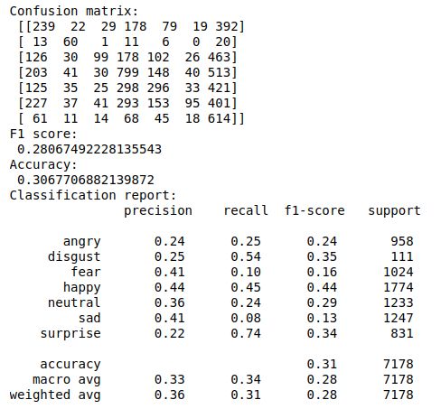
FER2013 – SVC model

Slide 34
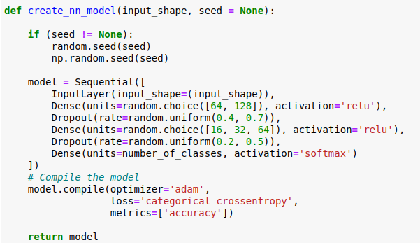
FER2013 – NN model
We train 11 different simple nn models using random.choice() function for parameters

Slide 35
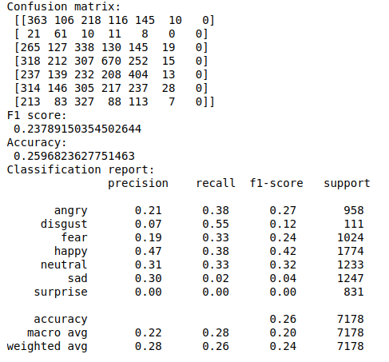
FER2013 – NN model

Slide 36
FER 2013 - comparison
CNN SVC NN

