Slide 1
BEYOND MULTIPLE LINEAR REGRESSION
Randomized block designs
BLR
Modeling center effects and comparing treatments
Dr Douwe Postmus
UMCG · Department of Epidemiology
METHODS · DESIGN · STATISTICS

Slide 2

Why go beyond multiple linear regression?
Experimental designs and sampling strategies in observational studies often lead to grouped observations.
Ignoring this structure can violate the iid error assumptions, potentially biasing effect estimates or giving incorrectly estimated uncertainty.
We use models that explicitly account for this structure, including linear mixed-effects models.
The course develops your ability to choose, fit and interpret these models.

Slide 3
How the course works
A weekly cycle of preparation, guided practice and independent application.
WHEN
WHAT YOU DO
Before class
Read the selected book chapters to prepare for the session.
During class
Build understanding through lectures and develop data analysis skills in guided R labs.
After class
Apply the readings and in-class material to a new dataset in the weekly assignment.

Slide 4
Assignments and reproducible reporting
Use Quarto to bring your analysis and interpretation together.
ONE REPRODUCIBLE REPORT
WHAT TO SUBMIT
A Quarto source file (.qmd) combines written explanations with R code.
The Quarto source file (.qmd), including all R code and annotations.
Rendering runs the analysis and produces a report containing the results.
The rendered HTML report, with the R code visible.
Explain your choices and interpret the findings alongside the analysis.
Use the provided assignment template.
Submit both the source and the rendered report so the analysis can be read and reproduced.

Slide 5
Certificate and assessment
COURSE CERTIFICATE
IF YOU REQUIRE A GRADE
Participate in at least 80% of the in-class meetings.
Your grade is based on the final data analysis assignment.
Submit the weekly data analysis assignments.
This applies, for example, to research master students and PhD students seeking Epidemiologist B registration.

Slide 6
PART 1
A multicenter trial: initial analysis

Slide 7

A multicenter rehabilitation trial
DESIGN AND OUTCOME
Simulated trial: 120 patients after knee replacement at 6 centers.
Randomized block design: centers are the blocks. Within each center, 10 patients are randomized to each treatment.
Standard care: weekly physiotherapy and home exercises.
Enhanced care: standard care plus a weekly supervised session.
Outcome: six-minute walk distance at 12 weeks.
RESEARCH QUESTION
How much do the mean walking distances differ between the programs?

Slide 8
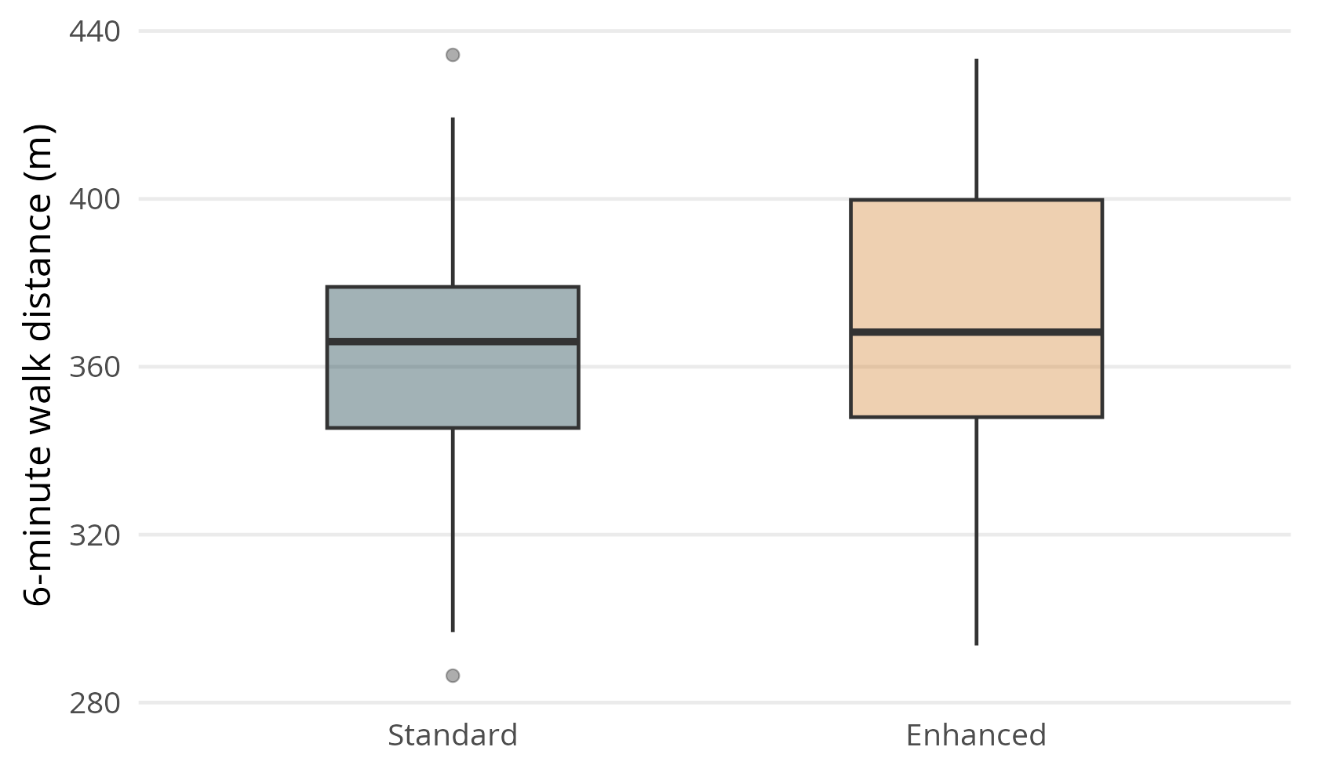
Walking distances pooled across centers
60 patients per program across all 6 centers.

Slide 9
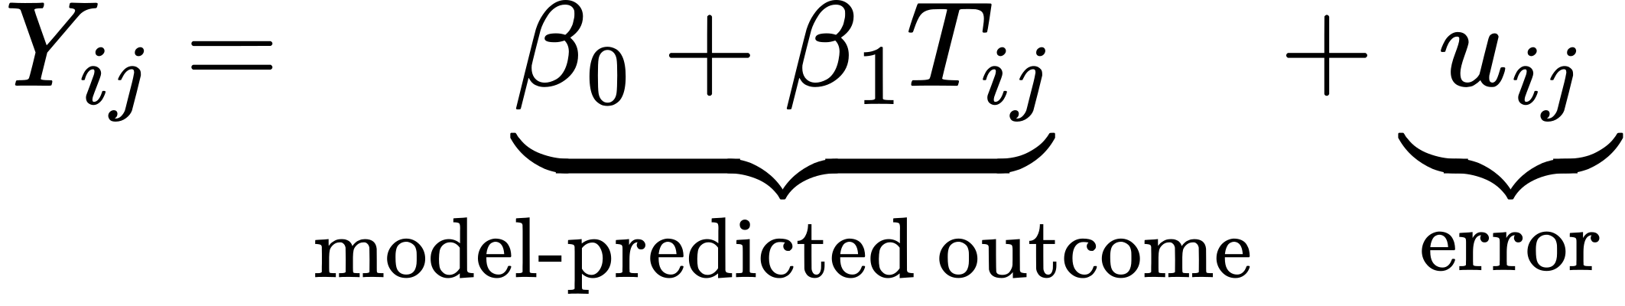
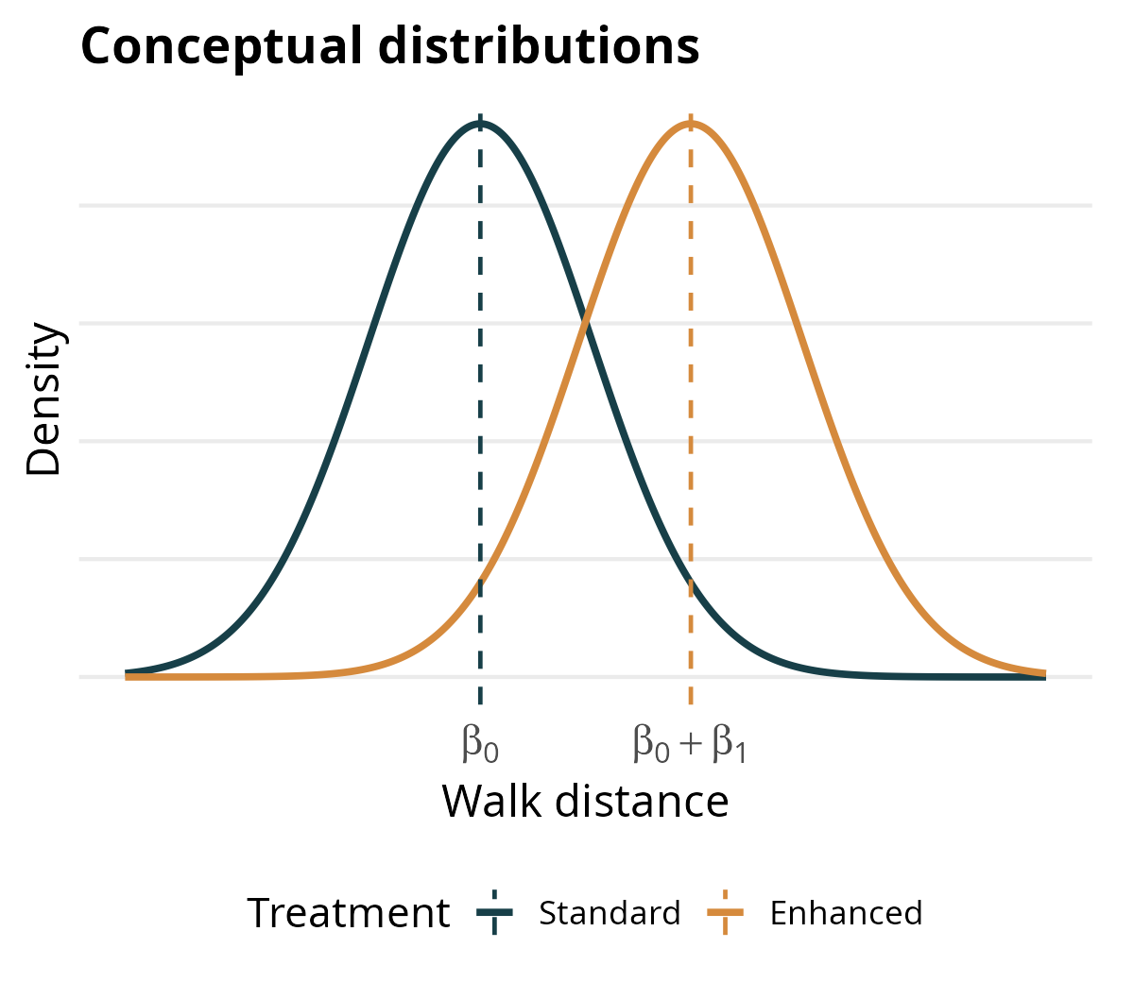
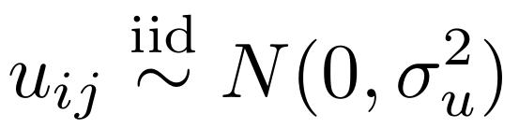
The treatment-only model
Patient i, center j: Yᵢⱼ is walking distance; Tᵢⱼ = 0 (standard) or 1 (enhanced).
SYSTEMATIC PART AND ERROR
MODEL-PREDICTED OUTCOMES
β₁ is the expected difference in walking distance between enhanced and standard care.
uᵢⱼ is the individual error. Errors are independent and identically distributed: Normal, with mean zero and a common variance.

Slide 10
Model results
Term
Estimate (m)
SE (m)
95% CI (m)
p-value
Intercept (β₀)
359.9
4.08
351.8 to 368.0
< .001
Enhanced care (β₁)
11.0
5.77
-0.4 to 22.5
0.059
Pooling across centers, patients assigned to enhanced care walked 11.0 m farther on average.
Estimated residual variance: 1000.2 m².
Corresponding residual SD: 31.6 m.

Slide 11
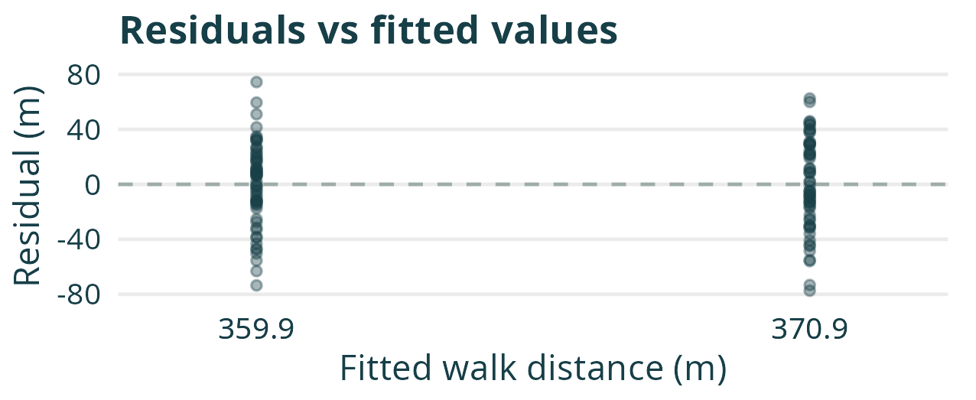
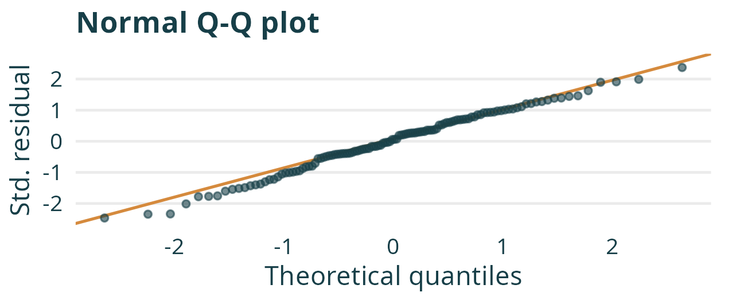
Model diagnostics
WHAT WE USE THIS PLOT FOR
WHAT WE USE THIS PLOT FOR
Assess whether residuals are centered around zero and have similar spread across fitted values.
Assess whether the residual distribution is approximately Normal.
The residual plots do not suggest clear violations of the Normality or equal-variance assumptions.

Slide 12
PART 2
Modeling center as a fixed effect

Slide 13

A multicenter trial, a pooled analysis
The trial used a randomized block design: patients were randomized to the two programs within each of six centers, with equal numbers per program in every center.
The treatment-only model represents each treatment group as one homogeneous sample, without distinguishing the centers from which patients were recruited.
Centers may differ in patient populations and care settings, shifting expected outcomes for both treatments.
Do center differences in expected outcomes matter for our treatment comparison?

Slide 14
Using simulation to investigate the consequences of ignoring center
To investigate whether ignoring center matters for the treatment comparison, we simulate repeated trials from a known model and analyse them using the treatment-only model.
STEP
SIMULATION WORKFLOW
1
Specify a data-generating model that reflects the study design.
2
Generate a dataset from that model.
3
Fit the treatment-only model, retaining the treatment estimate and its estimated SE.
4
Repeat the generation and analysis to build the estimator’s sampling distribution.

Slide 15

The data-generating model: fixed center effects
Patient i in center j: Yᵢⱼ is walking distance. Tᵢⱼ = 0 (standard) or 1 (enhanced).
TERM
INTERPRETATION
β₀
Expected standard-care outcome averaged equally across the six centers.
β₁
Enhanced-minus-standard difference, assumed to be the same in every center.
cⱼ
Center j’s deviation from the average standard-care outcome.
The center deviations sum to zero: c₁ + ⋯ + c₆ = 0.
εᵢⱼ
Deviation from the expected outcome given treatment and center.
Independent Normal errors with mean 0 and common variance σ².

Slide 16
Our experiment: new patients in the same centers
HOLD THE STUDY CONDITIONS FIXED
GENERATE DATA AND FIT THE MODEL
Six centers, 20 patients per center. Randomize 10 to each treatment within every center.
Draw new individual errors for new patients. Keep the six center effects unchanged.
Baseline: 360 m. True treatment effect: 10 m. Independent Normal individual errors: SD 24 m.
Fit the treatment-only model to every simulated study.
Fixed center effects A to F (m):
−17, +16, +8, −29, +27, −5.
Retain each treatment estimate and its estimated standard error.
The generating model includes center. The treatment-only analysis omits it.

Slide 17
Assessing bias and calibration
BIAS: LOCATION OF THE ESTIMATES
CALIBRATION OF REPORTED UNCERTAINTY
We know the true treatment effect because we specify it in the simulation.
Empirical SE: the standard deviation of treatment estimates across studies.
Compare the average treatment estimate across studies with that true effect.
Mean estimated SE: the average of the SEs reported by the model across studies.
Bias is the difference between the expected estimate and the true effect.
Does the reported uncertainty match the sampling variability?
Calibration matters for confidence-interval coverage and type I error.

Slide 18

Live demonstration: omitting center

Slide 19
Summary: unbiased estimates, overstated uncertainty
ESTIMATE AND REPORTED SE
CONSEQUENCES FOR INFERENCE
The treatment estimator is unbiased: estimates are centered at the true effect of 10 m.
Consequently, its usual 95% confidence intervals overcover: they contain the true treatment effect more than 95% of the time.
The mean estimated SE is larger than the empirical SE.
When the true treatment effect is zero, its tests reject less often than the nominal 5% (type I error).
The model reports more uncertainty than the actual spread of treatment estimates.

Slide 20

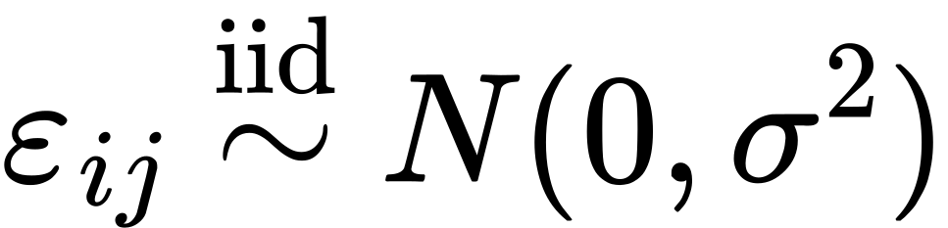
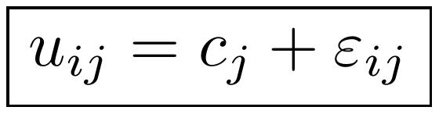
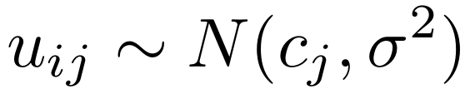
Omitting center: a mathematical explanation
TREATMENT AND CENTER
TREATMENT ONLY
Center differences are included in the expected outcome. The remaining errors satisfy the iid zero-mean Normal assumption.
The errors remain independent, but are no longer identically distributed: their means differ by center, while their variances remain equal.

Slide 21
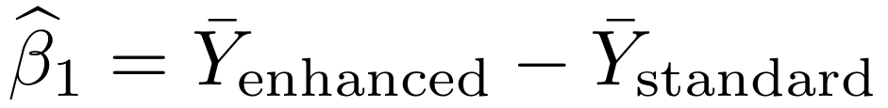
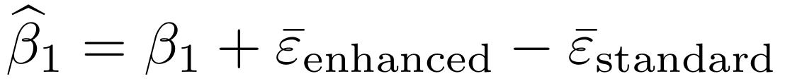
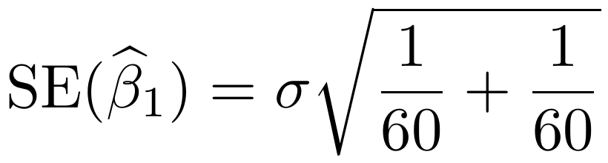
What determines the treatment estimate’s sampling variability?
SUBSTITUTE THE DATA-GENERATING MODEL
• Both groups contain 60 copies of the same baseline, so these terms cancel.
• Both groups contain 10 copies of every center effect, so these terms cancel.
Each epsilon bar averages the individual errors used to generate that group’s outcomes.

Slide 22
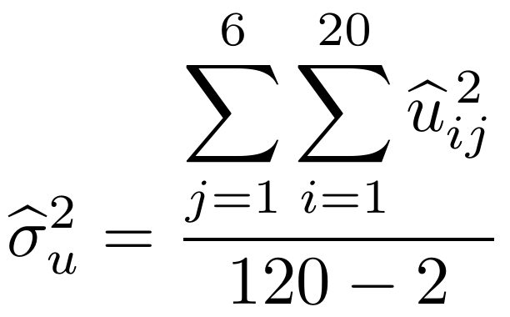
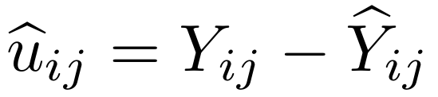
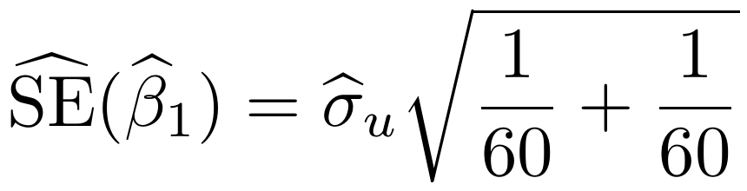
How does the treatment-only model estimate the SE?
FROM FITTED MEANS TO RESIDUALS
FROM RESIDUALS TO THE REPORTED SE
The model fits one mean per treatment group.
Estimate the error variance:
Each residual is a patient’s observed outcome minus their fitted group mean:
Use its square root in the SE formula:
The fitted group means do not account for center, so the residuals still contain center differences.
Center differences contribute to the estimated error variance, although they cancel from the treatment contrast.

Slide 23

Time for lab 1

Slide 24

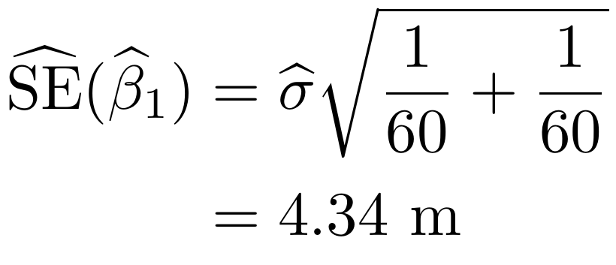
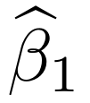
Lab 1 debrief: accounting for center
SAME TREATMENT ESTIMATE
BETTER-CALIBRATED UNCERTAINTY
The estimated treatment effect remains 11.0 m.
After accounting for treatment and center, the residual SD estimates the individual-error SD, σ.
With equal numbers in both treatment
The fitted model gives
= 23.8 m and
groups in every center, the two models
uses it to estimate the treatment effect’s
always give the same treatment estimate
SE:
(and therefore the same sampling
distribution of
).
The estimated SE now uses the individual variation that determines the treatment estimate’s sampling variability. Better calibration does not always mean a smaller SE.

Slide 25
PART 3
Modeling center as a random effect

Slide 26

From individual centers to a population of centers
Besides estimating the treatment effect, the fixed-effects model estimates an effect for each of the six included centers.
Often, our scientific interest is not in these particular centers or their individual effects.
A random-intercept model accounts for center differences by describing how center effects vary across a population of centers.
This gives a more parsimonious model and an estimate of the between-center variance.

Slide 27
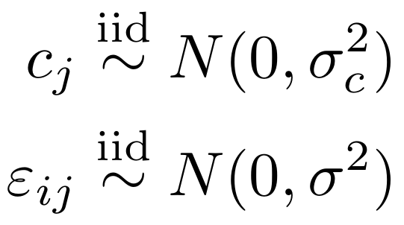

The random-intercept model
RANDOM-INTERCEPT MODEL
IMPLIED MARGINAL MODEL
Averaging over center effects gives the expected walking distance β₀ + β₁Tᵢⱼ, because center effects have mean zero. This is the marginal mean.
For a given center effect, the expected walking distance is β₀ + β₁Tᵢⱼ + cⱼ. This is the conditional mean.
Individual errors are independent of each other and of the center effects.
Patients in the same center share cⱼ, so their combined errors uᵢⱼ are correlated.
The implied marginal model has the same mean structure as the treatment-only model, but its errors are correlated within centers.

Slide 28
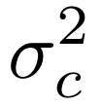
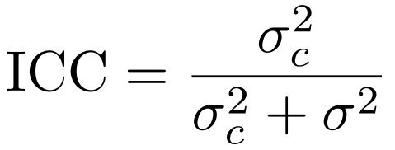

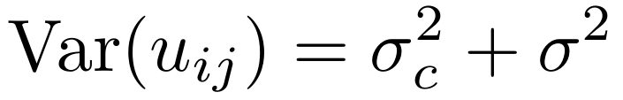
Between-center variation and the ICC
VARIANCE COMPONENTS
INTRACLASS CORRELATION
Variation between center intercepts.
The proportion of remaining outcome variance attributable to differences between centers.
Individual variation within centers.
After accounting for treatment, the total variance is:
The correlation between outcomes of two patients in the same center, after accounting for treatment.

Slide 29

Time for lab 2

Slide 30
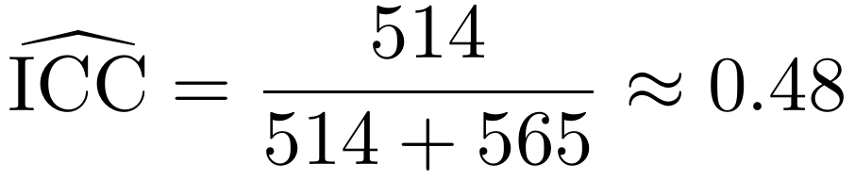
Lab 2 debrief: center variation and treatment uncertainty
INTERPRETING THE ICC
COMPARING THE MODELS
Model
Estimate
(m)
Standard
error (m)
Treatment only
11.0
5.77
About 48% of the outcome variance remaining after accounting for treatment is attributable to differences between centers.
Fixed center effects
11.0
4.34
Random center effects
11.0
4.34
Balanced treatment allocation within centers makes the treatment estimates identical.
The estimated correlation between outcomes of two different patients in the same center is 0.48, after accounting for treatment.
Both center models separate center variation from individual variation, giving better-calibrated standard errors in this example.
The treatment results agree here, but the models describe center variation differently: separate parameters for these six centers versus a distribution for a population of centers.

Slide 31
The End
Questions

