Slide 1
BEYOND MULTIPLE LINEAR REGRESSION · WEEK 2
Treatment effects across centers
BLR
Interactions and uncertainty
Dr Douwe Postmus
UMCG · Department of Epidemiology
METHODS · DESIGN · STATISTICS

Slide 2
Week 1 recap: comparing the models
THE REHABILITATION TRIAL
THE TREATMENT COMPARISON
Simulated trial: 120 patients after knee replacement at six centers.
Model
Estimate
(m)
Estimated
SE (m)
Within each center: 10 patients randomized to each treatment.
Treatment only
11.0
5.77
Standard care: weekly physiotherapy and home exercises.
Fixed center effects
11.0
4.34
Random center effects
11.0
4.34
Enhanced care: standard care plus a weekly supervised session.
Outcome: six-minute walk distance at 12 weeks.
All three models assumed a common treatment effect across centers.
Fixed center parameters and a random center distribution gave the same treatment estimate and estimated standard error in this setting.

Slide 3
Changing treatment allocation within centers
ORIGINAL ALLOCATION
UNEQUAL ALLOCATION
Center
Standard
care
Enhanced
care
Center
Standard
care
Enhanced
care
A
10
10
A
5
15
B
10
10
B
8
12
C
10
10
C
10
10
D
10
10
D
10
10
E
10
10
E
12
8
F
10
10
F
15
5
Total
60
60
Total
60
60
Only allocation changes: the underlying treatment effect remains 10 m in every center.

Slide 4
The models now give different treatment estimates
Unequal allocation within centers; estimated enhanced-minus-standard difference in walk distance.
Model
Estimate (m)
Estimated SE (m)
Treatment only
3.87
5.75
Fixed center effects
8.40
4.56
Random center effects
8.13
4.55
Accounting for center changes the estimate substantially. The two center models give slightly different estimates, with almost identical estimated standard errors.

Slide 5
The models use different comparisons
TREATMENT ONLY
FIXED CENTER EFFECTS
RANDOM CENTER EFFECTS
The model compares the average outcome of all enhanced-care patients with that of all standard-care patients.
The model allows each center to have its own baseline outcome.
The model uses comparisons both within and between centers.
It estimates treatment by combining comparisons between enhanced and standard care within the same center.
Do centers with more enhanced care have higher average outcomes?
Unequal allocation gives the groups different mixtures of centers. Their difference reflects both treatment and differences in center baselines.
Using between-center information assumes baseline center effects are unrelated to treatment allocation.
These comparisons remove the shared center baseline.
The random-intercept model also uses between-center information under additional assumptions, so its treatment estimate can differ.

Slide 6
Fixed versus random center effects
Design
Treatment estimates
Estimated standard errors
Equal center sizes;
50:50 allocation within each center
Identical
Identical
Unequal center sizes;
50:50 allocation within each center
Identical
Can differ
Treatment proportions differ across centers
Can differ
Can differ
With 50:50 allocation within every center, all three models, including the treatment-only model, give the same treatment estimate, even when center sizes differ.
So far, we have assumed the same treatment effect in every center. What changes when the treatment effect varies across centers?
Notes:
Scope: Gaussian additive models with independent homoscedastic individual errors and a common treatment effect. The fully balanced row describes the standard analysis used in this lecture: fixed-center OLS versus random-intercept REML, with an interior positive estimate of center variance. Under these conditions, both fits estimate individual-error variance identically and give identical estimated treatment standard errors. This is a general balanced-design result, not a peculiarity of the Week 1 dataset. Other variance-estimation methods or a center-variance estimate at the zero boundary need not preserve exact equality. With unequal center sizes but a constant treatment proportion, the treatment estimator and its true variance remain identical, while estimates of individual-error variance can differ.

Slide 7
PART 1
Treatment-by-center interaction

Slide 8
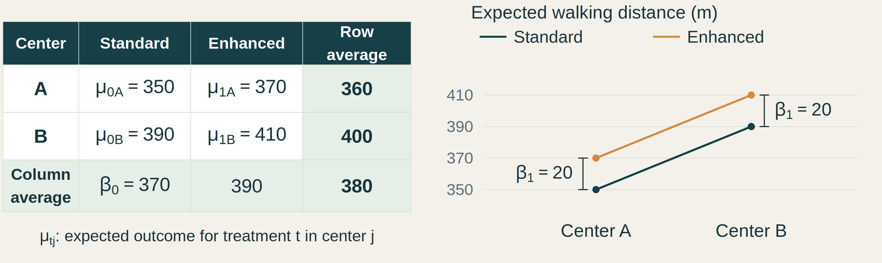
A common treatment effect in both centers
Hypothetical example: assume the four true group means are known.
Tᵢⱼ = 0 for standard care and 1 for enhanced care. i = patient; j = center.
Individual patient outcomes vary around their group mean through εᵢⱼ.
Notes:
The four numbers are assumed true expected outcomes, not sample estimates. The row and column averages weight both entries equally. Treatment is coded 0/1 and center uses effects coding: beta_0 = 370, c_A = -20, c_B = 20, beta_1 = 20. The grand mean is 380 and is not beta_0 under this parameterization. Center is on the horizontal axis and color denotes treatment. The plotted points contain no individual sampling noise. Y_ij is a patient outcome and epsilon_ij is its zero-mean deviation from the appropriate group mean. The mu subscripts identify treatment and center. Both vertical brackets show the same 20 m treatment gap; the line rise from A to B is the 40 m baseline center difference, not beta_1. The next slide introduces treatment-by-center interaction with the same average effect.

Slide 9
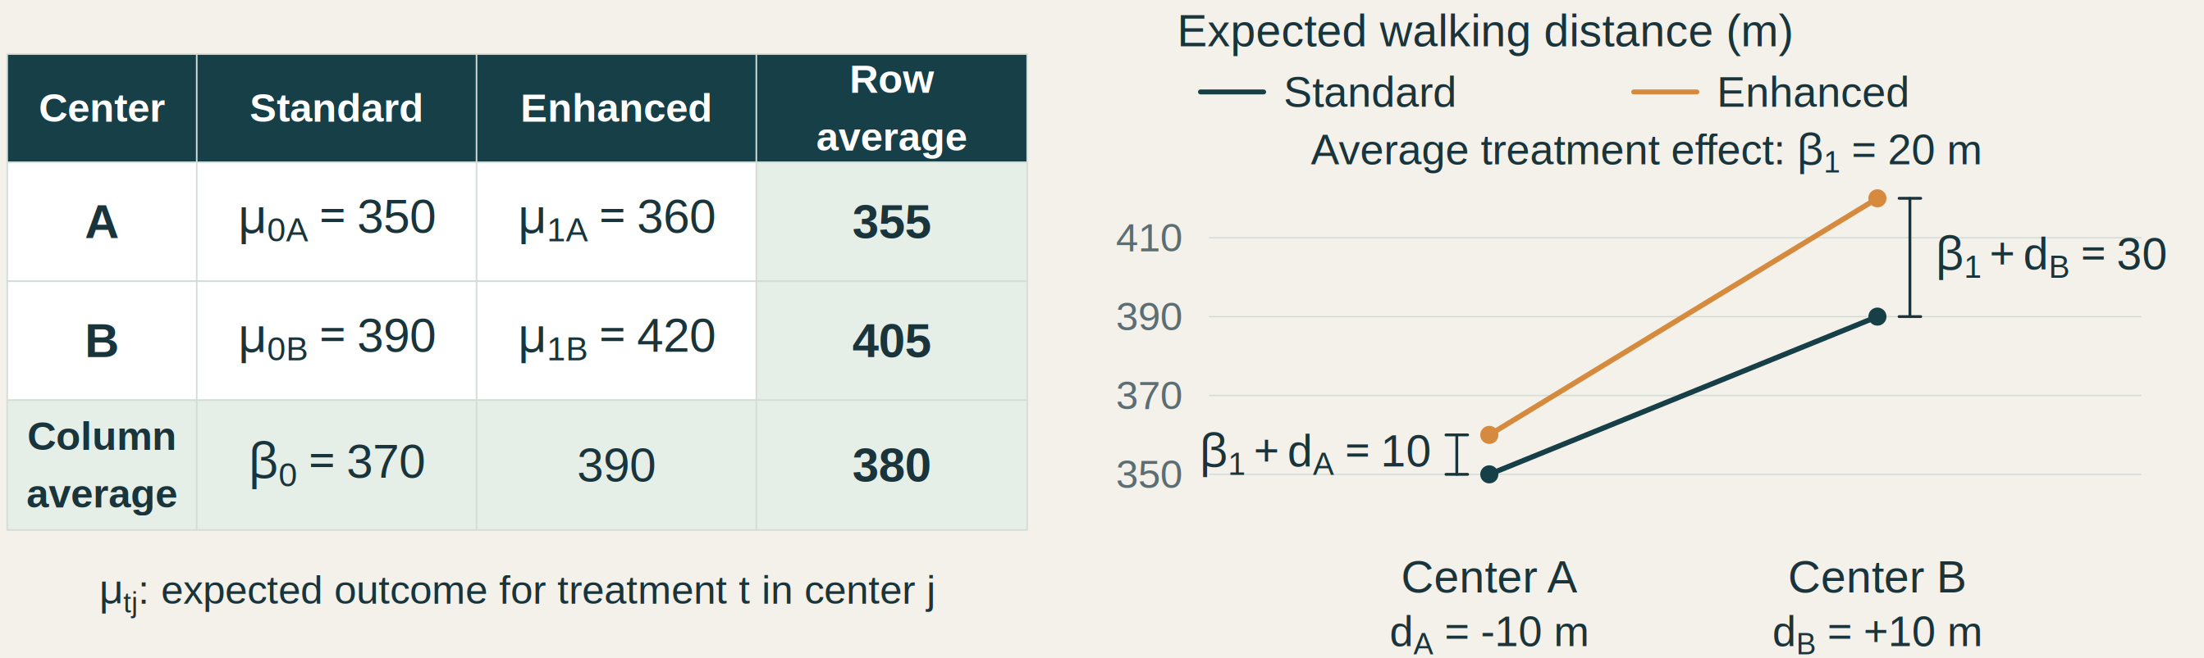
Different treatment effects across centers
Hypothetical example: assume the four true group means are known.
Tᵢⱼ = 0 for standard care and 1 for enhanced care. i = patient; j = center.
Individual patient outcomes vary around their group mean through εᵢⱼ.
Notes:
The four numbers are assumed true expected outcomes, not sample estimates. The row and column averages weight both entries equally. Treatment is coded 0/1 and center uses effects coding: beta_0 = 370, c_A = -20, c_B = 20, beta_1 = 20. The grand mean is 380 and is not beta_0 under this parameterization. Center is on the horizontal axis and color denotes treatment. The plotted points contain no individual sampling noise. Y_ij is a patient outcome and epsilon_ij is its zero-mean deviation from the appropriate group mean. The mu subscripts identify treatment and center. The treatment gap is 10 m in A and 30 m in B, averaging 20 m. The center-specific deviations d_A = -10 and d_B = +10 sum to zero. The standard-care means remain 350 and 390; the enhanced-care means become 360 and 420. Both treatment column averages and the grand mean are unchanged from the additive example, while the row averages become 355 and 405. Row averages do not define c_j under treatment dummy coding. The sloping treatment lines show changes across centers; the vertical gaps show the treatment effects.

Slide 10
How should we represent differences between centers?
Beyond two centers, we still allow differences in baseline outcome and treatment effect.
FIXED CENTER EFFECTS
RANDOM CENTER EFFECTS
Give each included center its own baseline deviation and treatment-effect deviation.
Describe baseline deviations and treatment-effect deviations through a population distribution.
Express the average treatment effect across the included centers.
Express the average treatment effect in the population represented by those centers.
We start with fixed center effects and ask what we can learn about treatment in the included centers.
Notes:
Both approaches allow treatment effects to vary between centers. The distinction is separate fixed center parameters versus a distribution of random center effects, not common versus varying treatment effects. This slide previews the included-center and population-average targets used in this lecture; it is not a claim that a random-effects model cannot estimate included-center contrasts or that model choice alone establishes population representativeness. Random treatment effects require random slopes as well as center intercepts. Implications for uncertainty are developed later.

Slide 11

From known means to patient data
THE REHABILITATION TRIAL
New simulated trial: 120 patients after knee replacement at six centers.
Within each center: 10 patients randomized to standard care and 10 to enhanced care.
Outcome: six-minute walk distance at 12 weeks.
Fit the fixed-effects interaction model to estimate treatment effects in these centers.
The group means are now unknown and must be estimated from patient outcomes.
Notes:
The preceding toy examples assumed the four true group means were known. We now begin an empirical analysis of a new simulated six-center trial: the analyst estimates unknown group means and treatment effects from individual patient outcomes. Each center has 10 patients per treatment. After exploring the data, formalize the grouped fixed-effects interaction model on the next model slide. The right-hand image is an AI-generated fictional illustration of a rehabilitation walking assessment, not a study participant photograph. Exploratory plots and fitted cell means follow on separate slides.

Slide 12
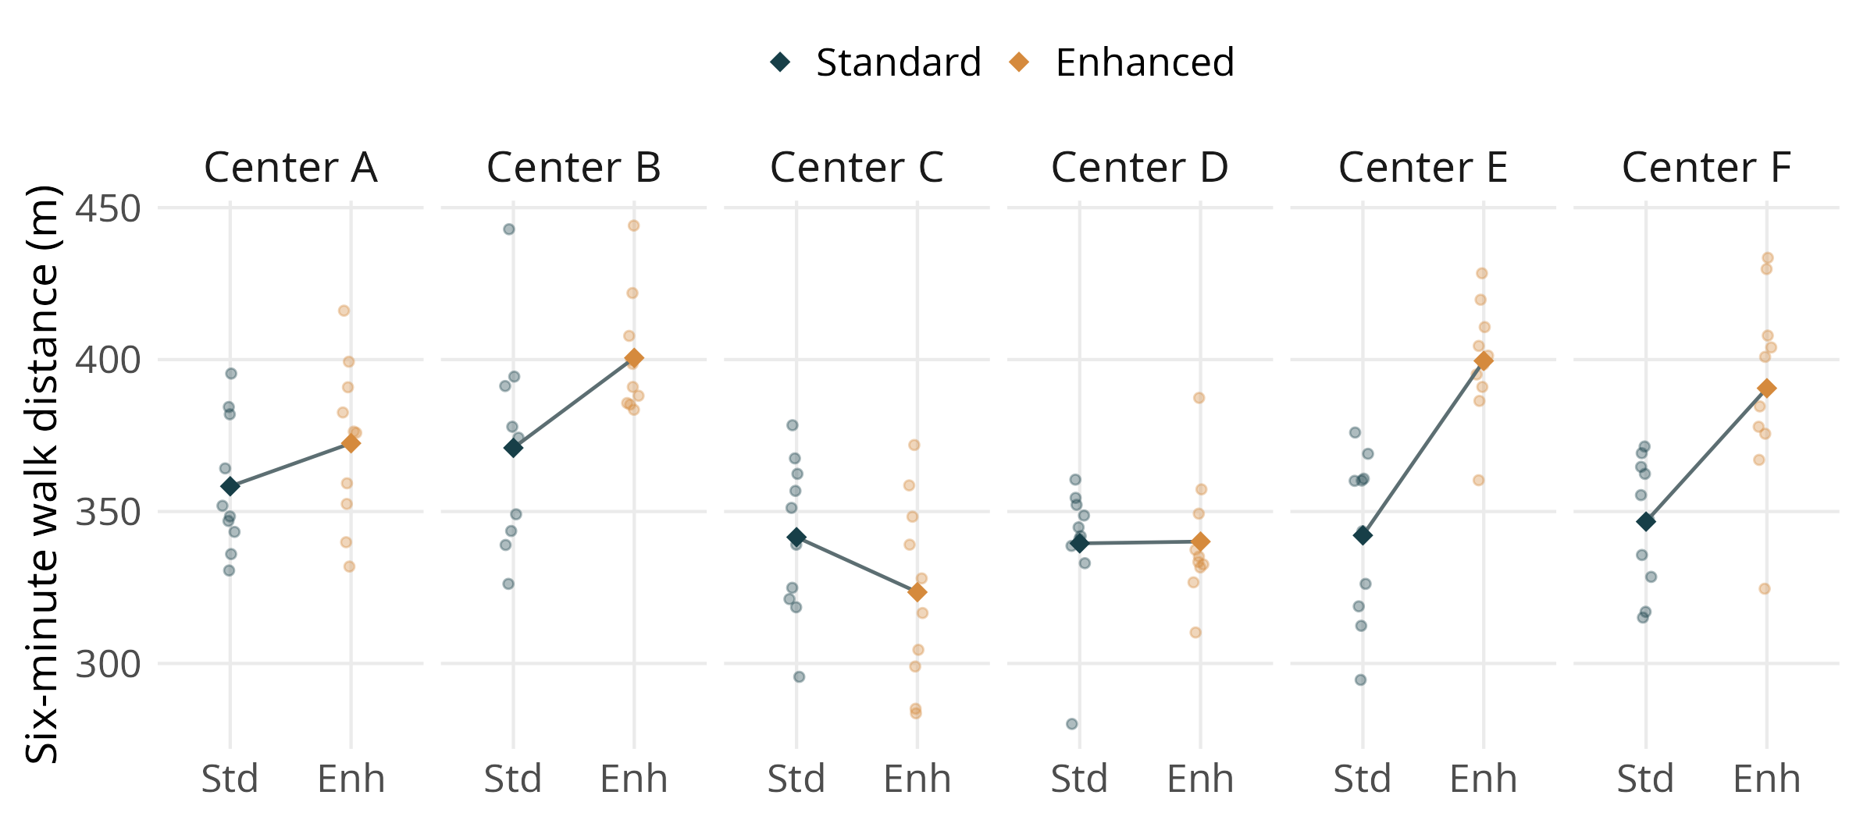
Explore outcomes by treatment and center
Each dot is a patient outcome; diamonds show sample means.
What differences do you notice in the treatment gaps across centers?

Slide 13
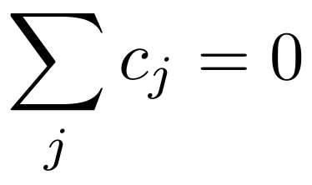
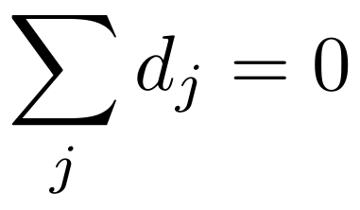
A fixed-effects model for treatment and center
Tᵢⱼ = 0 for standard care and 1 for enhanced care. Center uses effects coding.
BASELINE OUTCOMES
TREATMENT EFFECTS
β₀: average standard-care outcome across the included centers.
β₁: average treatment effect across the included centers.
cⱼ: center j’s deviation from that baseline average.
dⱼ: center j’s deviation from the average treatment effect.
Each center receives equal weight in the averages. Center deviations are fixed, unknown parameters.
Notes:
This is the same grouped model as the preceding toy interaction example. The center-specific standard-care mean is beta_0 + c_j and the center-specific treatment effect (the slope for treatment coded 0/1) is beta_1 + d_j. These treatment slopes are the vertical gaps in the earlier two-center toy plots. In the immediately preceding exploratory plot, each center has its own panel and treatment is on the horizontal axis. It applies to any number of centers with two treatments. Patient i is in center j. Effects coding imposes sum_j c_j = 0 and sum_j d_j = 0, so beta_0 and beta_1 are equally weighted included-center averages. Treatment retains 0/1 coding; beta_0 is the average standard-care mean, not the grand mean across both treatments. The patient error epsilon_ij has mean zero. Independent normal errors with a common variance are the assumptions used later for the fixed-model sampling variance and t interval; those assumptions and their role belong to the uncertainty section.

Slide 14
Fixed-effects interaction model: results
Term
Estimate (m)
Estimated
SE (m)
95% CI (m)
p-value
Intercept (β₀)
349.9
3.31
343.3 to 356.4
< .001
Enhanced care (β₁)
21.3
4.68
12.0 to 30.6
< .001
Center A
8.4
7.41
-6.2 to 23.1
0.257
Center B
21.1
7.41
6.4 to 35.8
0.005
Center C
-8.3
7.41
-23.0 to 6.4
0.265
Center D
-10.3
7.41
-25.0 to 4.3
0.166
Center E
-7.7
7.41
-22.4 to 7.0
0.301
Enhanced × Center A
-7.1
10.48
-27.9 to 13.7
0.499
Enhanced × Center B
8.4
10.48
-12.4 to 29.1
0.427
Enhanced × Center C
-39.4
10.48
-60.1 to -18.6
< .001
Enhanced × Center D
-20.7
10.48
-41.4 to 0.1
0.051
Enhanced × Center E
36.2
10.48
15.4 to 56.9
< .001
Effects coding: Center F follows from the sum-to-zero constraints.
Notes:
OLS coefficient estimates from lm(distance ~ treatment * center), with Standard as treatment zero and contr.sum for center. Columns follow the Week 1 convention: estimates and confidence limits to one decimal, estimated standard errors to two decimals, and p-values to three decimals or < .001. All intervals are pointwise 95% t intervals and p-values are two-sided t tests of a zero coefficient, using 108 residual degrees of freedom. The intercept is the equally weighted standard-care mean; the Enhanced care coefficient is the equally weighted treatment effect. Center A through E are baseline deviations c_j; Enhanced by Center A through E are treatment-effect deviations d_j. Their p-values test deviations from the included-center average, not each center's overall treatment effect. Center F has no separate regression coefficient: its baseline and treatment deviations are minus the corresponding sums for A through E. The global interaction test is a different, five-degree-of-freedom test.

Slide 15
Testing interaction by comparing two models
Fit the full model → fit the reduced model → compare their fit.
Model
Residual sum
of squares (RSS)
Residual df
Reduced: common treatment effect
90,694
113
Full: center-specific treatment effects
71,112
108
RSS: residual sum of squares. df: residual degrees of freedom.
Numerator: improvement in fit per additional parameter.
Denominator: estimated individual-error variance from the full model.
F(5, 108) = 5.95, p < .001: strong evidence that treatment effects differ across centers.
Notes:
Both models retain center-specific baselines, treatment coded 0/1, and effects coding for center. The full model is distance ~ treatment * center; the reduced model is distance ~ treatment + center, obtained by setting all d_j to zero. They are nested models fitted by OLS to the same 120 patients. RSS measures variation left unexplained, so smaller RSS means better fit. The full model always fits at least as well. The partial F test asks whether its improvement is larger than expected from sampling variation under the reduced model. The difference in residual degrees of freedom is 113 - 108 = 5, the number of additional interaction parameters. These five coefficients are tested jointly; the sixth deviation is implied by the sum-to-zero constraint. The numerator is the reduction in RSS per added parameter; the denominator estimates the common individual-error variance using the full model. Under independent normal errors with common variance and the null hypothesis, the statistic has an F distribution with 5 and 108 degrees of freedom. Table RSS values are rounded; the test and p-value use full-precision R output from anova(model_additive, model_interaction). This is a test of variation in treatment effects, not a test that the average treatment effect is zero. Next, inspect fitted means and center-specific contrasts to see where and by how much effects differ.

Slide 16

Which treatment effect do we want to estimate?
SIMPLE TREATMENT EFFECTS
MARGINAL TREATMENT EFFECT
How do treatments compare within a particular center?
How do treatments compare on average across centers?
Compare the enhanced and standard means within each center.
Average each treatment’s mean equally across centers, then compare the averages.
One treatment effect per center.
With effects coding, the treatment deviations average to zero.
Estimated marginal means (EMMs) are model-based estimates of group means, averaged over other factors where appropriate. Comparing these means gives the treatment effects.
Notes:
Recall the known-means two-center examples: differences within rows were simple treatment effects, while the difference between equally weighted treatment-column averages was the marginal effect. The same questions now concern unknown means estimated from patient data. Under effects coding for center and 0/1 coding for treatment, the true simple effect in center j is beta_1 + d_j; the equally weighted marginal effect is beta_1 because sum_j d_j = 0. Estimated effects use the corresponding fitted parameters. The estimate of the marginal treatment effect is beta-hat_1 = 21.3 m, the Enhanced care coefficient on slide 14. Estimated marginal means are predicted means for specified groups, possibly averaged over other factors. Keeping center separate gives the treatment-by-center cell means here; averaging equally across centers gives one marginal mean per treatment. The effects are contrasts of these means. This is a definition of the estimands and their model-based estimation, not a new regression model or a software tutorial.

Slide 17
Estimating simple treatment effects with estimated marginal means
CODING AND EFFECTS
Predicted means
Simple treatment effect
Center
Standard
mean
Enhanced
mean
Difference
95% CI
p-value
(Bonf.)
Coding determines which effects appear directly as coefficients.
A
358.3
372.5
14.2
-8.6 to 36.9
1.000
B
370.9
400.6
29.6
6.9 to 52.4
0.067
Here, a center’s effect combines the average effect with its treatment deviation.
C
341.6
323.5
-18.1
-40.8 to 4.7
0.707
D
339.5
340.1
0.6
-22.2 to 23.3
1.000
E
342.2
399.6
57.4
34.7 to 80.2
< .001
Predict both treatment means within each center, then compare them.
F
346.7
390.6
43.9
21.2 to 66.6
0.001
Means, differences and CIs in meters. Difference: enhanced minus standard.
Pointwise 95% CIs; p-values adjusted across six comparisons (Bonferroni).
Equivalent coding schemes give different coefficients, but the same fitted means and treatment comparisons.
Notes:
All quantities are derived from the same fitted full interaction model. Standard and Enhanced columns are model-based predicted cell means, which coincide with sample cell means in this full factorial model. Enhanced minus Standard is each center’s simple treatment effect, not the interaction coefficient d_j alone. Estimated standard errors use the full coefficient covariance matrix, including covariance between the two predicted means, and the pooled full-model residual variance. Confidence intervals are pointwise 95% t intervals with 108 residual degrees of freedom. Two-sided p-values test zero treatment difference in each center and are Bonferroni-adjusted as min(6 * p, 1), treating all six centers as one family. The p-value column is adjusted, whereas the confidence intervals are pointwise, so an interval can exclude zero while its adjusted p-value exceeds .05. The effect estimate and its uncertainty do not change under an equivalent full-rank recoding of the same fitted model. No package names or software syntax are needed for this lecture explanation.

Slide 18
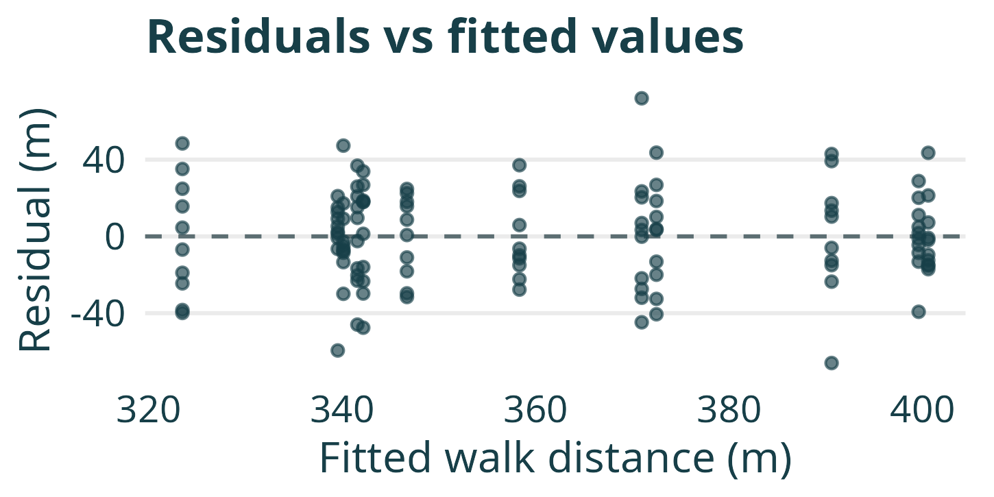
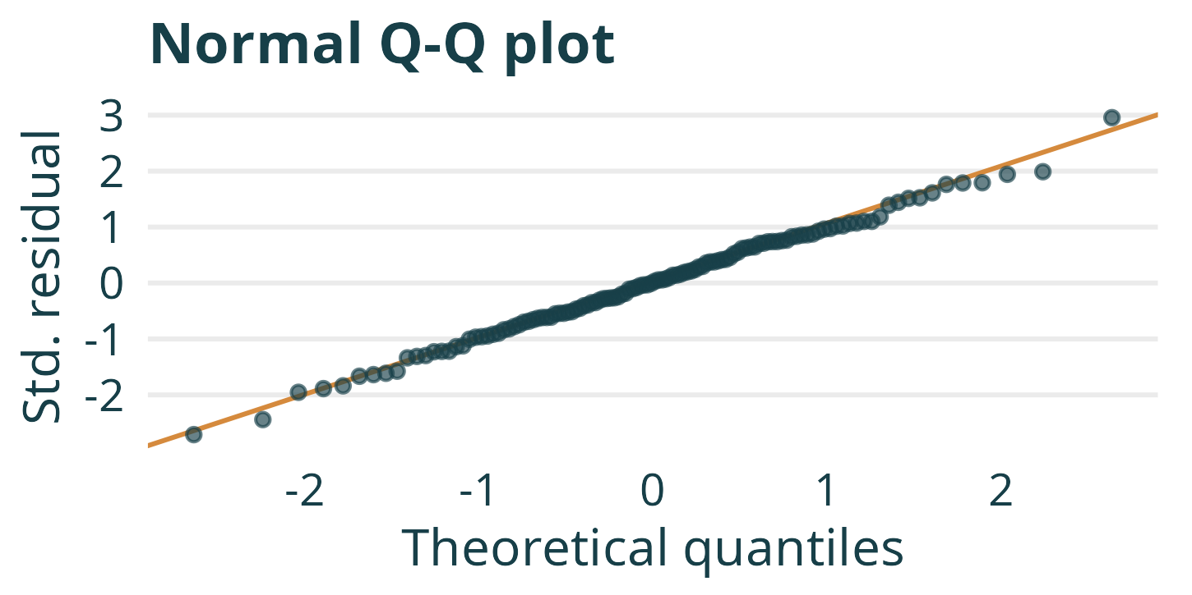
Model diagnostics: fixed-effects interaction
WHAT WE USE THIS PLOT FOR
WHAT WE USE THIS PLOT FOR
Assess whether residual spread is similar across fitted walk distances.
Assess whether the residual distribution is approximately Normal.
The plots show no clear change in residual spread and only small departures from the Normal reference line.
Notes:
These diagnostics use the fitted full fixed-effects interaction model from this case study: distance ~ treatment * center. The left plot shows raw residuals against fitted cell means in meters. Vertical stacks are expected because patients in the same treatment-center cell share a fitted mean. The fitted model includes a separate mean for each of the 12 cells, so residuals average to zero within every cell by construction; this fact alone does not validate the mean model. Look particularly for systematic changes in residual spread. The right plot compares internally standardized residuals, calculated using residual leverage and the estimated residual standard deviation, with theoretical Normal quantiles. The reference line uses the first and third quartiles. The displayed data show no clear funnel pattern and only small tail deviations from the line. These plots do not establish independence or prove the assumptions. No additional formal diagnostic test or p-value is used. This closes the fitted-model analysis; two concluding Part 1 slides compare omission of interaction and unequal center sizes.

Slide 19
What if we leave out the interaction?
Estimated average treatment effect across the six centers
Model
Estimate (m)
Estimated
SE (m)
95% CI (m)
p-value
Additive
21.3
5.17
11.0 to 31.5
< .001
With interaction
21.3
4.68
12.0 to 30.6
< .001
Same estimate: equal numbers in every treatment–center group make both models estimate the average of the six within-center treatment differences.
Larger estimated SE: without interaction, differences in treatment effects remain in the residuals, increasing the estimated residual variation.
In this balanced study, omitting interaction leaves the average treatment estimate unchanged but increases its estimated uncertainty.
Notes:
Both models include fixed center effects with effects coding and treatment coded 0/1. The current design has ten patients in every treatment-center cell, so the treatment coefficients are the same equally weighted average of the six observed differences. Omitting interaction does not change this estimator or its actual sampling variance. It leaves systematic treatment heterogeneity in the residuals and inflates the usual estimated residual variance in expectation. In this realization, the estimated SE rises from 4.68 to 5.17 m. Intervals and p-values are the usual model-based t summaries, with 113 residual degrees of freedom for the additive model and 108 for the interaction model. P-values are two-sided tests that the average treatment effect is zero; these are not interaction tests or the six Bonferroni-adjusted simple-effect tests. The additive model imposes a common effect despite the heterogeneity, so its conventional SE and interval are presented to explain the consequences of omission, not as a claim that it correctly specifies the cell means.

Slide 20
What if center sizes differ?
WHAT THE MODELS ESTIMATE
ILLUSTRATIVE EXAMPLE
With our effects coding, the interaction model estimates the equally weighted average treatment effect, regardless of center sizes.
Center
Patients
Treatment
effect (m)
Small
20
10
If centers have equal sizes, the additive model estimates this same average.
Large
80
30
Interaction model: 20 m
If center sizes differ, the additive model gives larger centers more weight.
Additive model: 26 m
When treatment effects differ across centers, omitting interaction can change both the interpretation of the treatment coefficient and its estimated uncertainty.
Notes:
Only center sizes are varied in this illustration; allocation remains half to each treatment within each center, as in the preceding empirical design. Keep that setup in the spoken explanation if needed rather than adding an allocation sentence to the slide. The displayed effects of 10 and 30 m are hypothetical known center-specific effects, not new estimates from the rehabilitation dataset. The model values are the averages targeted by the fitted treatment coefficients; equivalently they are fitted coefficients if the observed within-center differences equal these values. With effects coding and an interaction, beta_1 is the arithmetic average, (10 + 30) / 2 = 20 m, regardless of cell sizes when all cell means are estimable. With a common treatment proportion in all centers, OLS in the additive fixed-center model weights the within-center effects by total center size: (20 * 10 + 80 * 30) / 100 = 26 m. These weights are imposed by the additive fit, not chosen after fitting. For arbitrary unequal treatment proportions, the weights instead depend on n_j p_j (1-p_j); the simplified equal-size and size-weighting claims on this slide belong to the fixed-allocation illustration, not to all unbalanced designs. Describe a change in coefficient interpretation rather than universal bias. No general ordering of estimated SEs is asserted for unequal center sizes.

Slide 21
PART 2
From included centers to a population

Slide 22
What changes if the study uses different centers?
THESE SIX CENTERS
A POPULATION OF CENTERS
Repeat the study with new patients in the same six centers.
Repeat the study with new centers sampled from a wider population.
Each center’s true treatment effect stays the same.
The selected centers can have different true treatment effects.
Uncertainty comes from estimating those six effects using patient outcomes.
Uncertainty also comes from which centers enter the study.
A population-average treatment effect requires accounting for variation in treatment effects between sampled centers.

Slide 23
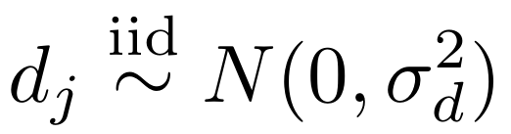
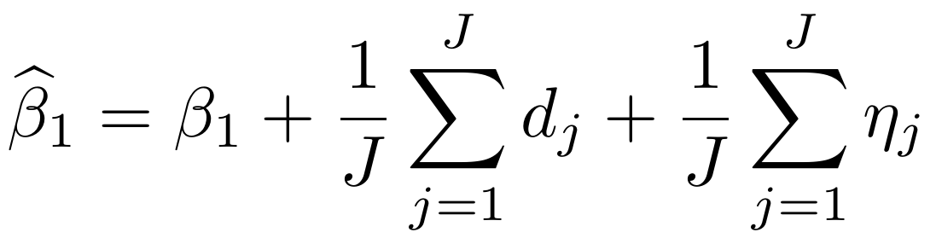
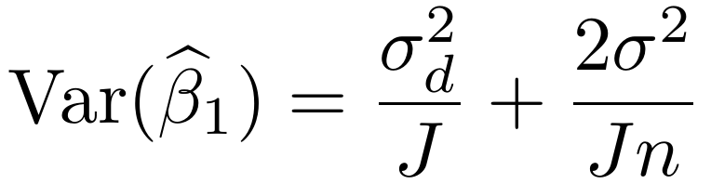
Random treatment effects add a source of uncertainty
Let β₁ be the population-average treatment effect, with independent random center deviations:
The deviations have expectation zero; their realized average need not be zero.
ηⱼ is patient sampling noise, independent of the random center effects.
J = centers; n = patients per treatment per center; σ² = individual-error variance.

Slide 24
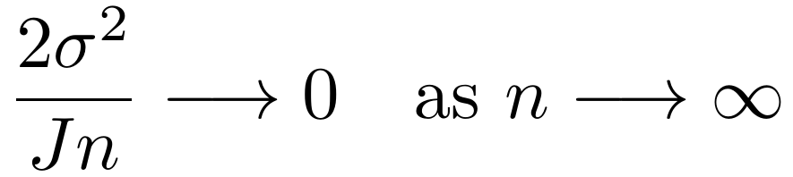
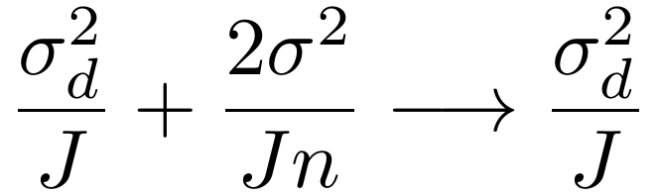
More patients and more centers answer different needs
AVERAGE IN THE INCLUDED CENTERS
AVERAGE IN THE POPULATION
Increasing patients per treatment makes each center’s effect more precise.
More patients reduce individual noise, but the study still samples only J centers.
Even heterogeneous treatment effects can have a precisely estimated average within these centers.
More centers reduce both variance terms. Six precisely measured centers still provide only six center effects.
These are sampling-variance formulas under the balanced model; fitted uncertainty also involves estimating the variance components.

Slide 25
The target determines which uncertainty belongs
FIXED INTERACTION
RANDOM TREATMENT EFFECT
Target: the average effect in the included centers.
Target: the average effect in a population of centers.
Patient sampling determines uncertainty around that fixed average.
Center sampling adds uncertainty about that population average.
Omitting the interaction can inflate the estimated uncertainty by leaving heterogeneity in the residuals.
A random-intercept-only model can understate uncertainty because it omits treatment-effect variation.
Next: model a population of center-specific intercepts and treatment effects using random intercepts and slopes.

Slide 26
BACKUP
Further discussion

Slide 27
Why are the estimated standard errors almost identical?
MOST PRECISION COMES FROM WITHIN CENTERS
BETWEEN CENTERS: LITTLE EXTRA PRECISION HERE
Both models compare enhanced and standard care within each center.
The random-intercept model can also use average outcomes from centers with different treatment proportions.
These comparisons are informative because the treatment groups share the same center baseline. Baseline differences between centers do not obscure these comparisons.
Centers differ substantially in baseline outcomes. A higher center average could reflect its baseline as well as its treatment allocation.
Under the random-intercept assumptions, this noisy evidence adds little precision: the estimated standard error barely decreases.
Both models obtain most of their precision from this same source.
The additional evidence shifts the estimate slightly, but adds little precision: the estimated standard errors are 4.56 and 4.55 m.

