Slide 1
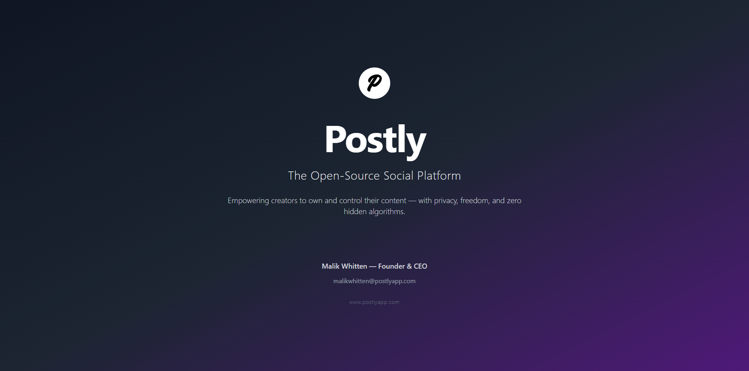
SPEAKING GLOBALLY
Public speaking workshop by Brita Tamm

Slide 2
The Problem
Existing platforms: closed, ad-driven, opaque algorithms.
Creators don’t fully own or control their content.
Users face censorship, privacy risks, and unpredictable reach.
Today’s platforms put profit above people. Remember when a blue check mark actually meant you were reputable? When social media really connected you with the people and communities you cared about — without hidden algorithms deciding for you? When it was truly a free space to share your views and passions?
Modern social media has lost its way. Users have lost control, trust, and real connection.

Slide 3
Our Solution
Postly exists to restore what’s been lost.
1. An open-source, community-driven platform where: 2. Creators truly own their content. 3. Verified status means real credibility again. 4. Feeds are transparent, with minimal algorithms deciding for you. 5. Privacy and free expression come first — not ads and hidden profit motives.

Slide 4
The Product
Hapta transforms PocketBase into a production-ready backend for real scale — handling auth, sessions, cache, and smart rate-limiting. By pushing edge servers closer to users and using dynamic caching, we can handle over 1.2 million requests a year with minimal database strain. The plan is to deploy across EC2 clusters with auto-scaling and leverage AWS tools to reach up to 500k concurrent users — and eventually 1–2 million.”
Modern frontend: SolidJS + TypeScript for a fast, reactive UI that’s easy to extend.
Serverless edge: Deployed as close to users as possible for low latency worldwide.
Hapta backend: A full-stack backend layer for PocketBase.
Smart auth, OAuth2, rolling sessions.
Advanced rate-limiting, robust request validation (Zod).
Built-in intelligent cache that optimizes JSON and smartly invalidates to keep data fresh.
Efficiency: Out of ~500k requests, only ~8.25k hit the database — Hapta’s cache handles the rest.
Scalable architecture: Handles notifications, node scaling, and cache sync.
Planned scale: Deploying multiple EC2 instances + S3, with CI/CD to grow from 500k to 1–2 million concurrent users in the next 5 years.

Slide 5
Market Opportunity
We’re seeing an undeniable shift — creators want more control, users want more privacy, and the market wants real alternatives to big, centralized social platforms. Postly is designed to tap into that demand with a sustainable, open, and user-first approach.
Creator economy: Over $100 billion global market and growing fast.
Millions leaving legacy platforms: Rising distrust in big tech drives demand for open, user-owned spaces.
Open-source adoption: Developers and communities want software they can trust, extend, and own.
Huge upside: Early traction for Mastodon, Bluesky, and Reddit migrations prove real demand for alternatives.

Slide 6
Competitive Landscape
Other open platforms often struggle with onboarding, moderation, or performance. Postly combines the freedom and transparency of open-source with the scale and polish of a mainstream app — that’s our moat.
Legacy players: Twitter/X, Reddit, Threads — centralized, ad-driven, closed.
Emerging open players: Mastodon, Bluesky — good intent, but fragmented UX, limited scale, or confusing onboarding.
Postly’s edge: Fully open-source and production-ready. Clear UX, built-in scalable backend (Hapta). Real content ownership and a practical path to grow to millions of users.

Slide 7
Business Model
We’ll never rely on invasive ads or exploit user data. Instead, we align our revenue with helping creators grow — plus community-run deployments and API licensing give us multiple ways to scale sustainably.
Freemium: Core social features always free.
Premium creator tools: Business Accounts, advanced analytics, monetization add-ons.
API licensing: Communities and developers can deploy Postly under their own brand.
Ethical sponsorships: Optional community-safe ways to fund hosting without intrusive ads.

Slide 8
Roadmap & Traction
✅ Today: MVP live, backend (Hapta) proven in real tests (1.2M+ requests/year).
🔄 Next 6–12 months: Deploy on AWS with edge servers, scale CI/CD, launch public beta.
🎯 Key milestone: Reach first 1,000–5,000 active users to validate and refine.
📈 5-year vision: 1–2 million concurrent users, supported by scalable infra and community growth.
We’re self-funded and already have the tech foundation. Now we’re focused on scaling, shipping fast, and building a trusted user base before expanding globally.

Slide 9
The Team
Founder: Malik Whitten — Full-stack developer, backend architect (Hapta), frontend engineer, dev ops, community lead.
Advisors/early contributors: Mini - Contributor Frontend developer
Next hires: Backend engineer, DevOps, community growth lead, Frontend Full Stack Lead.
I built Hapta from scratch to make PocketBase scale for real. I have the technical stack covered, and with the right partners we’ll grow the team to match our ambition.

Slide 10
The Ask
🚀 What we need: AWS credits, early funding, mentorship, or ecosystem partners.
📈 Goal: Deploy Postly on scalable infra, launch a public beta, and grow to 1–2M users with a robust open-source community.
🤝 How you can help: Support our infra costs, help us reach dev communities, connect us to early champions.
Postly is ready — I just need the right partners to help take it from a proven foundation to a global community platform

Slide 11
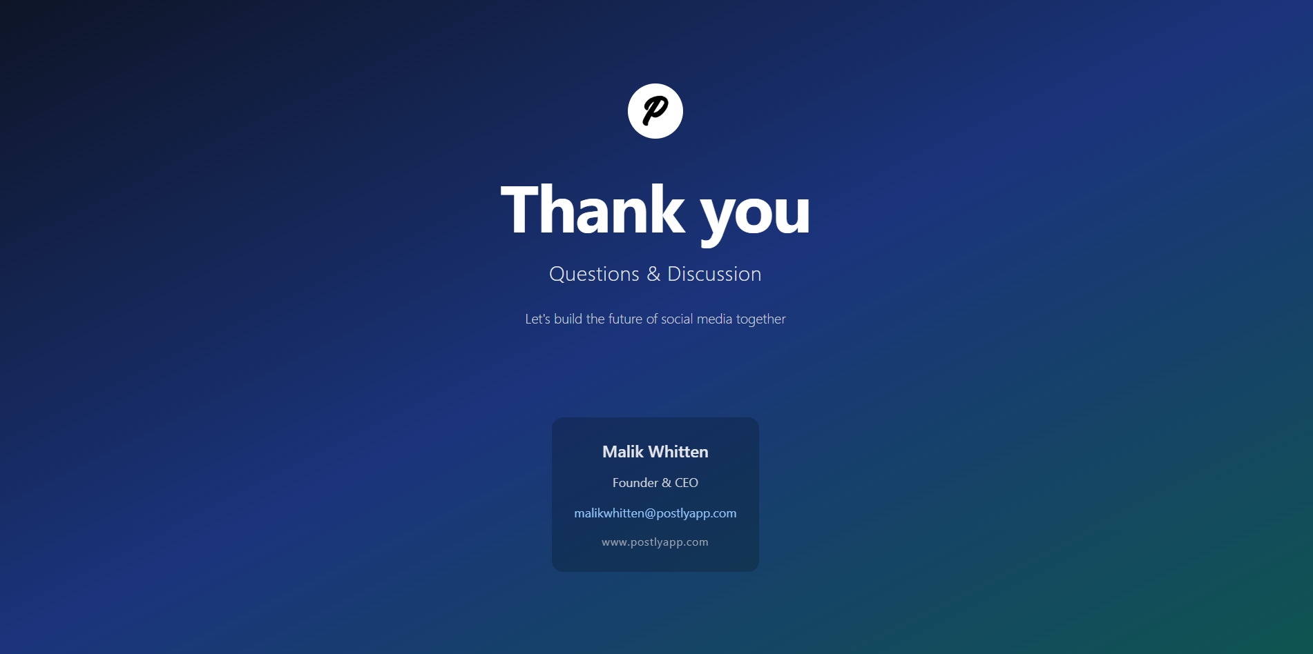
Thank you
Brita Tamm
502-555-0152
brita@firstupconsultants.com
www.firstupconsultants.com

