Slide 1
cryptographic hash function (CHF)
Yousef Shaban Ahmad Khamis Abdelrahman AbdelBagi Mohammad AlMari

Slide 2
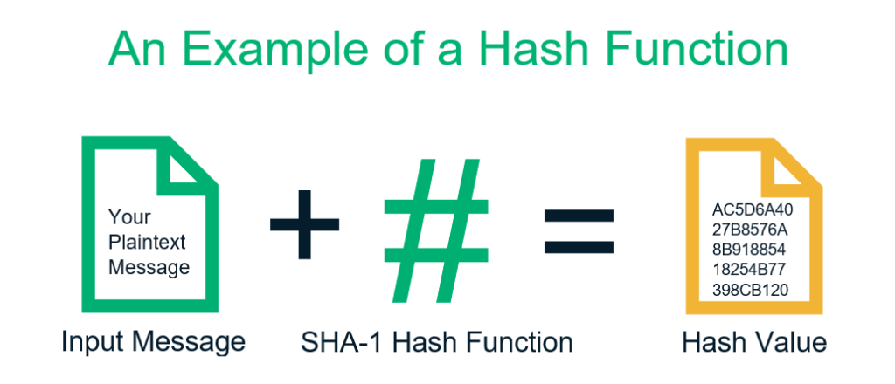
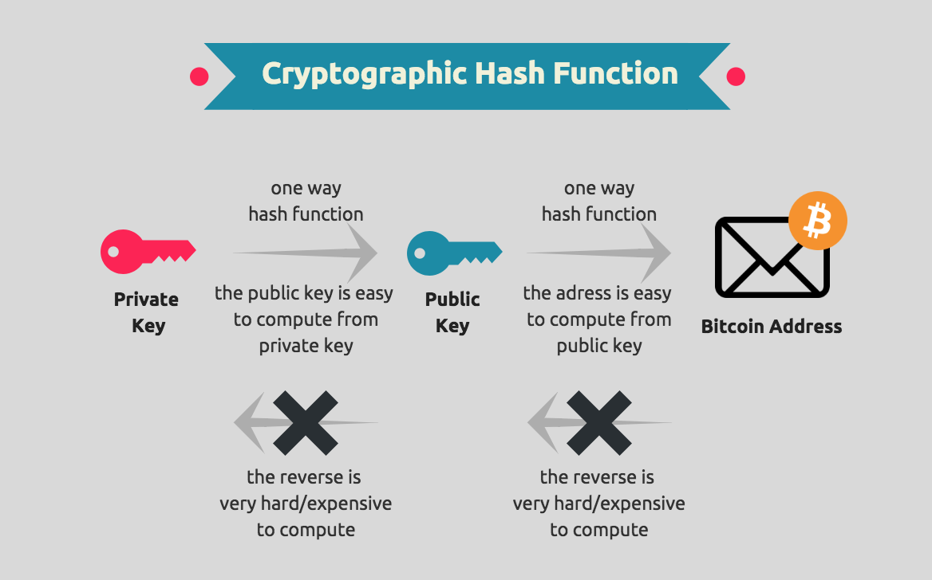
Cryptographic hash function (CHF): is a function that maps a message of any length into a fixed-length hash value that serves as the authenticator.
In other words, a cryptographic hash function is an algorithm that takes an arbitrary amount of data input—a credential— and produces a fixed-size output of enciphered text called a "hash value", or just "hash".
1. Introduction:
Notice it's a single direction work

Slide 3
2. Applications of cryptographic hash function
What is A cryptographic hash function (CHF)?
An equation used to verify the validity of data. It has many applications, notably in information security (e.g. user authentication), Here we will give some examples:
2.1. Message Authentication
Mechanism or service used to verify the integrity of a message; it assures that data received is exactly as sent (i.e., contains no modification, insertion, deletion, or replay).
2.2 Digital Signatures
In the case of the digital signature, the hash value of a message is encrypted with a user’s private key. Anyone who knows the user’s public key can verify the integrity of the message that is associated with the digital signature.
2.3 Data Integrity Check
The sender sends both the message and its hash value to the user. The receiver then checks whether the hash value of the message is the same as the hash value sent by the sender. This ensures that no modification has been done to the data while being transmitted.
2.4 Other applications
Such as: pseudo number generation, digital steganography, digital time stamping, Password Verification, Compiler Operation, etc.

Slide 4
3. Why we used cryptographic hash function?
It combines the message-passing capabilities of hash functions with security properties.
It has variable levels of complexity and difficulty.
It's used for cryptocurrency, password security, and message security.
It checks the integrity of messages and authenticates information.
It adds security features to typical hash functions, making it more difficult to detect the contents of a message or information about recipients and senders.

Slide 5
4. Differences among preimage resistant, second preimage resistant, and collision resistant?
4.1 Pre-Image Resistance
This property means that it should be computationally hard to reverse a hash function.
In other words, if a hash function h produced a hash value z, then it should be a difficult process to find any input value x that hashes to z.
4.2 Second Pre-Image Resistance
This property means that given an input and its hash, it should be hard to find a different input with the same hash.
In other words, if a hash function h for an input x produces a hash value h(x), then it should be difficult to find any other input value y such that h(y) = h(x).
4.3 Collision Resistance
This property means it should be hard to find two different inputs of any length that result in the same hash. This property is also referred to as a collision-free hash function.
In other words, for a hash function h, it is hard to find any two different inputs x and y such that h(x) = h(y).

Slide 6
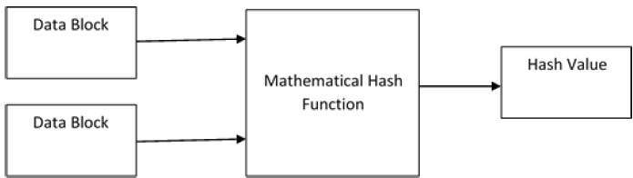
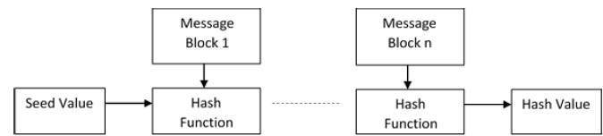
At the heart of hashing is a mathematical function that operates on two fixed-size blocks of data to create a hash code. The size of each data block varies depending on the algorithm.
The hashing algorithm involves rounds of the above hash function as a block cypher. Each round takes an input of a fixed size, typically a combination of the most recent message block and the output of the last round.
This process is repeated for as many rounds as are required to hash the entire message. A schematic of a hashing algorithm is explained in the following image:
5. Structure and Design of Hashing Algorithms

Slide 7

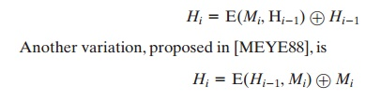
6. How ciphers block chaining to construct a cryptographic hash function?
functions based on using a cipher block chaining technique, but without using the secret key. One of the first such proposals was that of Rabin [RABI78]. Divide a message M into fixed-size blocks M1, M2, Á, MN and use asymmetric encryption system such as DES to compute the hash code G as:
This is similar to the CBC technique, but in this case, there is no secret key.
Several researchers have proposed refinements intended to strengthen the basic block chaining approach. For example, Davies and Price [DAVI89] describe the variation: .
Attention has been directed at finding other approaches to hashing.

Slide 8
Use the algorithm defined at the beginning of this subsection to calculate the unencrypted hash code G.
1
Construct any desired message in the form of
Q1, Q2 … QN-2.
2
Compute
Hi = E(Qi, Hi - 1) for 1 … i … (N – 2).
3
Generate 2^(m/2) random blocks. for each block X, compute E(X, HN - 2). Generate an additional 2^(m/2) random blocks; for each block Y, compute D(Y, G), where D is the decryption function corresponding to E.
4
Based on the birthday paradox, with a high probability there will be an X and Y such that
E(X, HN - 2) = D(Y, G).
5
Form the message Q1, Q2, Á, QN - 2, X, Y. This message has the hash code G and therefore can be used with the intercepted encrypted signature.
6
6. How ciphers block chaining to construct a cryptographic hash function?

Slide 9
7. The operation of SHA-512?
7.1 Append: Padding Bits
The first step is to carry out the padding function, in which we append a certain number of bits to the plaintext message to increase its length, which should be exactly 128 bits less than an exact multiple of 1024.
When we are appending these bits at the end of the message, we start with a ‘1’ and then keep on adding ‘0’ till the moment we reach the last bit that needs to be appended under padding and leave the 128 bits after that.
7.2 Append: Length bits
Now, we add the remaining 128 bits left to this entire block to make it an exact multiple of 1024, so that the whole thing can be broken down into ’n’ number of 1024 blocks of message that we will apply our operation on. The way to calculate the rest of the 128 bits is by calculating the modulo with 2⁶⁴.
Once done, we append it to the padded bit and the original message to make the entire length of the block to be “n * 1024” in length.
7.3 Initialize the buffers
Now, that we have “n x 1024” length bit message that we need to hash, let us focus on the parts of the hashing function itself. To carry on the hash and the computations required, we need to have some default values initialized.
These are the values of the buffer that we will need. There are other default values that we need to initialize as well. These are the values for the ‘k’ variable which we will be using.
The reason for initiating these values will be clear to you in the very next step that we will explore.

Slide 10
7. The operation of SHA-512?
7.4 Compression function
Now we need to take a closer look at the hash function to see what's going on. To begin, we partition(divide) a 1024-bit message into 'n' bits.
We'll do 80 rounds, and the input, W, will be derived from 1024 bits, which will be divided into 16 pieces. The message in plaintext is the value of W from 0 to 15, whereas the values of W from 16 to 79 are calculated from the previous 16 blocks.
Now that we know the methodology to obtain the values of W for 0 to 79 and already have the values for K as well for all the rounds from 0 to 79 we can proceed ahead and see where and how we do put in these values for the computation of the hash.
We have the values and formulas for each of the functions carried out we can perform the entire hashing process. These are the functions that are performed in each of the 80 rounds that are performed over and over for ‘n’ number of times.
7.5 Output
The output from every round act as an input for the next round, and this process keeps on continuing till the last bit of the message goes through one of the rounds, and the output from the last block of the last message is the hash code. The length of the output is 512 bits.
7.6 Conclusion
The SHA-512 hashing algorithm is currently one of the best and most secure hashing algorithms after hashes like MD5 and SHA-1 have been broken down. Due to its complicated nature, it is not widely accepted that SHA-256 is a general standard, but the industry is slowly moving towards this hashing algorithm.

Slide 11
8.1 Birthday attack 8.2 Birthday paradox
8. Overview of birthday paradox and birthday attack
The Birthday attack is a type of cryptographic attack that cracks the algorithms of mathematics by finding matches in the hash function. The method relies upon the birthday paradox, through which the chance of sharing one birthday by two people is quite higher than it appears. In the same way, the chance of collision detection is also higher within the target hash function, which thereby enables the attacker to find similar fragments by the use of a few iterations. The attack is mostly used to abuse communication between the two parties. The nature of the attack is dependent upon the collisions found among random attacks as well as the degree of the permutation.
The probability theory describes the birthday paradox problem as if you carry the ‘n’ number of people in the room; there is the probability that some of them might have their birthdays on a similar day. But, one important point to consider is that we do not focus on the matching birth dates but rather two people sharing one birthday is the major point.
So, the birthday attacks utilize the approach of probability to minimize the difficulty in the matched collision and to get the approximate hash collision risk in a certain number. It also shows that discovering a particular hash collision is the most problematic thing instead of finding the matched hash collisions with similar values.

Slide 12




8. Overview of birthday paradox and birthday attack
8.3 Calculating birthday paradox
This probability will be subtracted from the other one derived that includes at least two people will share one birthday.
The chance of one match at least = 1 – the probability of no match.
A 365/365 chance that there is no other shared birthday:
The second person will have only a 364/365 chance of not sharing a similar day birthday:1
The probability will be 363/365 of not sharing a similar day birthday:
The pattern for the entire population:

Slide 13
8. Overview of birthday paradox and birthday attack
8.4 How to prevent the Birthday attack?
To prevent the birthday attack, there is the possibility that the length of the output for the hash function of the signature scheme can be selected to be large enough such that the chance of a birthday attack becomes computationally impossible.
Along with using the extended bit length, the signer can also prevent the attack if make some inoffensive but random changes to the document before it is signed and keep the contract copy under possession. Such that he can demonstrate within the court that the signature matches the contract.
8.5 Final Thoughts
The birthday attack cracks the mathematics algorithm by its matching in the hash function. The birthday attack is best calculated with the probability theory. However, the attack can be prevented by increasing the bit length and if the signer makes some random changes within the document.

