Slide 1
Cost Effective Deployment of Hardware Accelerators Across Logic Simulator Modules
Taten H. Knight
College of Aviation, Science, and Technology
Lewis University

Slide 2
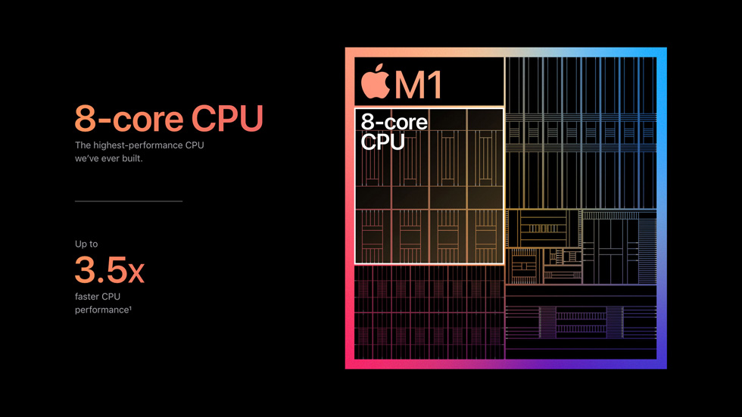

Introduction
Industry has moved to System-on-Chip SoC as the standard
Apple “M” Chipset
Google Tensor
Increases in speed and efficiency
Important for the development of custom silicon

Slide 3
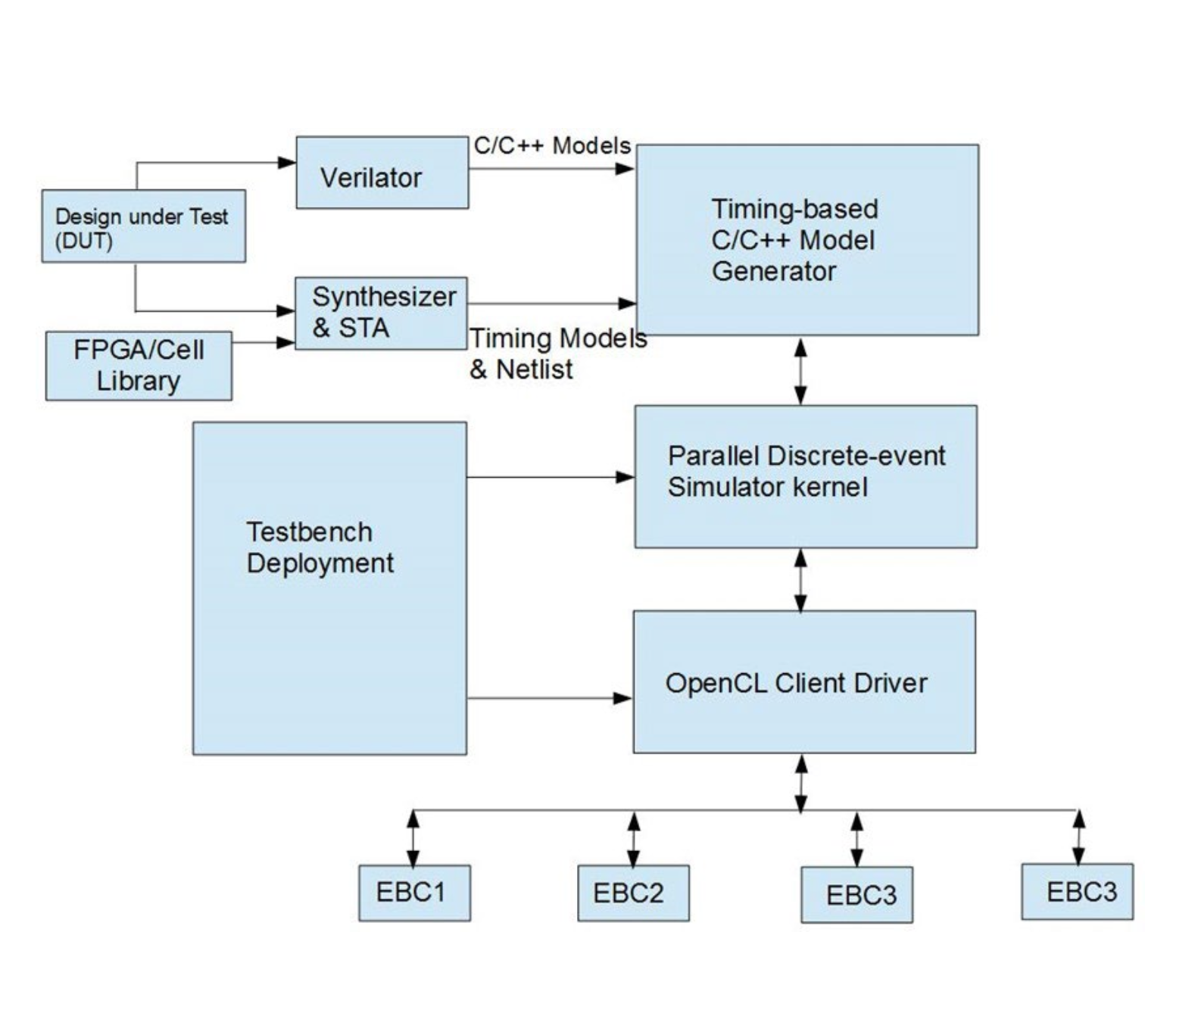
The Problem
Developing a cost effective and quality solution for SoC verification
Solve potential Parallel Discrete-event Simulator bottleneck

Slide 4
Module Breakdown
Software design, model specification, and model compilation

Slide 5
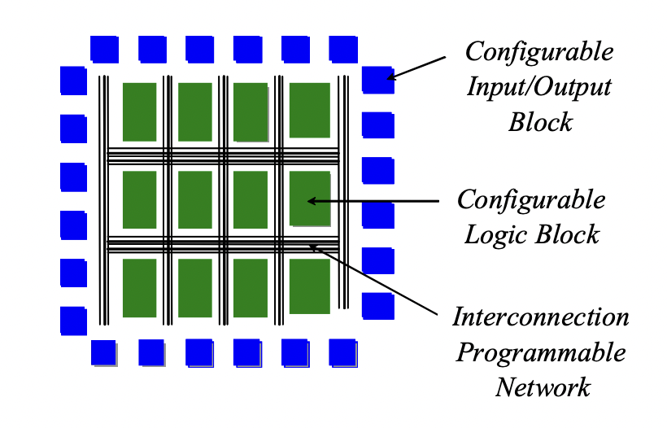
Module Breakdown
FPGA Cell
Synthesizer & Static Timing Analyzer

Slide 6
Module Breakdown
Timing Base Model Generator
Summarizer
Key input into PDES kernel

Slide 7
Module Breakdown
Testbench
PDES Kernel (Key Component)
OpenCL

Slide 8
Module Breakdown
Embedded computing modules
Actual parallelization

Slide 9
Previous Work
Defining PDES
“In a discrete event simulation changes to simulation state occur only through event computations.”
Made up of sequential simulators called a Logical Processes (LP)

Slide 10
Previous Work - Synchronization
Chandy, Misra, and Bryant (CMB) Algorithm
Blocks execution until it’s guaranteed that an ‘earlier’ message will not be received
Avoids deadlock via null messages and a lookahead value
Suffers from lookahead creep

Slide 11
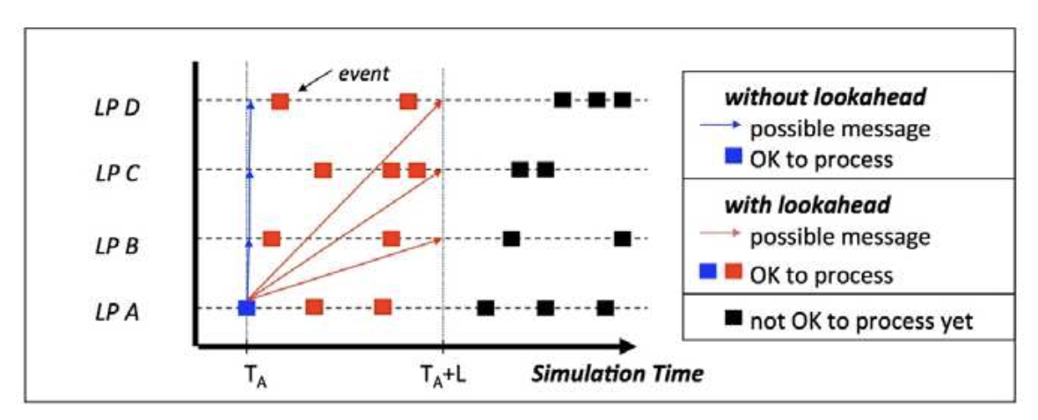
Lookahead

Slide 12
Previous Work – Next Gen
Bounded Lag and YAWNS
Synchronous
Processed via epochs
Find safe event
Process safe event and generate new events
Repeat

Slide 13
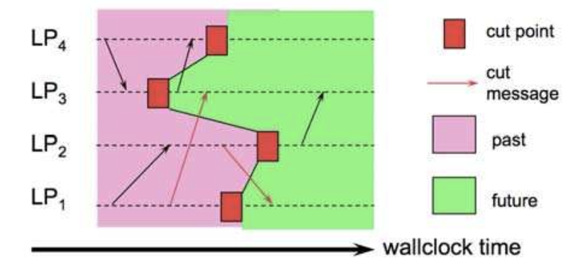
Previous Work – Time Warp
Local Control
Rollback state variables and sent messages
Copy state saving
Incremental state saving
Reverse computation
Anti-messages
Global Control
Global virtual time

Slide 14
Solution – Minor Improvements
Ensure that Verilator abstraction is sufficiently succinct with well-defined model
Verify that timing based model uses largest possible time step

Slide 15
Solution – Major Improvements
Use conservative method with well defined lookahead – Occam’s Razor
Take advantage of parallel CPU architecture (extremely fast) at the task level
If the simulation is massively parallel at the task level (many matrix ops per state transition) use OpenCL to offload to external GPU(s)

Slide 16
Future Work
PDES on supercomputers
Interesting but still waiting on more advanced parallelization algos
Modular verification via chip manufacturers
Interoperable models

Slide 17
References
Y. Moy, E. Ledinot, H. Delseny, V. Wiels and B. Monate, "Testing or Formal Verification: DO-178C Alternatives and Industrial Experience," in IEEE Software, vol. 30, no. 03, pp. 50-57, 2013. doi: 10.1109/MS.2013.43
R. Fujimoto, "Parallel and Distributed Simulation", Proceedings of the 2015 Winter Simulation Conference, L. Yilmaz, W. K. V. Chan, I. Moon, T. M. K. Roeder, C. Macal, and M. D. Rossetti, eds
R. C. Armstrong, R. J. Punnoose, M. H. Wong, J. R. Mayo, ``Survey of Existing Tools for Formal Verification'', in Sandia Report, 2014.
E. Monmasson, M. Cirstea, ``FPGA Design Methodology for Industrial Control Systems – a Review’’,
R. Nane, V. Sima, C. Pilato, J. Choi, B.Fort, A. Canis, et al., ``A Survey and Evaluation of FPGA High-Level Synthesis Tools'' in IEEE Transactions on Computer-Aided Design of Integrated Circuits and Systems, vol. 35, no. 10, pp. 1591-1604, Oct. 2016, doi: 10.1109/TCAD.2015.2513673.

