Slide 1
Online library Marketplace
Under supervision
Dr: Doaa Saleh

Slide 2
ID | Name
20200603 | Noor Eldeen Nizar
20200838 | Abdelrahman Hesham
20200279 | Abdelrahman Ahmed Ali
20200026 | Ahmed Abdelhameed Hassan
20200583 | Nabil Sherif Nabil Ibrahim Darwish
20201038 | Eman Ibrahim Shaban Gad
20201061 | Dina Ahmed Abdelrady
20200201 | Ziad Abdallah Sayed

Slide 3
Introduction.
An Online library Marketplace system's goal is to run a virtual library more efficiently and at a lower cost than traditional physical libraries, saving people time. Because the system is almost completely automated, it simplifies all of the library's operations. The software handles book purchases, book lending, categorizing, circulation recording, and stock checking. Such software reduces the human labor factor and reduces the likelihood of errors.
The marketplace section connects users with each other, By making the selling, trading, and buying process as easy as possible for the users by allowing a secure and reliable transaction. A user can search for a book and view the list of books that are available in the library.

Slide 4
Project steps
Step 1
Planning
Step 2
Organizing
Step 3
Influencing
Step 4
Controlling

Slide 5

Planning
Our plan for the online library bookstore is to allow a broad audience to enjoy a reliable and safe environment to communicate, sell, trade, and buy books.
For reaching our target
we will utilize News Paper advertisements.
We Will also attract sponsors and popular authors.
held events on two scales international events or weekly.
we will create a platform to give talks about future books.
we will deal with a company that will supply a team to help us.
create an environment for our managers to focus on high-level issues.

Slide 6
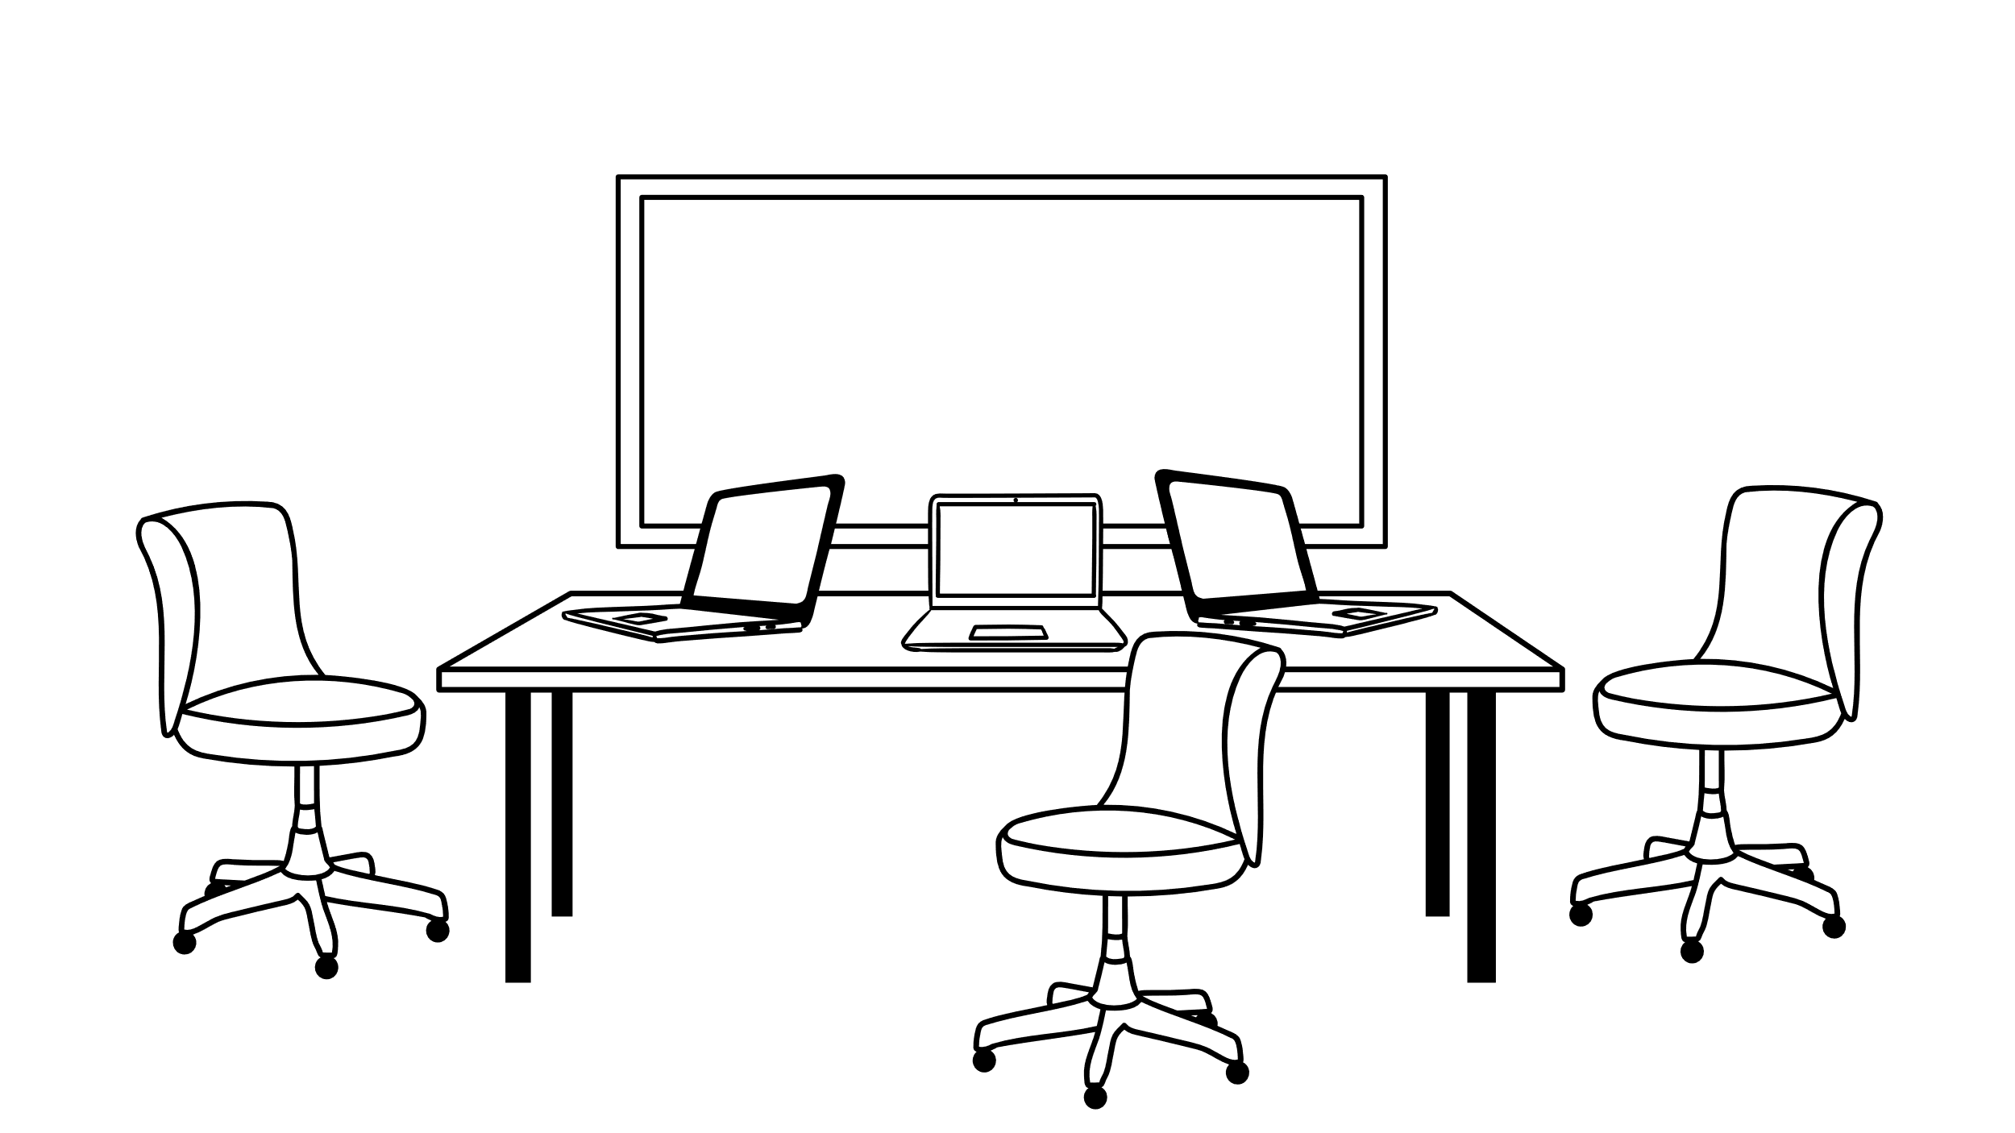
Organizing
Organizing is a function that follows the planning function, where a manager can begin to organize. Involves creating an organizational structure and deploying people to reach their goals.
The process of the Organizing involves
Identification of activities
Functional organizing
Clarifying the functionality
Facilitates administration

Slide 7


Influencing
Influencing is a process of transforming the behaviors of employees to create a productive environment in any organization
The process of the influencing subsystem involves
Leadership
Motivation
Consider groups
Communication
Encouraging creativity and innovation
Building a company culture.
The header plays a magic role, why ??

Slide 8


Controlling
Control is a primary goal-oriented function of management in an organization. It is a process of comparing the actual performance with the set standards of the company to ensure that activities are performed according to the plans and if not then taking corrective action.
The process of the Controlling subsystem involves
Measuring Performance.
Comparing Measured Performance to Standards.
Taking Corrective Action

Slide 9
Preserve the past Open the Future.
Thank You.

