Slide 1
Gradient Boosting Trees
FONG, Ho Yin
(20599045)
YouTube Presentation video link:
https://youtu.be/HZPgiYyqej8

Slide 2
Contents
Background – Decision Trees
Motivation – Problems in decision trees
Simplified Gradient Boosting
Mathematical model
Strengths and Weaknesses
AdaBoost
Conclusion

Slide 3
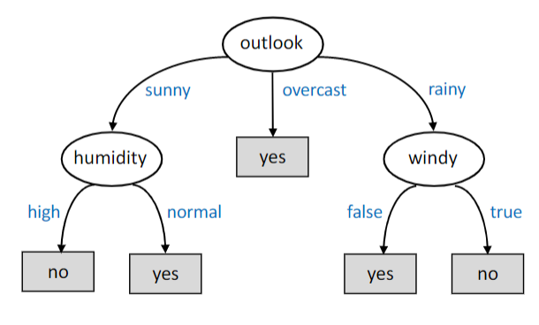
Decision Trees (from lectures)
Decision Trees :
Given an input data with a certain amount of attributes (X[0]…X[n-1])
Recursively picking attributes to divide samples
Construct tree with chosen attribute in internal nodes

Slide 4
Shortcomings
Subject to overfitting
Fewer samples available in deeper nodes after division
Sensitive to data variance
Small changes in input data can lead to huge tree construction difference
E.g. adding (outlook: overcast, windy: true, no) in the previous example

Slide 5
Solutions
Random Forests :
Alleviates overfitting with bootstrap samples and tree ensemble
Make each tree in ensemble independent with attribute bagging
(trees are constructed with only a subset of attributes)
Average the predictions from all constructed trees
Gradient boosting trees

Slide 6







Idea of Gradient Boosting
Instead of constructing multiple trees at once, slowly improve a single tree
Start with predictions all at trivial value
Calculate residual (error, difference from actual value)
Construct a new tree based on the residual
Perform prediction from new tree
Repeat step 2 to 4 until condition met (e.g. converged residual, accuracy reached)
$y_{0}=avg(y)$ or $y_{0}=log(odds)$
$r_{1}=y−y_{0}$
$r_{n}=y−y_{n−1}$
$T_{1}=construct_tree(X,r_{1})$
$T_{n}=construct_tree(X,r_{n})$
$y_{1}=T_{1}.predict\left(X\right)$
$y_{n}=T_{n}.predict\left(X\right)$

Slide 7


Example: Real Estate Prices
$r_{0}=y−y_{0}$
 | Age | Size (sq. ft.) | Location | Price (M)
1 | 10 | 750 | 5 | 480
2 | 22 | 1015 | 12 | 1040
3 | 40 | 721 | 6 | 350
4 | 16 | 1250 | 4 | 1310
5 | 24 | 650 | 9 | 400
Prediction
716
716
716
716
716
Residual
-236
324
-366
594
-316
716
$$y_{0}=\frac{480+1040+350+1310+400}{5}=716$$

Slide 8

Tree Constructing
$T_{1}=construct_tree(X,r_{1})$
Size > 750
Similar to normal decision trees
Choose best attribute to divide samples
Recursively construct entire tree
Location > 10
Age > 20
-341
-236
324
594
-316, -366
 | Age | Size (sq. ft.) | Location | Price (M)
1 | 10 | 750 | 5 | 480
2 | 22 | 1015 | 12 | 1040
3 | 40 | 721 | 6 | 350
4 | 16 | 1250 | 4 | 1310
5 | 24 | 650 | 9 | 400
Residual
-236
324
-366
594
-316

Slide 9


Further Prediction
Size > 750
Similar to normal decision trees
Learning rate is introduced
$y_{n}=y_{n−1}+α∙results from T_{n}$
Location > 10
Age > 20
324
594
-341
-236
Results from tree
-236
324
-341
594
-341
$$α=0.1$$
 | Age | Size (sq. ft.) | Location | Price (M)
1 | 10 | 750 | 5 | 480
2 | 22 | 1015 | 12 | 1040
3 | 40 | 721 | 6 | 350
4 | 16 | 1250 | 4 | 1310
5 | 24 | 650 | 9 | 400
Prediction
692.4
748.4
681.9
775.4
681.9

Slide 10






Math behind
$$L\left(y_{i},γ\right)=\frac{1}{2}{\left(y_{i}−γ\right)}^{2}$$
Start with predictions all at trivial value
In the previous example, n=5 samples. The initial value is the sum of all 5 output values (price) divided by 5 (which is just the average value).
$$F_{0}(x)=\underset{γ}{argmin}{\sum_{i=1}^{n}{L(y_{i},γ)}}$$
$$\sum_{i=1}^{n}{\left(γ−y_{i}\right)} =0$$
$$\frac{∂L}{∂γ}=0$$
$$F_{0}\left(x\right)=γ=\frac{\sum_{i=1}^{n}{y_{i}}}{n}$$
$γ$: initial prediction
$y$: target values

Slide 11




Math behind
$$L\left(y_{i},γ\right)=\frac{1}{2}{\left(y_{i}−γ\right)}^{2}$$
Calculate residual (error term)
The final simplified version is also called the pseudo-residual
$$r_{im}=−{\left[\frac{∂L(y_{i},F(x_{i})}{∂F(x_{i})}\right]}_{F\left(x\right)=F_{m−1}(x)}$$
$$\frac{∂L}{∂F(x_{i})}=F(x_{i})−y_{i}$$
$$r_{im}=y_{i}−F_{m−1}(x_{i})$$
(iterate i for n, i represents the index of sample)
$$r_{m}=y−y_{m−1}$$
(m represents which tree/iterating run this is)

Slide 12





Math behind
$$L\left(y_{i},γ\right)=\frac{1}{2}{\left(y_{i}−γ\right)}^{2}$$
Construct a new tree based on the residual
Recall how the multiple values in leaf node are combined in an average value
$$γ_{jm}=\underset{γ}{argmin}{\sum_{x_{i}εR_{ij}}{L(y_{i},F_{m−1}\left(x_{i}\right)+γ})}$$
$$\frac{∂L}{∂γ}=F_{m}\left(x_{i}\right)+γ−y_{i}=0$$
$$\sum_{x_{i}εR_{ij}}{\left(F_{m−1}\left(x_{i}\right)+γ−y_{i}\right)} =0$$
each $R_{ij}$ represents a leaf node
$$γ_{jm}=\frac{\sum_{x_{i}εR_{ij}}{y_{i}−F_{m−1}\left(x_{i}\right)}}{|R_{ij}|}$$

Slide 13



Math behind
$$L\left(y_{i},γ\right)=\frac{1}{2}{\left(y_{i}−γ\right)}^{2}$$
$J_{m}$ represents the number of leaf nodes
in this run m.
Perform prediction from tree
Recall how the multiple values in leaf node are combined in an average value
$$F_{m}(x)=F_{m−1}\left(x\right)+α\sum_{j=1}^{J_{m}}{γ_{m}I(x∈R_{jm})}$$
$$y_{m}=y_{m−1}+α∙results from T_{m}$$

Slide 14

More examples (Classification)
 | Age | Size | Location
1 | 10 | 750 | 5
2 | 22 | 1015 | 12
3 | 40 | 721 | 6
4 | 16 | 1250 | 4
5 | 24 | 650 | 9
Label
0
1
1
1
0
Label instead of Prices
0 = Bad, 1 = Good
$$y_{0}=log\left(odds\right)$$
$=log\left(\frac{3}{2}\right)$
Residual
-0.176
0.824
0.824
0.824
-0.176
Prediction
0.176

Slide 15




“Gradient” Boost
$r_{n}=y−y_{n−1}$
$T_{n}=construct_tree(X,r_{n})$
$y_{n}=T_{n}.predict(X)$
$y_{n}=y_{n−1}+α∙results from T_{n}$
$y_{1}=y_{0}+α∙T_{1}(X)$
$y_{2}=y_{1}+α∙T_{2}(X)$
$=y_{0}+α∙T_{1}\left(X\right)+α∙T_{2}(X)$
$y_{n}=$ $y_{0}+α∙T_{1}\left(X\right)+α∙T_{2}\left(X\right)+…+α∙T_{n}\left(X\right)$
Somewhat similar to linear regression

Slide 16

“Gradient” Boost
$r_{n}=y−y_{n−1}$
$T_{n}=construct_tree(X,r_{n})$
$y_{n}=T_{n}.predict(X)$
$y_{n}=y_{n−1}+α∙results from T_{n}$
$≈y_{n−1}+αr_{n}$
$=y_{n−1}+α\left(y−y_{n−1}\right)$
$y_{n}=\left(1−α\right)y_{n−1}+ay$
$=\left(1−α\right)\left(\left(1−α\right)y_{n−2}+αy\right)+ay$
$={\left(1−α\right)}^{2}y_{n−2}+α^{2}y$
$={\left(1−α\right)}^{n}y_{0}+a^{n}y$

Slide 17
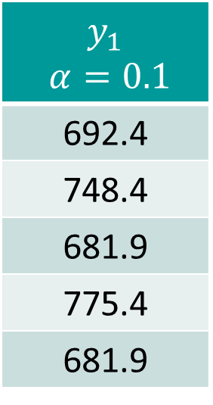

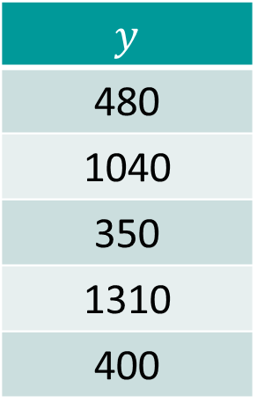
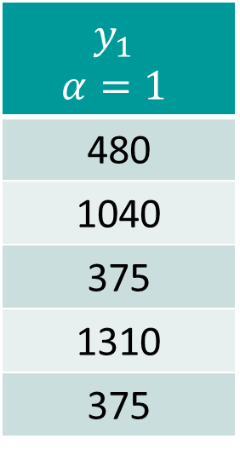
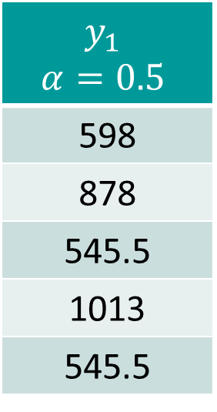
Learning rate
Learning rate determines how quick results change
The lower the learning rate, the closer the results are to original
$y_{n}=y_{n−1}+α∙results from T_{n}$
Results from tree
-236
324
-341
594
-341
$$y_{1}$$ $α=0.1$
692.4
748.4
681.9
775.4
681.9
$$y_{1}$$ $$α=0.5$$
598
878
545.5
1013
545.5
$$y_{1}$$ $$α=1$$
480
1040
375
1310
375
$y$
480
1040
350
1310
400

Slide 18
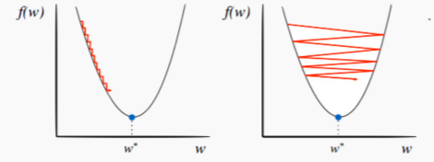
Learning rate
Consider learning rate in the loss function
Learning rate too low: slow convergence, computation overhead
Learning rate too high: bouncing to and from convergence point

Slide 19
Strengths and Weaknesses
Alleviates overfitting with constantly changing tree structure
Customizable learning rate and loss function
Easy to understand if a simple loss function is used
Computational time and power
Need experiments and optimization for model tuning

Slide 20
Strengths and Weaknesses
Compared to Random Forests :
Less subject to randomness, more consistent performance with suitable learning rate initialized
Faster predictions
May require more computational power in training depending on number of runs and number of experiments for tuning
More sensitive to overfitting if data is noisy

Slide 21
Possible Improvements
Using other loss functions?
Exponential / Logistic loss
Make results less linear on initial data, alleviates overfitting more
Regression vs. Classification?

Slide 22

AdaBoost
Replacing Squared Loss function with Exponential Loss
$Loss=\frac{1}{N}\sum_{n=1}^{N}{e^{−y_{n}γ_{n}}}$
Apply gradient descent algorithm as well
$\frac{∂L}{∂γ_{n}}=−y_{n}e^{−y_{n}γ_{n}}=−y_{n}w_{n}$ ← gradient can be seen as reweighted targets
Constructs trees according to reweighted targets
Useful in classification problems, helps adjust misclassified points

Slide 23
Conclusion
Gradient Boosting Trees :
Utilizes concept of gradient descent, applied in decision trees
More stable performance than Random Forests
Can be simplified, assuming a differentiable loss function is used
AdaBoost for alternative loss for classification

Slide 24
Thanks for listening!

Slide 25
References
COMP4211 lecture notes (Module 12, Decision Trees) https://canvas.ust.hk/courses/36189/files/4213820?module_item_id=549808
Towards Data science (Gradient Boosting Tree Algorithm Explained) https://towardsdatascience.com/machine-learning-part-18-boosting-algorithms-gradient-boosting-in-python-ef5ae6965be4
PaperSpace Blog (Gradient Boosting in Classification) https://blog.paperspace.com/gradient-boosting-for-classification/
Harvard lecture notes (2018-CS109A, Lecture 17 – Boosting) https://harvard-iacs.github.io/2018-CS109A/lectures/lecture-17/presentation/lecture17_boosting.pdf
StatQuest (Gradient Boost 2) https://www.youtube.com/watch?v=2xudPOBz-vs
J.H. Friedman (Stochastic Gradient Boost) https://statweb.stanford.edu/~jhf/ftp/stobst.pdf

