Slide 1

DEPARTMENT OF COMPUTER SCIENCEFACULTY OF COMPUTER SCIENCE AND MATHEMATICSKRAKOW UNIVERSITY OF TECHNOLOGY
BLOCKCHAIN-BASED ELECTRONIC VOTING APP
Wiktor Zmiendak
Supervisor: Dr Marcin Wątorek
Cracow 2026

Slide 2

PURPOSE AND SCOPE
Creation of a fully functional web application for conducting online elections and surveys
1
Web application
Creating a secure voting system without the need to create accounts
Voting system
2
3
Using blockchain networks to record and read votes
Integration with Ethereum

Slide 3
MAIN ISSUES OF THE WORK
Blockchain technology
1
Smart contracts and the Solidity language
2
Relayer and meta transactions
3
Testnets and fauceting
4
Signing a vote using private keys
5

Slide 4



SIMILAR SOLUTIONS
Follow My Vote - inactive voting platform that allowed users to view their votes
Horizon State - also an inactive platform for conducting elections and consultations on their conduct
Other tools: poll-maker, google forms, survio

Slide 5
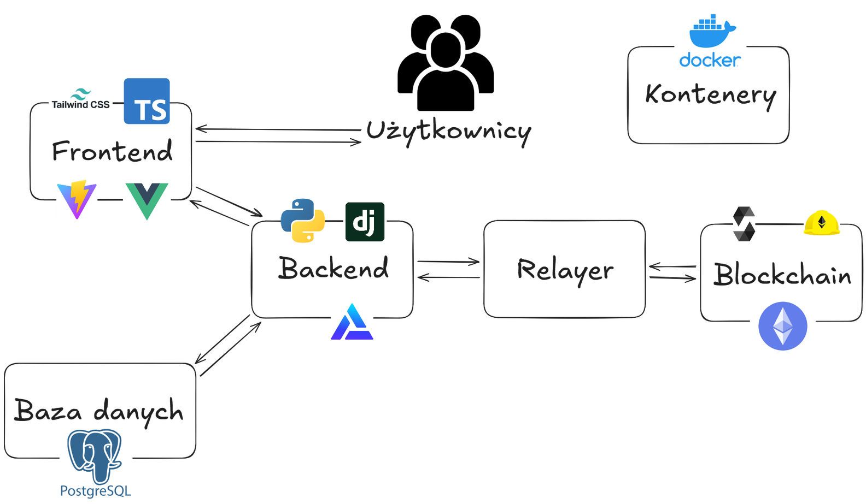
ETHERVOTE APP

Slide 6
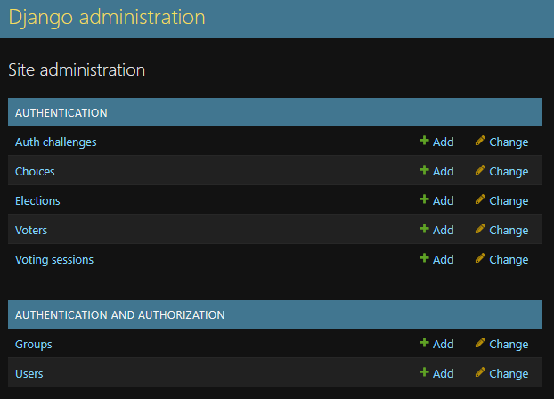
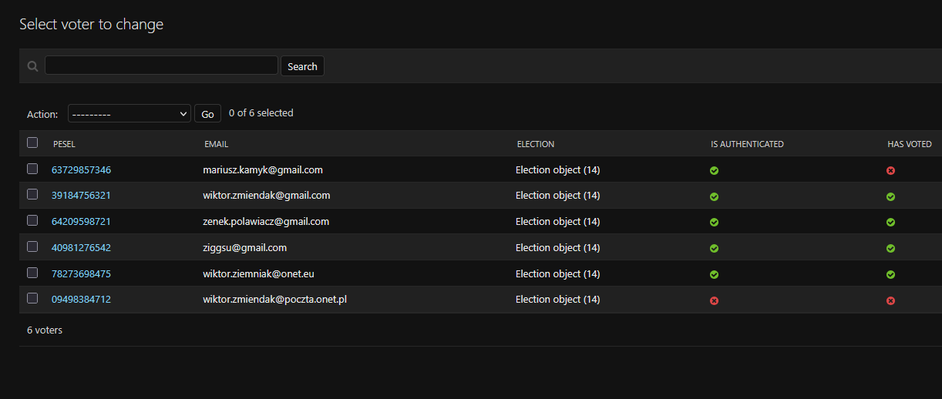
ADMINISTRATIVE POINT OF VIEW

Slide 7
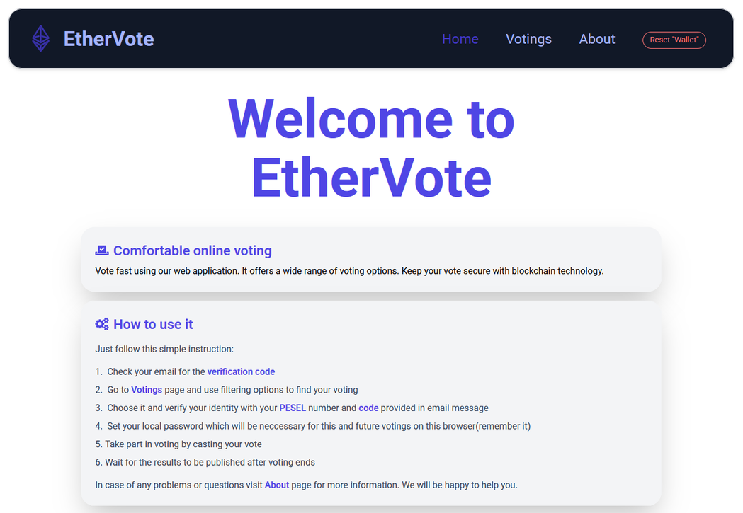
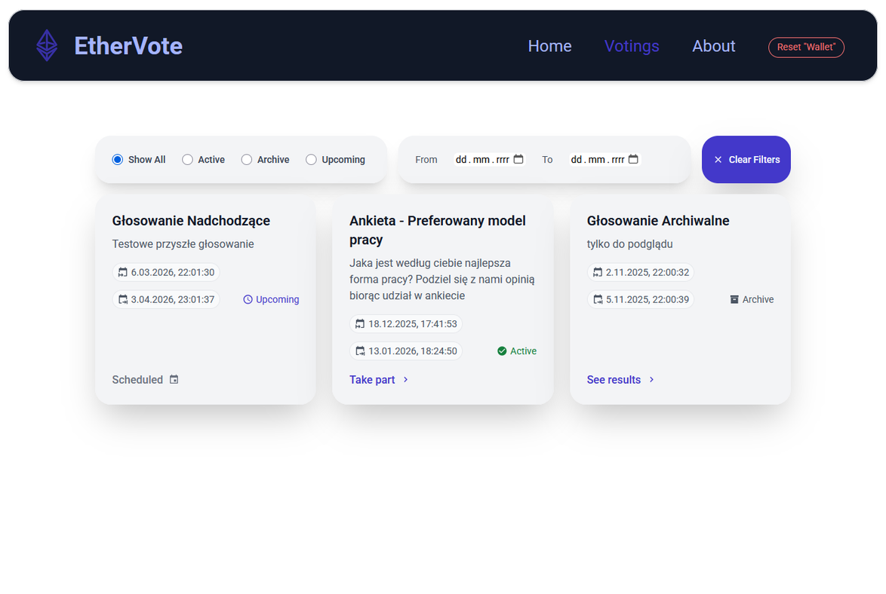
THE USER'S POINT OF VIEW

Slide 8
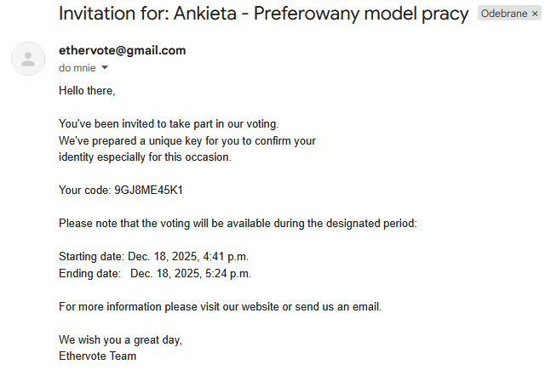
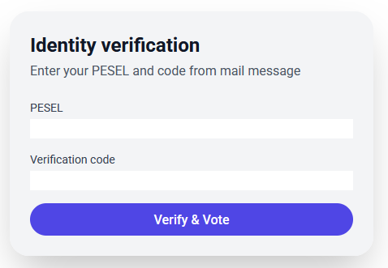
THE USER'S POINT OF VIEW

Slide 9
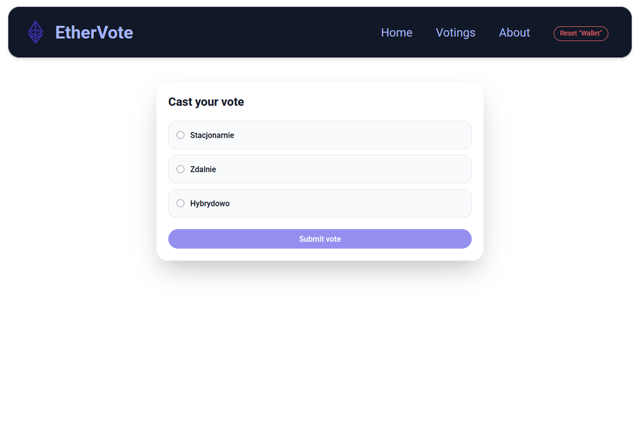
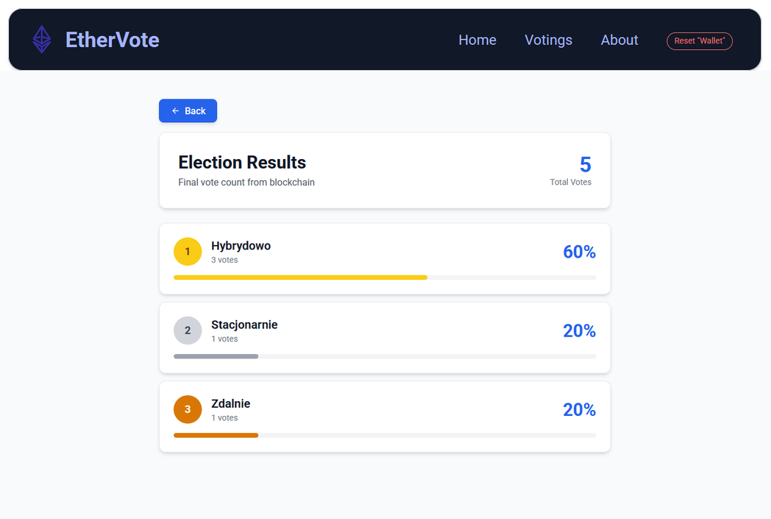
THE USER'S POINT OF VIEW

Slide 10

APPLICATIONS
Social organizations, associations, corporations
Public voting
Schools and universities
  Local referendums
  Local elections
  Public consultations
  Student council elections
  Student surveys
  Employee opinion survey

Slide 11

THANK
YOU

