Slide 1
KAIST · DIGITAL HISTORY · PROJECT IN PROGRESS
How the World Talks About AI
1990 – 2023
A history of AI in books and news
potchara1411.github.io/Digital-history-project
Notes:
Hello. My project is about AI — but not the technology. It is about how people TALK about AI. I looked at 30 years of books and news. My question is simple: when did AI become a big topic? And were people ever happy about it? [~20s]

Slide 2
MY IDEA
Adding data to Atlas of AI
• Kate Crawford’s book Atlas of AI (2021) says AI is really about power — but she uses ideas, not data
• I use data: 30 years of books + 13 years of news from around the world
• My question: WHEN did people’s view of AI change? I use old AI news as evidence
Notes:
A famous scholar, Kate Crawford, wrote a book called Atlas of AI. She says AI is really about power and control. But she uses ideas, not data. She does not show WHEN people's view of AI changed. So I use data: 30 years of books, and 13 years of news from around the world. I use old AI news as evidence about history. [~45s]

Slide 3
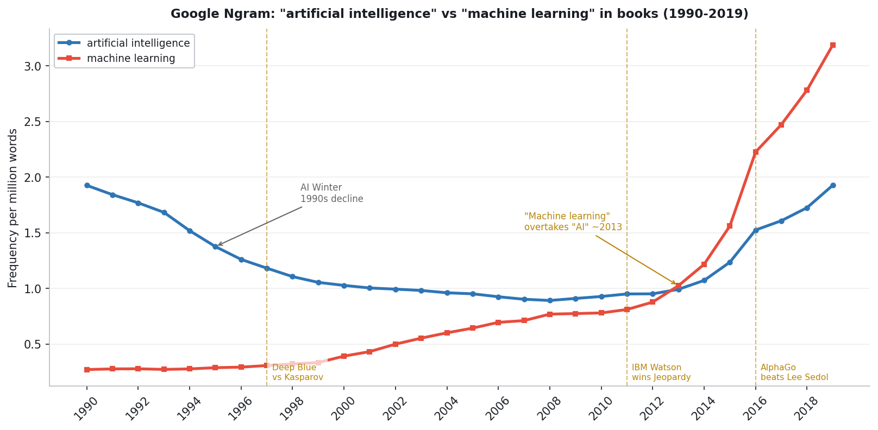
FINDING 1
First AI went down — then it changed its name
• In the 1990s, the word “artificial intelligence” went DOWN in books — people lost interest
• A new word, “machine learning,” became more popular and passed it by 2013
Notes:
My first finding is a surprise. In the 1990s, the word 'artificial intelligence' went DOWN in books. People lost interest. Then a new word, 'machine learning,' became more popular. By 2013, it passed 'artificial intelligence.' So the field changed its name. [~40s]

Slide 4
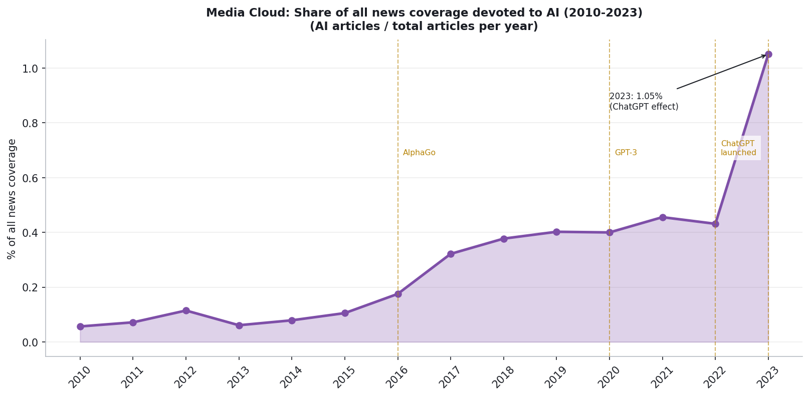
FINDING 2
Then AI news exploded
• After AlphaGo (2016) and ChatGPT (2022), AI news grew very fast — about 1% of ALL news by 2023
• There is more news today in general. But even so, AI grew much, much faster
Notes:
My second finding: after 2016 and 2022 — after AlphaGo and ChatGPT — AI news exploded. In 2023, about 1 percent of ALL news in the world was about AI. Of course, there is more news today in general. But even so, AI grew much, much faster. People really paid more attention to AI. [~40s]

Slide 5
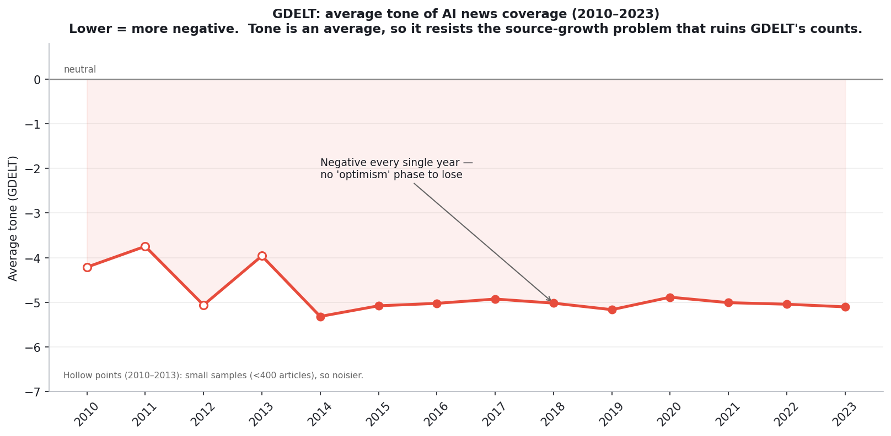
FINDING 3 · THE SURPRISE
People were never happy about AI
• The news about AI was negative EVERY year — even in 2010. People were never very hopeful
• The feeling did not change. What changed: AI became (1) a much BIGGER topic, and (2) a POLITICAL one — countries competing, danger, control
Notes:
Now the surprising part. Many people think: first we were happy about AI, then we became afraid. But look. The news about AI was negative EVERY year — even in 2010. People were never really happy about AI. So the FEELING did not change. Two things changed. One: AI became a much BIGGER topic. Two: AI became a POLITICAL topic — about countries competing, like the US and China, and about danger and control. [~50s]

Slide 6
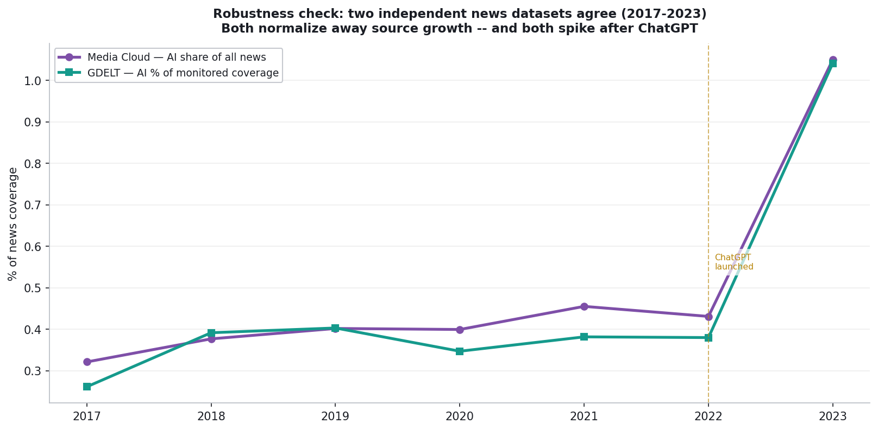
IS IT REAL?
I checked with another source
• Is the 2023 rise real, or just a mistake in my data? I compared it with a different news database
• Both show almost the same result — so the rise is real
Notes:
Is this real, or just a mistake in my data? To check, I used a different news database. The two databases show almost the same result. So I am sure: the big rise in 2023 is real. [~35s]

Slide 7

See my website — and please share your questions
Scan to open the exhibit
potchara1411.github.io/Digital-history-project
github.com/Potchara1411/Digital-history-project
Notes:
You can see everything on my website. Please look at it. And please share your questions and opinions — I really want to hear them. Thank you. [~25s]

