Slide 1
KAIST · DIGITAL HISTORY
From Scientific Optimism
to Geopolitical Anxiety
A Computational History of AI Discourse · 1990–2023
potchara1411.github.io/Digital-history-project
Notes:
My project is a computational history of artificial intelligence — not the technology, but the discourse. I treat media coverage of AI as a primary source, and ask when and how the way we talk about AI actually changed, across more than thirty years.

Slide 2
THE GAP
Filling a gap in Crawford's Atlas of AI
• Kate Crawford's Atlas of AI (2021) argues AI is a system of power and extraction — but qualitatively. It never proves computationally WHEN public discourse shifted, or HOW FAST.
• This project supplies that evidence: 30 years of book data + 13 years of global news data, locating the turning points and measuring their speed.
• It flips the question — not “what can AI do for historians?” but “what can historians do with AI discourse as a primary source?”
• Secondary frame: AI anxiety (2010s–20s) reuses the template of nuclear anxiety (1950s–60s).
Notes:
My starting point is Kate Crawford's Atlas of AI. She argues powerfully that AI is a system of power and extraction — but it's a qualitative argument. She never shows, computationally, WHEN public discourse shifted or HOW FAST. That's the gap I fill, with 30 years of book data and 13 years of global news data. And I flip the usual question: not what AI can do for historians, but what historians can do with AI discourse as a source. My second frame: this looks a lot like nuclear anxiety in the 1950s and 60s.

Slide 3
DATA & METHOD
Two kinds of evidence
• Conventional sources frame the project: Crawford's Atlas of AI; print archives (Wired, TIME, The Economist); government & policy documents.
• Digital sources provide the numbers: Google Ngram (books, 1990–2019); Media Cloud (news, 2010–2023); GDELT (normalized coverage + tone).
• Method: quantitative pattern detection + qualitative interpretation — adapting Dr. Woo's semantic-shift approach to Cold War newspapers.
• Fully reproducible: every chart is built by one Python script from public CSVs.
Notes:
Two kinds of evidence. Conventional sources frame the project — Crawford's book, print archives like Wired, TIME and the Economist, and policy documents. Digital sources give me the numbers — Google Ngram for books, Media Cloud for news, and GDELT. The method pairs quantitative pattern detection with qualitative interpretation, adapting Dr. Woo's work on semantic shifts in Cold War newspapers. And it's all reproducible — one script, public data.

Slide 4
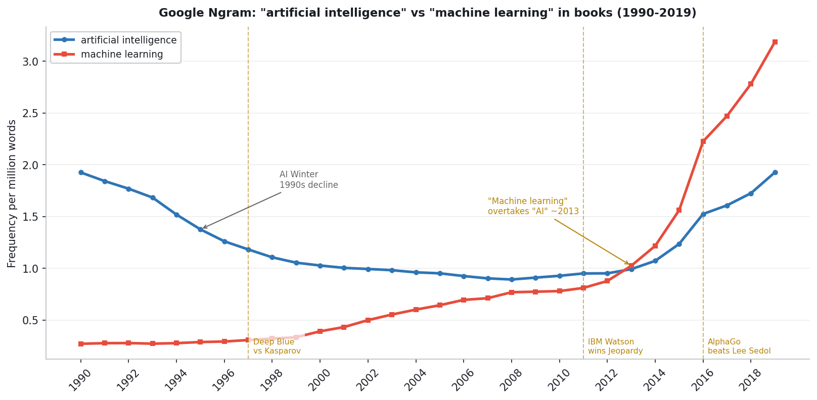
ACT I · 1990–2013
The Winter and the Rebranding
• “Artificial intelligence” DECLINES through the 1990s AI Winter
• “Machine learning” rises and overtakes it ~2013 — the field rebrands around concrete method
Notes:
Act one — the first surprise: the story starts with DECLINE. The blue line, 'artificial intelligence,' falls through the 1990s — the AI Winter, when the term became almost embarrassing. But the red line, 'machine learning,' rises and overtakes it around 2013. The field didn't quit; it rebranded around concrete method.

Slide 5
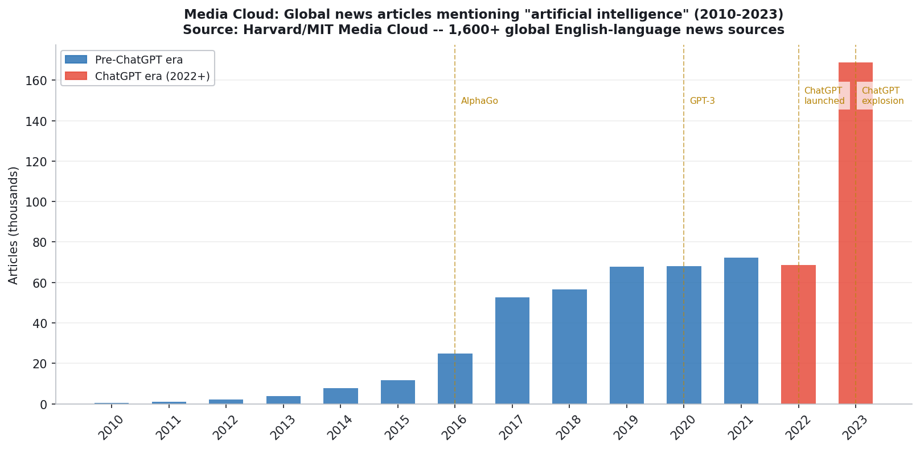
ACT II · 2012–2021
Back into the Light
• Deep learning works (2012 ImageNet); AlphaGo stuns the public (2016)
• News coverage climbs from a few thousand to tens of thousands of articles a year
Notes:
Act two: how AI came back. The technology started working — deep learning around 2012 — and there was public spectacle, above all AlphaGo beating the world's best Go player in 2016. News coverage climbs from a few thousand to tens of thousands of articles a year.

Slide 6
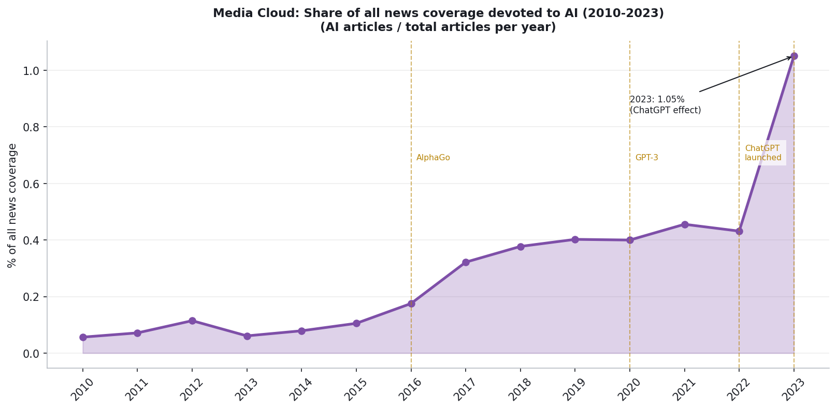
ACT III · 2022–2023
The ChatGPT Explosion
• ChatGPT (Nov 2022) puts AI in everyone’s hands
• AI’s SHARE of all news more than doubles in a year — to ~1% of everything in the press
Notes:
Act three: the explosion. ChatGPT, late 2022. But raw counts can mislead, so I measure AI's SHARE of all coverage. Even controlling for the growth of news, it more than doubled in one year — to about 1% of everything in the press. A real shift in attention.

Slide 7
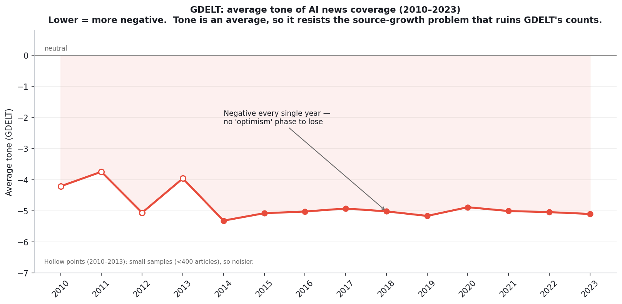
THE TWIST
It was never optimism
• Average tone of AI coverage was NEGATIVE every single year — even in 2010
• There was no golden age of optimism to fall from — the “optimism → fear” story is wrong
Notes:
Now the twist — and this is where I push back on the obvious story. The conventional narrative is optimism turning to fear. But look at the tone of AI coverage: it's negative EVERY single year, around minus five, even back in 2010. There was no golden age of optimism to fall from. I'm honest about the data — the early years are small samples, marked hollow — but the pattern is clear.

Slide 8
THE ARGUMENT
Scale and salience — not sentiment
• AI discourse did not drift from hope to fear; it was wary from the start.
• What changed was SCALE — attention exploded after AlphaGo (2016) and ChatGPT (2022–23).
• And POLITICAL SALIENCE — AI shifted from a scientific keyword (Deep Blue, research) to a geopolitical one (US–China, existential risk, regulation).
• The anxiety isn’t new; its scale and its politics are — the same template as 1950s–60s nuclear fear.
Notes:
So here's my argument. AI discourse didn't drift from hope to fear; it was wary from the start. What actually changed was SCALE — the explosion of attention after AlphaGo and ChatGPT — and POLITICAL SALIENCE: AI went from a scientific keyword to a geopolitical one, tied to US-China competition and existential risk. The anxiety isn't new; its scale and its politics are. And that's the same template societies used for nuclear fear in the 1950s and 60s.

Slide 9
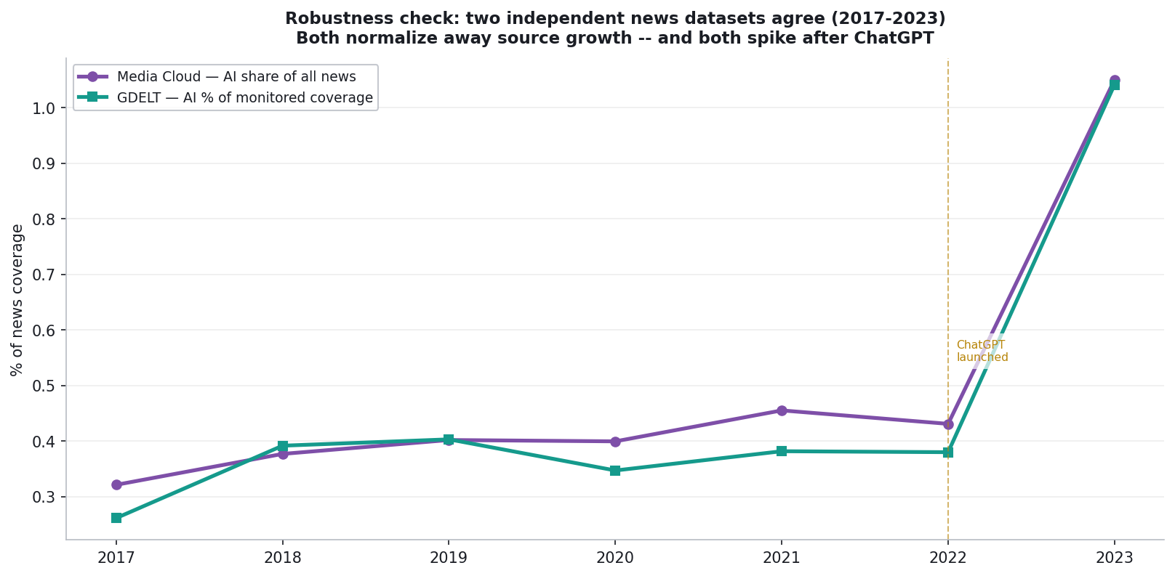
ROBUSTNESS CHECK
Does a second source agree?
• GDELT (normalized) and Media Cloud track each other across 2017–2023
• In 2023 they land at nearly the same value — ~1.04% vs ~1.05% — so the surge is real, not a single-source artifact
Notes:
A skeptic should ask: what if the 2023 spike is just a Media Cloud quirk? So I test it against GDELT's normalized measure. Two datasets, different teams, different methods — yet they track closely and in 2023 land at almost the same value, 1.04 versus 1.05 percent. The surge is real.

Slide 10
A METHODOLOGICAL CHOICE
Why we did NOT trust GDELT’s raw counts
• GDELT’s AI event count jumps 347 (2013) → 52,830 (2014) → 3.9 MILLION (2015) — a ~10,000× leap in two years.
• That is not AI exploding; it is GDELT 2.0 expanding its own sources in 2015. The instrument changed, not the world.
• Fix: use only its time-comparable metrics — normalized share and average tone — and flag the small early samples.
• Source criticism is the scholarship: a measurement is only as good as the instrument’s consistency over time.
Notes:
The slide I'm proudest of. I almost used GDELT as my main news source — but its raw counts go from 347 to 53,000 to 3.9 MILLION in two years. That's not AI exploding; it's GDELT expanding its own sources in 2015. The instrument changed, not the world. So I use only its time-comparable metrics. This source criticism is the actual scholarship.

Slide 11
CONCLUSION
AI discourse as a primary source
• Books — slow, deliberate — recorded a quiet rebranding: AI → machine learning → AI.
• News — fast, reactive — recorded an explosion in scale and political salience after ChatGPT.
• The shift was scale and politics, not optimism to fear — extending Crawford’s argument with quantitative evidence.
Treating AI coverage as a primary source shows how societies negotiate power, fear, and technological change.
Notes:
To conclude: books recorded a quiet rebranding; news recorded an explosion in scale and political salience. The shift was scale and politics, not optimism to fear. By treating AI coverage as a primary source, I extend Crawford's argument with the quantitative evidence it was missing — and show how societies negotiate power, fear, and technological change.

Slide 12
Thank you
Explore the interactive exhibit
potchara1411.github.io/Digital-history-project
Code & data: github.com/Potchara1411/Digital-history-project
Notes:
That's my project. The interactive exhibit and all the code and data are online. Thank you — happy to take questions.

