Slide 2
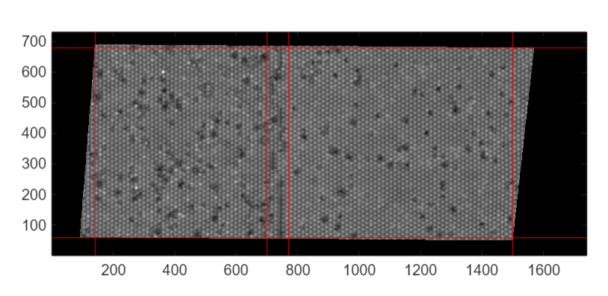
Region segmentation
C-type
A-type
Topographic difference: C-type is more unperiodic than A-type

Slide 3
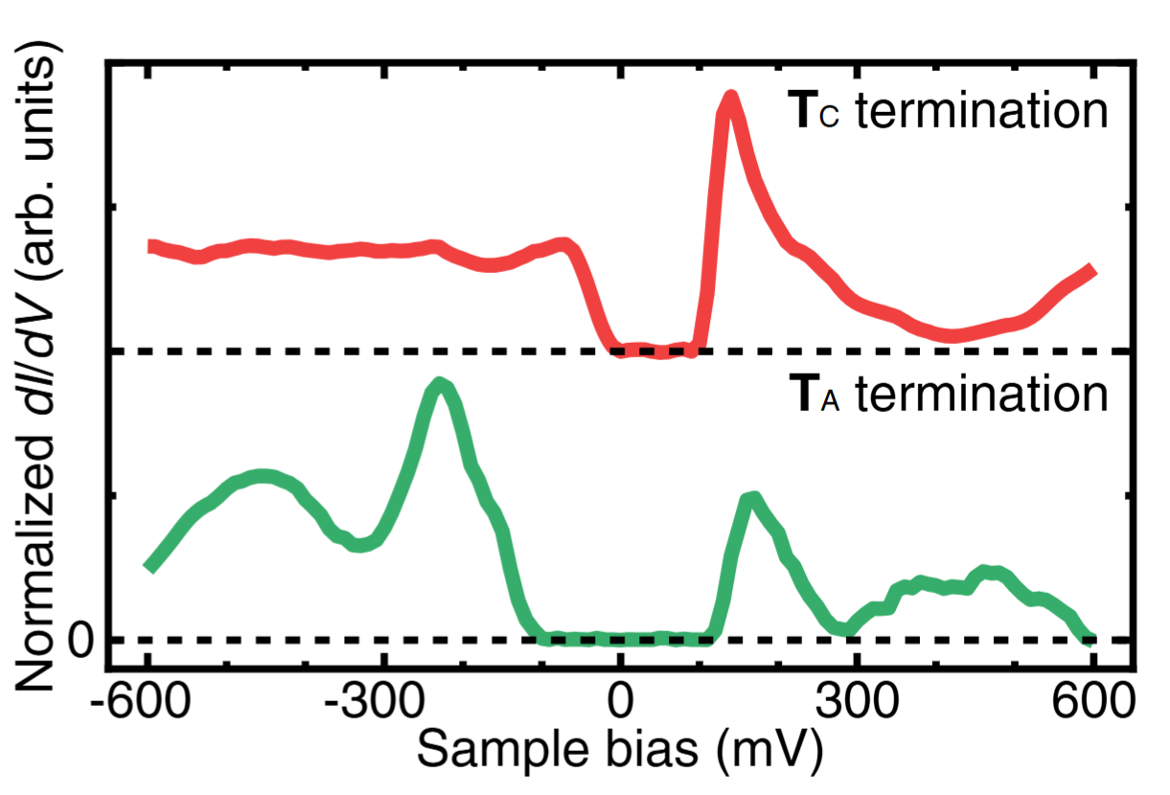
Average LDOS
Current data
Previous data

Slide 4
Compare with previous data: 1) Peak position of TC match but unclear gap structure 2) TA seems to be translated
Translation(80mV) considered: 1) TA fit very well 2) TC compeletely disagree with previous one…
I don’t have confidence which scheme is better but I’ll calculate the gap by original one

Slide 5
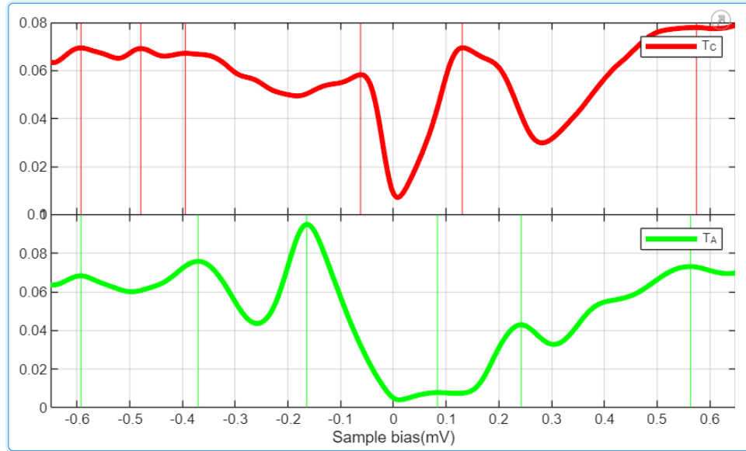
3
4
1
2
1: minor negative peak
2: major negative peak
3: major positive peak
4: minor positive peak
1
3
1: minor negative peak
2: major negative peak
3: major positive peak
2

Slide 8

Energy-wise Histogram

Slide 9
Energy-wise Histogram
In-gap state
In-gap state

Slide 11
Conclusion
positive in-gap states exist in both phase
Positive in-gap state and Positive band state would be distinguished(C-type is much unclear…)
Side peaks are same origin with major peak?
We need some spatial context
to distinguish ingap and p-band
To survey the origin of side peaks

Slide 12
Naïve guess of p,n band(for quick survey)
We choose a 1st positive local maximum as a p band and 2nd negative 1st negative local maximum as n band.
It can not distinguish in-gap state and p band

Slide 14
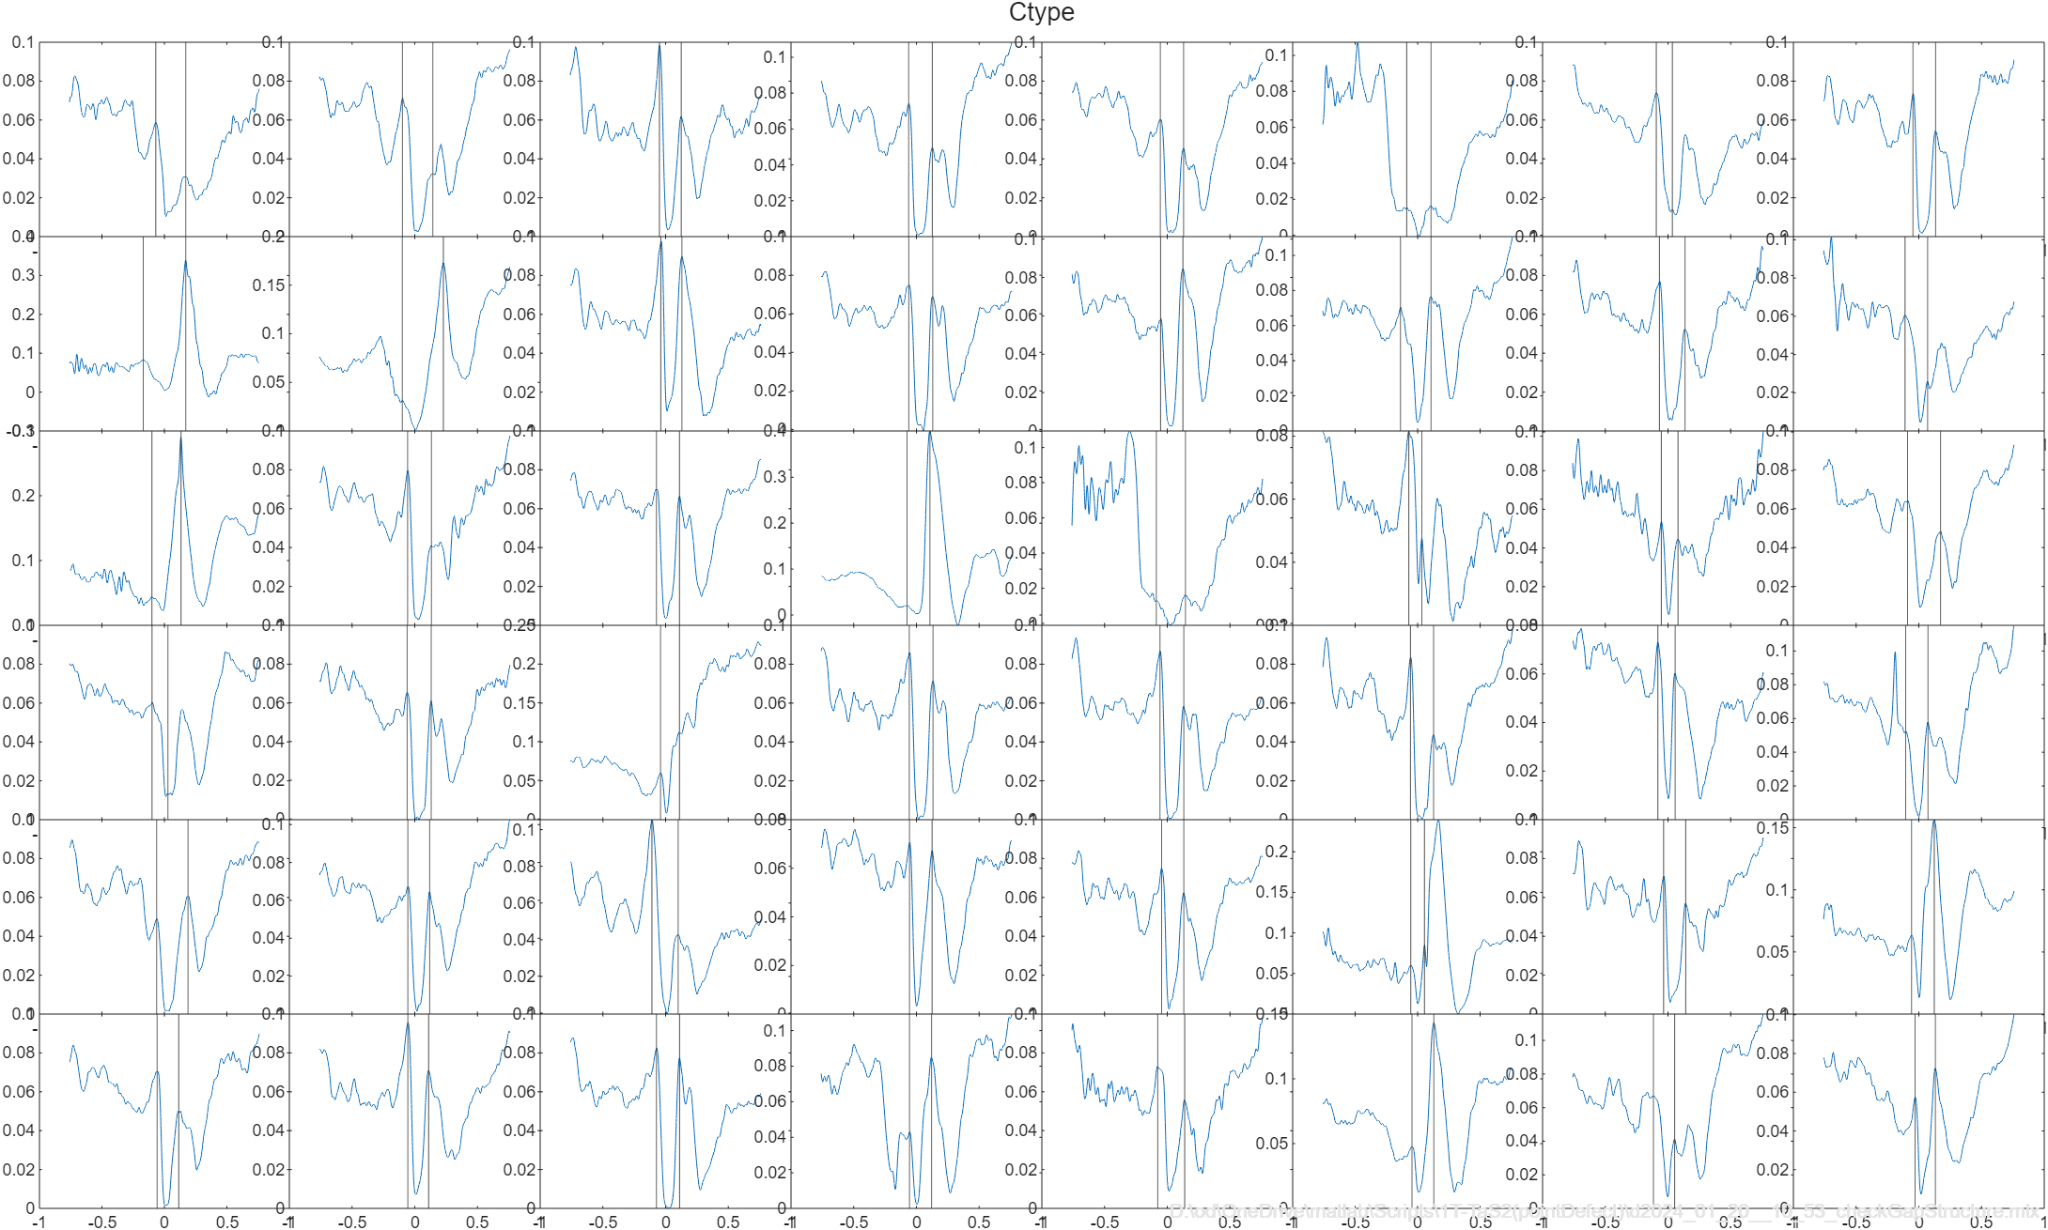
In gap
In gap

Slide 15
