Slide 1
Domain Wall Network Analysis in 2H-TaSe2
We investigated the Charge Density Wave (CDW) in 2H-TaSe2.
Topological domain walls (DW) and solitons were observed.
A network of these domain walls forms a 'Domain Wall Network' (DWN).
Spectroscopy confirms the insulating nature of the C-phase.

Slide 2
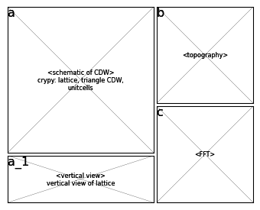
Figure 1: Overview of Domain Wall Network
Info:
  STM Data (78K)
  T=TaSe2
Argument:
  Shows the overall domain structure.
  Confirms 3Q CD

Slide 3
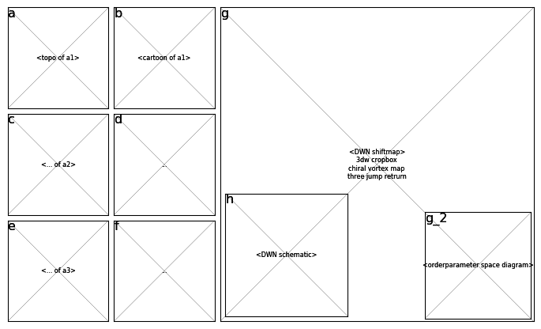
Figure 2: FFT Analysis of Domain Wall Network
Info:
  Fig 1b data
  High-pass filter
Argument:
  Q-peaks clearly visible.
  No satellite peaks observed.

Slide 4
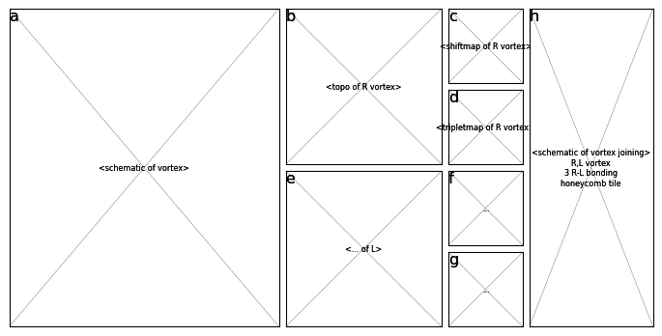
Figure 3: Vortex Analysis of Domain Wall Network
Info:
  Vortex Data
  Topological Analysis
Argument:
  Identifies R and L vortices.
  Calculates vortex charges.

Slide 5
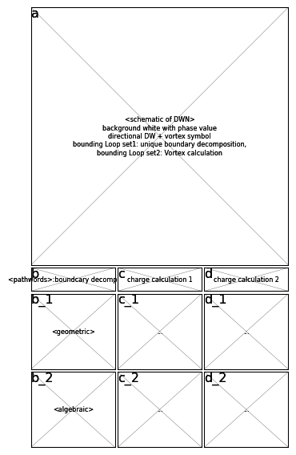
Figure 4: Phase Pinning at the Domain Walls
Info:
  Phase Pinning
  Domain Wall Interaction
Argument:
  Demonstrates phase pinning at domain walls.
  Shows interaction effects.

