Slide 1
Chiral vortex interlocking in topological soliton lattice
We investigated the 3x3 Charge Density Wave (CDW) in 2H-TaSe2.
3 types of topological domain walls (DW) were observed.
two types of chiral vortices (R and L) were identified
Spectroscopy confirms the insulating nature of the C-phase.

Slide 2
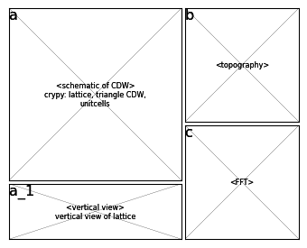
Figure 1: 3x3 Charge Density Wave (CDW) in 2H-TaSe2
Info:
  Lattice structure
  CDW in real space
  FFT of Topo
Argument:
  atom(Se) and CDW both corrugation are observed
  CDW center is hollow
  3x3 CDW from FFT

Slide 3
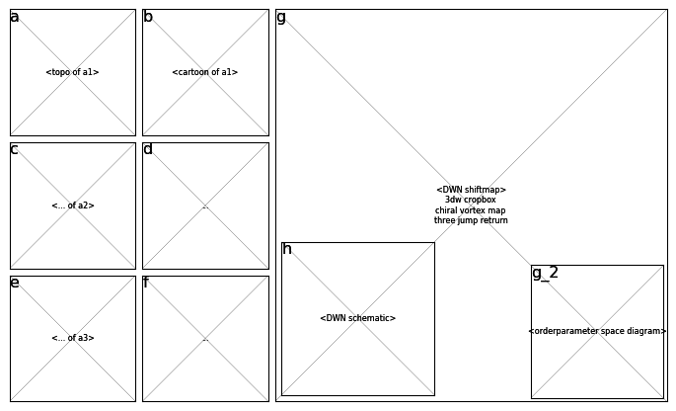
Figure 2: 3 types of topological domain walls (DW)
Info:
  three DWs topo
  three DWs cartoon
  phaseshiftmap of DWN
Argument:
  atom corruation is fixed but CDW currgation localy shift
  three shift rgb has a b^3=g^3=r^3=rgb=0
  shiftmap shows honeycomb-like DWN

Slide 4
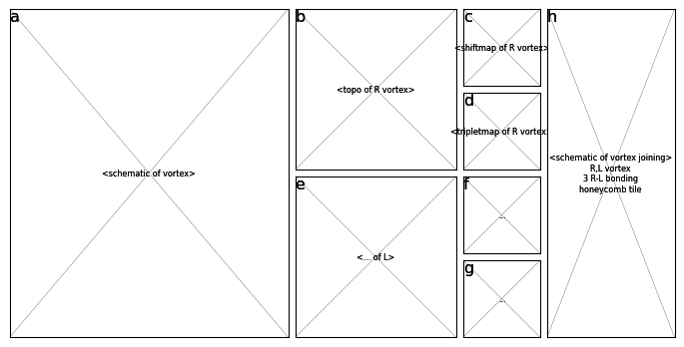
Figure 3: two types of chiral vortices (R and L)
Info:
  schematic of DV
  phase infos of DV
  tinker toy model of DV
Argument:
  tri-junction of 3 differnet phase
  Identified by not only shift but also centerness
  honeycomb structure is naturally formed by the existence of R,L vortex

Slide 5
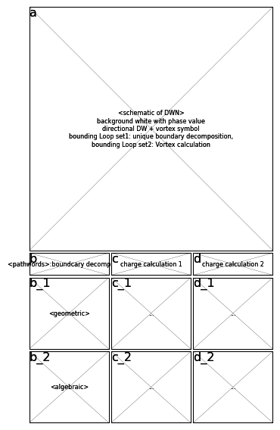
Figure 4: Phase Pinning at the Domain Walls
Info:
  DWN topological encoded
  geometric diagram
  algebraic diagram
Argument:
  Bulk-boundary correspendence(Uniqueness of boundary decomposition)
  charge calculation from bounding loops
  Topological invariant is rigorously defined by group

