Slide 1
Mood Projection
The Last of Us
Kent, Chan, Harrison

Slide 2
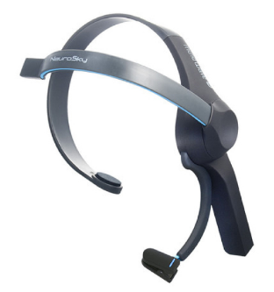
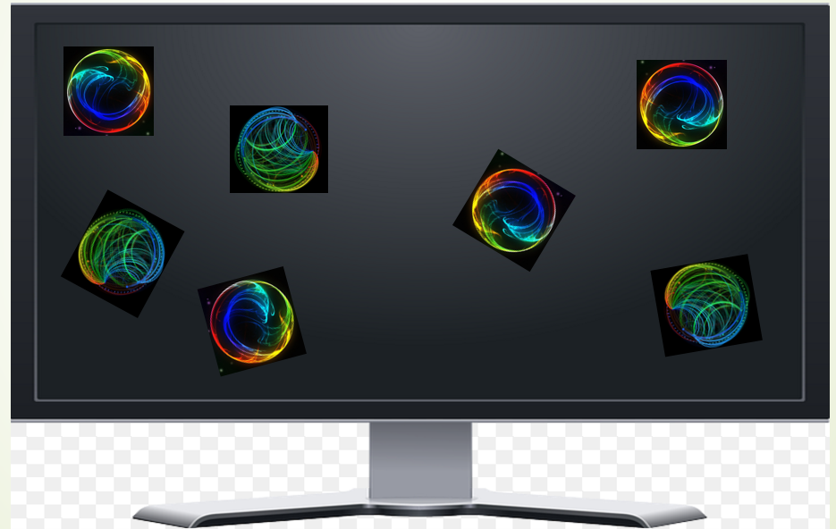
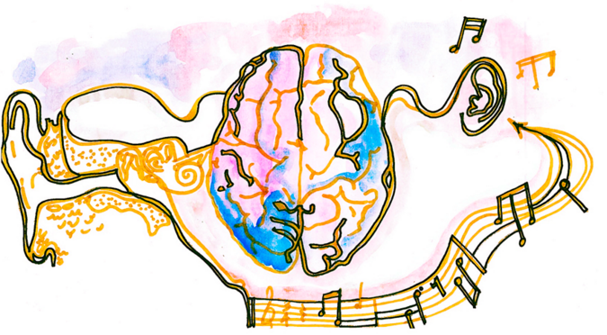
From the last presentation
We talked about using the Mindwave to record our brain activity
Recording the brain wave and presenting it in a color ball

Slide 3
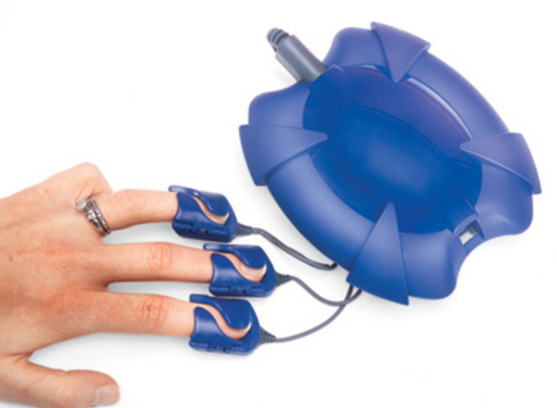

Tested another device
We tested another device called that was used for a meditation program.
This device connects to your fingers and displays your heartbeat rate and breathing (Inhale & Exhale). Pretty accurate.

Slide 4
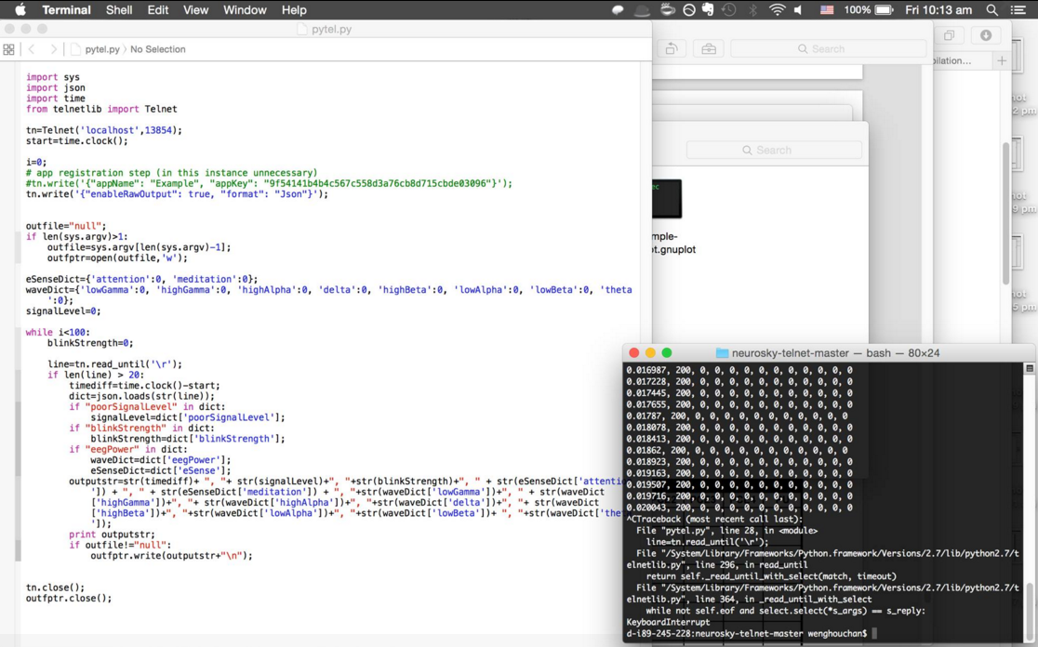
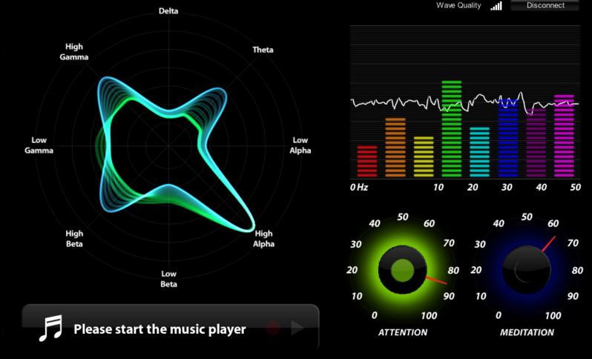
Coding for the MindWave
We are still working on the coding.
Using Python to code.
We have decided to focus on he Attention function of the Mindwave
Not the meditation function

Slide 5
Limitation
Limitation of the Mindwave
It only records 90% of the Blinks accurately
It is not as advance as normal EEG that has to be tuned to the brain and the headware covers the whole head
We can’t get emotion data
We are not Neuro scientist, do not really understand the different brain wave (e.g. Gamma, Delta, beta??)
What we can record accurately is the Attention and even heart rate on the other device.

Slide 6
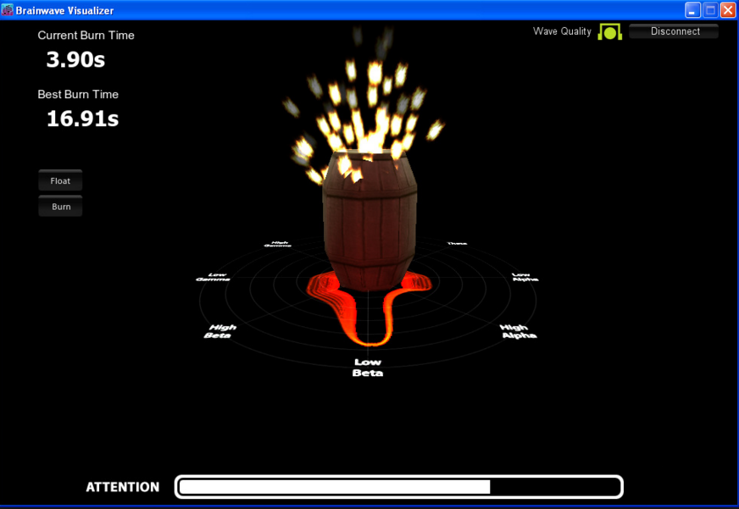
What’s Next.
Continuing the coding for the mindwave so we can have a more tangible data.
Selecting the correct brainwave to focus on
We have decided to make it interactive where the user focus his attention on an object (Like the game)
The attention that the user exert can produce a better experience as they can find out that they can actually control their brain.

Slide 7
Back to Work!
Thanks for listening.
Questions?

