Slide 1
Mood Projection
The Last of Us

Slide 2

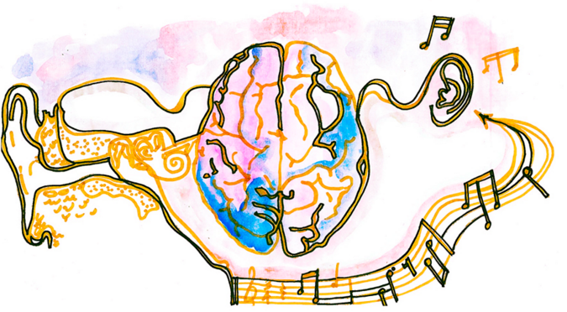
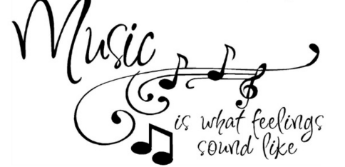
- What - Concept Mood and Emotion
Our project Is focus on mood and emotion, the original idea we had was to allow users to understand that music changes ones emotion. When a user listens to a piece of music, their brainwave change.
Example, the song calms a person down(relaxation music, instrumental) or the music makes the user more excited(think about a boss fight scene with a fight music)

Slide 3
- Who - Targeted Audience
This device measures brain waves of the individual, so audiences from the event who are interested in how brainwave looks.
Open to all, young adults, children, teachers and students.
Anyone who is interested in what is going on in their mind

Slide 4
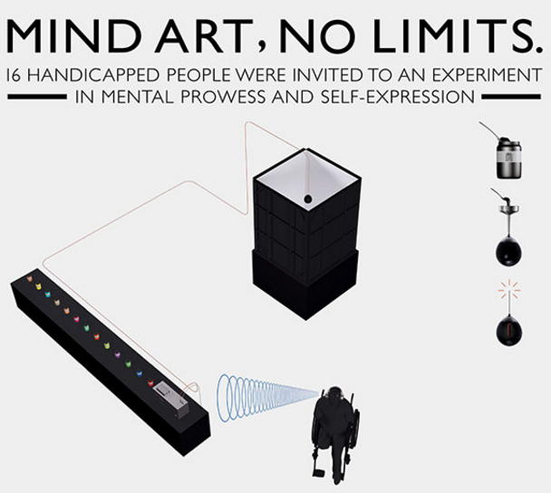

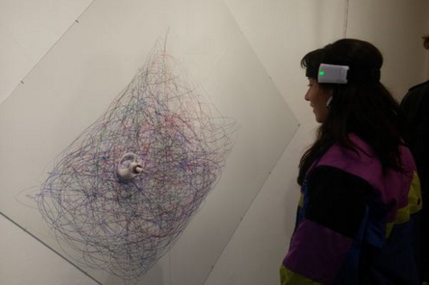
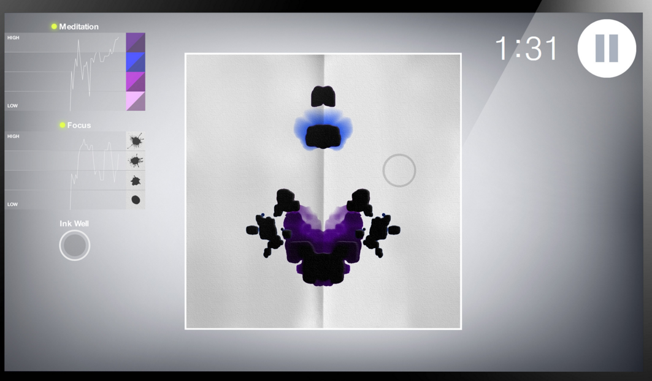
- Why – Inspirations Understanding Human Mind
Idea was built around multiple project that we saw online.
Mind Art
Brainwave drawing project
Mico Neurowear
Braintone Art

Slide 5
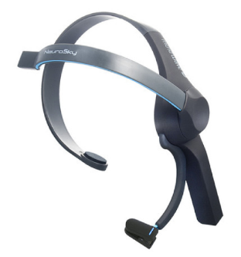
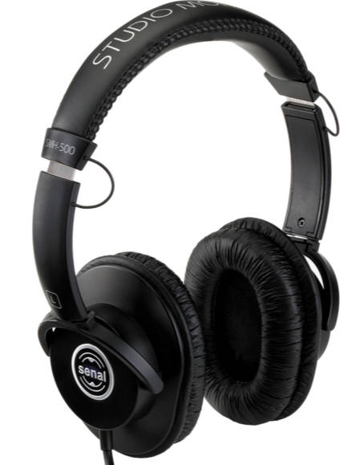
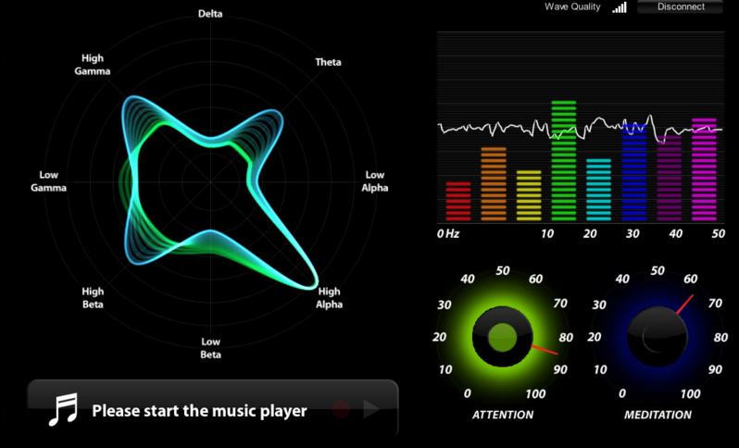
- How - Installation Works
Wearing the Mind wave and listen to a selected music.

Slide 6
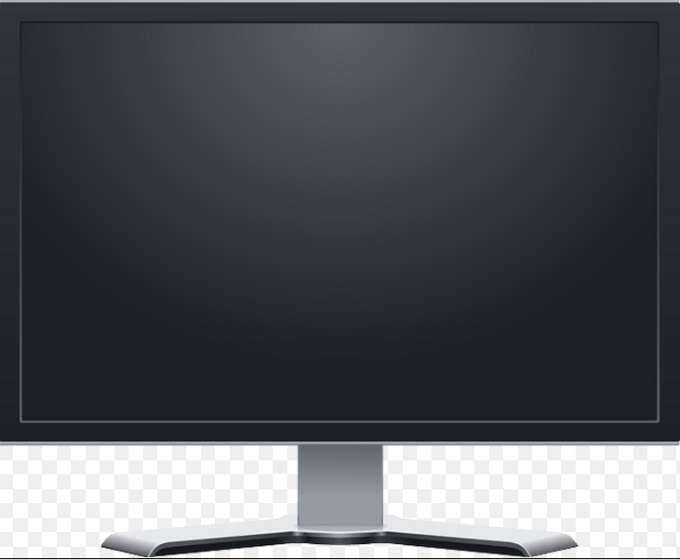

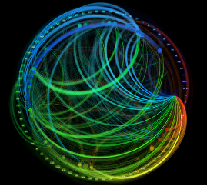
Further Installation

Slide 7
Mindwave showcase

Slide 8
Problem we face
How to make it more interactive?
Following a different approach, using the Mindwave to play a game?
Controlling a ball to make it float?

Slide 9
Thanks for listening.
Questions?

