Slide 1
Crop yield prediction using neural networks
presented by: Pothiyappan.s
III year,KVCET
NM ID-au421221243301
Email ID-pothinivas@gmail.com

Slide 2
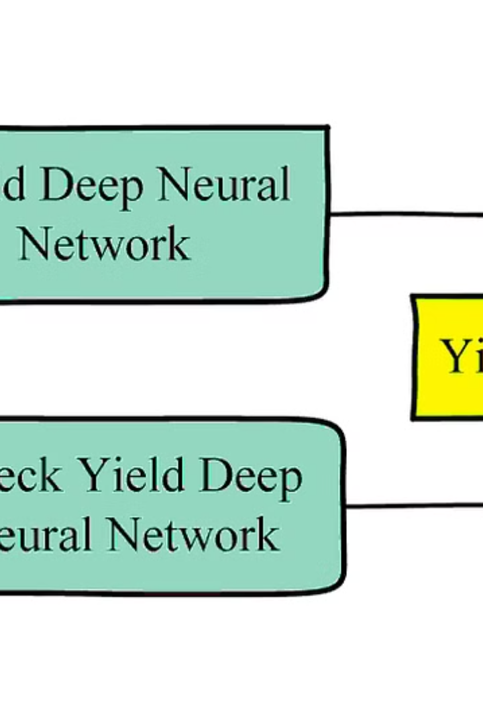
PROPOSED SYSTEM
In the proposed system, we will implement a
cutting-edge neural network model for
predicting crop yields. Leveraging the power
of artificial intelligence, our system aims to
revolutionize agricultural yield forecasting.

Slide 3
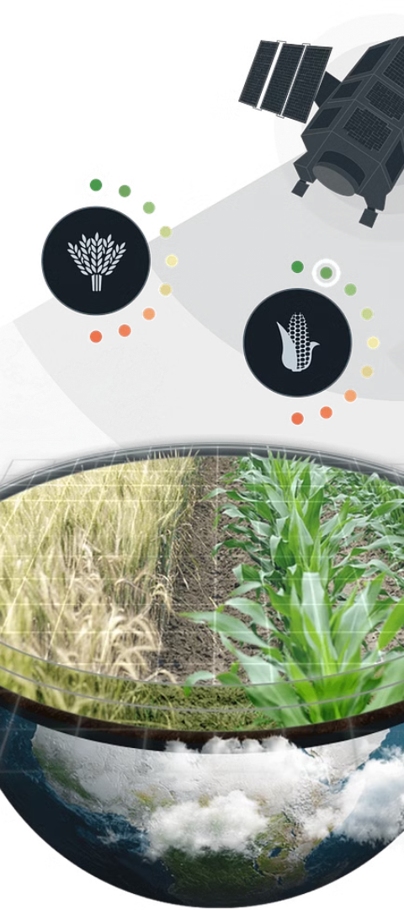
PROBLEMS
Lack of Accurate Yield Prediction
Impact of Inaccurate Predictions
Current methods for predicting crop yield lack precision and reliability.
Inaccurate predictions lead to inefficient resource allocation and economic loss.
Dependency on Traditional Techniques
Farmers rely on outdated methods for yield estimation, limiting productivity.

Slide 4
Proposed Solution
Implementation of neural network: Utilizing a multi-layer perceptron to process historical data.
Data preprocessing techniques: Applying normalization and feature scaling for optimal model performance.
Integration of predictive analytics: Incorporating advanced algorithms to forecast future crop yields.

Slide 5
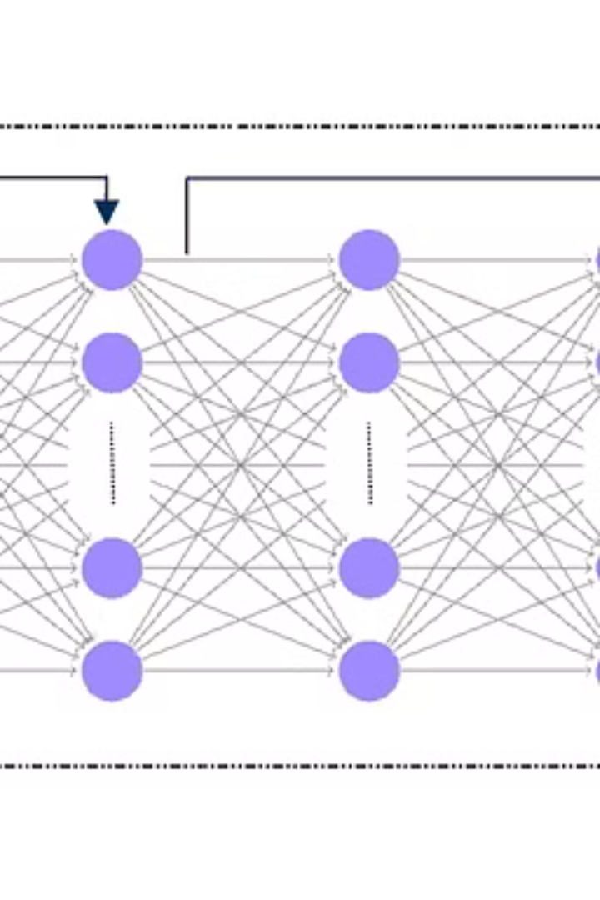
Neural Network Architecture for Yield Prediction
Implementing a neural network for crop yield prediction involves designing a multi-layered architecture with interconnected nodes. An efficient architecture considers input features, hidden layers, and output nodes for accurate predictions.
Each layer in the architecture performs specific computations, with the final layer providing the predicted yield. Understanding the neural network layout is crucial for optimizing prediction accuracy.

Slide 6

Training the Neural Network
Data Collection and Preprocessing
1
Collecting and preparing the training data for input into the neural network.
2
Model Configuration
Setting up the architecture and parameters of the neural network for training.
Backpropagation and Optimization
3
Using backpropagation to adjust the weights and biases, optimizing the network's performance.

Slide 7
Evaluating the Model's Performance
Accuracy
Loss Function Analysis
Validation Metrics
Evaluating the model's accuracy is crucial to determine its reliability in making predictions.
Assessing the loss function can provide insights into how well the model is learning from the training data.
Examining validation metrics such as precision, recall, and F1-score helps gauge the model's performance on unseen data.

Slide 8
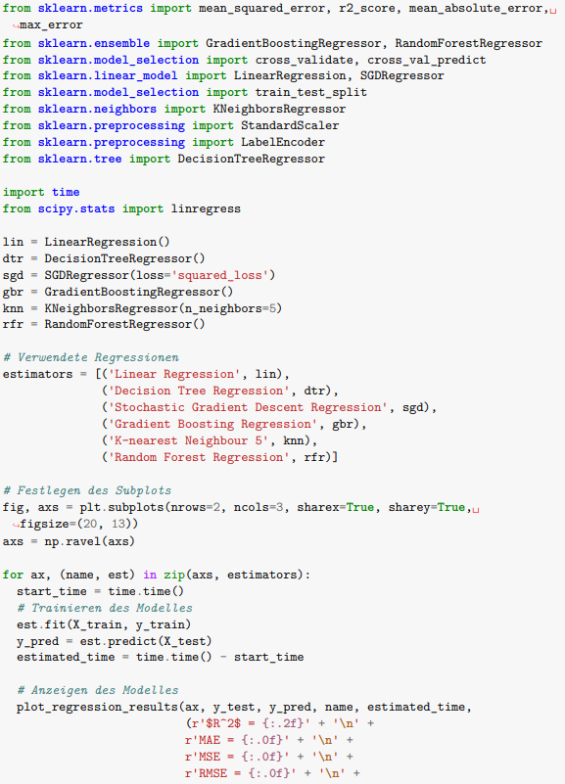
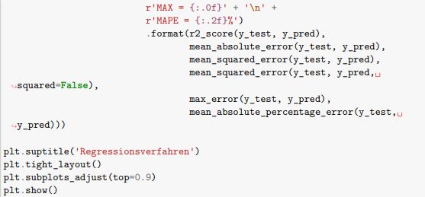

Slide 9
Implementing the prediction model
Data Preparation
Training the Model
Collect and clean historical yield data for training the neural network.
Use the cleaned data to train the neural network and optimize the model.
Validation and Testing
Deployment and Integration
Validate the model's performance using testing data sets to ensure accuracy.
Implement the model for real-time or future yield prediction applications.

Slide 10
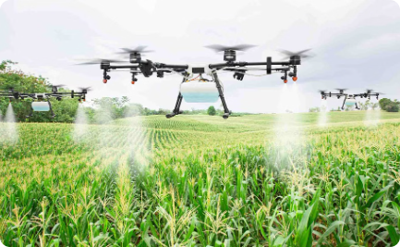

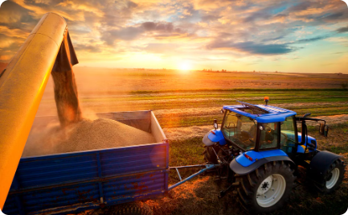
Future advancements in crop yield prediction
Precision Agriculture Technology
Machine Learning Integration
Remote Sensing Solutions
Innovative sensors and drones for precision monitoring of crop health and yield.
Integration of machine learning algorithms for accurate yield prediction and risk assessment.
Utilizing advanced satellite imagery and remote sensing for comprehensive crop yield analysis.

Slide 11



Case Studies and Real-World Applications
Increased Yield
1
Using predictive models to optimize crop productivity.
Resource Management
2
Efficient utilization of water, fertilizers, and land.
Climate Resilience
3
Adapting farming practices to changing weather patterns.

Slide 12
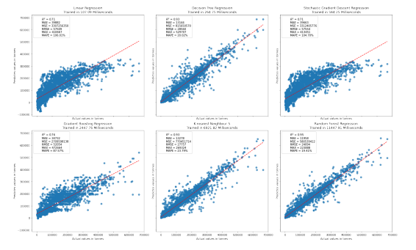
Output

Slide 13
Conclusion and key takeaways
After evaluating the neural network model's performance, we can conclude that it's a promising tool for predicting crop yields. The integration of machine learning with agriculture holds great potential for optimizing production and resource management. Key takeaways include the significance of data quality and continuous model refinement.

