Slide 1

CUSTOMER SHOPPING BEHAVIOR ANALYSIS
PRESENTED BY:P.CHAITANYA KUMAR

Slide 2
PROJECT OVERVIEW
The Customer Shopping Behaviour Analysis project focuses on analyzing customer
purchasing patterns, preferences, and spending habits using data analytics techniques. The project
involves data cleaning, exploratory data analysis (EDA), SQL-based data querying, and interactive
Dashboard creation to uncover meaningful business insights.
Using Python (Pandas, NumPy, Matplotlib, Seaborn), the dataset was cleaned and analyzed
to identify trends in customer demographics, product categories, purchase amounts, subscription
status, payment methods, and seasonal shopping behavior. MySQL was used to perform data
extraction and business-driven queries, while Power BI was utilized to create an interactive
dashboard for visualizing key performance indicators and customer insights.
The main objective of this project is to help businesses understand customer behavior, improve
decision-making, optimize marketing strategies, and enhance customer engagement through data
driven insights.

Slide 3
OBJECTIVES
This project aims to analyze customer shopping behavior and purchasing patterns to gain a deeper
understanding of customer preferences and spending habits. By examining demographic information,
product categories, purchase amounts, subscription status, payment methods, and seasonal trends, the
project seeks to identify key factors influencing customer buying decisions. The analysis helps
uncover valuable business insights, improve customer engagement, optimize marketing strategies,
and support data-driven decision-making. Additionally, interactive visualizations and dashboards are
developed to effectively communicate findings and assist businesses in enhancing overall sales
performance and customer satisfaction.

Slide 4
DATASET SUMMARY
The Customer Shopping Behaviour Dataset contains customer transaction and demographic
information used to analyze purchasing patterns, spending behavior, and customer preferences. The
dataset includes details such as age, gender, product category, purchase amount, payment
methods, subscription status, and customer reviews.
Dataset Overview
Total Records: 3,900
Total Features: 18
Data Type: Structured Data
Format: CSV Dataset
Key Features
Customer Demographics (Age, Gender, Location)
Product Information (Item Purchased, Category, Size, Color)
Transaction Details (Purchase Amount, Payment Method)
Customer Engagement (Subscription Status, Review Rating)
Shopping Trends (Season, Purchase Frequency, Previous Purchases)

Slide 5
UNDERSTANDING THE DATASET
Before performing the analysis, it is important to understand the structure and contents of the
dataset. The Customer Shopping Behaviour dataset contains customer demographic
information, purchase details, product preferences, and transaction-related attributes. Each
record represents a customer's shopping activity and provides valuable information for
analyzing purchasing patterns and consumer behavior.
The dataset includes both numerical and categorical variables such as age, gender, purchase
amount, product category, payment method, subscription status, review rating, and purchase
frequency. Understanding these variables helps identify relationships between customer
characteristics and buying behavior. This step enables effective data cleaning, exploratory
analysis,and visualization, ensuring accurate insights and meaningful business
recommendations.

Slide 6
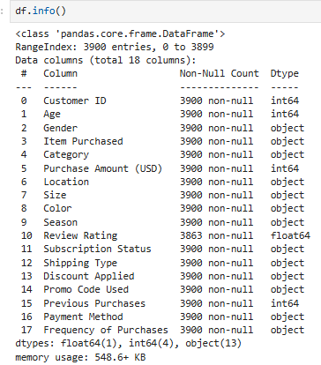
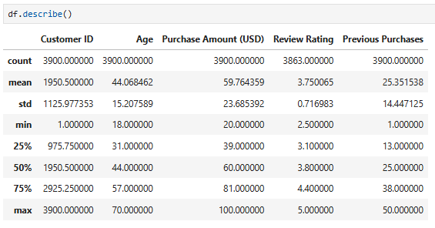
UNDERSTANDING THE DATASET

Slide 7
DATA CLEANING AND PROCESSING
Data cleaning and preprocessing were performed to ensure the dataset was accurate, consistent,
and ready for analysis. The dataset was thoroughly examined for missing values, duplicate
records, incorrect data types, and inconsistencies. Necessary transformations were applied to
improve data quality and reliability.
Steps Performed
Imported the dataset into Python using Pandas.
Checked the dataset structure, data types, and summary statistics.
Identified and handled missing or null values.
Verified and removed duplicate records.
Standardized categorical variables for consistency.
Validated numerical columns and corrected data formatting issues.
Checked for outliers and data inconsistencies.
Converted data into an analysis-ready format.
Prepared the cleaned dataset for EDA, SQL analysis, and Power BI visualization.

Slide 8
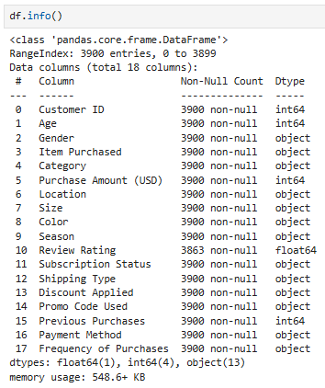
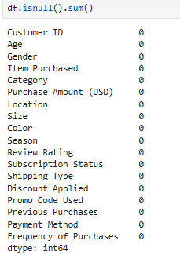
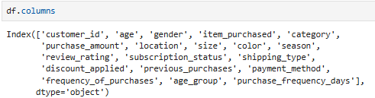
DATA CLEANING AND PROCESSING

Slide 9
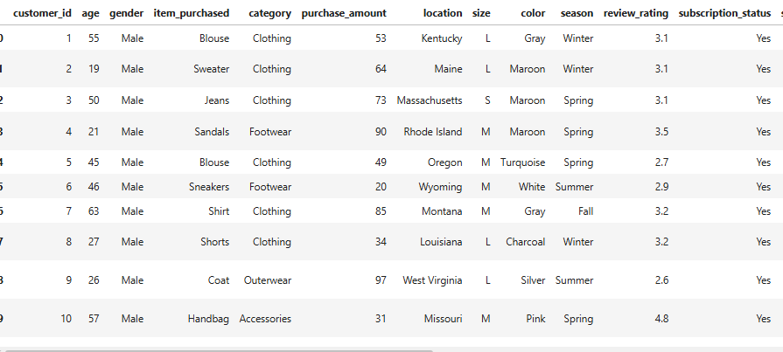
DATASET
4

Slide 10
DATA ANALYSIS USING MYSQL
MySQL was used to perform business transaction analysis on the customer shopping dataset. SQL
queries were written to extract, filter, aggregate, and analyze transaction data to uncover
meaningful business insights. The analysis focused on customer purchasing behavior, sales
performance, product category trends, subscription patterns, and payment preferences.
By utilizing SQL operations such as SELECT, WHERE, GROUP BY, ORDER BY, COUNT,
SUM, AVG, and Aggregate Functions, the dataset was transformed into valuable business
information. This analysis helped identify top-performing product categories, customer spending
patterns, preferred payment methods, and the impact of subscription status on purchasing
behavior.
The insights generated through MySQL analysis provided a strong foundation for data-driven
decision-making and supported the creation of interactive Power BI dashboards for business
reporting and visualization.

Slide 11


DATA ANALYSIS USING MYSQL
REVENUE BY GENDER-Compared total revenue generated by male vs female customers
Shipping type comparisons-Compared average purchase amounts between standard and express shipping

Slide 12
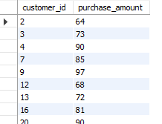
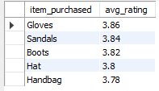
DATA ANALYSIS USING MYSQL
High-Spending Discount Users-Identified customers who used discounts but still spent above the average purchase amount
Top 5 Products by Rating-Found products with the highest average review ratings

Slide 13
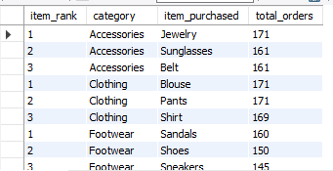

DATA ANALYSIS USING MYSQL
Top 3 Products per Category-Listed the most purchased products within each category
Repeat Buyers & Subscriptions-Checked whether customers with >5 purchases are more likely to subscribe

Slide 14
POWER BI DASHBOARD
The Power BI dashboard provides an interactive and comprehensive view of customer shopping behavior,
sales performance, and purchasing trends. It combines key business metrics, visualizations, and filters to
help users analyze customer preferences and make data-driven decisions. The dashboard enables
stakeholders to monitor revenue, customer demographics, product category performance,subscription trends,
and payment preferences in a single interface. Through dynamic charts and KPIs, it transforms raw
transaction data into actionable insights, helping businesses identify growth opportunities, improve customer
engagement, and optimize overall sales performance.
Key Dashboard Components:
Total Revenue
Total Customers
Average Purchase Amount
Revenue by Gender
Category-wise Sales Analysis
Seasonal Purchase Trends
Subscription Status Analysis
Payment Method Preferences
Customer Rating Insights
Interactive Filters and Slicers

Slide 15
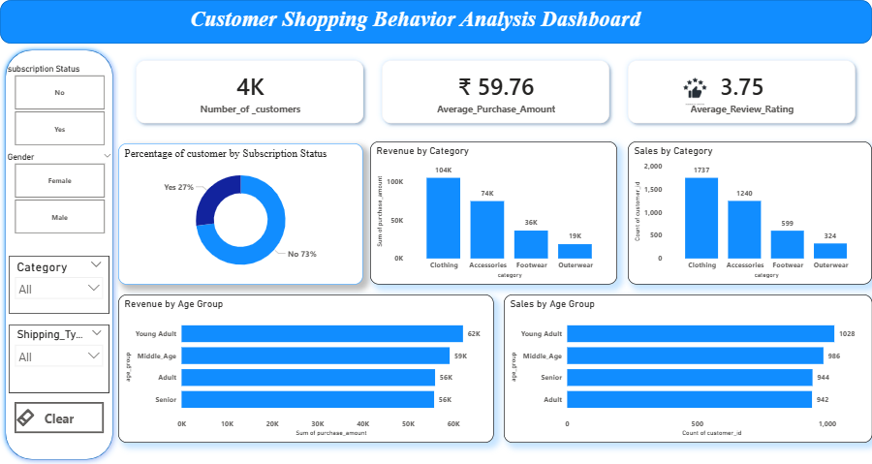
POWER BI DASHBOARD

Slide 16
BUSINESSS INSIGHTS
Clothing emerged as the highest-performing product category, contributing significantly to overall revenue.
Male and female customers showed similar purchasing behavior, indicating balanced revenue contributions across genders.
Subscribers demonstrated higher purchase frequency, highlighting the effectiveness of subscription programs in customer retention.
Digital payment methods were the most preferred, reflecting customer preference for convenient and secure transactions.
Seasonal variations influenced customer purchases, with certain periods generating higher sales than others.
Customer review ratings remained consistently positive, indicating a satisfactory shopping experience.
Repeat customers contributed substantially to total sales, emphasizing the importance of customer loyalty.
Product categories and customer demographics directly impacted purchasing patterns, helping identify target customer segments.

Slide 17
CONCLUSION
The Customer Shopping Behaviour Analysis project successfully transformed raw customer
transaction data into meaningful business insights using Python, MySQL, and Power BI.
Through data cleaning, exploratory data analysis, SQL-based business transaction analysis, and
Interactive dashboard development, valuable patterns in customer purchasing behavior, spending
habits,product preferences, and seasonal trends were identified.
The analysis revealed key factors influencing customer purchases, highlighted top-performing
product categories, and demonstrated the importance of customer retention through
subscription programs and repeat purchases. The Power BI dashboard provided an effective
platform for visualizing these insights and supporting data-driven decision-making.
Overall, this project demonstrates how data analytics can help businesses better understand
customer behavior, optimize marketing strategies, improve customer satisfaction, and drive
business growth through informed decision-making.

Slide 18
The End

