Slide 1

EMPLOYEE MANAGEMENT SYSTEM

Slide 2
INTRODUCTION
The Employee Management System (EMS) is designed to streamline the management of employee data, job roles, and departmental information within an organization. This system allows for efficient tracking of employee details, job assignments, qualifications, and performance metrics.
Key domain knowledge elements for this system include:
Employee Information Management
Job Role Assignment
Departmental Structure
Payroll and Compensation
Qualifications and Skills Tracking
Leave and Absence Management
This system ensures that all employee-related information is stored securely, easily accessible for reporting, and aligned with organizational goals for performance, compensation, and growth.

Slide 3
PROBLEM STATEMENT
The objective of this project is to design and implement an Employee Management System that efficiently stores and manages employee-related data within an organization. The system needs to track various aspects of employee information, including personal details, job roles, salary structures, qualifications, leave records, and payroll data. The system should ensure the integrity and consistency of data by using relational tables with appropriate foreign keys and cascading actions.
The system should allow for easy management and querying of employee data, providing insights such as payroll calculation, leave tracking, and department-specific job roles. The goal is to streamline HR operations, ensuring that all relevant employee data is accessible and accurately updated across different modules.

Slide 4
OBJECTIVES
The main objective of this project is to design and implement a database-driven Employee Management System that efficiently stores and manages employee-related information.
This system helps organizations maintain important data such as employee details, job roles, department information, salary, qualifications, leave records, and payroll data in a structured way.
By using SQL and relational database design, the system ensures data accuracy, avoids duplication, and maintains relationships between different tables.
The project also allows us to analyze employee data, generate useful insights such as department-wise employee count, salary distribution, and leave patterns, which helps management make better decisions.
Overall, the system improves data organization, efficiency, and reporting capabilities for HR operations.

Slide 5
TABLES
.
Table name | Description
JobDepartment | Stores job roles, departments, and related salary ranges
SalaryBonus | Contains salary, bonus, and annual pay linked to specific job roles.
Employee | Maintains personal, contact, and login details of all employees.
Qualification | Records qualifications and required skills for employee job positions.
Leaves | Tracks employee leave records with reasons and dates.
Payroll | Combines employee, job, salary, and leave data to calculate net payments.

Slide 6
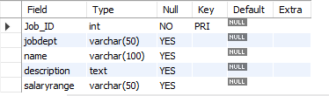
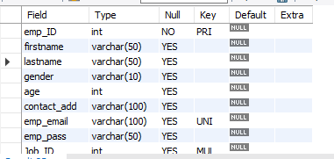
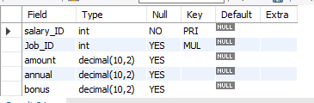
TABLE STRUCTURE
JOBDEPARTMENT
EMPLOYEE
SALARYBONUS

Slide 7
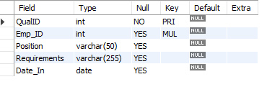
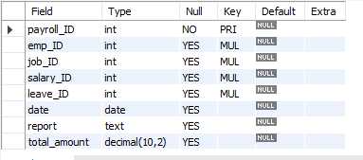
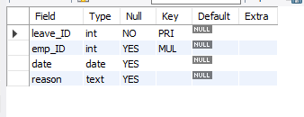
TABLE STRUCTURE
QUALIFICATION
PAYROLL
LEAVES

Slide 8
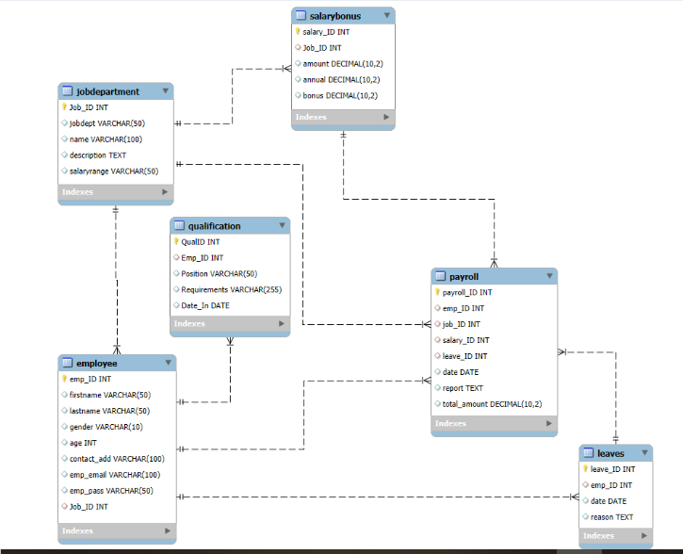
ER DIAGRAM
.

Slide 9


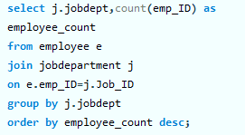
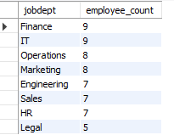
Analysis Questions
1. EMPLOYEE INSIGHTS
How many unique employees are currently in the system?
Which departments have the highest number of employees?

Slide 10
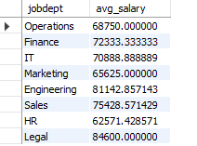
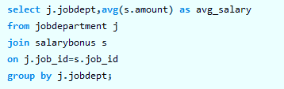
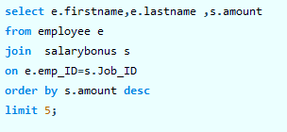
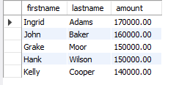
Analysis Questions
What is the average salary per department?
Who are the top 5 highest-paid employees?

Slide 11


Analysis Questions
What is the total salary expenditure across the company?

Slide 12
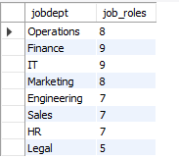

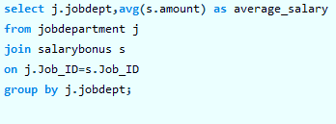
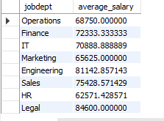
Analysis Questions
2. JOB ROLE AND DEPARTMENT ANALYSIS
How many different job roles exist in each department?
What is the average salary range per department?

Slide 13
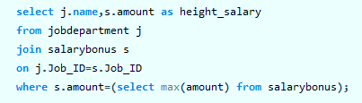

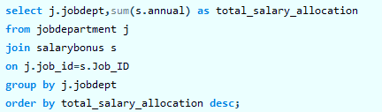
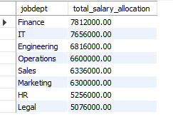
Analysis Questions
Which job roles offer the highest salary?
Which departments have the highest total salary allocation?

Slide 14

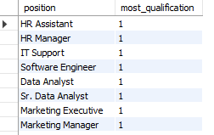

Analysis Questions
3. QUALIFICATION AND SKILLS ANALYSIS
How many employees have at least one qualification listed?
Which positions require the most qualifications?

Slide 15
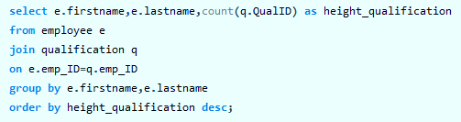
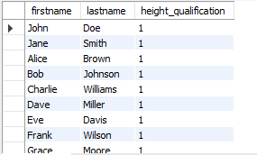
Analysis Questions
Which employees have the highest number of qualifications?

Slide 16


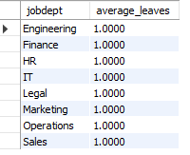
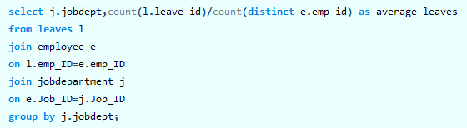
Analysis Questions
4. LEAVE AND ABSENCE PATTERNS
Which year had the most employees taking leaves?
What is the average number of leave days taken by its employees per department?

Slide 17
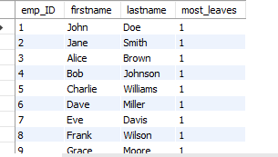
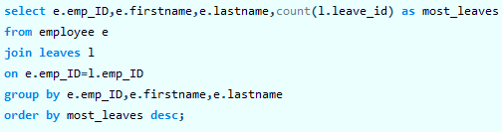

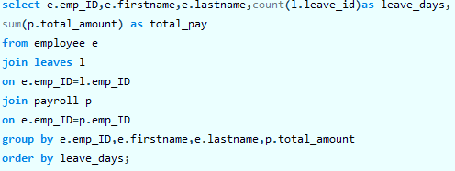
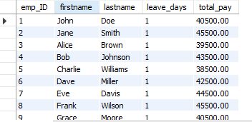
Analysis Questions
Which employees have taken the most leaves?
What is the total number of leave days taken company-wide?
How do leave days correlate with payroll amounts?

Slide 18

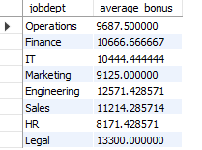
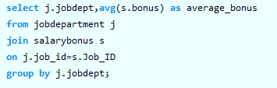
Analysis Questions
5. PAYROLL AND COMPENSATION ANALYSIS
What is the total monthly payroll processed?
What is the average bonus given per department?

Slide 19
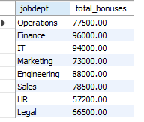
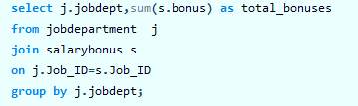
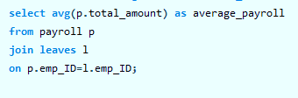

Analysis Questions
Which department receives the highest total bonuses?
What is the average value of total_amount after considering leave deductions?

Slide 20
KEY INSIGHTS
The company maintains a well-organized system to manage employee details, departments, job roles, and payroll records. This helps in efficient data management and easy access to employee information.
Employees are distributed across different departments based on job roles and responsibilities. This shows how workforce allocation supports various organizational functions.
A large portion of the company’s expenses is spent on employee salaries and compensation.This highlights the importance of effective payroll management.
The Finance department receives the highest salary allocation compared to other department. This indicates higher compensation levels for financial roles and responsibilities
Many employees possess multiple qualifications and certification. This demonstrates a highly skilled workforce within the organization.
Leave records show that employees take leaves at different times for various reasons. Analyzing these patterns helps in planning workforce availability.
Bonus amounts differ across departments depending on performance and job roles. This reflects a performance-based reward system within the organization

Slide 21
RECOMMENDATIONS
1. Improve Workforce Planning
The company should analyze employee distribution across departments to ensure balanced workload.
Proper workforce planning can help improve productivity and operational efficiency.
2. Optimize Payroll Management
Since payroll is a major expense, the organization should regularly review salary structures.
This will help control costs while maintaining fair employee compensation.
3. Encourage Skill Development
Employees should be encouraged to gain additional qualifications and certifications.
This can improve employee performance and support career growth within the organization.
4. Monitor Leave Patterns
The company should monitor employee leave trends to avoid workforce shortages.
Better leave management can ensure smooth workflow and operational continuity.
5. Implement Performance-Based Rewards
Bonuses and incentives should be linked to employee performance and achievements.
This will motivate employees and improve overall productivity.
6. Enhance Data Management System
The organization should maintain accurate and updated employee records in the system.
This ensures reliable reporting and better decision-making for HR management.

Slide 22
CONCLUSION
The Employee Management System helps in efficiently managing employee information, departments, payroll, qualifications, and leave records within an organization.
By using a structured database and SQL queries, the system ensures accurate data storage, easy retrieval, and better analysis of employee-related information.
The analysis provides valuable insights into employee distribution, salary structures, payroll expenditure, and leave patterns, which support better decision-making for HR and management.
Overall, the system improves data organization, operational efficiency, and workforce management within the organization.

Slide 23

THANK YOU

