Slide 1
Diesel Exhaust, Demographics, Traffic Proximity and Geography
How much of the diesel PM gap remains after accounting for density, income, traffic proximity and EPA region?
Kayla and Manasvi · INFO 536 Midterm · EJScreen 2024
Notes:
Introduce yourself and the question. My part of the project focuses on the models and on geography: whether the demographic gap in diesel exposure looks the same in every EPA region.

Slide 2
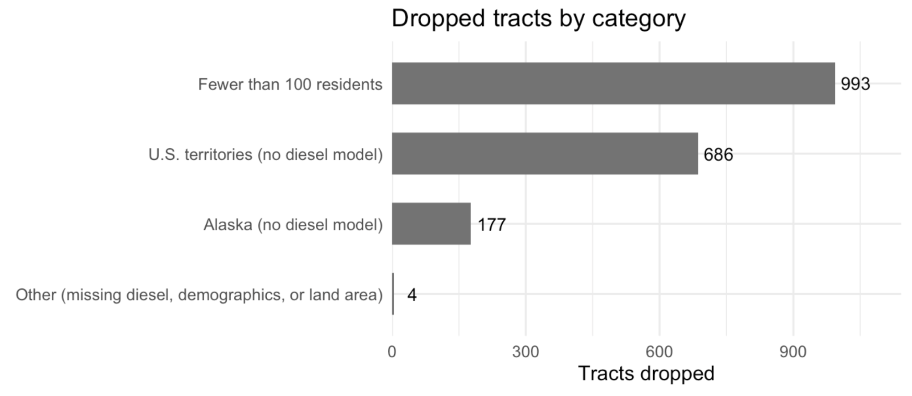
“Cleaned” data for region analysis
Began with 86,082 tracts, and after “cleaning” and dropping the unnecessary tracts brought our count down to 84,222

Slide 3
Region data
Residents of different demographic groups live with different levels of modelled diesel PM. How much of that gap remains once we account for population density, income, and geographic location?
84,222
census tracts in every model
EPA EJScreen 2024 (v2.32); diesel PM from EPA's 2020 AirToxScreen model
Unit: census tract (about 4,000 people), not individuals
Kept tracts with at least 100 residents and a diesel estimate: 49 states, D.C., Puerto Rico
Outcome on a log10 scale, so every coefficient reads as a % change in diesel PM
10
EPA regions (New England is the reference)
+10 pts
unit for % people of color and % low income
Notes:
This part of the project asks how much of the diesel PM gap remains once we account for population density, income, and geographic location. I used the same EJScreen 2024 data: 84,222 census tracts, each about 4,000 people. Everything describes neighbourhoods, not individual people. I kept tracts with at least 100 residents and a diesel estimate, covering 49 states, D.C., and Puerto Rico. The outcome is on a log scale, so every result reads as a percent change in diesel PM, per 10 percentage points more residents of color

Slide 4
Every model tested
Model | Type | Formula / change | What it asks
m1 | Simple linear | log_dsl ~ poc10 | Do tracts with more residents of color have more diesel PM?
m2 | Multiple linear | + log_density | ...among tracts with the same density?
m3 | Multiple linear | + lowinc10 | ...and the same income?
m4 | Multiple linear | + region | ...and in the same EPA region?
m4c | Multiple linear | m4, centered predictors | What does a typical tract look like?
m4_rl | Multiple linear | m4, Southeast as reference | Does the reference region matter?
m5 | Interaction | poc10 * region + density + income | Does the slope differ by region?
Notes:
These are the models I tested. Model 1 uses only the share of residents of color. Models 2, 3, and 4 add density, then income, then EPA region, one at a time. Model 4 is my main model. m4c and m4_rl are checks on Model 4. Model 5, the last row, lets the race gap be different in each region, and it’s my final geographic model.

Slide 5
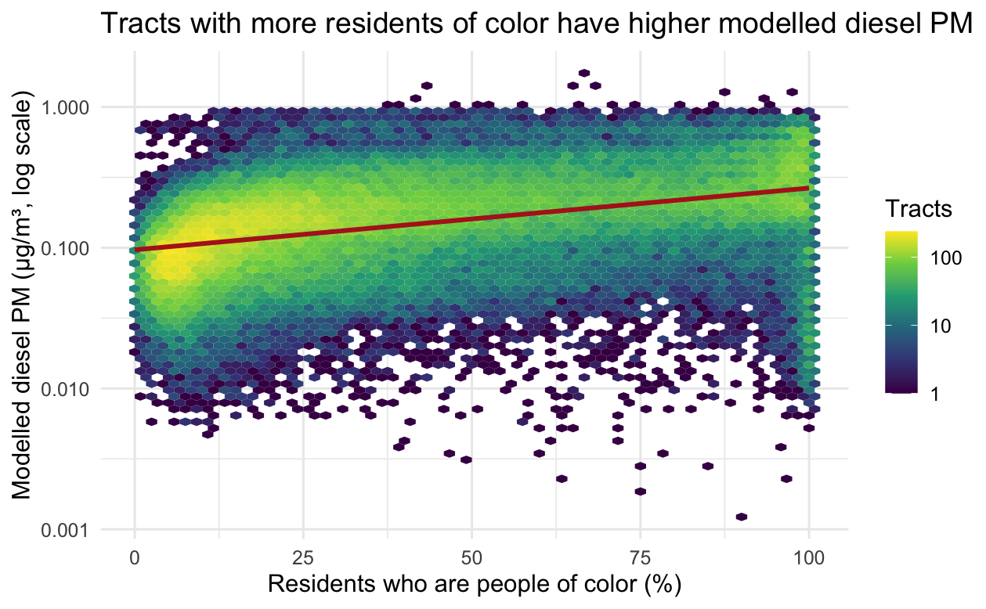
Model 1: more residents of color, more diesel PM
+10.6%
diesel PM per +10 pts people of color (95% CI 10.4 to 10.8)
R² = 0.158
race alone explains about 16% of the variation
×2
typical miss (RSE 0.304 on the log10 scale)
Hexagons count tracts; red line = m1 with 95% CI band. Log scale.
Notes:
Starting simple: tracts with more residents of color have more diesel PM. Each 10 points more residents of color goes with about 10.6% more diesel PM. Race alone explains about 16% of the variation, so it’s a real pattern, but most of the variation comes from other things.

Slide 6
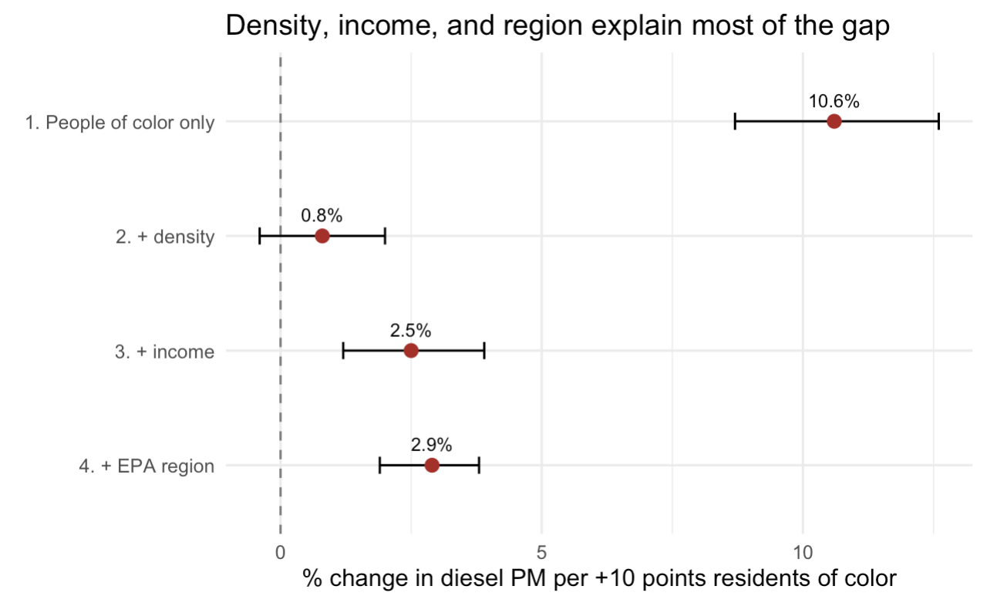
Density explains most of the gap, but not all
Model | % per +10 | Clustered 95% CI | R² | RSE
1. Race only | 10.6 | 8.7 to 12.6 | 0.158 | 0.304
2. + density | 0.8 | −0.4 to 2.0 | 0.614 | 0.205
3. + income | 2.5 | 1.2 to 3.9 | 0.625 | 0.202
4. + region | 2.9 | 1.9 to 3.8 | 0.642 | 0.198
Density drops it from 10.6% to 0.8%
Income brings it back to 2.5% (suppression)
Region: 2.9%, interval above zero
Points are estimates; lines are county-clustered 95% CIs
Notes:
Then I added predictors one at a time. Adding density drops the race effect from 10.6% to under 1%, so most of the raw gap is about where people live: denser areas have more diesel and more residents of color. Adding income actually brings it back up to 2.5%. That’s called suppression: lower-income tracts have slightly less diesel at the same density, so leaving income out was hiding part of the gap. With region added, the final estimate is 2.9%, and the interval stays above zero.

Slide 7
Reading the main model (m4)
Term | Estimate | % change | Clustered 95% CI | t | p
poc10 (+10 pts) | 0.0123 | +2.9 | 1.9 to 3.8 | 5.87 | 4.3e-09
log_density (×10) | 0.2652 | +84.2 | 79.4 to 89.1 | 45.68 | <1e-16
lowinc10 (+10 pts) | −0.0229 | −5.1 | −6.2 to −4.1 | −9.27 | 2.0e-20
Intercept | −1.6396 | — | — | −74.47 | <1e-16
+2.9%
+84%
−5.1%
per +10 pts residents of color, holding density, income, and region constant
for a tract ten times denser: by far the strongest predictor
per +10 pts low income: the suppression effect
Notes:
Here’s the full main model. Holding everything else constant, 10 more points of residents of color means 2.9% more diesel PM. A tract ten times denser has 84% more, by far the strongest predictor. More low-income residents means slightly less diesel, which is the suppression effect again.

Slide 8
VIF checks and a meaningful intercept
Correlations
Centering the predictors
 | % POC | % low inc. | log density
% POC | 1 | 0.45 | 0.48
% low income | 0.45 | 1 | 0.05
log density | 0.48 | 0.05 | 1
0.023
0.113
µg/m³ uncentered: a tract that doesn't exist
µg/m³ centered: a typical tract in New England
Variance inflation factor
Slopes identical (0.0123) and every prediction identical
Only the meaning of the intercept changes
Predictor | VIF
poc10 | 2.01
log_density | 1.46
lowinc10 | 1.38
All below 5: coefficients can be trusted
Notes:
Two quick checks. First, the predictors aren’t so closely related that the model can’t separate them: every VIF is below 5. Second, the original intercept describes a tract that doesn’t exist, with zero people and zero income. Centering the predictors makes it describe a typical tract, about 0.113. The slopes and predictions don’t change at all.

Slide 9
Region terms: every region is above New England
Region | Estimate | % diff. | Clustered 95% CI | t | p
10 Pacific Northwest | 0.1777 | +50.5% | 27.3 to 78.0 | 4.79 | 1.7e-06
7 Central Plains | 0.1660 | +46.5% | 35.2 to 58.9 | 9.27 | 1.8e-20
5 Great Lakes | 0.1592 | +44.3% | 31.7 to 58.1 | 7.84 | 4.5e-15
9 Pacific Southwest | 0.1356 | +36.7% | 15.3 to 62.0 | 3.60 | 3.1e-04
4 Southeast | 0.1106 | +29.0% | 19.1 to 39.7 | 6.27 | 3.6e-10
3 Mid-Atlantic | 0.1083 | +28.3% | 18.6 to 38.8 | 6.22 | 5.1e-10
2 NY/NJ/PR | 0.0801 | +20.2% | 1.6 to 42.3 | 2.15 | 0.032
6 South Central | 0.0698 | +17.4% | 6.7 to 29.2 | 3.29 | 0.001
8 Mountains & Plains | 0.0396 | +9.5% | −5.6 to 27.1 | 1.20 | 0.228
+50.5%
Pacific Northwest: the largest gap over New England
+9.5%
Mountains & Plains: CI includes zero (p = 0.23)
2.5 → 2.9%
race coefficient when region is added (R² 0.625 → 0.642)
Each row vs. 1 New England (reference), from m4, holding race, density, and income constant.
Notes:
Now geography. Region is a category, so each region is compared with New England. Holding demographics, density, and income constant, every region has more diesel PM than New England, up to 50% more in the Pacific Northwest. Mountains & Plains is the only one we can’t tell apart from New England. Notice that adding region barely moved the race effect, from 2.5 to 2.9%. Region changes the overall level of diesel, but it doesn’t explain away the demographic gap.

Slide 10
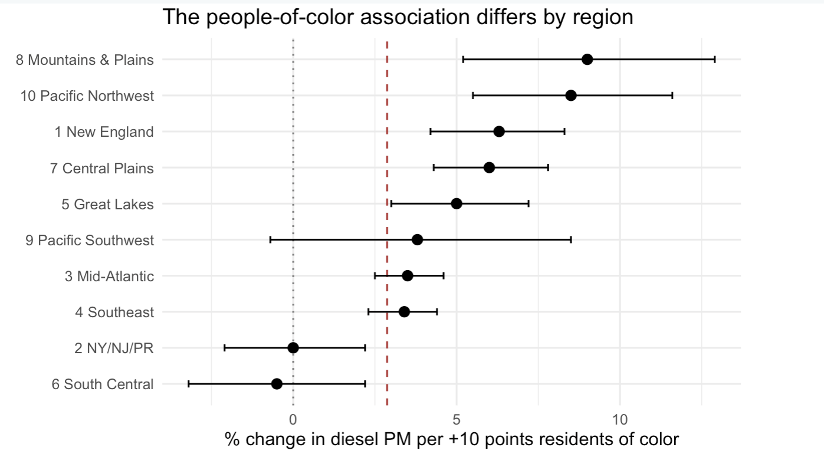
The race gap is not the same in every region
7 of 10
regions positive with an interval above zero
~9%
Mountains & Plains and Pacific NW: about 3× national
≈ 0%
NY/NJ/PR and South Central
Fit separately in each region, holding density and income constant. Bars: county-clustered 95% CIs. Dashed: national 2.9%.
Notes:
Here it is visually. Each dot is one region’s race gap, and the dashed line is the national 2.9%. In 7 of 10 regions the gap is clearly above zero, so this isn’t driven by one place. In Mountains & Plains and the Pacific Northwest it’s about 9%, three times the national number. In NY/NJ/PR and South Central it’s essentially zero. So one national number is a compromise that hides where the disparities are steepest.

Slide 11
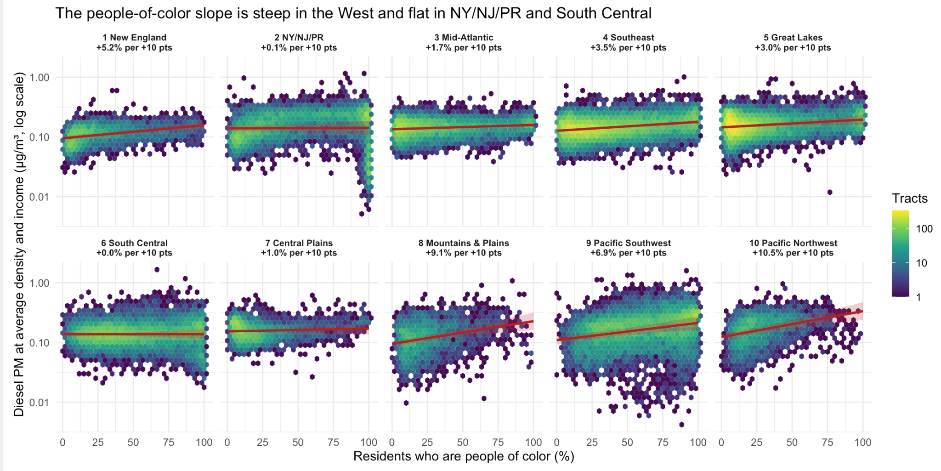
The final geographic model against the data
Red line: m5's prediction in each region at average density and income
Slope: the region's race gap (panel title)
Height: the region's overall diesel level
Spread: what the model doesn't explain
Notes:
This is the final model plotted against the real tracts, one panel per region. The red line is the model’s prediction. The steeper the line, the bigger the race gap. You can see it’s steep in the Pacific Northwest and Mountains & Plains and flat in South Central. The wide spread of the hexagons shows there’s still a lot the model doesn’t explain.

Slide 12
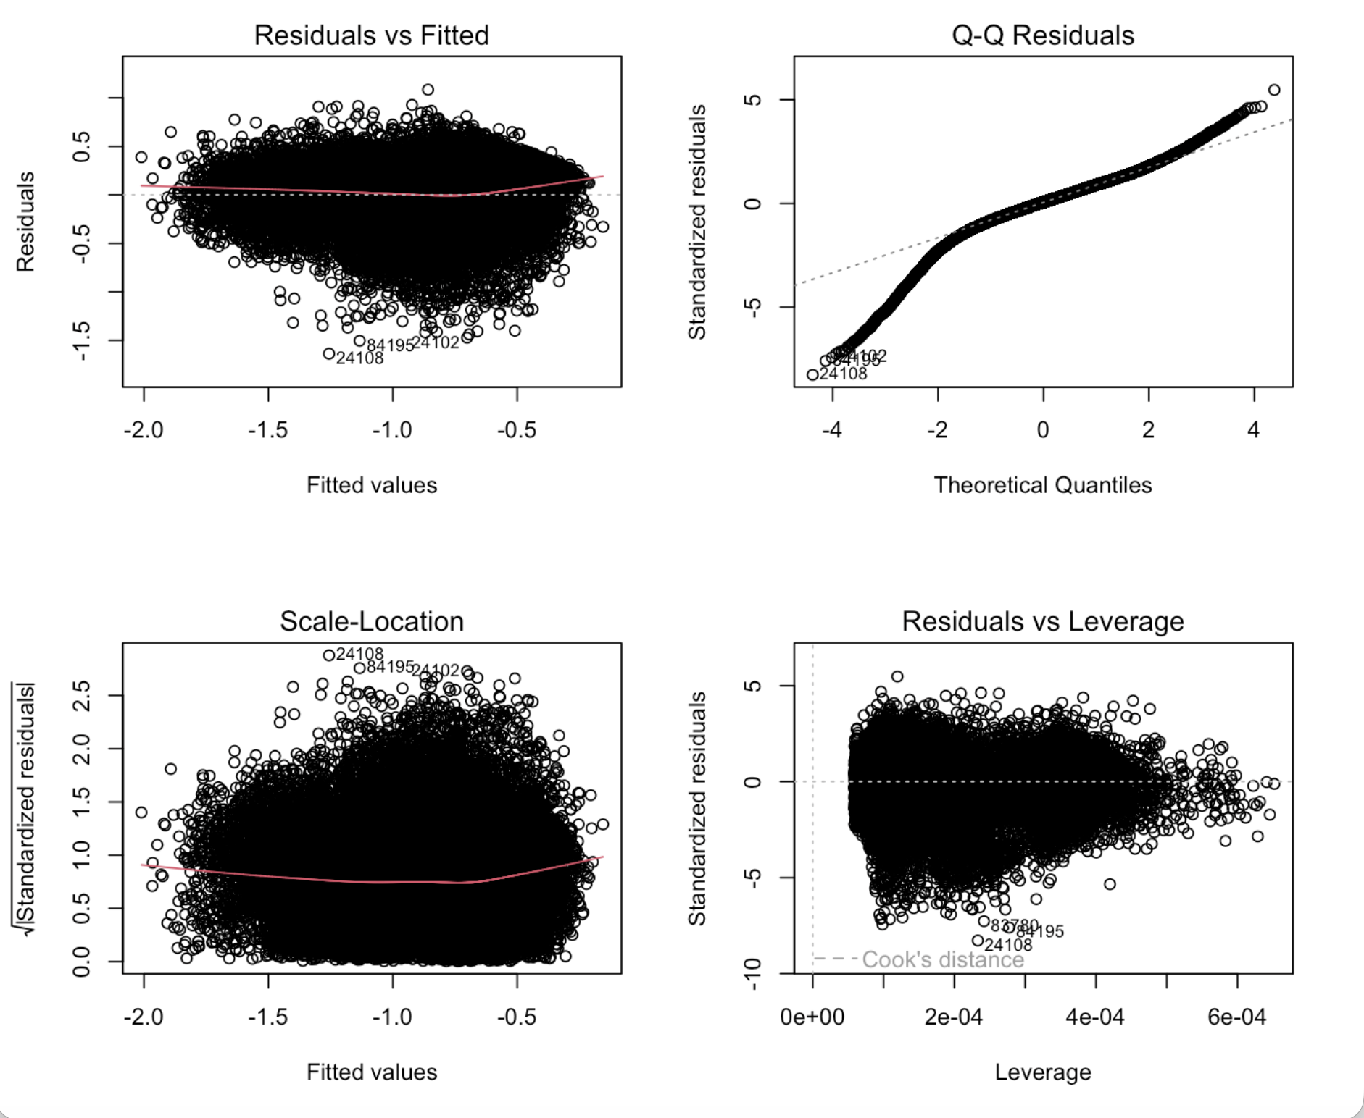
Assumption checks: a linear model is reasonable (m4)
Linearity: red line mostly flat
Constant variance: slightly wider spread at the highest predictions
Normality: heavy tails, little effect with 84,222 tracts
Influence: no tract near Cook's distance
Independence: fails; neighbouring tracts share roads and air-model inputs
Notes:
Finally, I checked the regression assumptions (m4). The model is reasonable: the trend line is mostly flat, and no single tract drives the results. The tails are a bit heavy, but with 84,000 tracts that has little effect. The one assumption that fails is independence, because neighbouring tracts share roads and air-model inputs. So I clustered the confidence intervals by county. That made them about six times wider, from 2.7–3.0% to 1.9–3.8%, but the result still stayed above zero.”

Slide 13
Traffic Proximity and Diesel PM Exposure
RQ1: How strongly is traffic proximity associated with modeled diesel PM?
RQ2: Does accounting for traffic proximity change the association between residents of color and diesel PM?
Background
Traffic-related pollution can contribute to unequal environmental exposure.
Neighborhood demographics may be associated with differences in traffic proximity and diesel PM.
Data & Methods
Data: EPA EJScreen 2024 | 84,222 census tracts
Methods: Linear regression, adjusted model comparison, and decile analysis
Focus: Traffic proximity, diesel PM, and demographic disparities

Slide 14
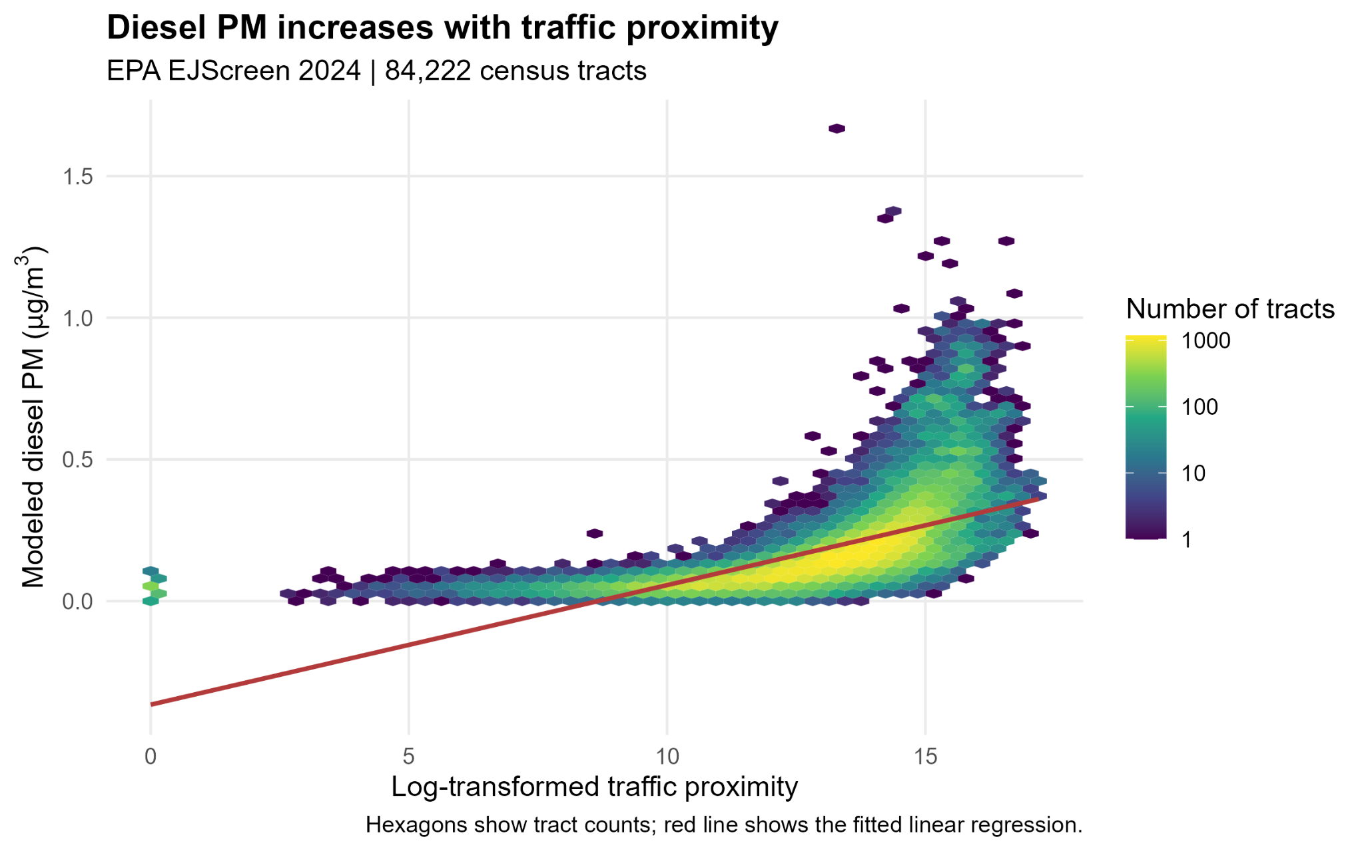
Traffic Proximity and Diesel PM
Key Findings
Traffic proximity coefficient: β = 0.0422 (95% CI: 0.0418–0.0426).
A one-unit increase in log-transformed traffic proximity is associated with 0.0422 µg/m³ higher modeled diesel PM.
Traffic proximity alone explains 39.2% of the variation in diesel PM (R² = 0.392).
Interpretation
Neighborhoods with higher traffic proximity generally have higher modeled diesel PM concentrations, although traffic alone does not explain all the variation.

Slide 15
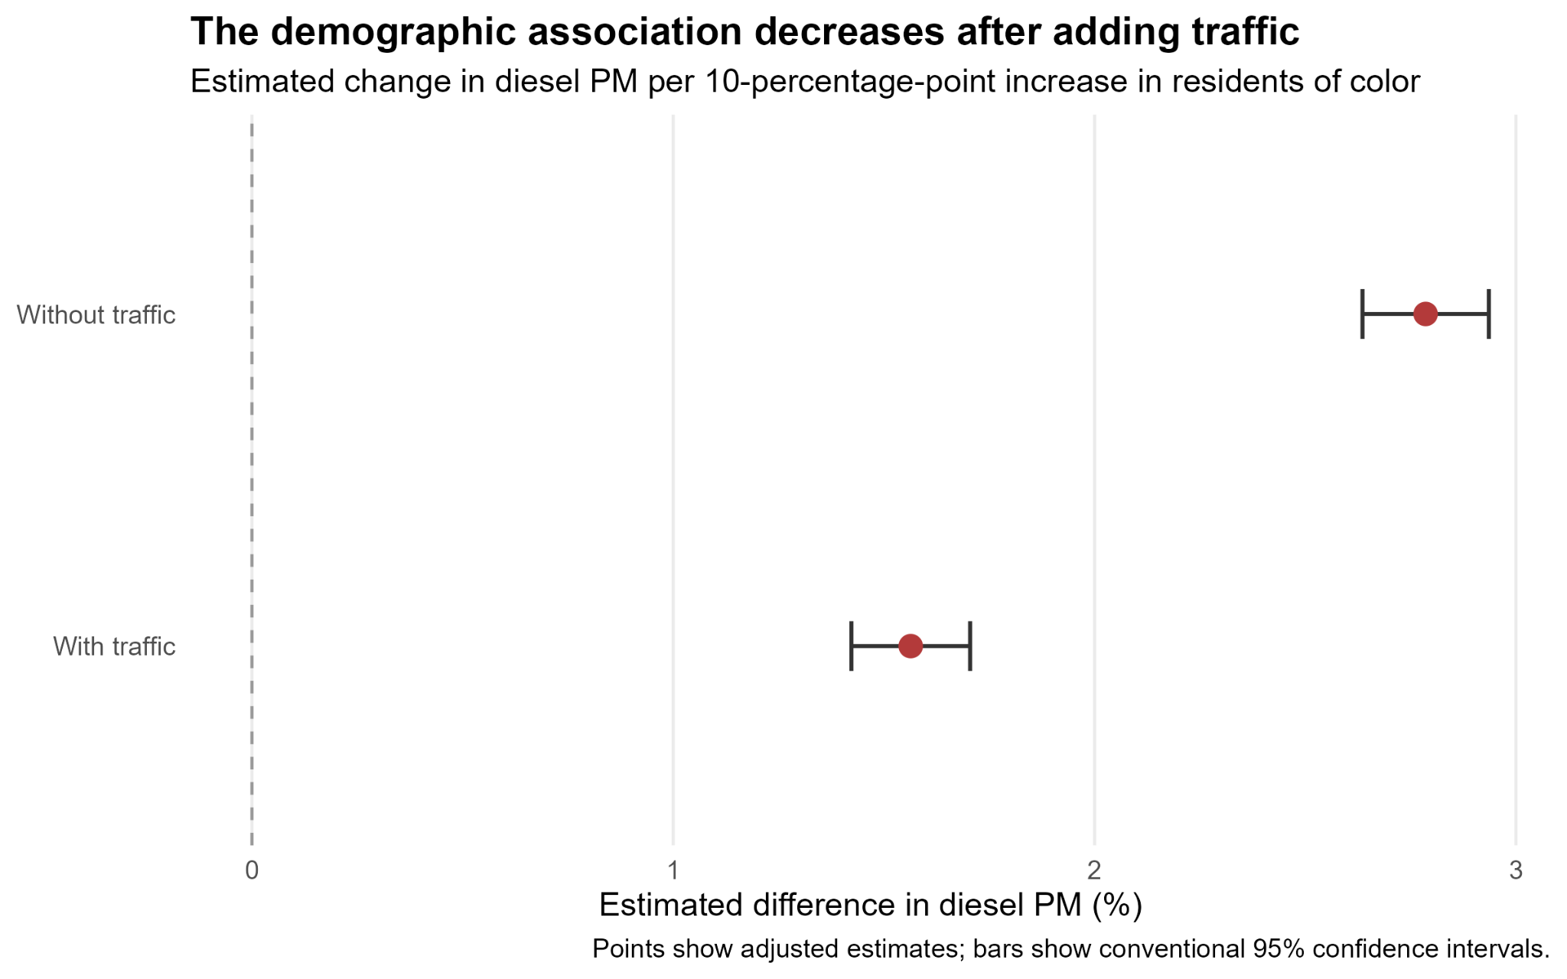
Does Traffic Change the Demographic Association?
Key Findings
The demographic coefficient decreases by approximately 44% after adding traffic.
Adjusted traffic coefficient: β = 0.0543 (95% CI: 0.0533–0.0553).
Model fit improves by 4.3 percentage points in R².
Interpretation
Traffic proximity accounts statistically for part of the demographic association, but the association remains positive after adjustment.

Slide 16
Impact of Traffic Proximity on the Demographic Association
Key Findings
Without traffic: +2.79% diesel PM per 10-percentage-point increase in residents of color.
With traffic: +1.56% per 10-percentage-point increase.
The demographic coefficient decreases by 43.5%.
Model R² improves from 0.642 to 0.685.
Adjusted traffic coefficient: β = 0.0543 (95% CI: 0.0533–0.0553).

Slide 17
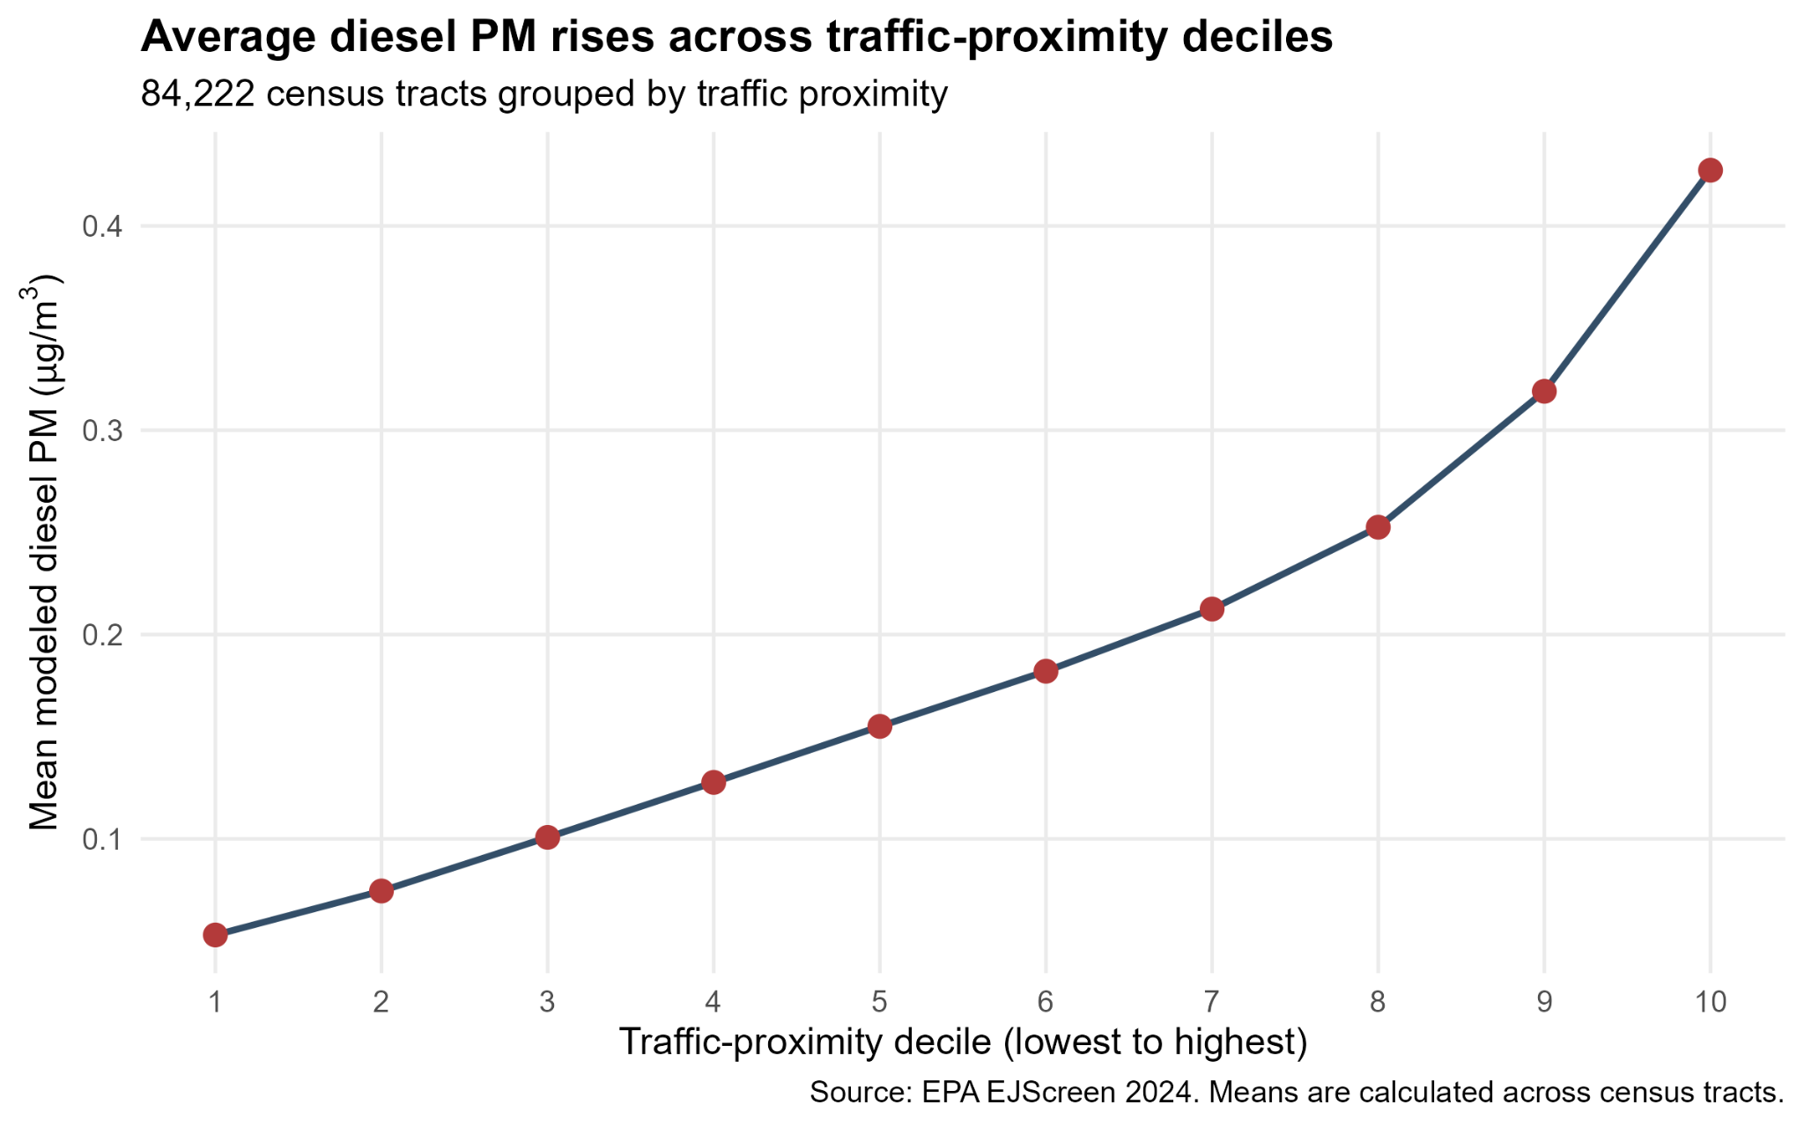
Diesel PM Across Traffic-Proximity Deciles
Key Findings
Census tracts were divided into ten approximately equal-sized groups based on traffic proximity.
Mean diesel PM increases consistently across the deciles.
Lowest traffic decile: 0.0529 µg/m³
Highest traffic decile: 0.4273 µg/m³
8.1×
Higher mean diesel PM in the highest traffic decile compared with the lowest.
Interpretation
The decile analysis supports the regression results, showing higher average diesel PM in areas with greater traffic proximity. These are unadjusted comparisons.

Slide 18
Key Findings and Limitations
39.2%
Variation in diesel PM explained by traffic alone
44%
Decrease in demographic coefficient after adding traffic
8.1×
Highest versus lowest traffic-decile mean diesel PM
Key Findings
Traffic proximity explains 39.2% of the variation in diesel PM.
Adding traffic reduces the demographic coefficient by 44%.
The highest traffic decile has 8.1× higher mean diesel PM than the lowest.
Limitations
Residual diagnostics suggest some curvature and unequal variance.
Spatial correlation may affect the precision of confidence intervals.
Diesel PM is modeled at the census-tract level, not measured as individual exposure.
These associations do not establish causation.

Slide 19
Takeaways (for both region and traffic proximity)
Raw gap: 10.6% more diesel PM per +10 pts residents of color
Density explains most of it; 2.9% remains after density, income, and region (CI 1.9 to 3.8)
The gap varies by region: about 9% in Mountains & Plains and the Pacific NW, about 0% in NY/NJ/PR and South Central
Region is the second-strongest predictor (f² = 0.046); one national number hides where disparities are steepest
Traffic proximity captures an important environmental dimension that demographic and socioeconomic variables alone do not fully represent.
The remaining demographic association suggests that other environmental and neighborhood characteristics may also contribute to differences in diesel PM.
Notes:
To sum up: without adjustment, each 10 points more residents of color goes with 10.6% more diesel PM. Density explains most of that, but 2.9% remains after density, income, and region. That gap isn’t the same everywhere. It’s about 9% in Mountains & Plains and the Pacific Northwest and close to zero in NY/NJ/PR and South Central. Region is the second-strongest predictor, and one national number hides where the disparities are steepest. And remember, these are neighbourhoods, not individuals, and diesel PM is a model estimate, not a measurement. Thank you.

