Slide 1

CO-2 EMISSIONS GROUP NO : 5
GROUP MEMBERS:
POTLACHERVU SRILATHA
JAYSHREE SURYAWANSHI
SIGA KARTHIK
DHARMENDRA YEOLE
PAYAL LANJE
BOJJA SAHITH DATTA GANESH ATCHUTH
SIVANADH
MANNEM NAGA LAKSHMI PRASANNA

Slide 2

Business objective:
The fundamental goal here is to model the CO2 emissions as a function of several car engine features.

Slide 3
PROJECT ARCHITECTURE & PROJECT FLOW:
Model deployment
Model Evaluation
Model Building
Exploratory Data Analysis
(EDA)
Data Preprocessing
Data understanding

Slide 4
DATA SET DETAILS:
The dataset contains 12 columns and 7385 rows.
MAKE - Car brand under study.
MODEL - The specific model of the car.
VEHICLE CLASS - Car body type of the car.
ENGINE SIZE - Size of the car engine, in Liters.
CYLINDERS - Number of cylinders.
TRANSMISSION - "A" for Automatic', "AM" for `Automated manual', "AS" for 'Automatic with select shift', "AV" for 'Continuously variable’, & "M" for 'Manual’.

Slide 5
FUEL TYPE - "X" for 'Regular gasoline', "Z" for 'Premium gasoline', "D" for 'Diesel', "E" for 'Ethanol (E85)’, & "N" for 'Natural gas’. FUEL CONSUMPTION CITY - City fuel consumption ratings, in liters per 100 kilometers. FUEL CONSUMPTION HWY - Highway fuel consumption ratings, in liters per 100 kilometers.
FUEL CONSUMPTION COMB (l/100km) - The combined fuel consumption rating (55% city, 45% highway), in L/100 km.
FUEL CONSUMPTION COMB (mpg) - The combined fuel consumption rating (55% city, 45% highway), in miles per gallon (mpg).
CO2-EMISSIONS - The tailpipe emissions of carbon dioxide for combined city and highway driving, in grams per kilometer.

Slide 6
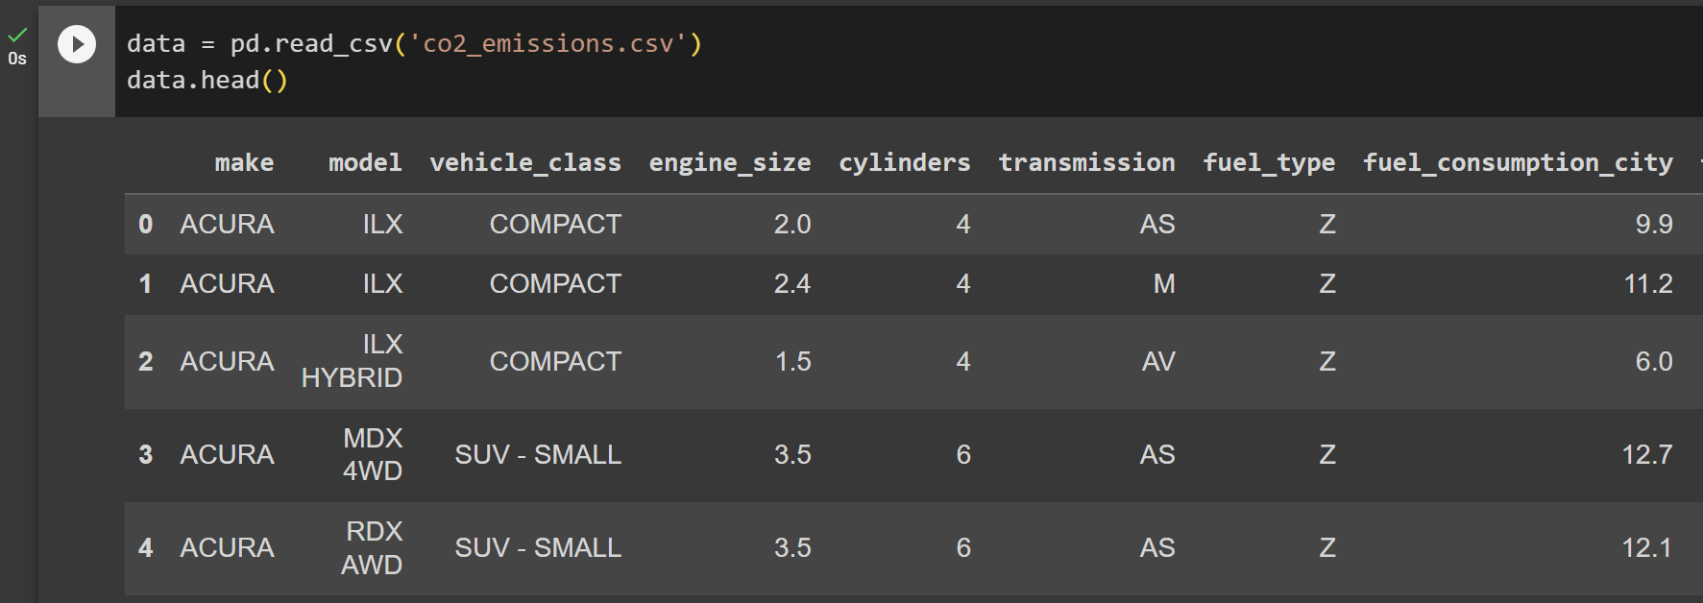
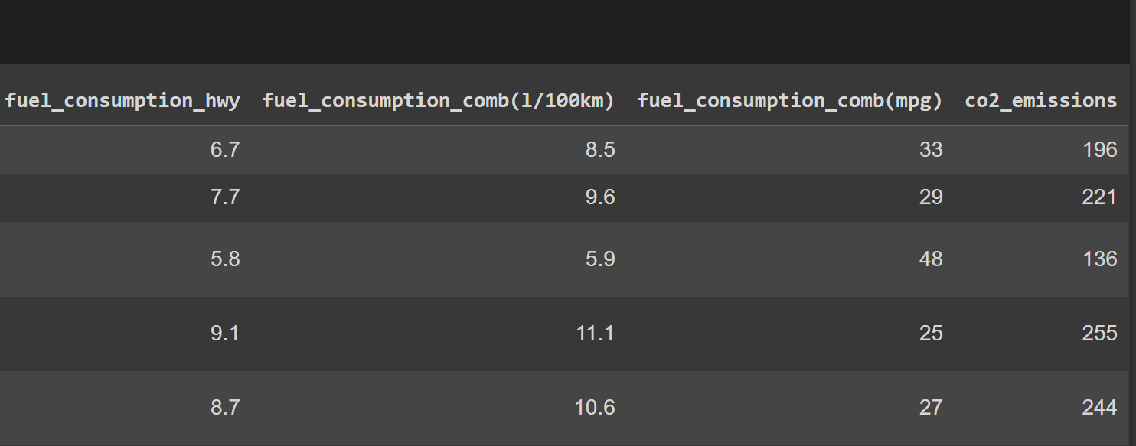
Data Set with top 5 rows:

Slide 7

EXPLORATORY DATA ANALYSIS (EDA)

Slide 8
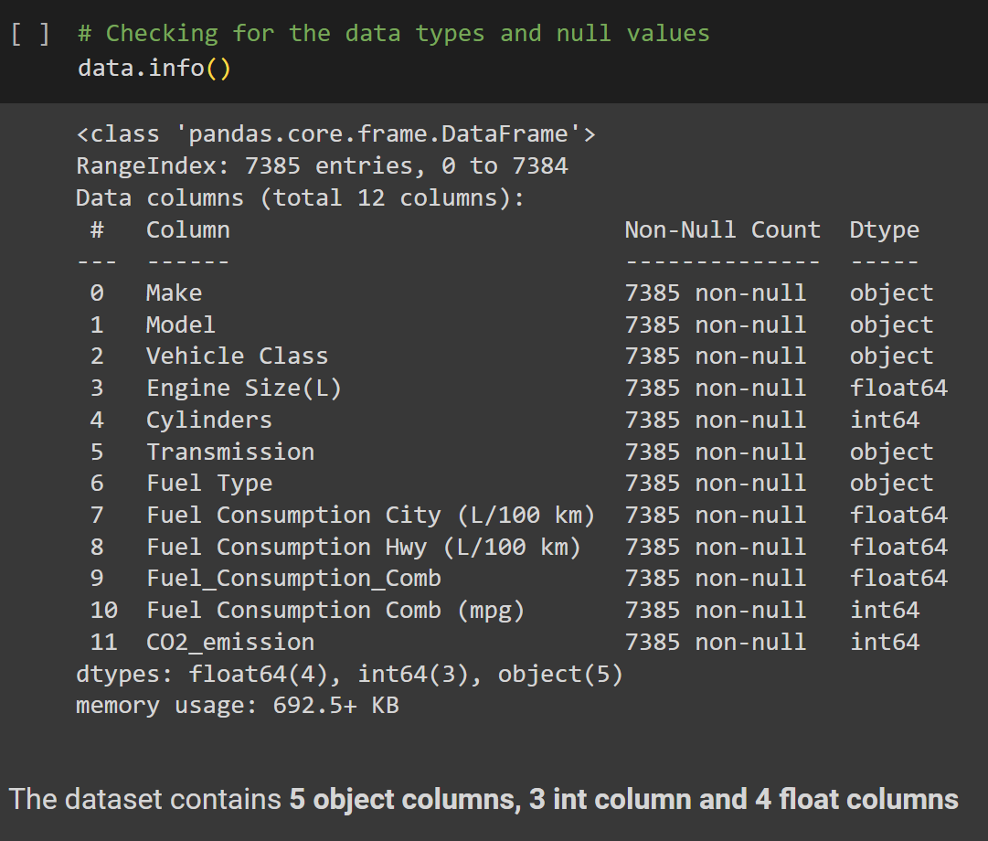
EXPLORATORY DATA ANALYSIS:
Checking Data types and Null values:

Slide 9
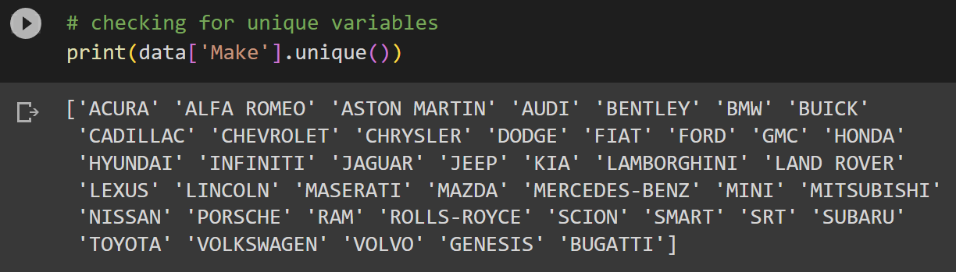
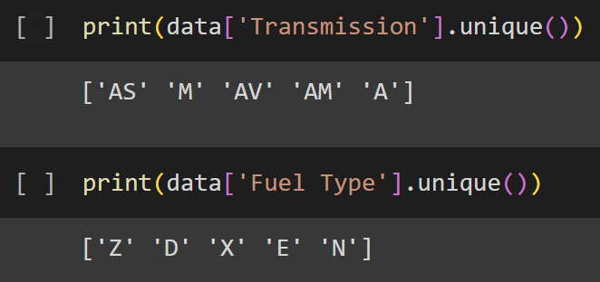
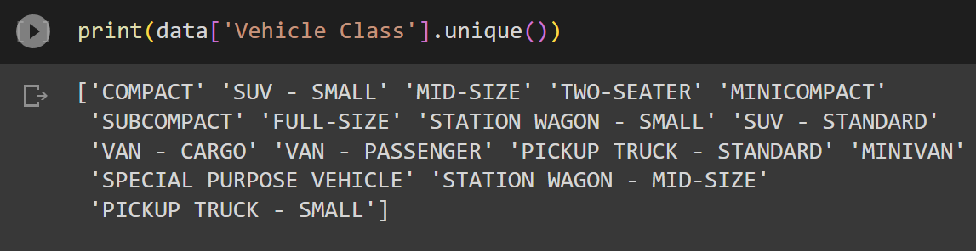
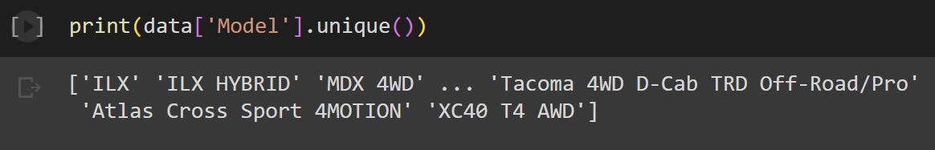
EXPLORATORY DATA ANALYSIS
Checking for unique values in different variables:

Slide 10
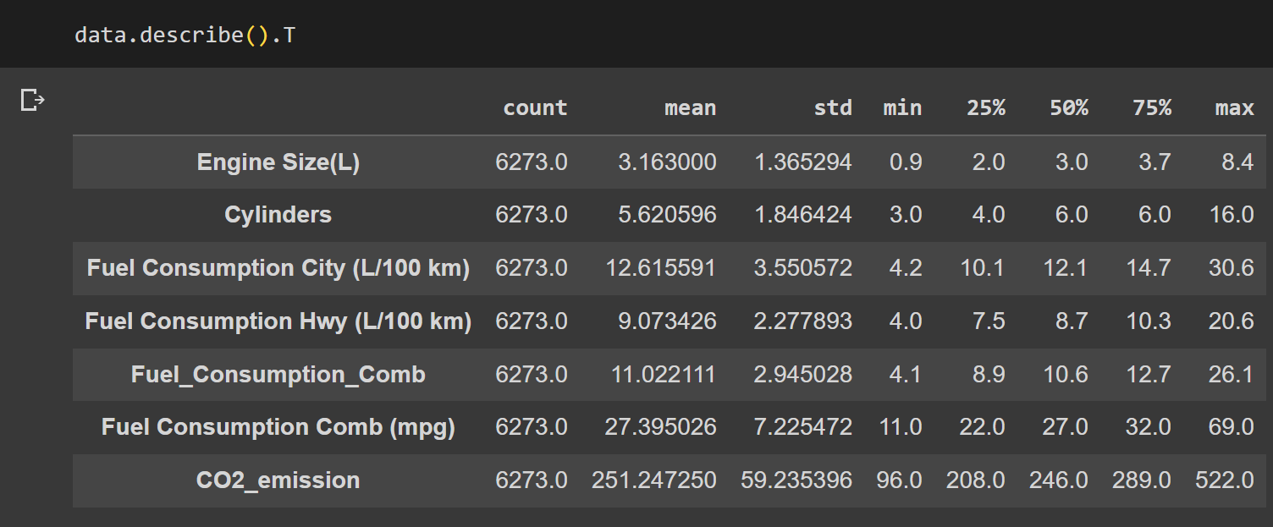
EXPLORATORY DATA ANALYSIS
Insight of different statistical distribution of features and label:

Slide 11
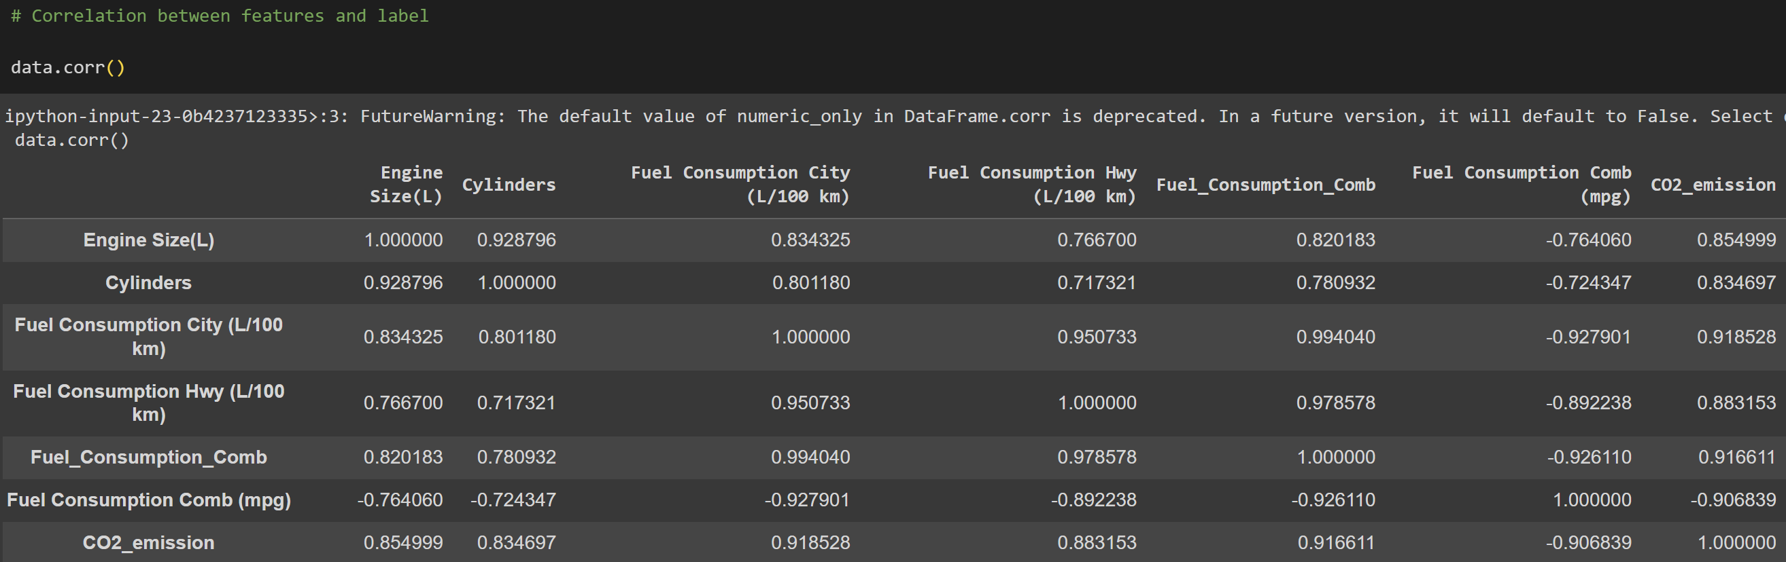
EXPLORATORY DATA ANALYSIS
Correlation between features and label:

Slide 12
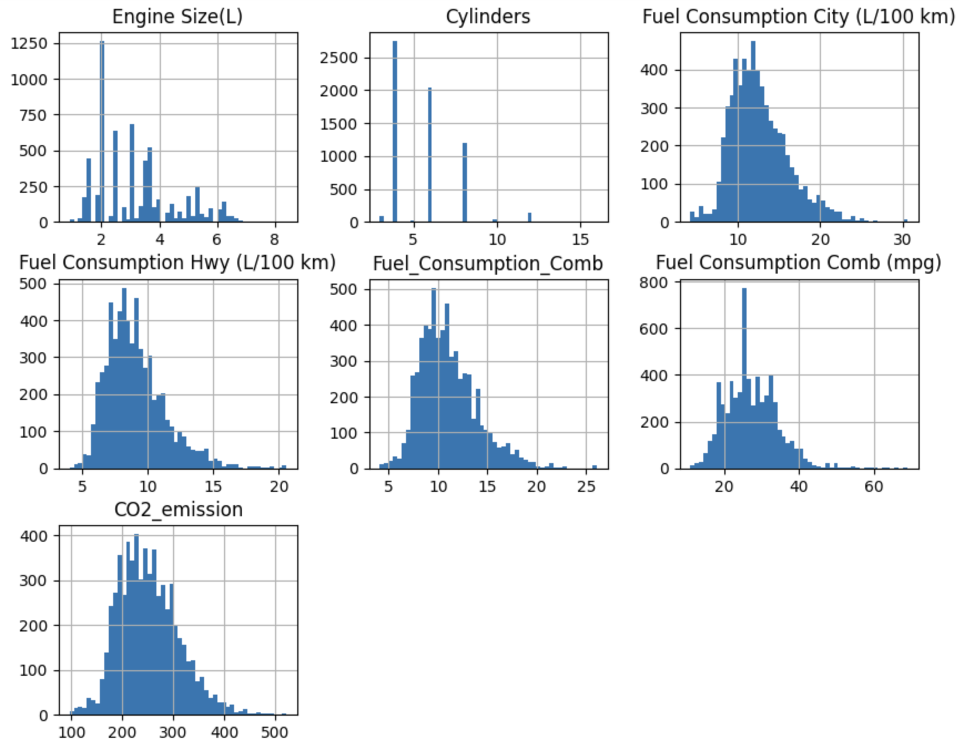
EXPLORATORY DATA ANALYSIS
Distribution of Numerical features:

Slide 13
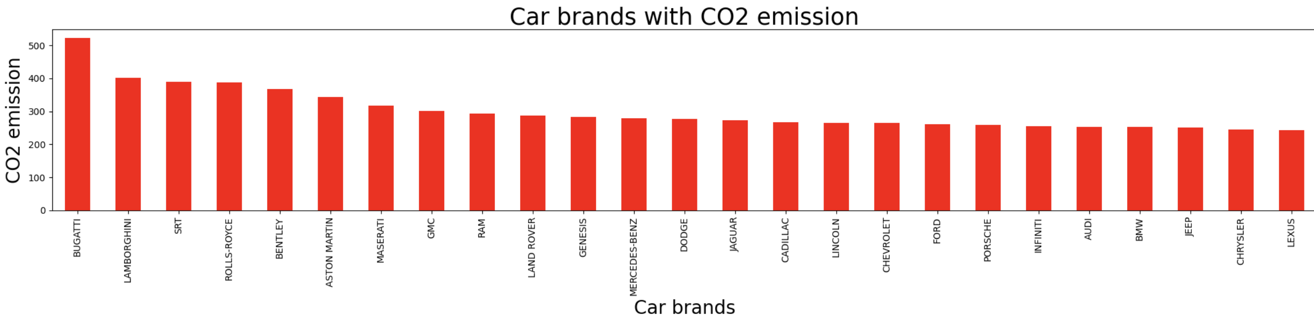
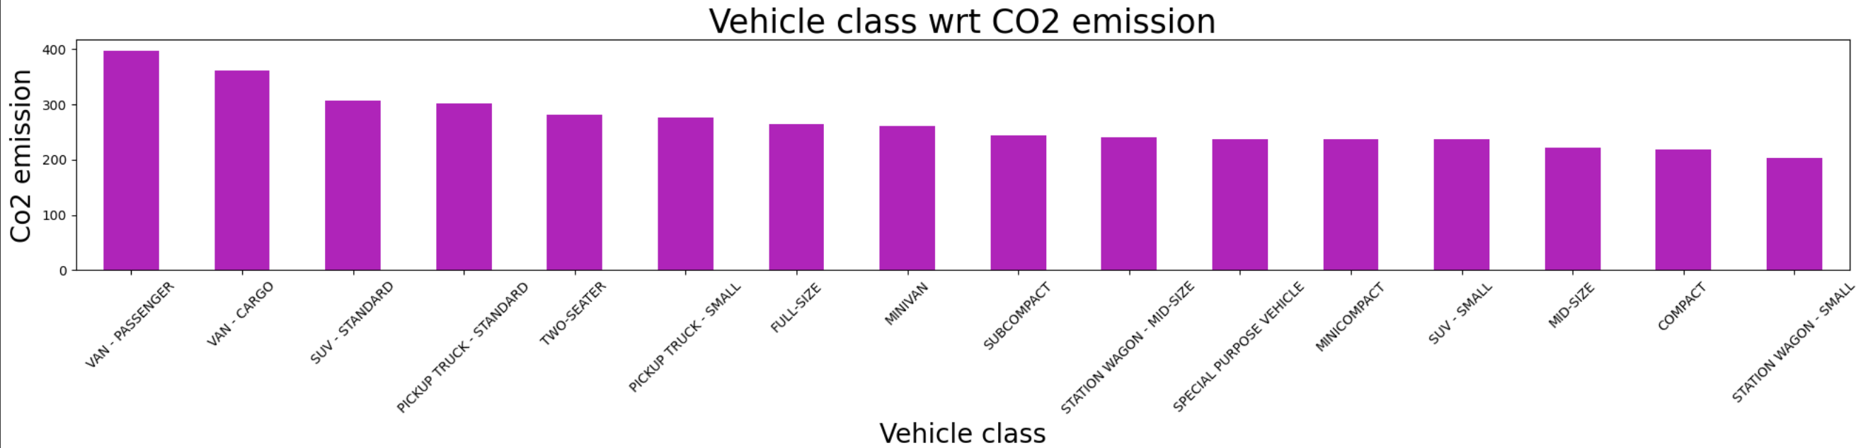
Feature distribution with respect to CO2 Emission:

Slide 14
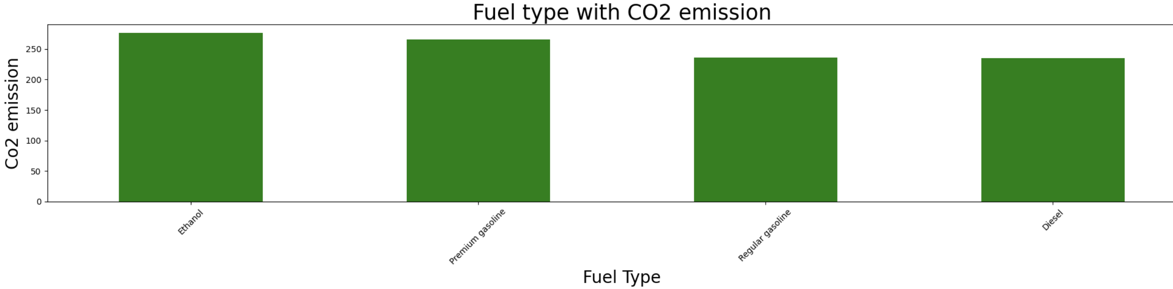
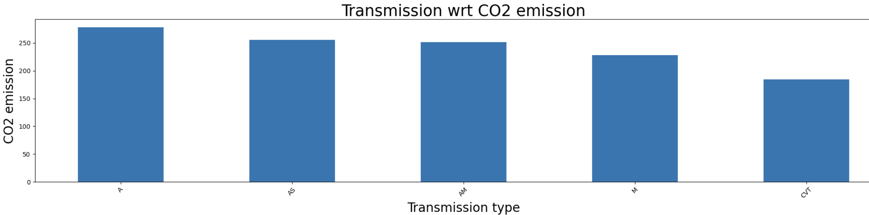

Slide 15
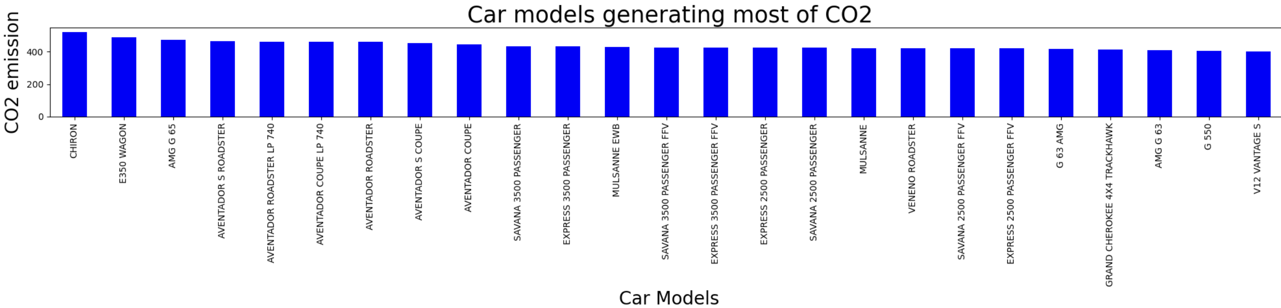
Car models generating most CO2:

Slide 16
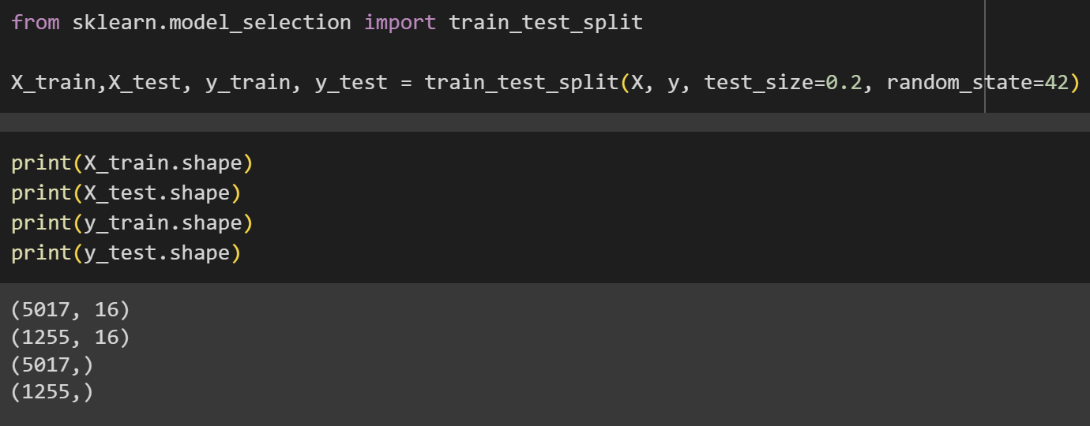
SPLIT DATA INTO TRAIN AND TEST:

Slide 17
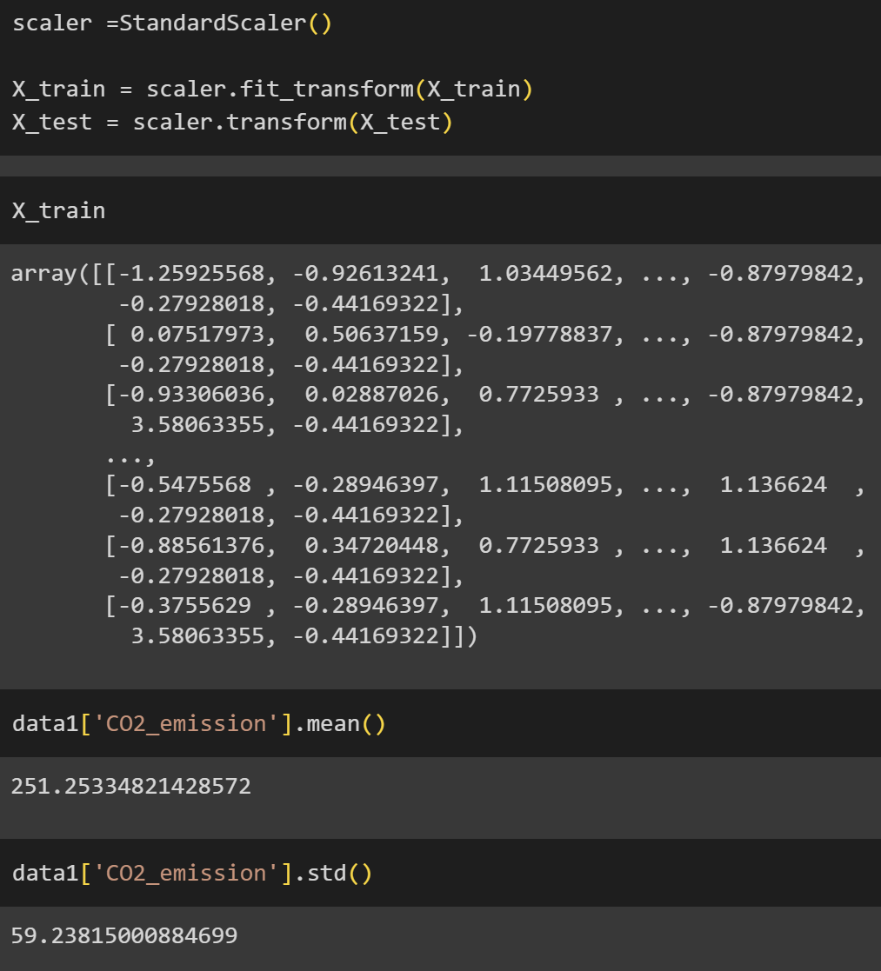
Standardization:

Slide 18
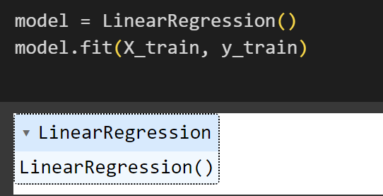
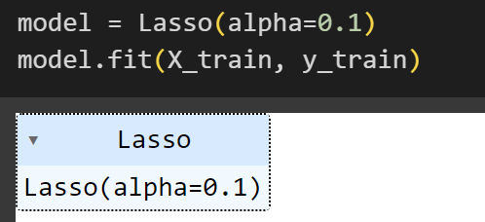
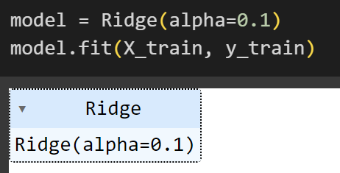
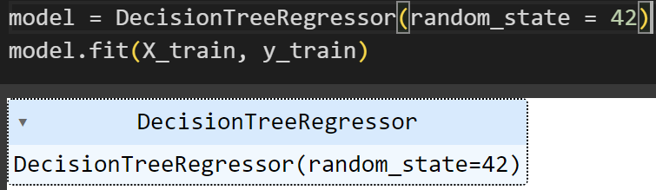
MODEL BUILDING
Linear Regression
Lasso Regression
Ridge Regression
Decision Tree Regression

Slide 19
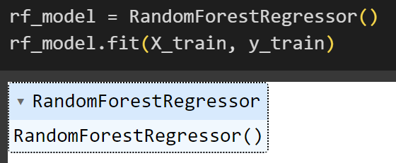
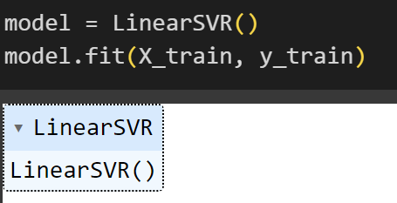
MODEL BUILDING
Random Forest Regression
Support Vector Regression

Slide 20
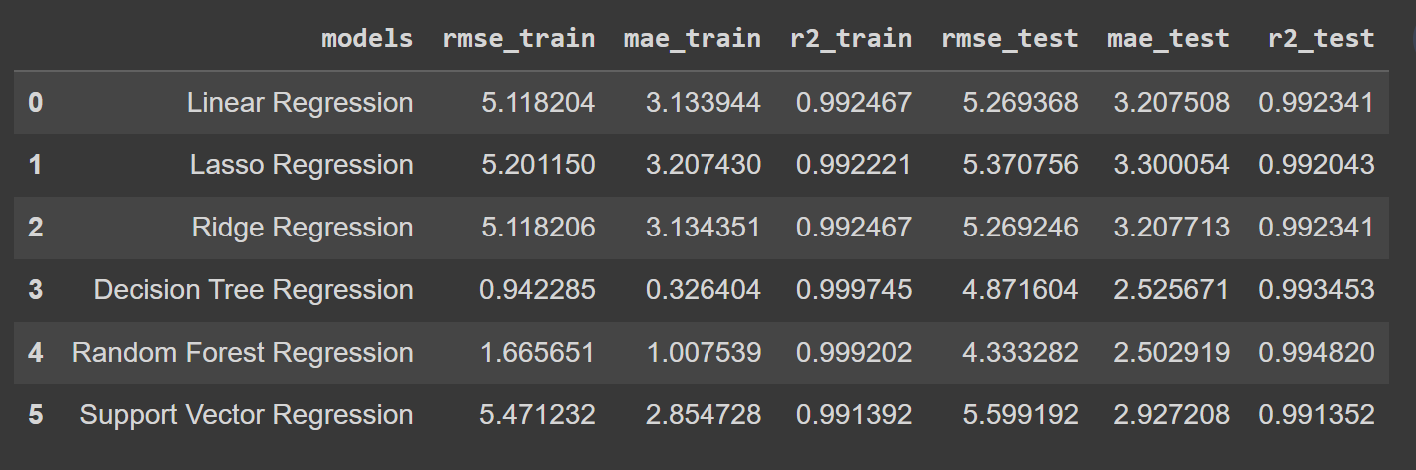
Overall performance of all models in a dataframe:

Slide 21
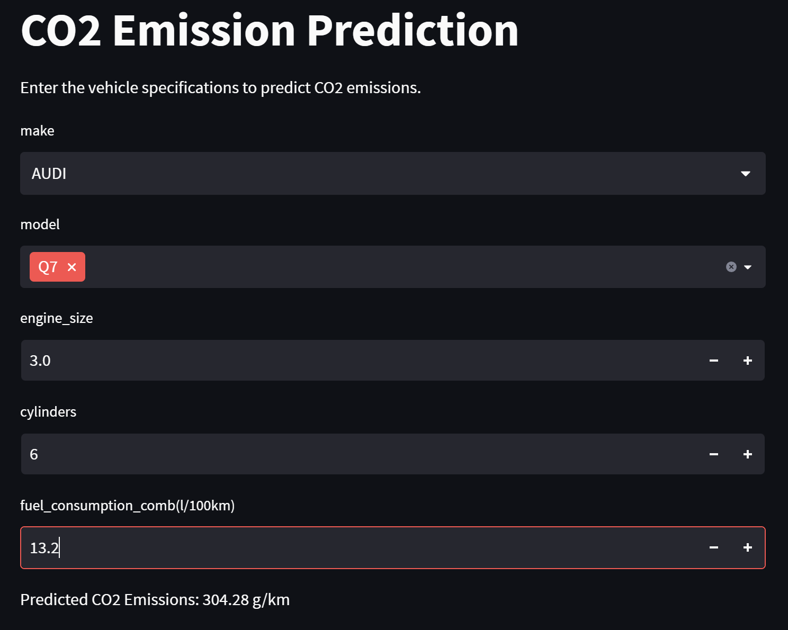
DEPLOYMENT:
We used Random Forest for final deployment :

Slide 22
Thank you

