Slide 1
Option 1

Slide 2
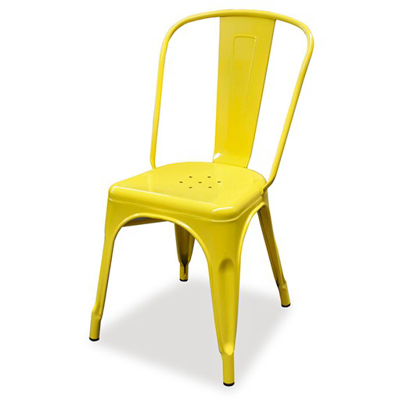
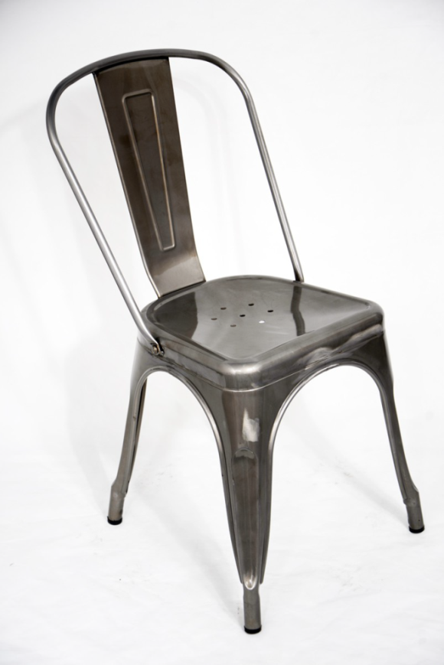
80 x Café chairs
Replica Tolix Café Chairs
Size: D53 x W45 x H85mm
Yellow (x20)
Galvanised gunmetal (x60)

Slide 3
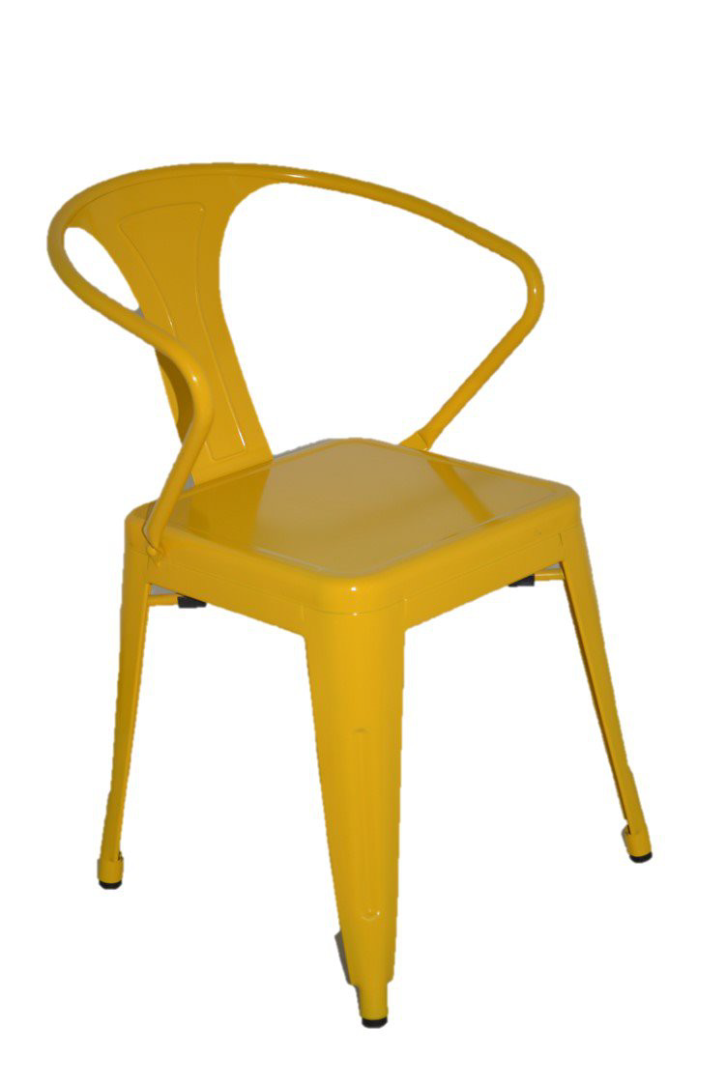
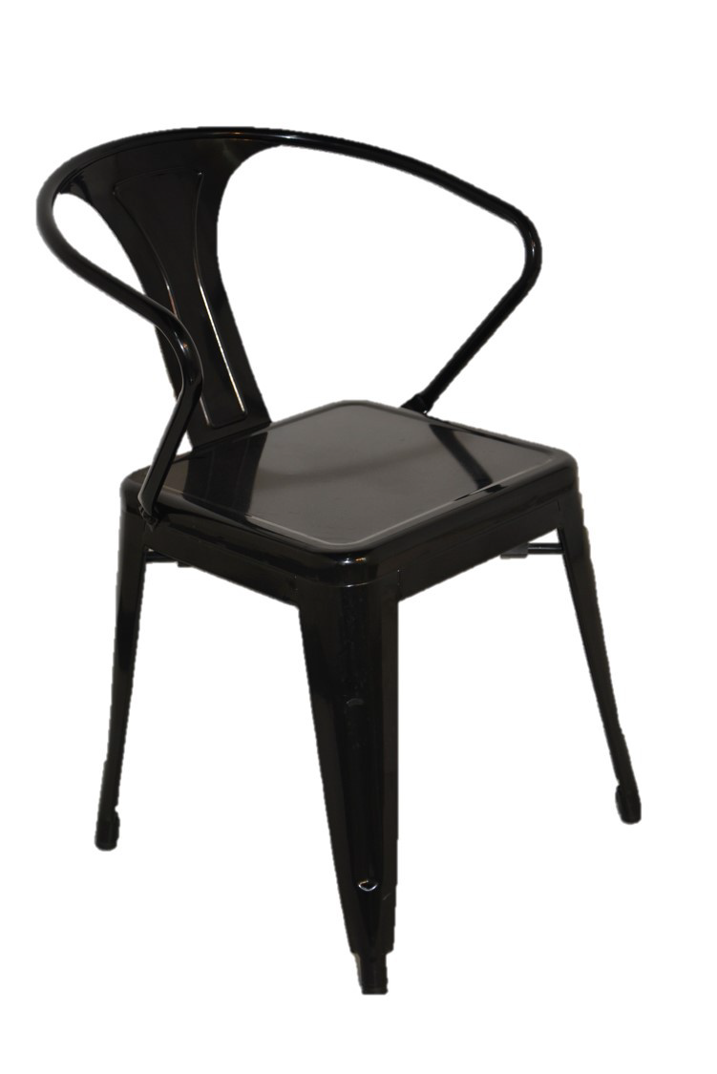
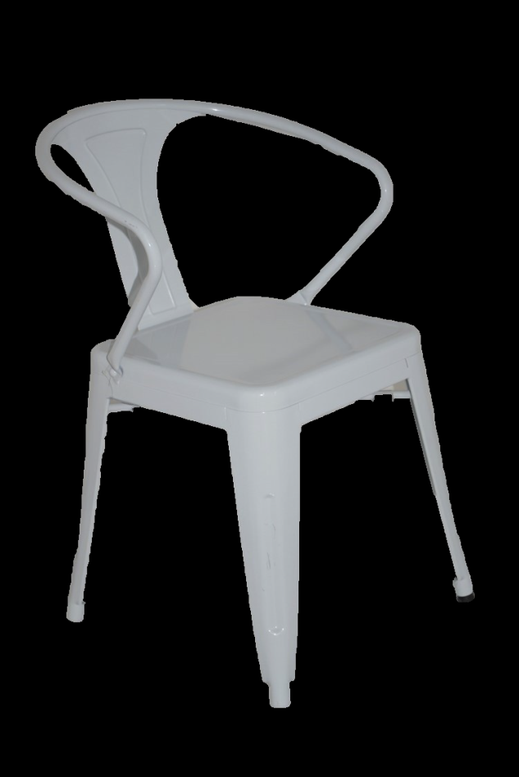
80 x Café chairs
Replica Tolix Café Chairs
Size: D50.5 x W55 x H79mm
or
Yellow (x20)
Black (x50)
White(x10)

Slide 4
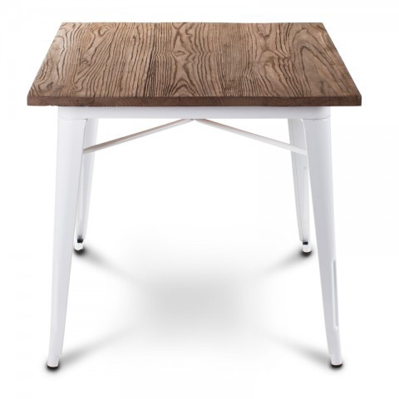
20 x Café tables
White metal legs with natural wood top Replica Tolix Café Table
Size: D80 x W80 x H75 mm

Slide 5
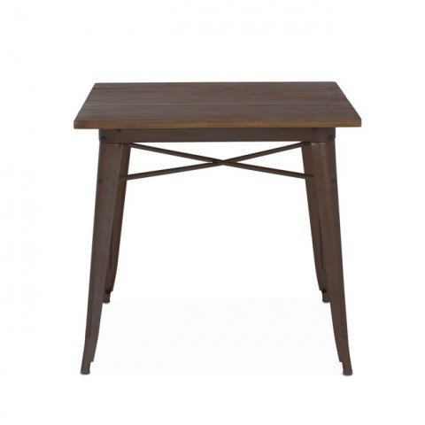
20 x Café tables
Galvinised metal legs with natural wood top Replica Tolix Café Table
Size: D80 x W80 x H75 mm
or

Slide 6
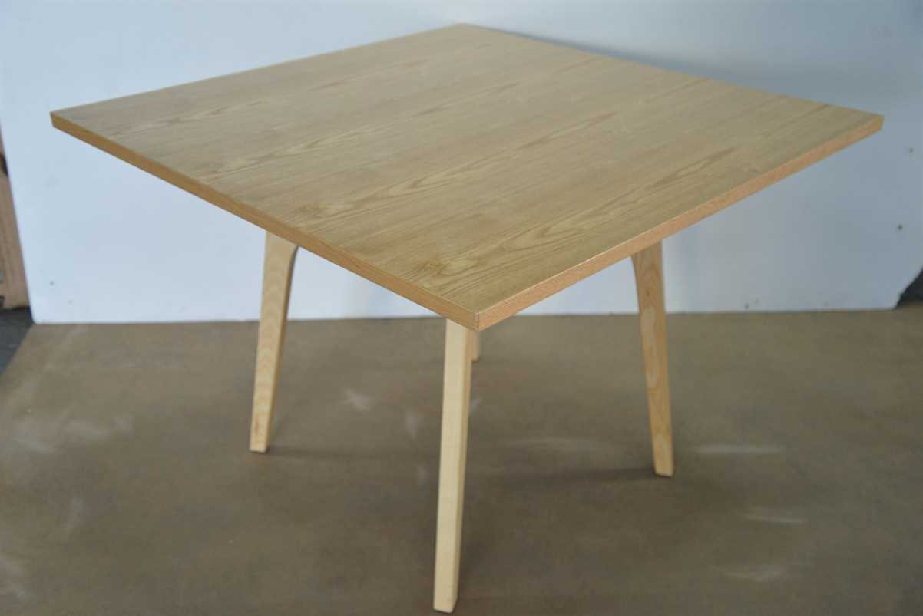
20 x Café tables
Natural wood top café tables
Size: L100 x W100 x H72 mm
or

