Slide 1


KUPPAM ENGINEERING COLLEGE
KES NAGAR, KUPPAM-517425, CHITTOOR DISTRICT, AP.
DEPARTMENT OF COMPUTER SCIENCE & ENGINEERING
An Project Presentation
on
“ Stock Price Forecasting with Machine Learning ”
PRESENTED BY
M. DINESH - 20F41A0562
R. JAYANTH - 20F41A0587
P. SOMESH - 20F41A0582
P. GEETHIKA - 20F41A0584 Under the Guidance of
Ms. Lydia
Assistant Professor, Dept of CSE, KEC

Slide 2

Stock Price Forecasting
with
Machine Learning

Slide 3
Contents
Introduction
Problem Statement
Work Flow
Data Collection
Data Preprocessing
Model Training
Evaluation Metrics
Future Scope
References

Slide 4

Introduction
Stock price prediction is a critical task in the financial industry, aiding investors and traders in decision-making.
This project aims to utilize deep learning techniques, particularly Long Short-Term Memory (LSTM), to forecast future stock prices accurately.

Slide 5
Problem Statement
Predicting stock prices is challenging due to the inherent complexity of financial markets and the multitude of influencing factors.
Traditional methods often struggle to capture the dynamic patterns present in financial data, necessitating the adoption of advanced deep learning algorithms like LSTM for improved prediction accuracy.

Slide 6
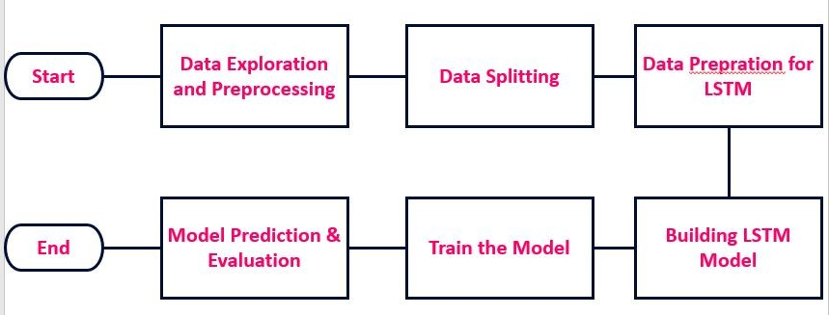
Work Flow

Slide 7

Data Collection
Historical stock data for the chosen stock (e.g., GOOG) is obtained from Yahoo Finance.
The data includes essential features such as Open, High, Low, Close prices, and trading volume.
The timeframe for data collection spans
from January 1, 2012, to the current date.

Slide 8
Data Preprocessing
The collected data is preprocessed using MinMaxScaler to scale the numerical features, particularly the closing prices, to a range between 0 and 1.
Sequences of closing prices are created to capture temporal dependencies, crucial for time series forecasting using LSTM.
This preprocessing step ensures that all features contribute effectively to the model and facilitates efficient training.

Slide 9
Model Training
Long Short-Term Memory (LSTM)
LSTM is chosen as the predictive model due to its ability to effectively capture long-term dependencies in sequential data.
LSTM networks consist of memory cells that can maintain information over time, making them well-suited for time series prediction tasks.
The LSTM model architecture is defined using the Keras Sequential API, with one or more LSTM layers followed by a Dense output layer.
The model is trained using historical stock data, optimizing its parameters to minimize the prediction error.

Slide 10
Evaluation Metrics
Mean Squared Error (MSE)
Mean Squared Error (MSE) is employed as the evaluation metric to assess the performance of the LSTM model.
MSE measures the average squared difference between predicted and actual stock prices, providing a quantitative measure of prediction accuracy.
A lower MSE indicates better performance, reflecting the model's ability to capture stock price fluctuations effectively.

Slide 11
Future Scope
Enhancements and Integration
Develop an AI system to make predictions by considering outside factors like news and economic trends.
Use natural language processing to analyze news and social media for valuable insights.
Adjust predictions in real-time based on emerging information.
Collaborate with experts to improve the AI's accuracy and effectiveness.

Slide 12
References
Python libraries: NumPy, pandas, Matplotlib, scikit-learn, yfinance
Long Short-Term Memory (LSTM): Hochreiter, S., & Schmidhuber, J. (1997). "Long Short-Term Memory". Neural Computation.
Data source: Yahoo Finance (https://finance.yahoo.com)

Slide 13

Thank You

