Slide 1

JACK$ Fashion
Retail Analytics
Sales, inventory and promotion dashboards
for a Visakhapatnam fashion store
Team name: DataWizards
Team members: Samitha Rao, Sharon, Sai Ganesh, Yaswanth
HACKATHON PROJECT | OCTOBER 2026

Slide 2
1. Problem Statement
JACK$ is a 3,000 sq. ft. fashion store in a Visakhapatnam shopping mall
THE PROBLEM
OUR GOAL
Sales, stock and promotion data are stored in separate files. It is difficult to identify best-selling products, low stock and whether discounts are effective.
Clean and combine the datasets, analyse them using SQL, and create dashboards that help the store make data-driven decisions.
WHAT IS SELLING?
WHAT IS RUNNING LOW?
DO DISCOUNTS PAY OFF?
Revenue by category, product, customer segment and payment method.
Opening, received and closing stock for 21 products.
Discount levels from 0% to 30% and a calendar of 12 promotions.
All data is synthetic sample data created for this hackathon.

Slide 3
2. Datasets
Four files used in the analysis; one unrelated file excluded
FILE | ROWS × COLS | CONTENTS / USE
Stores.csv | 500 × 17 | Transaction date, category, product, price, discount, revenue, customer, payment, footfall and stock
sales.csv | 500 × 7 | Bill, product ID, quantity, MRP, selling price and discount
stock.csv | 21 × 6 | Opening, received and closing stock per product
promotion.csv | 12 × 5 | Promotion name, start/end dates and discount percentage
Products.csv | 50 × 5 | Electronics catalogue; unrelated to fashion sales, excluded
File relationships: Stores.transaction_id = sales.bill_id | sales.product_id = stock.product_id

Slide 4
3. Data Cleaning
Validation and preparation checks completed before analysis
0
0
500 / 500
0
Missing values
Duplicate rows
Bill IDs matched
Revenue mismatches
VALIDATION CHECKS
PREPARATION STEPS
• Every transaction_id matched a bill_id
• Recomputed revenue matched all 500 rows
• Units, MRP and discount values agreed across sales files
• All dates valid: 1 Jan–31 Oct 2026
• Converted dates to date format
• Added revenue, gross sales, total discount and discount %
• Built product ID-to-name lookup
• Excluded unrelated Products.csv
• Used transaction-row category for multi-category products
Result: all data-quality checks passed.

Slide 5
4. SQL Queries
Queries used to calculate KPIs and answer retail business questions
HEADLINE KPIs
SALES & CATEGORY ANALYSIS
SELECT SUM(selling_price*quantity) AS revenue,
COUNT(*) AS bills,
SUM(quantity) AS units
FROM sales;
₹1,702,930 revenue • 500 bills • 1,729 units
GROUP BY month / product_category
ORDER BY revenue DESC;
Women 30.6% • Men 28.5%
Peak month: February ₹218,848
TOP PRODUCTS & DISCOUNTS
INVENTORY & PROMOTIONS
JOIN sales with product lookup
GROUP BY product_id
ORDER BY revenue DESC;
Jeans ₹187,768 • Sneakers ₹173,612
10% discount: ₹429,747 revenue
ORDER BY closing_stock ASC
Calculate promotion duration
Reconcile stock issued with units sold
Frock lowest stock: 38
1,729 issued = 1,729 sold
Date functions shown in the source queries use SQLite syntax.

Slide 6
5. Business Requirements
Each business requirement is mapped to a dashboard view and result
BUSINESS REQUIREMENT | DASHBOARD VIEW | KEY RESULT
Sales performance | Sales overview | ₹1,702,930 revenue • 500 bills • ₹3,406 avg bill
Product performance | Product analysis | Women 30.6% share • Jeans top product
Customer & payments | Customer/payment | Returning customers lead revenue • UPI 29.9%
Store traffic | Store performance | 109 average daily footfall • 24.4% conversion
Discount control | Discount analysis | ₹236,841 discount • 11.8% average discount
Stock health | Inventory | 1,728 closing units • Frock lowest at 38
Promotion planning | Promotion view | 12 promotions • 21% average discount
Limitation: promotion lift cannot be measured because sales rows have no promo_id.

Slide 7
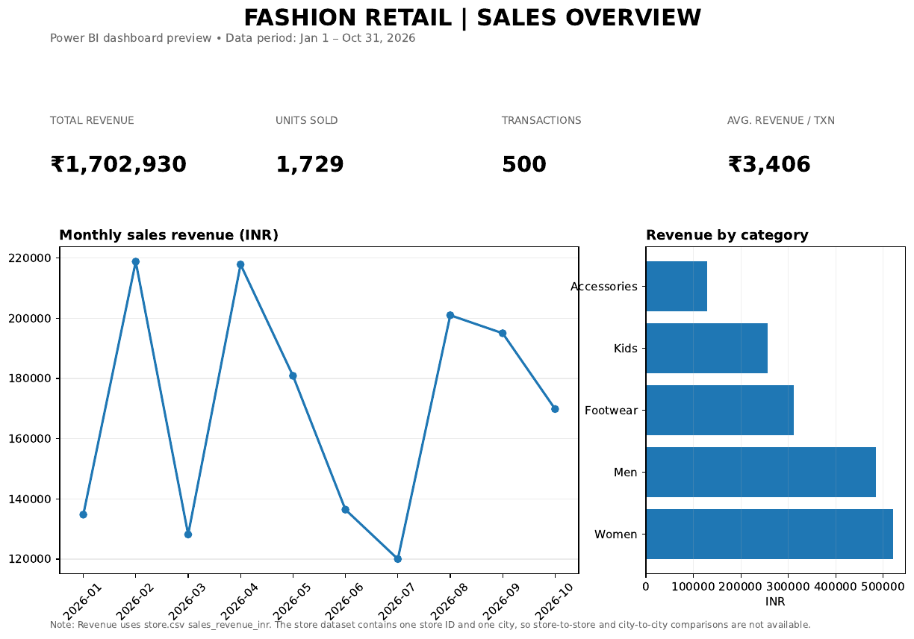
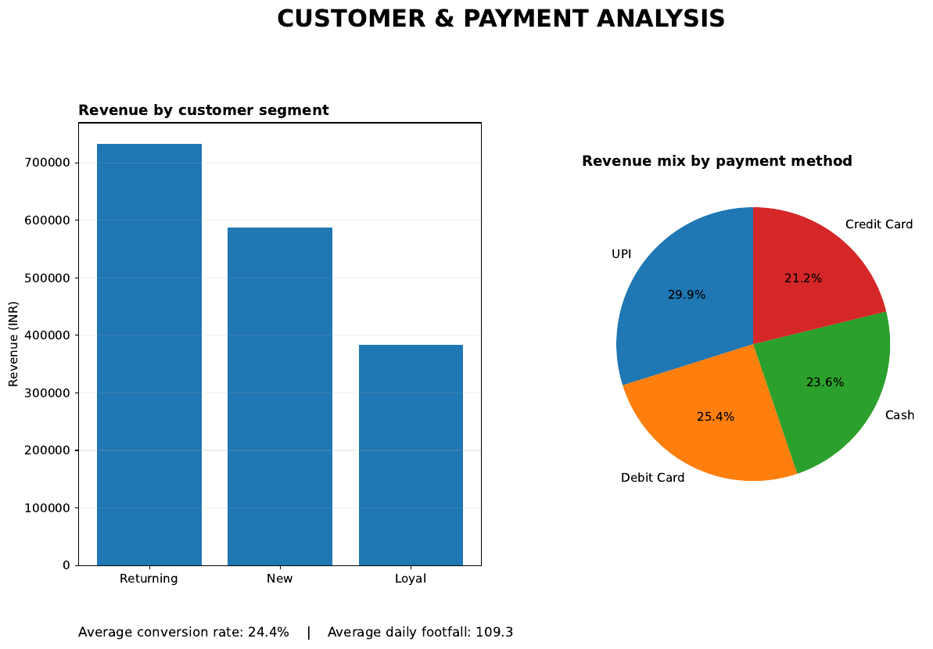
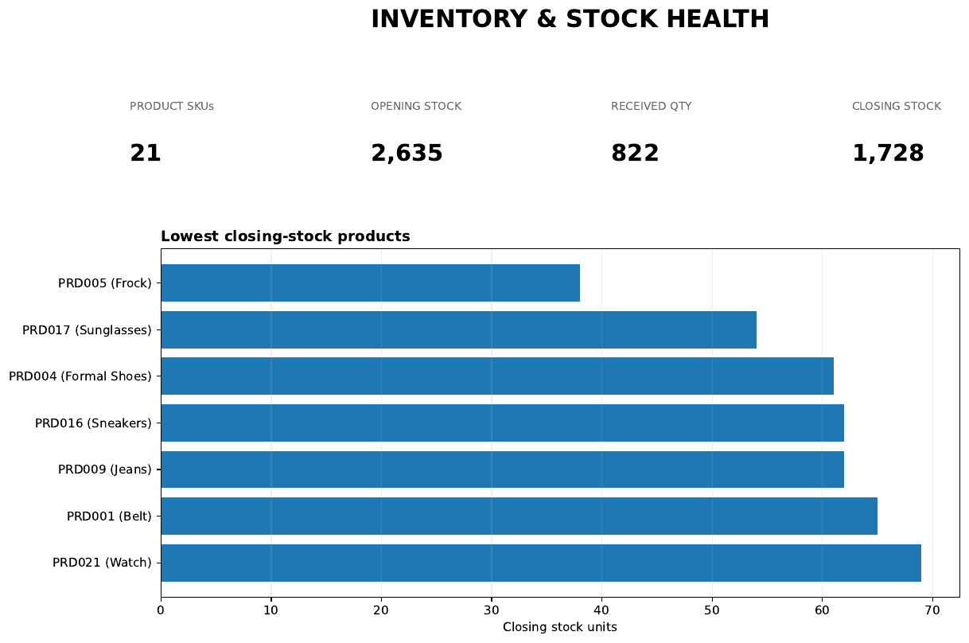
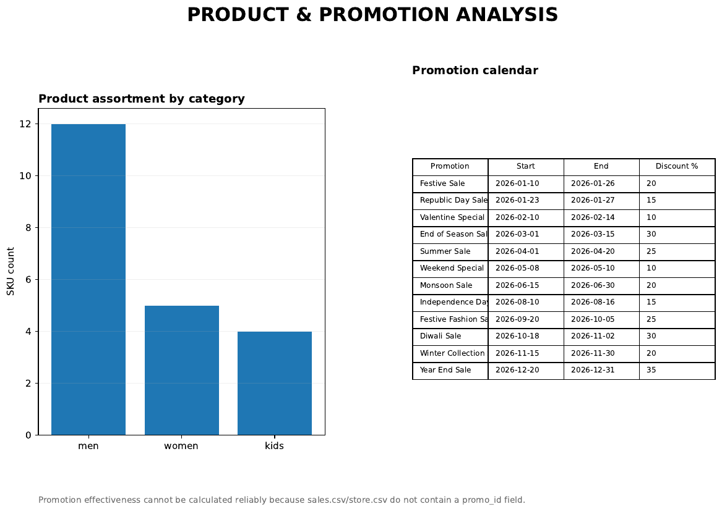
6. Dashboards — Power BI
Sales, customers, inventory and promotion analysis
Sales: ₹1.70M revenue • UPI: 29.9% • Inventory: 21 SKUs • Promotions: 12

Slide 8
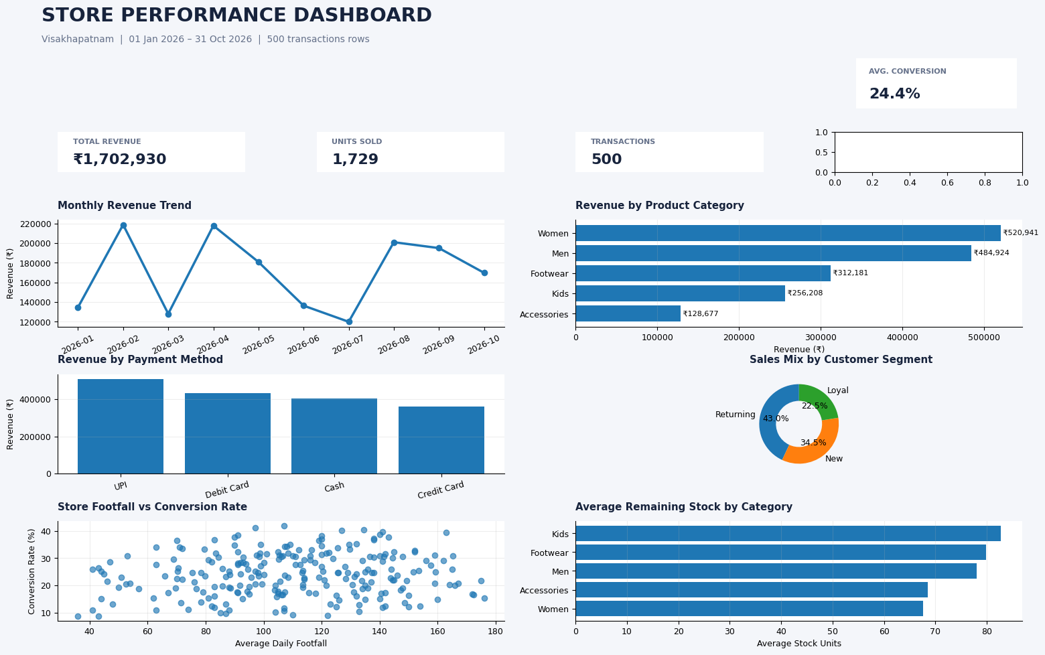
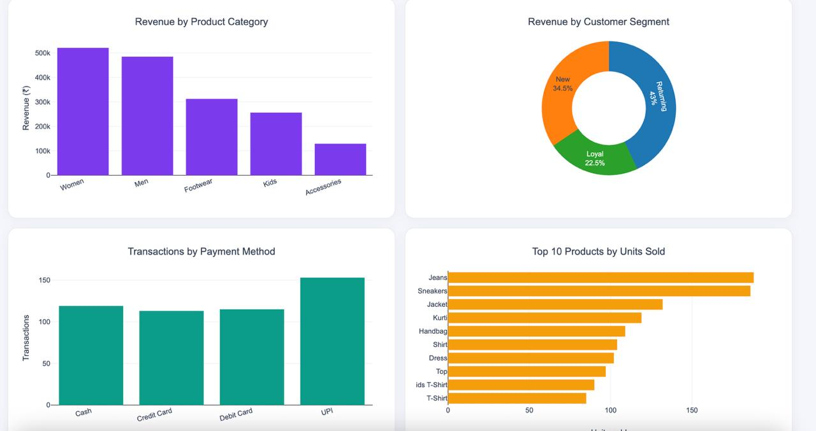
6. Dashboards — Python & Web
Store performance dashboard and interactive dashboard
STORE PERFORMANCE
INTERACTIVE WEB DASHBOARD
₹1.70M revenue • 24.4% conversion • 109 daily footfall
KPIs, daily revenue, category mix, payments, top products and stock.

Slide 9
Thank You!
Questions?
JACK$ Fashion Retail Analytics

