Slide 1
A STUDY ON EMAIL SPAM DETECTION USING
SUPERVISED LEARNING ALGORITHMS
Submitted By
Potnuru Deepika (19341A05D5)
Mr. D.Siva Krishna
Assistant Professor, CSE Department
GMR Institute of Technology
Rajam, AP.

Slide 2
ABSTRACT
Social networking helps to collaborate, contribute and connect. Social network is prevalent that all people across the globe are visible to anyone and anywhere. Increase in growth of interest in various social network platforms lead to the huge number of interactions between the users to users or users to websites. Among all, most of the business and general communication agents are working through email because of its cost effectiveness as sending an email is easy and cheap.This leads various attacks like Spamming, Phishing email, Spear Phishing, Link Manipulation, Fake Websites,CEO fraud, Content injection and many more. Therefore, detecting of these spam mails that were fraud is of the most important. Spam detection methods can be broadly divided into expert-based and machine learning based detection methods. In this study, it aims the detection of spam emails using machine learning techniques which improves a way in social network analysis. In this work, spam detection includes different Machine Learning Techniques such as supervised and unsupervised learning. In supervised learning ,K-Nearest Neighbor (KNN), Naive Bayes, Decision Trees, Support Vector Machine (SVM) are performed. Finally, at the end of study, the comparison of different spam email detection techniques will be presented and demonstrates the overall performances of all algorithms regarding accuracy rate.
Keywords:Spamming,supervised, classification, Naïve Bayes,decision tree,Accuracy rate.

Slide 3


INTRODUCTION
Over the past few years, the Internet has been leaping forward, and the intelligent terminals have been progressively popularized and in this form, Machine learning models have been utilized for multiple purposes in the field of computer science from resolving a network traffic issue to detecting a malware. Coming to digital communications, Email is an primary medium throughout the world. Every personal, social and business communication needs Email and malware is spamming.

Slide 4
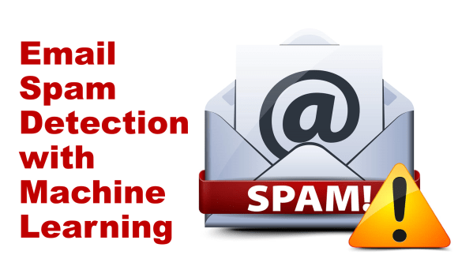
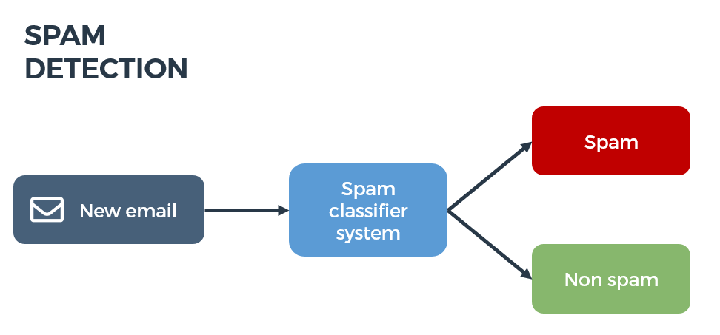
INTRODUCTION
Email spamming is generally defined as the act of dispersing messages that are unsolicited sent in bulk, using the medium of email. On the other side, emails that are communicated for genuine, lawful and authorised and legitimate purposes are defined as Ham . Spammers use the act of spamming for not only marketing purposes, but also to achieve more malicious goals such as reputational damage and financial disruption, both in institutional and personal front.

Slide 5
LITERATURE SURVEY

Slide 6
[1] J. Choi and C. Jeon, "Cost-Based Heterogeneous Learning Framework for Real-Time Spam Detection in Social Networks With Expert Decisions," in IEEE Access, vol. 9, pp. 103573-103587, 2021, doi: 10.1109/ACCESS.2021.3098799.
A sophisticated framework is designed in which experts and machine learning algorithms collaborate worked together to detect spam filed effectively.
The author has used tree-based J48, random forest (RF), rule-based PART, Naïve Bayes network algorithms in Machine Learning.
The paper have shown by experiments that it is difficult to detect spam using only machine learning because of various problems encountered in reality. So,author proposed a collaborative system including both machine learning and experts for spam detection.
While reducing the time-consuming or costly expenses that can be problematic when experts are involved.

Slide 7
[2] A. Karim, S. Azam, B. Shanmugam, K. Kannoorpatti and M. Alazab, "A Comprehensive Survey for Intelligent Spam Email Detection," in IEEE Access, vol. 7, pp. 168261-168295, 2019, doi: 10.1109/ACCESS.2019.2954791.
This paper focused about Artificial Intelligence (AI) and Machine Learning (ML) methods for intelligent spam email detection.
The authors has considered 4 parts in the email’s structure for analysis. There are of :1)Headers Provide Routing Information
2)SMTP(Simple Mail Transfer Protocol) Envelope
3) First part of SMTP Data
4) Second part of SMTP Data.
Supervised algorithms mentioned in this paper are Naïve Bayes, Decision Tree, Support Vector Machine(SVM), Logistic Regression.

Slide 8
[3] S. Gibson, B. Issac, L. Zhang and S. M. Jacob, "Detecting Spam Email With Machine Learning Optimized With Bio-Inspired Metaheuristic Algorithms," in IEEE Access, vol. 8, pp. 187914-187932, 2020, doi: 10.1109/ACCESS.2020.3030751.
This paper aimed to detect the spam emails with machine learning algorithms that are optimized with bio-inspired methods.
The paper has implementation of various Machine Learning algorithms that are Naïve Bayes, Support Vector Machine, Random Forest, Decision Tree along with feature extraction and pre-processing combined with bio-inspired algorithms.
Various ratios of training and testing were performed to get the best ratio among 60:40, 70:30, 75:25, 80:20 and 80:20 was chosen as it got good F1-score, Precision and Recall in comparison to Accuracy.

Slide 9
[4] Z. Zhang, R. Hou and J. Yang, "Detection of Social Network Spam Based on Improved Extreme Learning Machine," in IEEE Access, vol. 8, pp. 112003-112014, 2020, doi: 10.1109/ACCESS.2020.3002940.
In this paper, the author focused on spam in twitter in which the detection done on user attribute, content, activity and relationship of each accounts.
In the features used by the author are of age of account, number of tweets, number of retweets, number of hashtags, URLs, character, digits, spam words, time between replies, Number of followers, followings and favorites.
It has considered both balanced and unbalanced datasets and calculated the performance by supervised algorithms.

Slide 10
[5] T. Xia, "A Constant Time Complexity Spam Detection Algorithm for Boosting Throughput on Rule-Based Filtering Systems," in IEEE Access, vol. 8, pp. 82653-82661, 2020, doi: 10.1109/ACCESS.2020.2991328.
This paper addresses the challenging throughput issue and proposes a constant time complexity rule-based spam detection algorithm.
The author stated that machine learning approaches usually require a beginning training for spam filter and training again if rules are updated. Then, the filter may be required to restart to load the updated models.
A constant time complexity spam detection algorithm was completed to boost throughout on rule-based filtering systems with overall time complexity for spam detection is O(1).

Slide 11
[6] Rakesh Nayak and Salim {Amirali Jiwani} and B. Rajitha, " Spam email detection using machine learning algorithm",in Sciencedirect,Materials Today: Proceedings,ISSN 2214-7853,https://doi.org/10.1016/j.matpr.2021.03.147,2021
After dataset collection through kaggle, author has specified the preprocessing on dataset such as tokenization, stop word removal.
The researchers conducted experiments on email dataset by performing the various algorithms .They are of K-Nearest Neighbor (K-NN), Support Vector Machine (SVM) and Naive Bayes classification (NB).
The author has used four steps in the algorithms. They are: pre-processing of email dataset, feature description, classification of spam and evaluation of system performance.
The author of paper concluded that the utmost precision, recall and accuracy were offered by using the Naive Bayes algorithm.

Slide 12
DATASETS

Slide 13
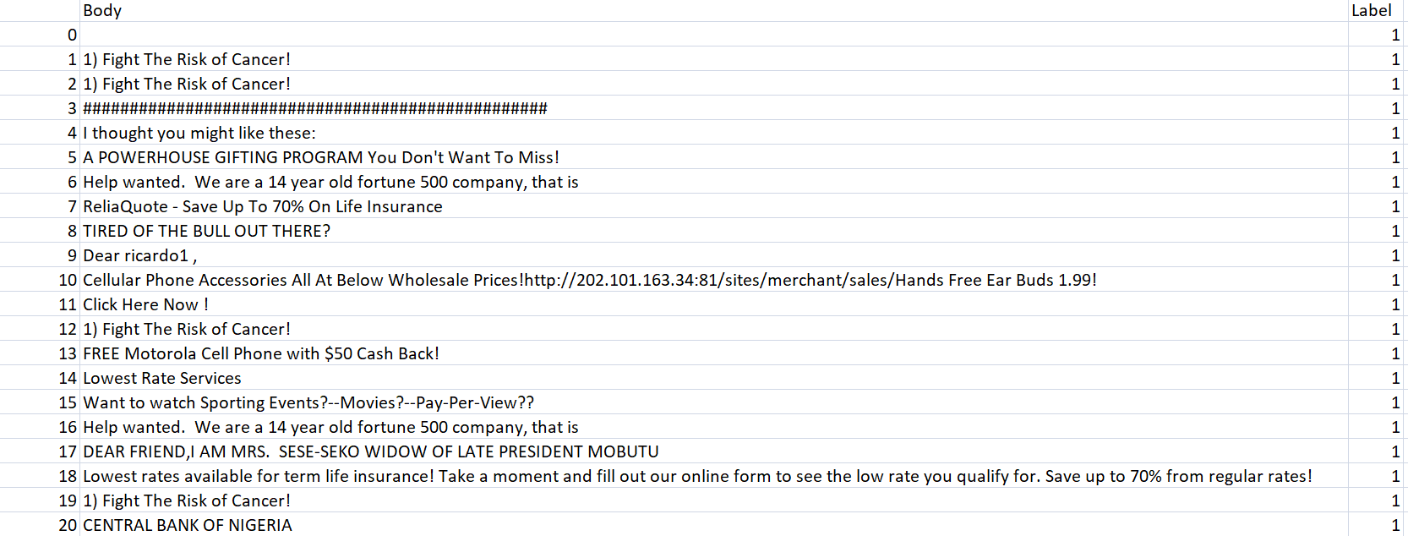
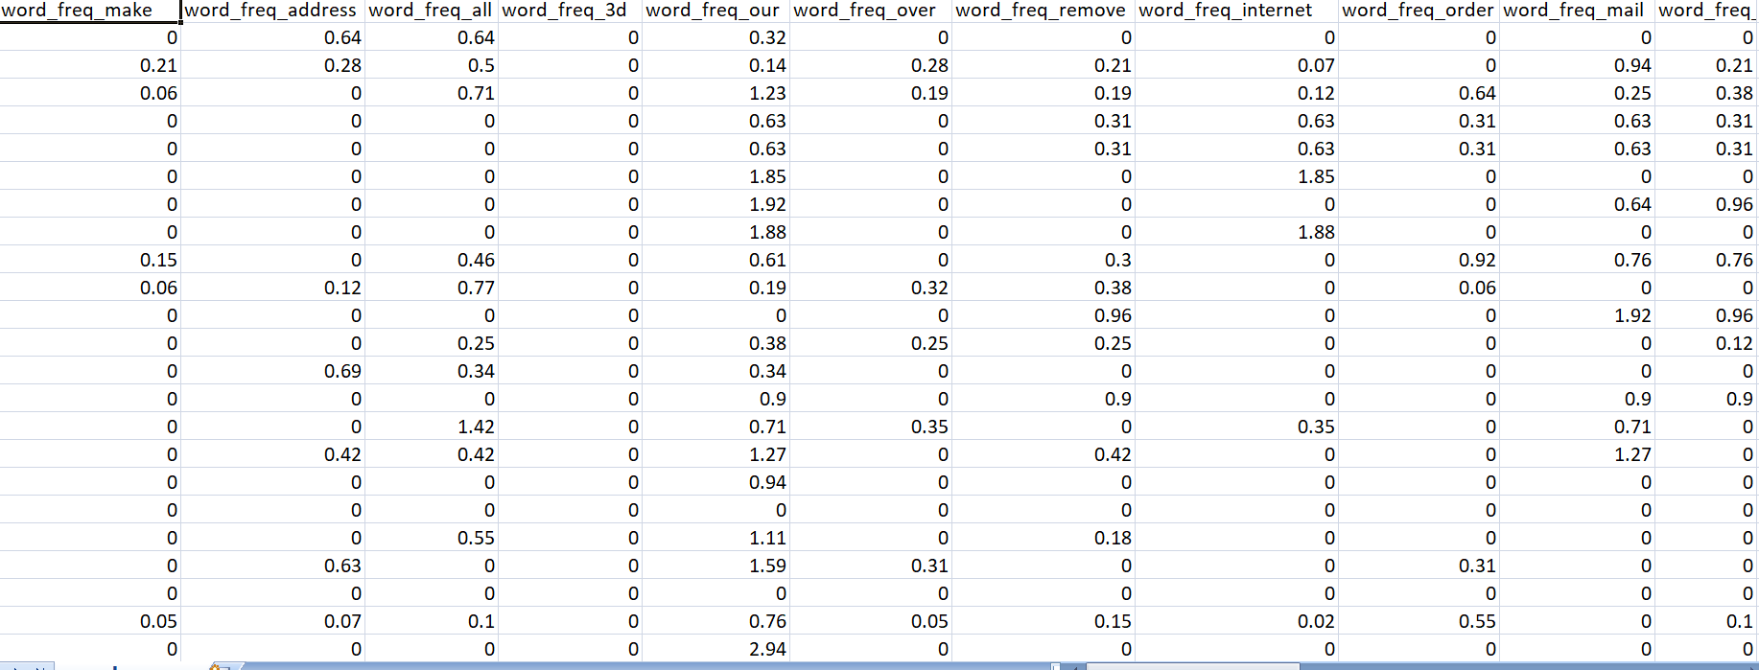
Dataset 1:-
This dataset contains of 3 columns i.e. S.No, Body of the Email, Label.
Dataset 2:-
This dataset contains of 26 columns of frequent words along with their frequency.

Slide 14
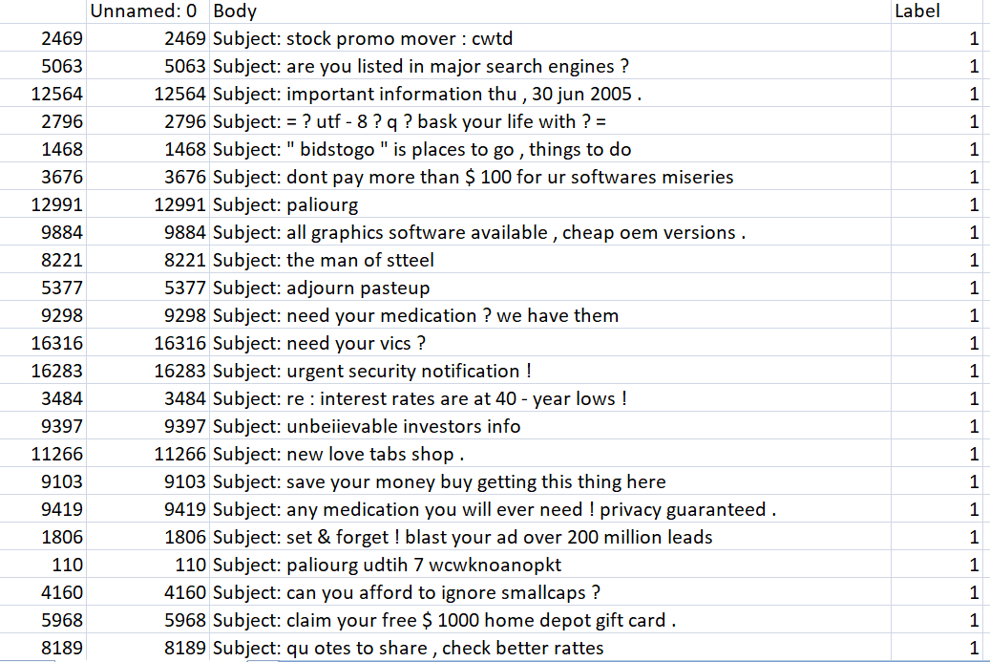
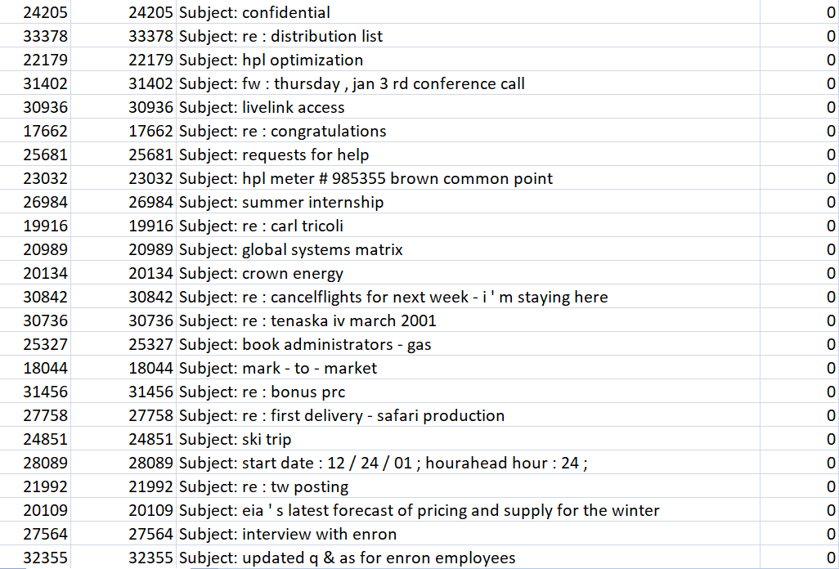
Dataset 3:-
This dataset contains of 4 columns with label as 1 with it is spam and 0 if it is ham mail.

Slide 15
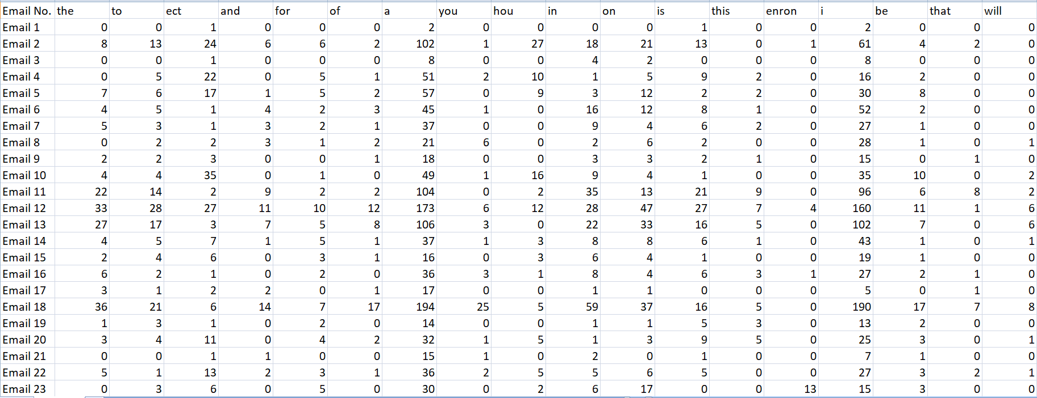
Dataset 4:-
This dataset contains of 3000 columns with frequency of specific words.
Table 1: Details of datasets
Dataset number | No. of rows | No.of columns
Dataset 1 | 22415 | 3
Dataset 2 | 4601 | 58
Dataset 3 | 10766 | 4
Dataset 4 | 5172 | 3000

Slide 16
METHODOLOGY

Slide 17
SUPERVISED MACHINE LEARNING
Supervised learning is defined as machines that are trained using well "labelled" training data.
On basis of that labeled data, machines predict the output.
Supervised learning is a process of providing input data as well as correct output data to the machine learning model.
As input data is fed into the model, it adjusts its weights until the model has been fitted appropriately.
The aim of a supervised learning algorithm is to find a mapping function to map the input variable(x) with the output variable(y).
EXAMPLES : Risk Assessment, Image classification, Fraud Detection, spam filtering, etc.
Supervised learning can be separated into two types : 1)Classification
2)Regression
So, Spam detection comes under the classification that classifies the email as Spam or Ham. The algorithms used are : 1) K-Nearest Neighbor (KNN),
2)Naive Bayes,
3)Decision Tree
4)Support Vector Machine (SVM)

Slide 18
K-Nearest Neighbour Algorithm (KNN)
K-Nearest Neighbour is one of the simplest Machine Learning algorithms based on Supervised Learning technique.
KNN algorithm assumes the similarity between the new case/data and available cases and put the new case into the category that is most similar to the available categories.
KNN algorithm stores all the available data and classifies a new data point based on the similarity.
KNN algorithm can be used for Regression as well as for Classification but mostly it is used for the Classification problems.
KNN is a non-parametric algorithm and also called a lazy learner algorithm .
Working :
Step-1: Select the number K of the neighbors
Step-2: Calculate the Euclidean distance of K number of neighbors
Step-3: Take the K nearest neighbors as per the calculated Euclidean distance.
Step-4: Among these k neighbors, count the number of the data points in each category.
Step-5: Assign the new data points to that category for which the number of the neighbor is maximum.
Step-6: Our model is ready.

Slide 19
Naïve Bayes
Naïve Bayes algorithm is a supervised learning algorithm, which is based on Bayes theorem and used for solving classification problems.
It is a probabilistic classifier, which means it predicts on the basis of the probability of an object.
EXAMPLES : spam filtration, Sentimental analysis, and classifying articles.
The Naïve Bayes algorithm is comprised of two words Naïve and Bayes, Which can be described as:
Naïve: It is called Naïve because it assumes that the occurrence of a certain feature is independent of the occurrence of other features.
Bayes: It is called Bayes because it depends on the principle of Bayes' Theorem
Bayes' Theorem : Bayes' theorem is also known as Bayes' Rule or Bayes' law, which is used to determine the probability of a hypothesis with prior knowledge. It depends on the conditional probability.
P(B/A)=P(A/B)*P(B)/P(A)

Slide 20
Decision Tree
Decision Tree is a Supervised learning technique that can be used for both classification and Regression problems.
It is a tree-structured classifier, where internal nodes represent the features of a dataset, branches represent the decision rules and each leaf node represents the outcome.
In a Decision tree, there are two nodes, which are the Decision Node and Leaf Node.
Decision tree simply asks a question, and based on the answer (Yes/No), it further split the tree into subtrees.
Working :
Step-1: Begin the tree with the root node, says S, which contains the complete dataset.
Step-2: Find the best attribute in the dataset using Attribute Selection Measure (ASM).
Step-3: Divide the S into subsets that contains possible values for the best attributes.
Step-4: Generate the decision tree node, which contains the best attribute.
Step-5: Recursively make new decision trees using the subsets of the dataset created in step -3. Continue this process until a stage is reached where you cannot further classify the nodes and called the final node as a leaf node.

Slide 21
Support Vector Machine(SVM)
Support Vector Machine (SVM) is one of the most popular Supervised Learning algorithms, which is used for Classification as well as Regression problems.
The goal of the SVM algorithm is to create the best line or decision boundary that can segregate n-dimensional space into classes so that it can easily put the new data point in the correct category in the future.
This best decision boundary is called a Hyperplane.
SVM chooses the extreme points/vectors that help in creating the hyperplane. These extreme cases are called as support vectors, and hence algorithm is termed as Support Vector Machine.
Hyperplane: There can be multiple lines/decision boundaries to segregate the classes in n-dimensional space, but it need to find out the best decision boundary that helps to classify the data points. This best boundary is known as the hyperplane of SVM.
Support Vectors:The data points or vectors that are the closest to the hyperplane and which affect the position of the hyperplane are termed as Support Vector.

Slide 22
RESULTS & DISCUSSION

Slide 23
A framework with the combination of the experts and machine learning techniques collaboratively performed well in detecting spam on social networks.
It is difficult to detect spam using only machine learning because of various problems encountered in reality. When only experts are involved in spam detection, it leads to the more time-consuming or costly expenses that can be problematic.
The study results in several different observations especially in the realm of Machine Learning based proposition.
It is observed that better consistency in the performance of the model is through supervised approaches.
SVM and Naïve Bayes are performed well comparing to Decision Tree and KNN.
Support Vector Machines (SVM) performed with the ‘Test Accuracy’ of 97. 44% and Naive Bayes (NB) with 94. 57%.

Slide 25
CONCLUSION

Slide 26
In a security point of view, classification of emails as a spam and ham has most important for the users.
All the classification techniques have to be trained first in separating spam emails from other emails before they are actually used. A data set called training set is used to train these techniques.
But even after this much work spam mail still persists. They persist because every day a new kind of spam mail is introduced. Thus, even if it can get old spam mail sorted and marked, new one keep coming in.
One of the solutions is to make the training set up-to-date by gathering information about the new kind of spam mail. If it is successful in doing so it will have the spam mail dealt with before it reaches our mailbox.
This will also save our time and inbox will be less crowded thus making it easier to find useful emails.
Finally, Machine Learning especially supervised learning plays a key role in this classification process for detecting the Spam Mail in real life.

Slide 27
References
[1] J. Choi and C. Jeon, "Cost-Based Heterogeneous Learning Framework for Real-Time Spam Detection in Social Networks With Expert Decisions," in IEEE Access, vol. 9, pp. 103573-103587, 2021, doi: 10.1109/ACCESS.2021.3098799.
[2] A. Karim, S. Azam, B. Shanmugam, K. Kannoorpatti and M. Alazab, "A Comprehensive Survey for Intelligent Spam Email Detection," in IEEE Access, vol. 7, pp. 168261-168295, 2019, doi: 10.1109/ACCESS.2019.2954791.
[3] S. Gibson, B. Issac, L. Zhang and S. M. Jacob, "Detecting Spam Email With Machine Learning Optimized With Bio-Inspired Metaheuristic Algorithms," in IEEE Access, vol. 8, pp. 187914-187932, 2020, doi: 10.1109/ACCESS.2020.3030751.
[4] Z. Zhang, R. Hou and J. Yang, "Detection of Social Network Spam Based on Improved Extreme Learning Machine," in IEEE Access, vol. 8, pp. 112003-112014, 2020, doi: 10.1109/ACCESS.2020.3002940.
[5] T. Xia, "A Constant Time Complexity Spam Detection Algorithm for Boosting Throughput on Rule-Based Filtering Systems," in IEEE Access, vol. 8, pp. 82653-82661, 2020, doi: 10.1109/ACCESS.2020.2991328.
[6] Rakesh Nayak and Salim {Amirali Jiwani} and B. Rajitha, " Spam email detection using machine learning algorithm",in Sciencedirect,Materials Today: Proceedings,ISSN 2214-7853,https://doi.org/10.1016/j.matpr.2021.03.147,2021

Slide 28


