Slide 1
Power BI Dashboard — Summary & Build Guide (Sample)
Generated from uploaded dataset: Recent_Sales_Financial_Dataset.csv
Created on 2025-09-25 05:53:00

Slide 2
Dataset Snapshot
Rows: 300
Columns: 11
Detected columns (sample): Order_ID, Product, Region, Sales_Channel, Customer_Type, Units_Sold

Slide 3
Key KPIs (sample calculations)
Total Sales: 36,153,250.00
Total Profit: 15,208,065.02
Profit Margin: 0.42

Slide 4
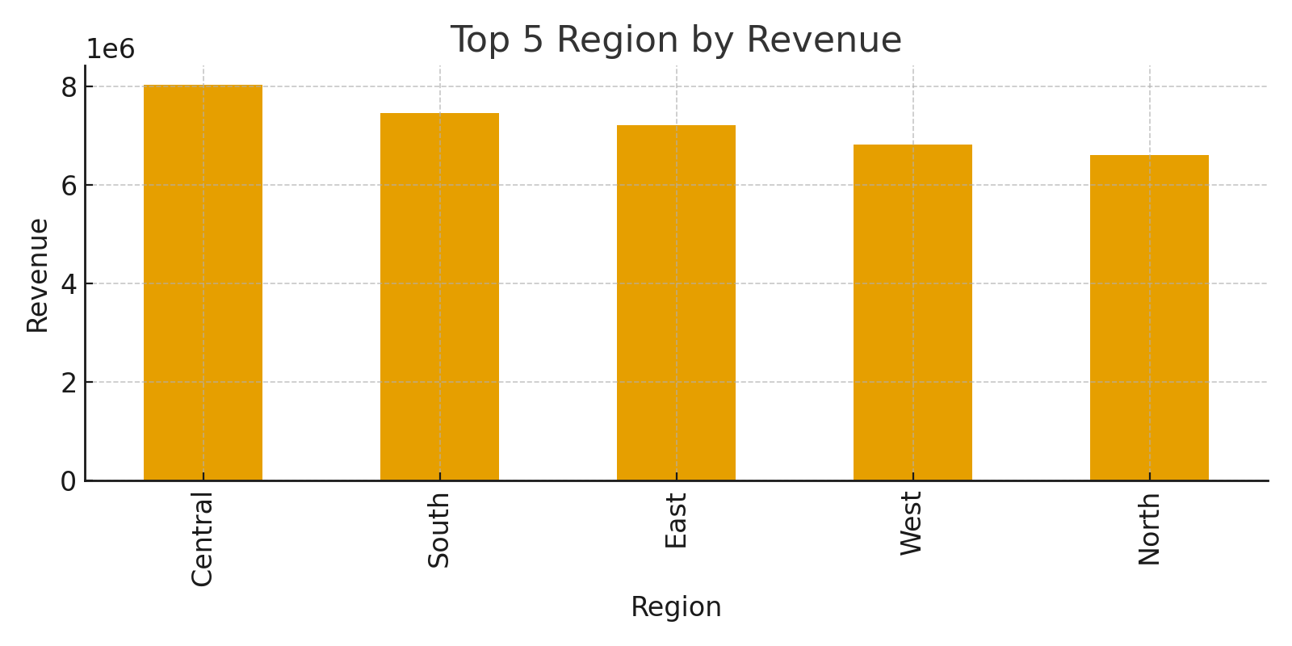
Chart By Region

Slide 5
Recommendations & Next Steps
- Use these KPIs on cards at the top of the dashboard
- Add slicers for Date, Region, Category, and Customer
- Use bookmarks and buttons for a navigation menu
- Publish to Power BI Service and set scheduled refresh
- Validate measures with small sample checks

