Slide 1

Sprocket Central Pty Ltd
Data analytics approach
Poulami Bakshi

Slide 2
Agenda
Introduction
Data Exploration
Model Development
Interpretation

Slide 3
Introduction
Identify and Recommend Top 1000 Customer to Target from Datasets
Outline of Problem
Sprocket Central is a company that Specilizes in high-quality bikes and Cycling accesories.
Their marketing team is looking to boost business sales by analyzing provided datasets.
Using the 3 datasets provided the aim is to analyze and recommend 1000 customers that Sprcket Central should Target to drive higher value for the company.
Content of Data Analysis
‘New’ and ‘Old Customer Age Distribution
Bike related purchases over the last 3 years by gender
Job industry distribution
Wealth segmentation by age category
Number of cars owned and not owned by state
RFM analysis and customer classification

Slide 4
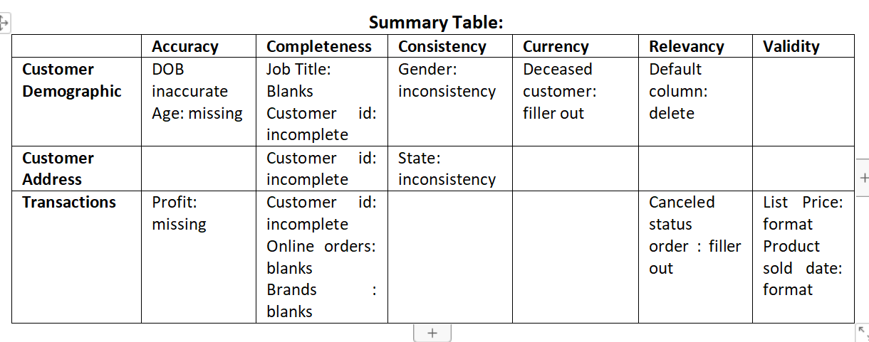
Data Exploration
Data Quality Assessment and ‘Clean Up’
Key Issues for Data Quality Assessment
Accuracy: Correct Values
Completeness: Data fields with values
Consistency: Values free from Contradiction
Currency: Values up to date
Relevancy: Data items withvalue Meta-data
Validity: Data Containing Allowable Values
Uniquesness: Records that are duplicated
Details analysis sent via email.

Slide 5
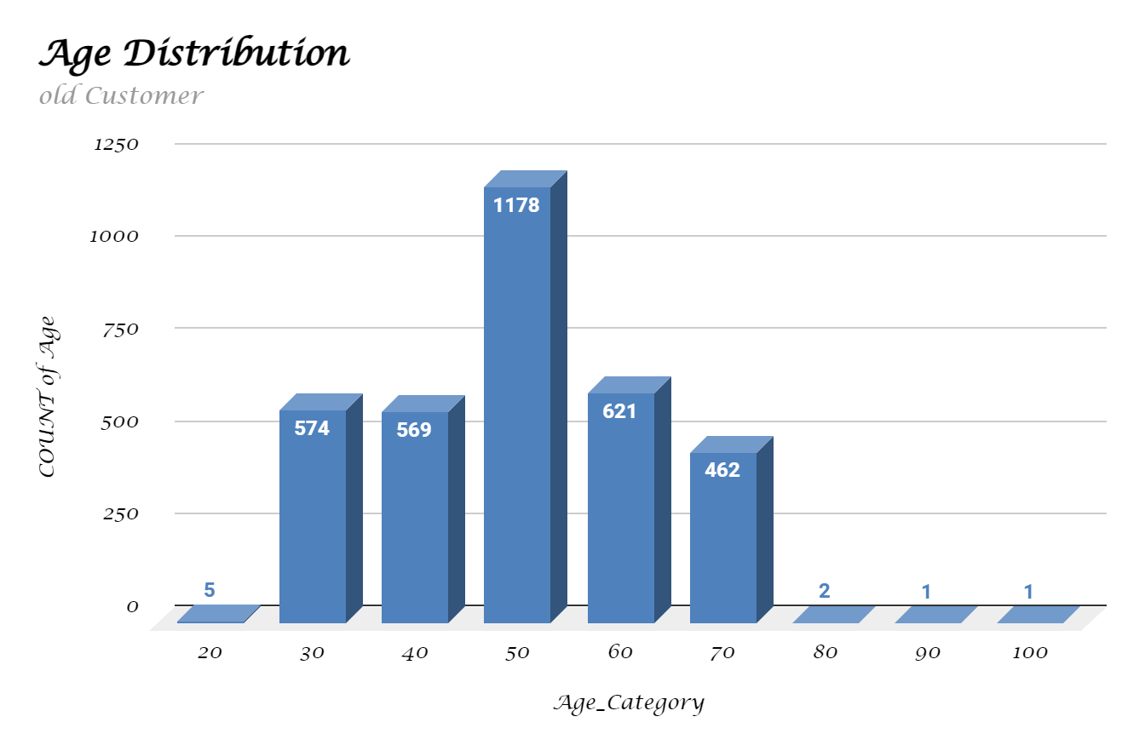
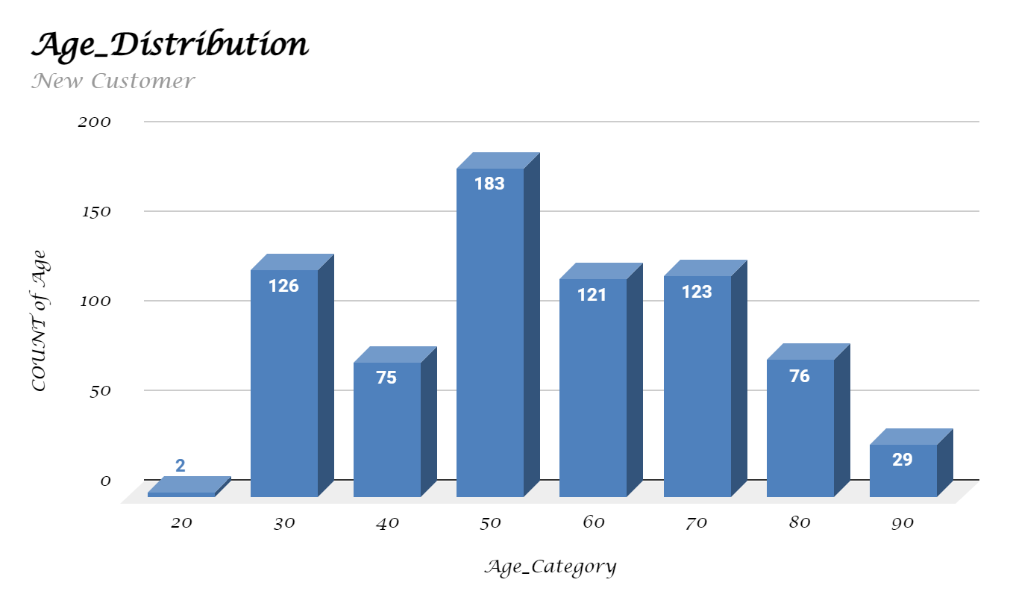
Data Exploration
‘New’ and ‘Old’ Customer Age
Distributions
Most customer are aged between 50-60 in ‘New’ . In ‘old’ majority of customets are between 50-60 also.
The lowest age groups are under 20 and 80+ for both ‘New’ and ‘Old’ customer list.
Their is a steep drop in 31-49 age group in ‘New’ customer list.
The ‘old’ customer list suggest 30-70.

Slide 6
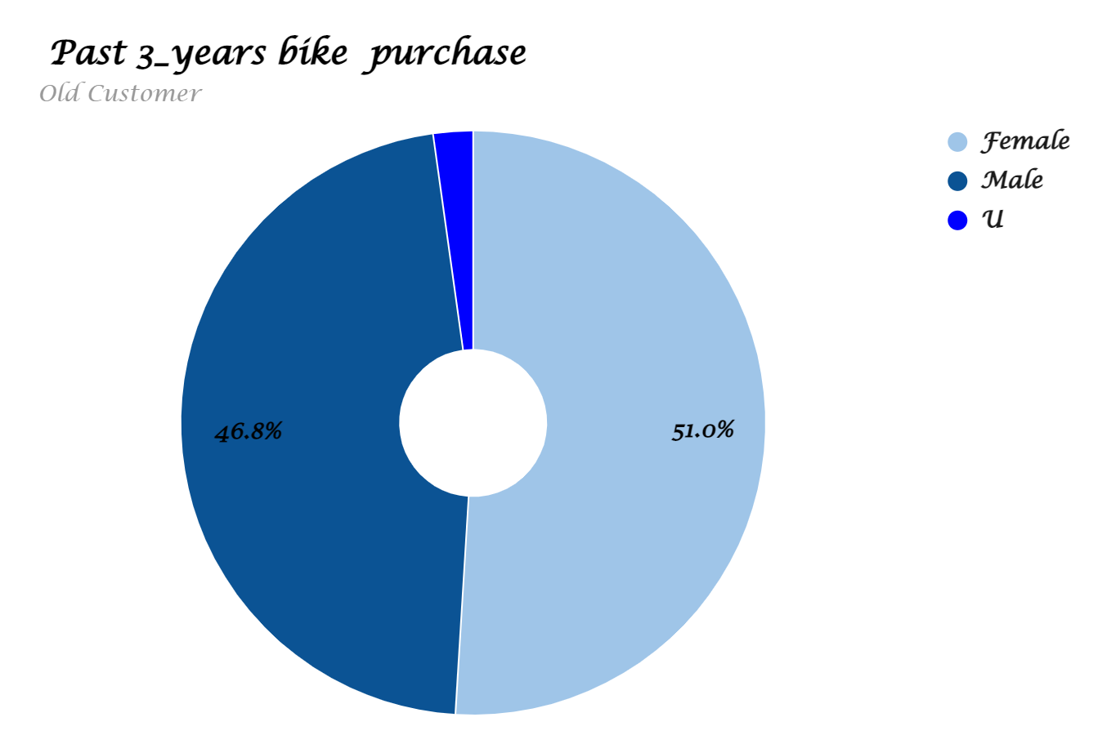
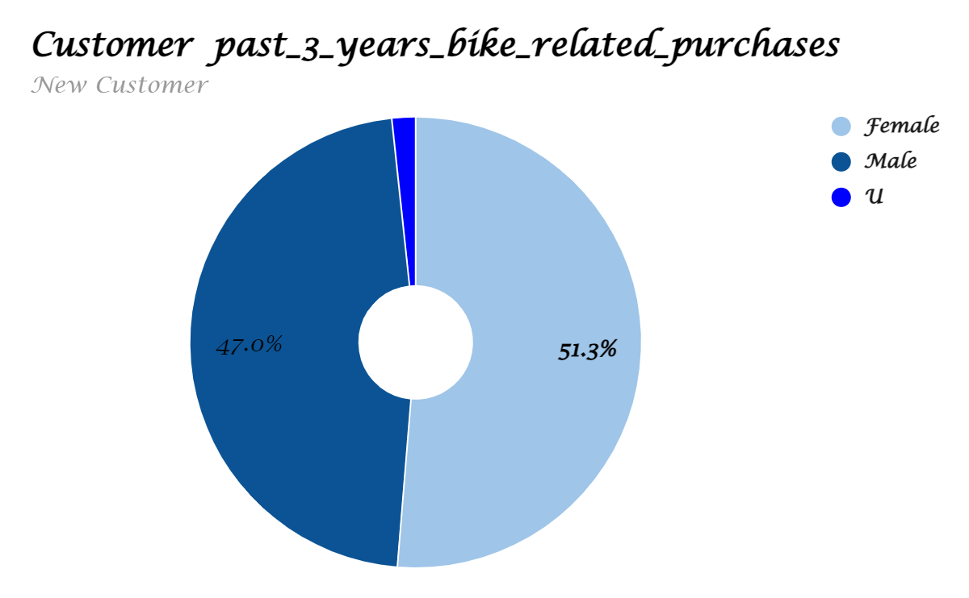
Data Exploration
Bike related purchases over
last 3 years by gender
Over the last three years about 50% of bike related purchases were made by females to 48% of purchases made by males. Apporx 2% were made by unknown gender.
Numerically, females purchases almost 10000 more than males.
Females make up majority of bike related sales.

Slide 7
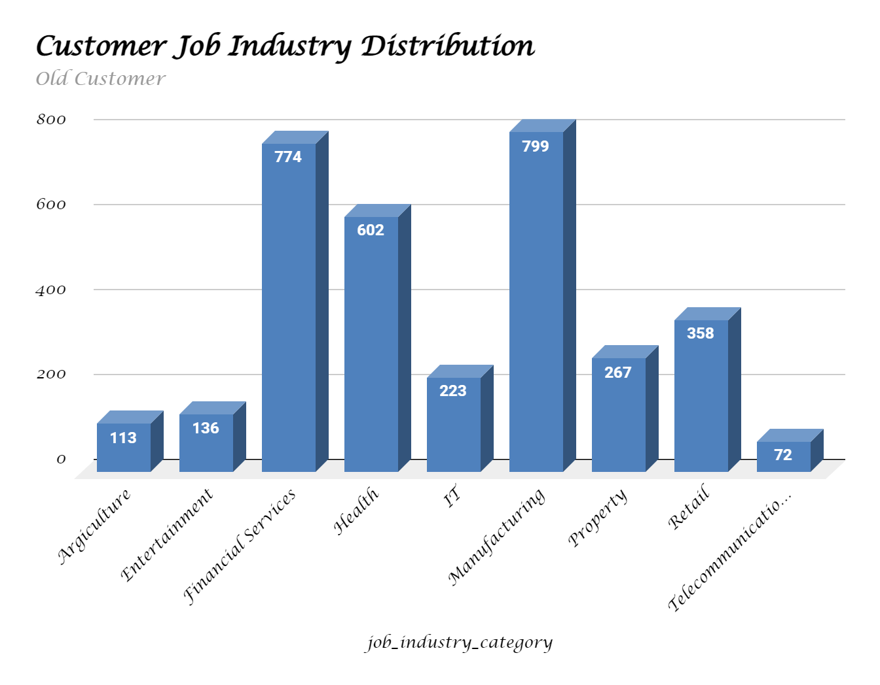
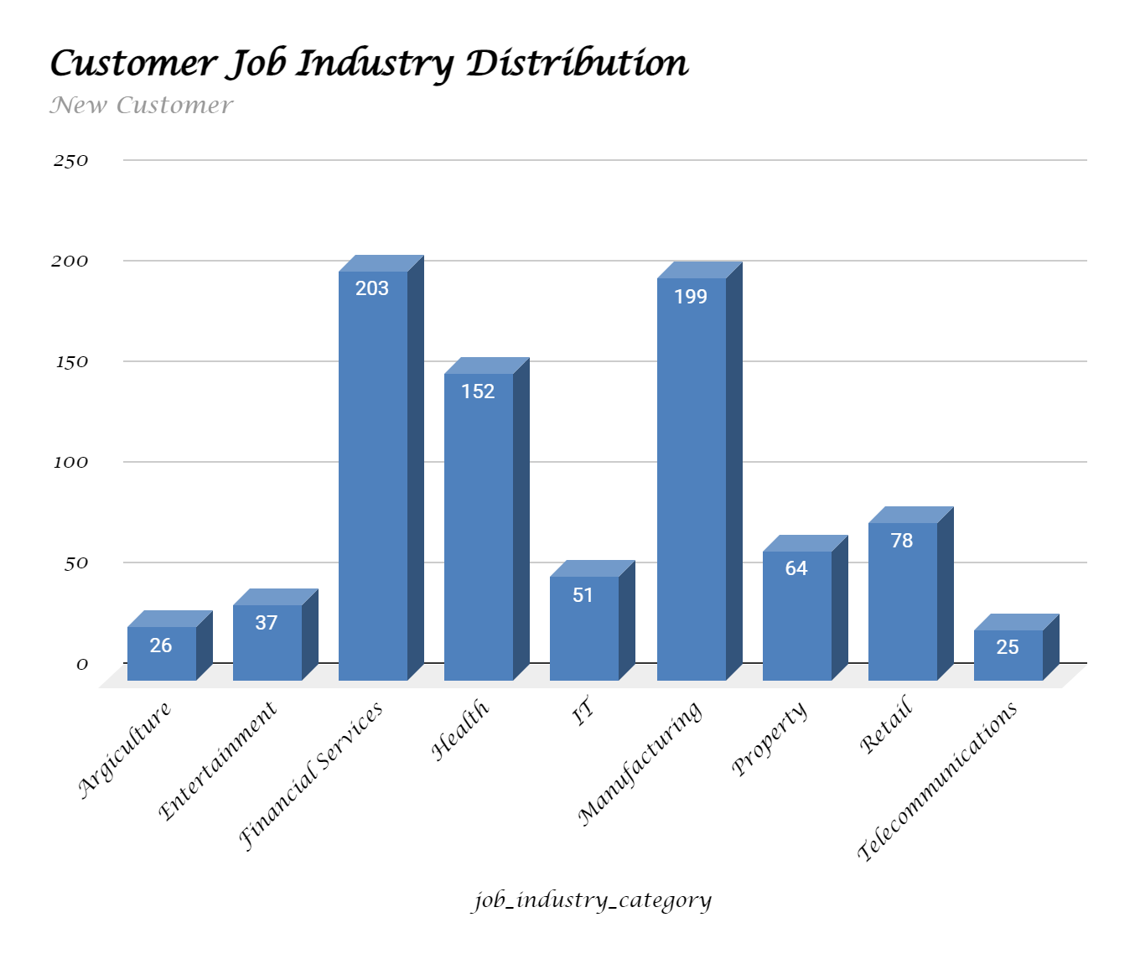
Data Exploration
Job Industry Distribution
20% of ‘New’ Customer are in Manufacturing and Financial Services.
The smallest number of customers are in Agriculture and Telecommunications.
Similar pattern in ‘Old’ and ‘New’ Customer list.

Slide 8
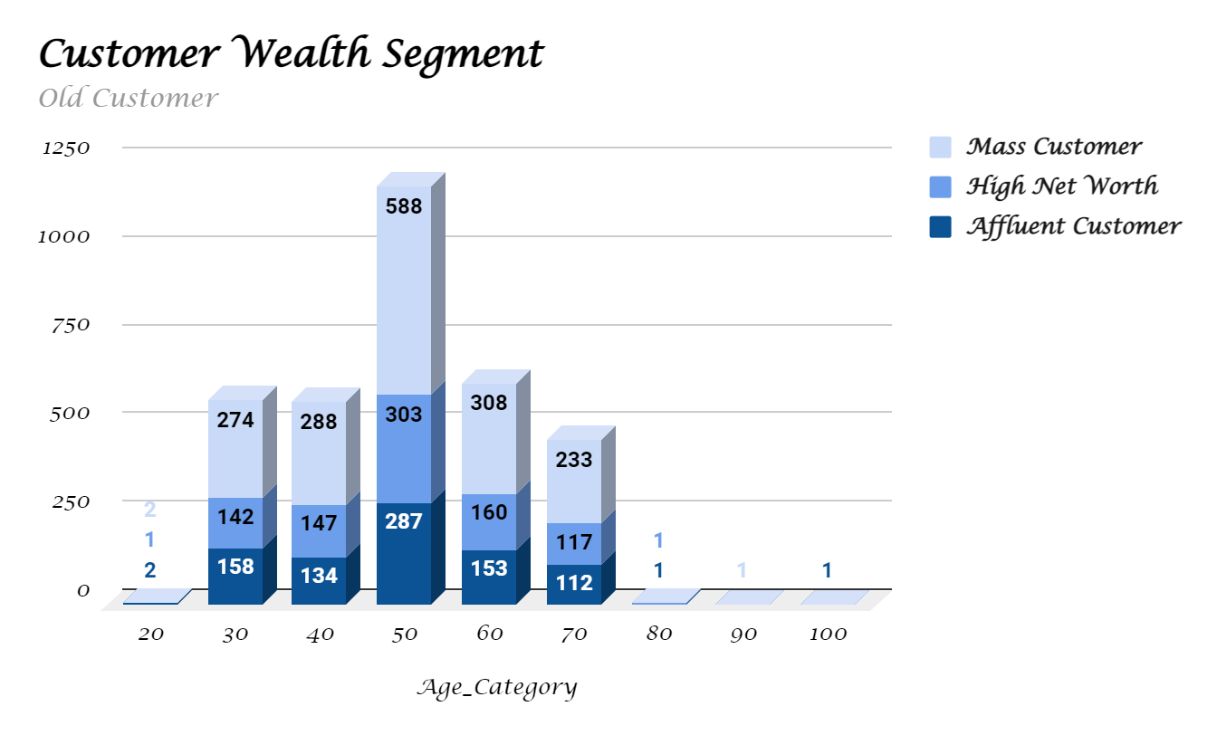
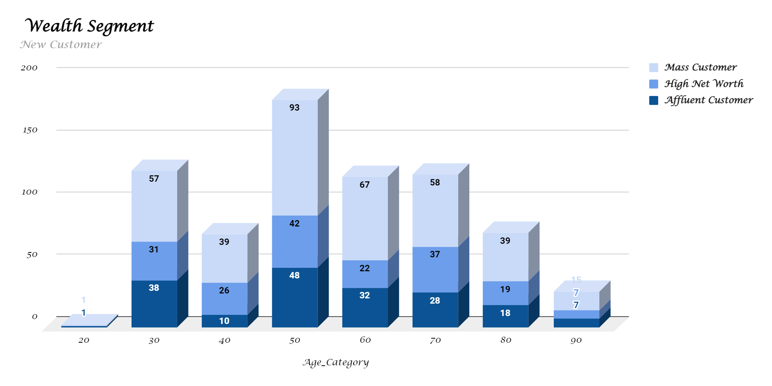
Data Exploration
Wealth Segmentation
by age category
In all age categories the largest number of customers are classified as ‘Mass Customer’.
The next category is the ‘High Net Worth’ customers.
The ‘Affluent Customer’ can outperforms the ‘High Net worth’ customer in the 40-49 age group.

Slide 9
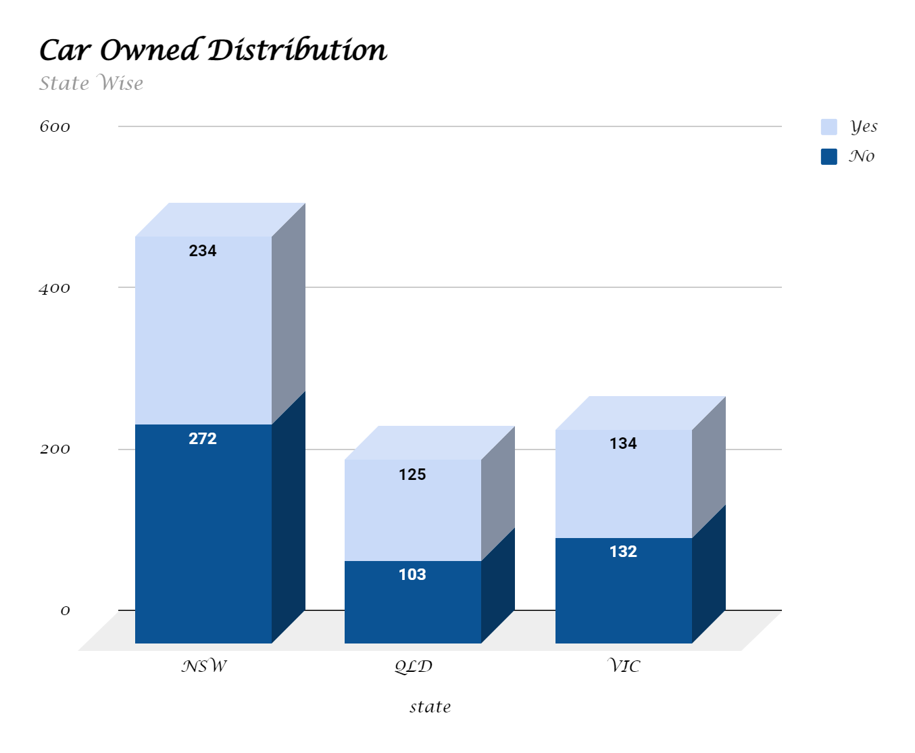
Data Exploration
Number of Cars owned and not owned by state.
NSW has the largest amount of people that do not own acar.NSW seems to have a higher number of paople from which data is collected.
Victoria is also split quite evenly. But both the numbers are significantly lower than those of NSW.
QLD has a relatively high number of customers that own a car

Slide 10
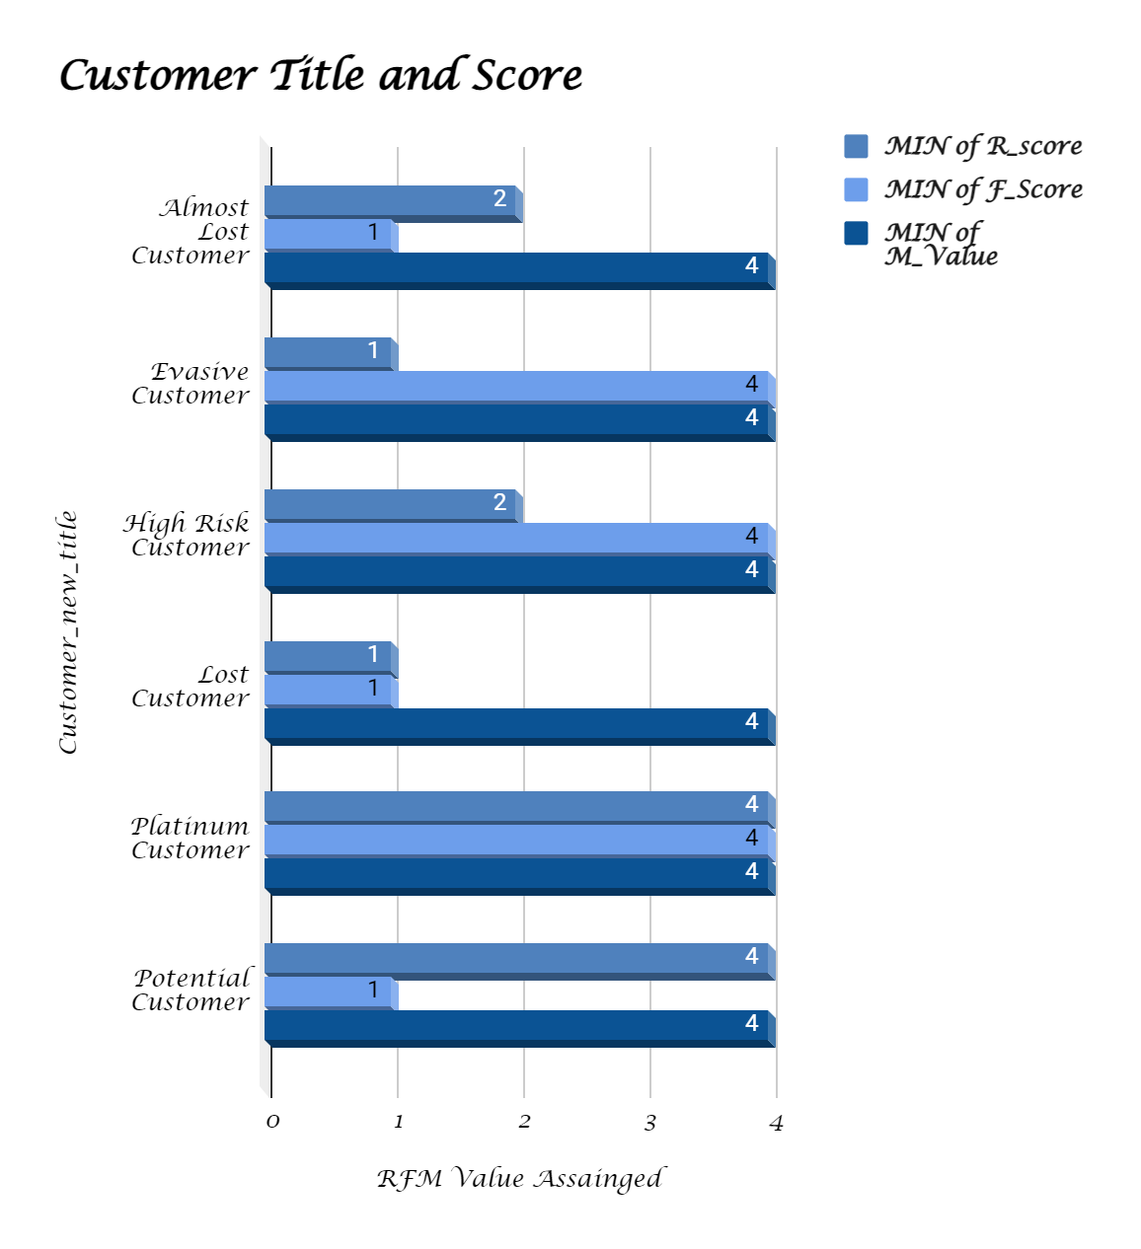
Model Development
RFM Analysis and Customer
Classification
RFM analysis is used to determine which customers a business should target to increase its revenue and value.
The RFM(Recency, Frequency, and Monetary) model shows customers that have displayed high levels of engagement with the business in three categories mentioned.

Slide 11
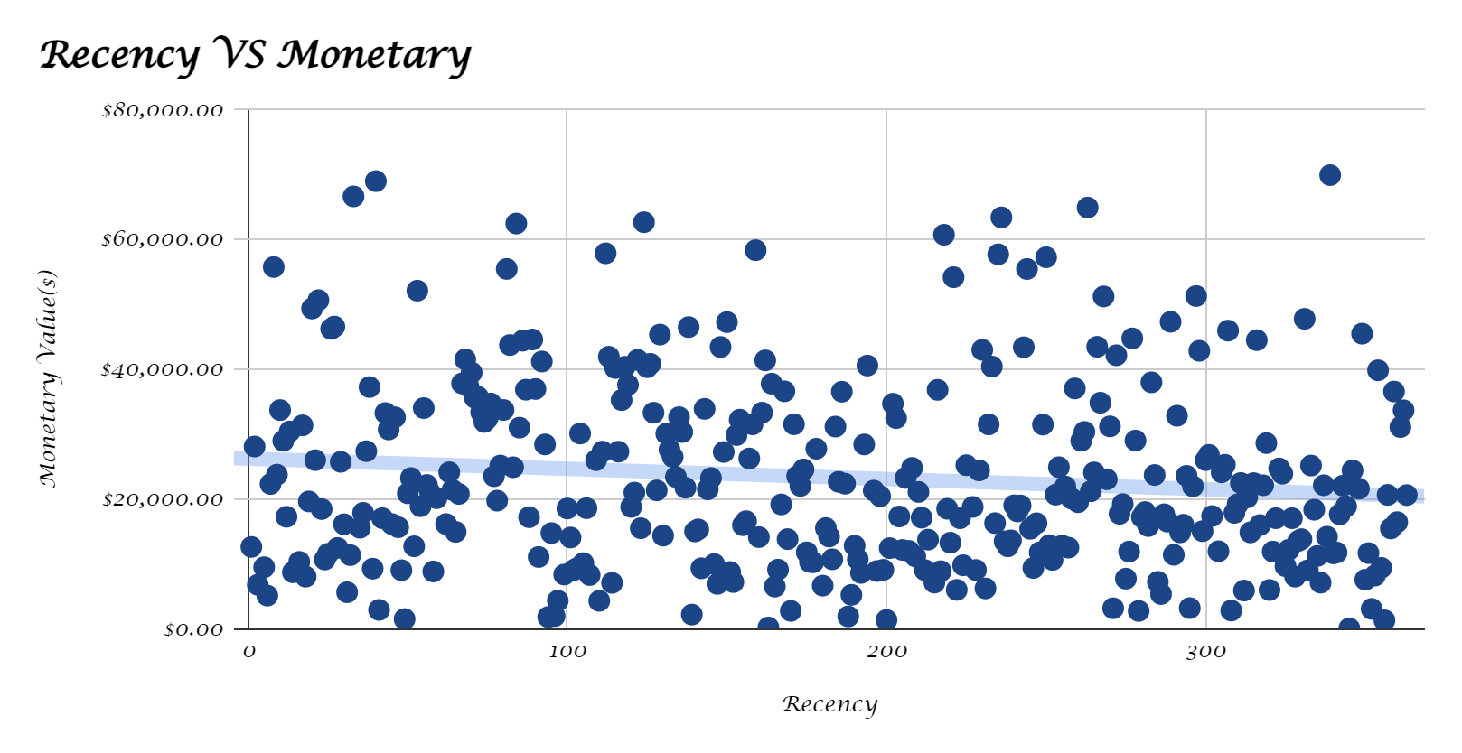
Model Development
Scatter-Plot based off RFM Analysis
The chart shows that customers who purchased more recently have generated more revenue, than customer who visited a while ago.
Customers from recent past(50-100 days) are shows to generate almost same revenue as of the customer who are older.

Slide 12
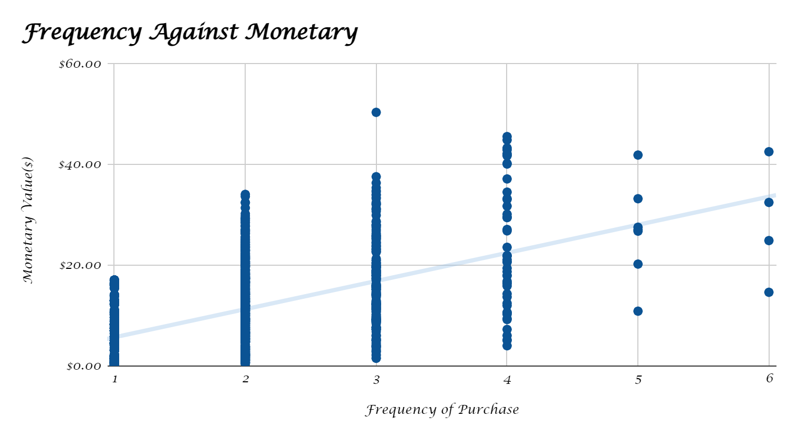
Model Development
Scatter-Plot based off RFM
Analysis
Customer classified as “platinum customer”, “Loyal Customer” who visited frequently, which correlated with increased revenue for the business
Naturally, there is a positive relationship between frequency and monetary gain for the business.

Slide 13
Appendix

