Slide 1
Countries in need of aid
Poulomi Mukherjee

Slide 2
Agenda
In this presentation, we shall discuss about below mentioned points.
Objective
Child mortality rate across the world
Child mortality in each of the clusters
GDPP across the countries
Cluster-wise distribution of GDPP
Country-wise average income
Distribution of income across various clusters
Comparison of GDPP, Child Mortality and Income amongst clusters
Child mortality Vs. Income / GDPP for countries that need aid
Conclusion

Slide 3
Objective
As, HELP International is an international humanitarian NGO that is committed to fighting poverty and providing the people of backward countries with basic amenities and relief during the time of disasters and natural calamities. We need to find out the following to prevent above challenges in the world.
Short listing the countries that are in the direst need of aid
Categorize the countries using socio-economic and health factors

Slide 4
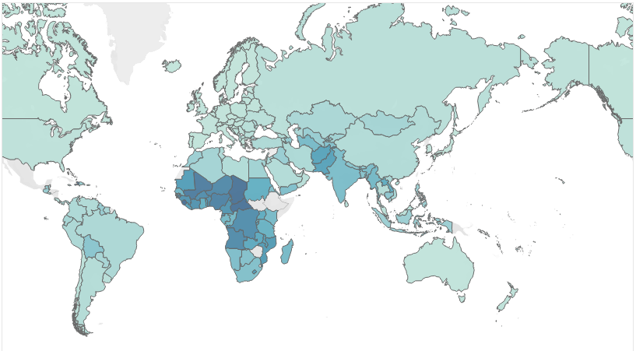
Child mortality rate across the world

Slide 5
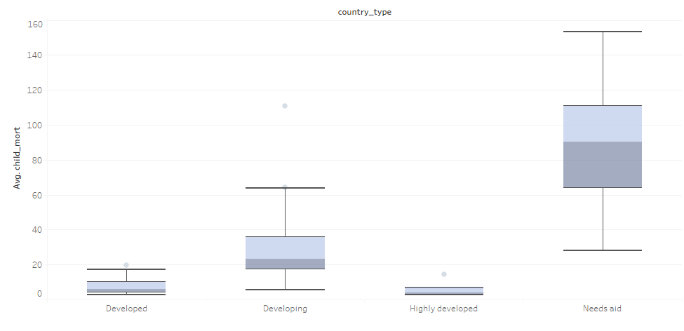
Child mortality in each of the clusters

Slide 6
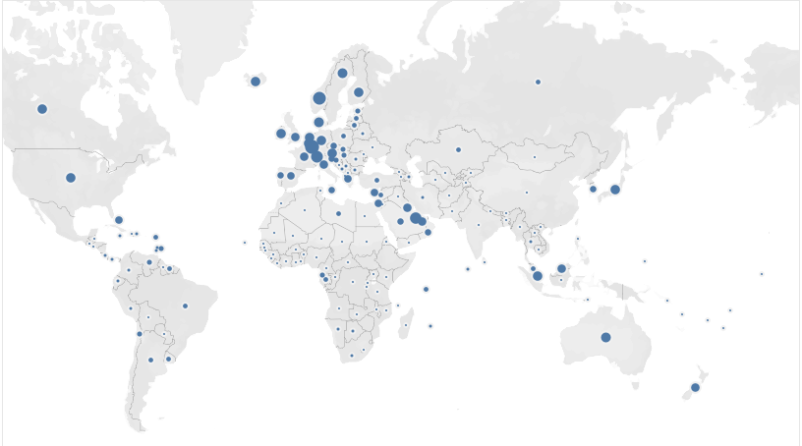
GDPP across the countries

Slide 7
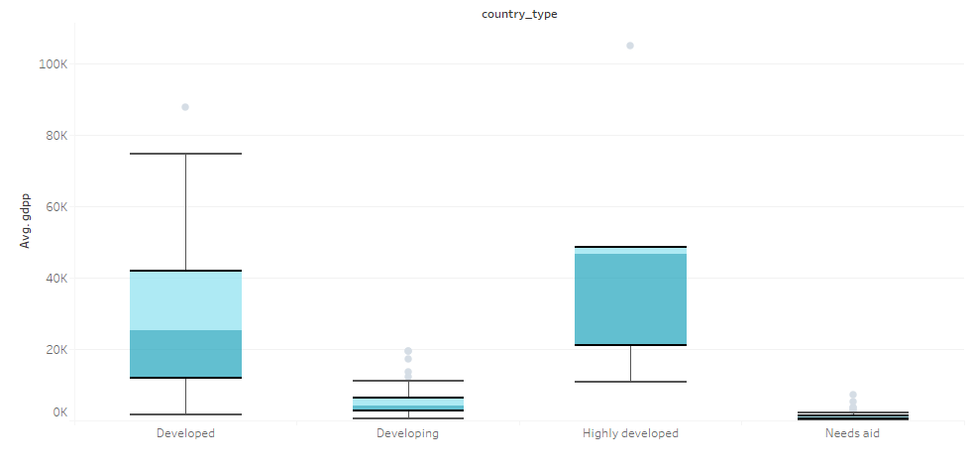
Cluster-wise distribution of GDPP

Slide 8
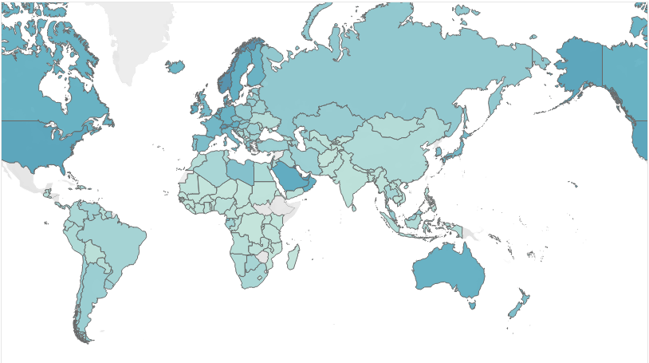
Country-wise average income

Slide 9
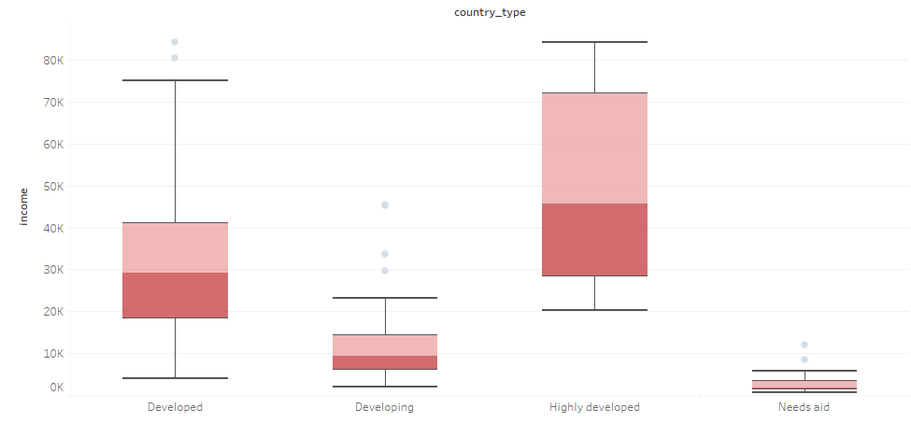
Distribution of income across various clusters

Slide 10
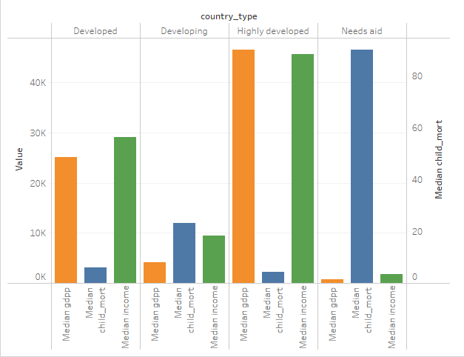
Comparison of GDPP, Child Mortality and Income amongst clusters

Slide 11
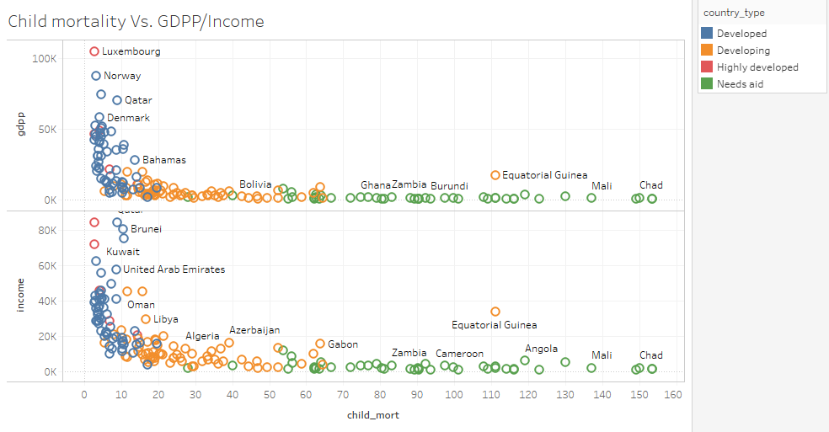
Comparison of GDPP, Child Mortality and Income amongst clusters

Slide 12
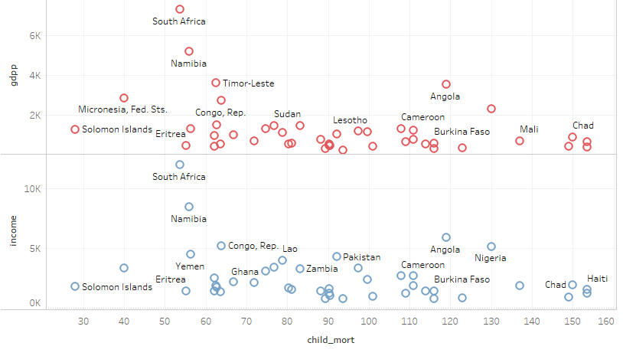
Child mortality Vs. Income / GDPP for countries that need aid

Slide 13
Conclusion
Some of the countries that are in urgent need of aid are:
Central African Republic
Sierra Leone
Haiti
Chad
Congo, Dem. Rep.
Niger
Mali
Burundi
Burkina Faso
Liberia, and more

Slide 14
Thank You

