Slide 1
ITK Engineering
AutoRelease
Rollout, Getting Started & Quick Reference

Slide 2
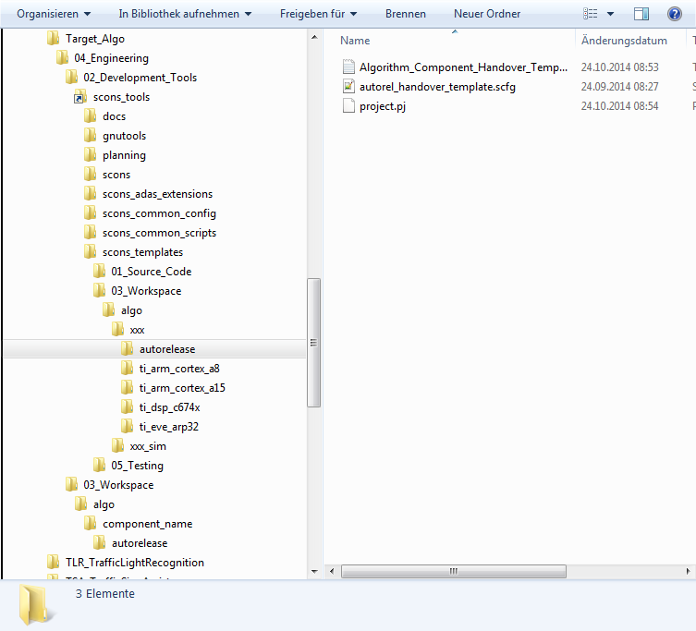
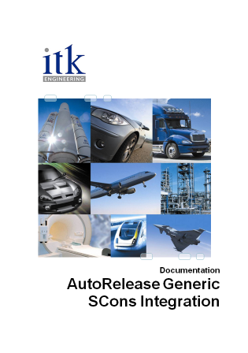
AutoRelease Rollout 1
Create the folder \04_Engineering\03_Workspace\algo\component_name\autorelease
Copy \02_Development_Tools\scons_tools\scons_templates\03_Workspace\algo\xxx\autorelease\ autorel_handover_template.scfg to the new folder. This is the AutoRelease configuration file.
Rename it: autorel_handover.scfg
Edit the configuration file, refer to SCons_auto_release_integration.docx, chapter 3
Add configuration to MKS: Add Members…/Add Directory/ “autorelease”

Slide 3
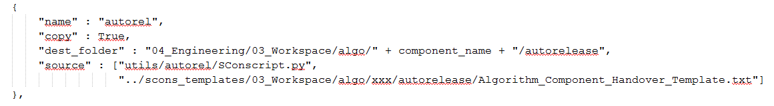
AutoRelease Rollout 2
Copy the following text block from \02_Development_Tools\scons_tools\scons_templates\03_Workspace\algo\xxx\ sconscript_setup_config.scfg
to the file \03_Workspace\algo\component_name\sconscript_setup_config.scfg
Check-in changes to MKS

Slide 4
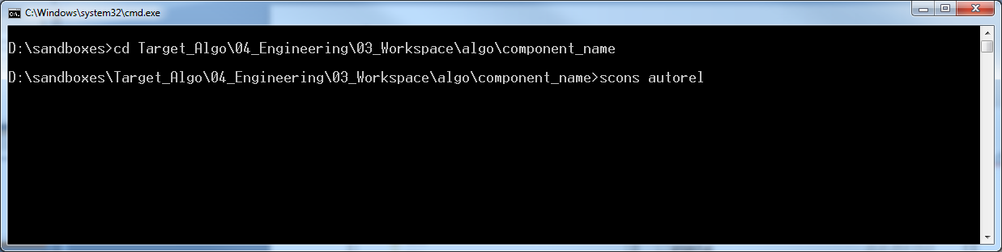
AutoRelease Rollout 3
Add the following line to \03_Workspace\algo\component_name\sconstruct_config.scfg # support AutoRelease autorel_support = True
Check-in changes in MKS
Now AutoRelease can be started typing the command “scons autorel” in \03_Workspace\algo\component_name

Slide 5
AutoRelease Overview
Minimum Pre-Conditions
Before the script is started ensure the following pre-conditions are met.
Access to the MKS server must be available (ports 7001 & 7002)
At least the configured build targets (autorelease/autorel_handover.scfg) compile without errors. Otherwise the script will terminate in that particular step which is annoying.
The ECU evmhil targets were built before the script is started. This is needed for collecting ram/rom usages.
Configuration of the dynamic part in “autorelease/autorel_handover.scfg” is set and checked in. The AutoRelease configuration must be part of the generated checkpoint. The consistency check will fail if the configuration is not checked in! See also SCons_auto_release_integration.docx (chapter 3) and the brief documentation in the configuration file for further information.

Slide 6
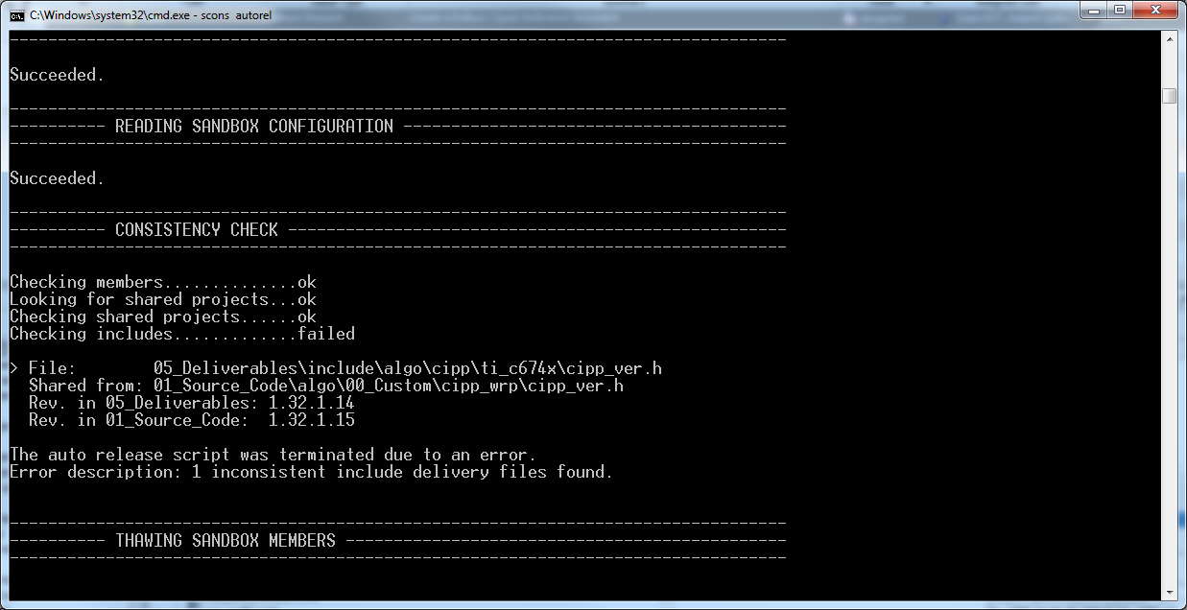
AutoRelease Execution
Start the script (“scons autorel”) and follow the instructions…

Slide 7
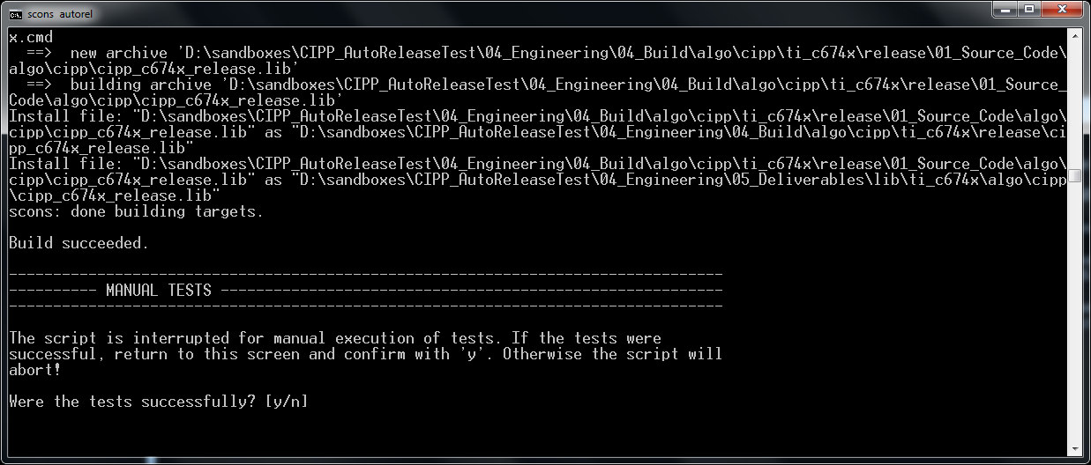
AutoRelease Execution
There is a point (after compilation), when the script execution is interrupted for tests.
This is intended to be used for…
EVM tests
determine runtime/stack usage information
etc.

Slide 8
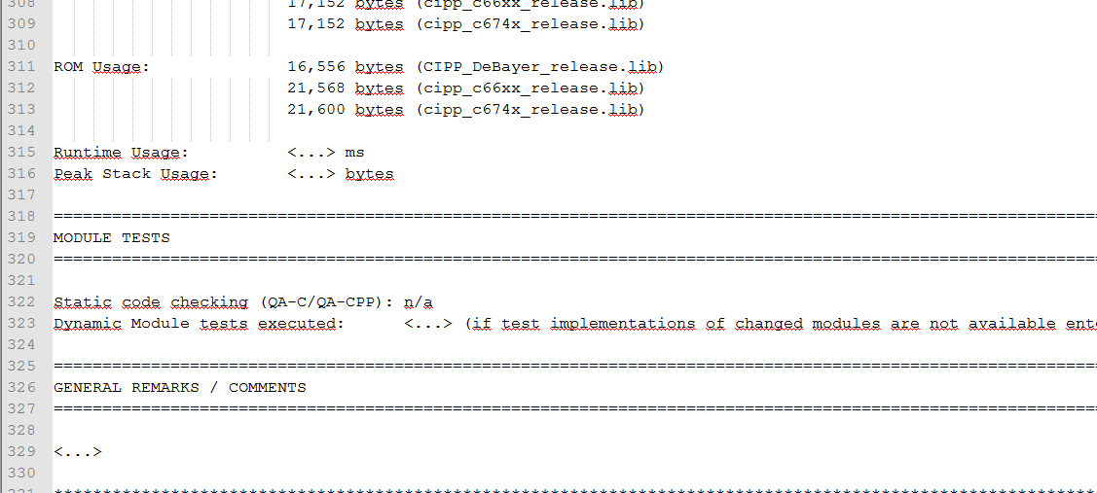
AutoRelease Code Handover
The code handover document is a text format file and opens in the operating systems default text editor.
All the information collected by the script are included. However, there are some places in the document that couldn’t filled by the script. These places are marked by “<…>” and all of them have to be filled, otherwise the script will not accept the code handover document for creating a checkpoint.

Slide 9
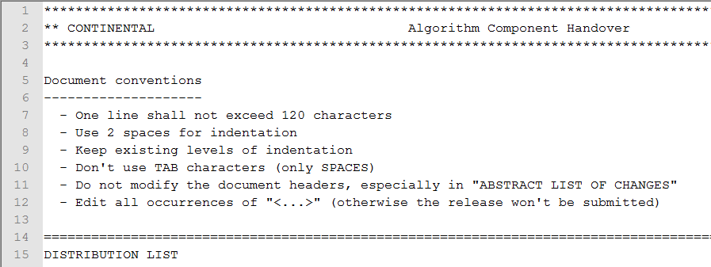
AutoRelease Code Handover
Please respect the editing conventions (rules) at the top of the code handover document!

Slide 10
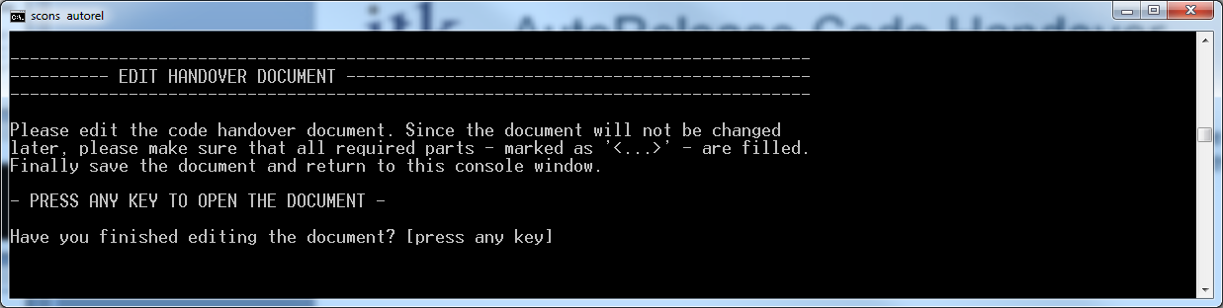
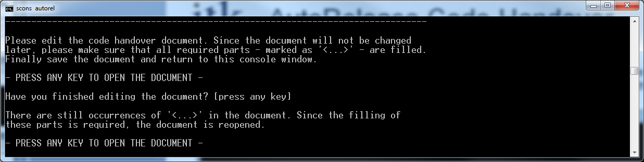
AutoRelease Code Handover
Since the code handover document is a text format file, it is normally not blocked by the editor. Therefore the script is waiting and you have to return to the script’s console window and confirm the modifications.
The handover is checked for occurrences of tabs and non-filled places. If such were found an error is printed and the code handover document is re-opened.

Slide 11
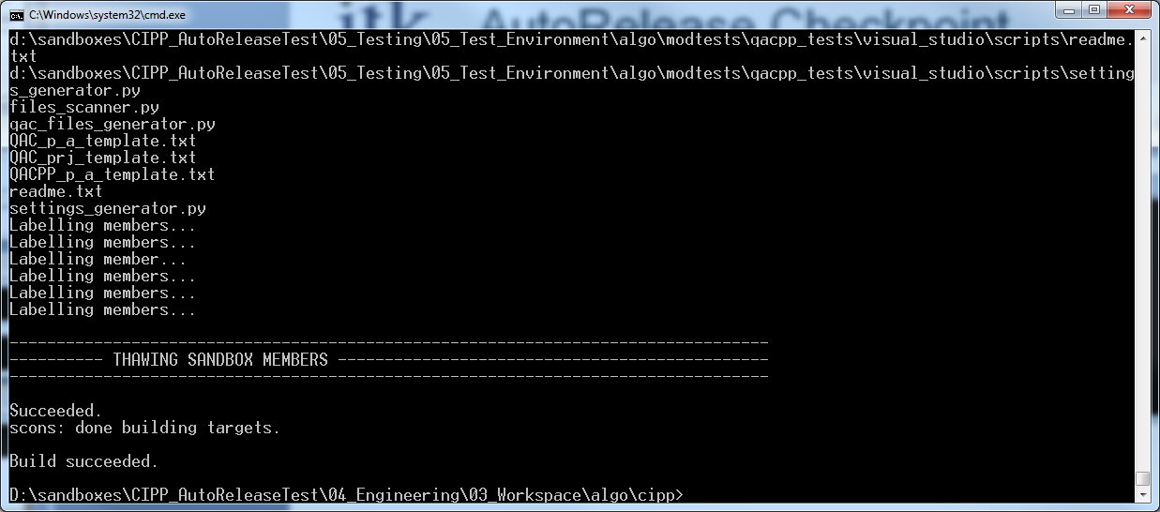
AutoRelease Checkpoint
Finally the checkpoint is generated. Before it starts you have to confirm this step. It is useful to have a look in MKS to make sure everything is as you expect. Finally the script finishes and a status message is printed.

Slide 12
AutoRelease Return Code
Status output
The auto release script returns a numeric code
This code is also returned by SCons an may be used in batch files
There is also clear text output
This gives more information whether the script has been succeeded or failed
The auto release script was terminated due to an error.
Error description: 1 inconsistent files found.
scons: *** [D:\sandboxes\CIPP_AutoReleaseTest\04_Engineering\04_Build\algo\cipp\CIPP_AlgorithmCodeHandover_AutoRelease.docx] Error 1
scons: building terminated because of errors.
Build FAILED!!!!
Error Code
Detailed error description (clear text)

Slide 13
AutoRelease Return Code
Complete list of return codes
Value | Label in script code | Description
0 | AUTOREL_OK | no errors
1 | AUTOREL_ERR_CONSCHECK | consistency check failed
2 | AUTOREL_ERR_LISTCHGP | getting change packages failed (not used anymore due to re-scan feature)
3 | AUTOREL_ERR_VERFILE | the version file was not found
4 | AUTOREL_ERR_INVVERFILE | invalid version file format (unexpected content)
5 | AUTOREL_ERR_LOCKMEM | locking single member failed
6 | AUTOREL_ERR_LOCKDIRS | locking release paths failed
7 | AUTOREL_ERR_WRITEVERFILE | changing version file failed
8 | AUTOREL_ERR_LIBSIZE | libsize files were not found
9 | AUTOREL_ERR_REBUILD | rebuilding libs failed
10 | AUTOREL_ERR_HANDOVER | creating code handover document failed
11 | AUTOREL_ERR_INSTALL | the installation of the code handover failed
12 | AUTOREL_ERR_CHECKIN | check-in failed
13 | AUTOREL_ERR_CHECKPOINT | creating checkpoint failed
14 | AUTOREL_ERR_PROJCONF | parsing xml project configuration failed
15 | AUTOREL_ERR_INV_VERNUM | invalid version number (8 bit unsigned it expected) or max number 255.255.255 (not increasable)
16 | AUTOREL_ERR_ADD_HANDOVER | adding handover to MKS sandbox failed
17 | AUTOREL_ERR_NON_BUILD | shared sub-projects found that are not of type build
18 | AUTOREL_ERR_UPDT_VER_DELIV | updating delivered version file revision failed.
19 | AUTOREL_ERR_FREEZE | Freezing complete sandbox or single member failed. See detailed error message.
20 | AUTOREL_ERR_THAW | Thawing complete sandbox or single member failed. See detailed error message.
21 | AUTOREL_ERR_MANUAL_TEST | Manual tests are declared to be not successful.
100 | AUTOREL_ERR_USERTERM_CP | user terminated the script at change package selection (not used anymore due to re-scan feature)
101 | AUTOREL_ERR_USERTERM_CI | user terminated the script before committing the release

