Slide 1

Generic Scons: Extraction of TI-Tools
Dr. André Fischer
ITK Engineering AG

Slide 2
Motivation
Individual Build Steps
Constituents
Dependencies

Slide 3
Generic Scons: Extraction of TI-Tools
Motivation
Ti Tools are provided by MKS in a zipped form.
→ In order to use them for building they need to be unzipped beforehand.
Status AL_ETK_SCT_01.15.01 and below:
Prior to every Scons build the script 02_Development_Tools\ti_tools\unzip_tools\unzip_tools.bat is called which extracts all TI Tools, if not present.
Disadvantage: They are unzipped no matter if they are needed or not for the build.
Additional info: TI-Tools are not required for PC-simulation, QAC-tests, or Cantata tests → People only working on those topics are still forced to wait untill the extraction has finished before they can build.
Status versions ≥ AL_ETK_SCT_01.16.00
It is not necessary to unzip the TI Tools „by hand“ or by script, Scons takes care of that by analyzing the dependencies between build target and TI Tools.
Also possible: Extracting TI Tools directly by
scons.bat unzip_tools

Slide 4
Generic Scons: Extraction of TI-Tools
Individual Build steps
Remark: Direct integration of the pure extraction steps will not do, see below for explanation.
Actual Build Steps:
Create a symbolic link under C:\tools\Link\ to the folder, where TI Tools shall be extracted (=„Prepare Extraction“ in build log).
Extract TI Tools to the symbolic link just created.
If successful, create unzip_report.txt in the same directory where the archive is located.
Remove symbolic link created in 1.).

Slide 5
Generic Scons: Extraction of TI-Tools
Individual Build steps - Explanation
Justification of symbolic link-workaround:
Problem:
Windows allows only paths of maximum length of 260 characters.
If unzip-tools try to extract a file, s.t. the resulting file has a path name with more characters, it fails.
Some TI archives produce files with very long path names.
If unzip-tools extracted to the actual location, the build would always fail, if sandbox path is too long.
Resolution/Workaround:
Create a symbolic link to the actual location, where TI Tools shall be present, with rather short path.
Extract to the link location. → unzip tool does not report any errors.
In doing so, the extracted files actually end up in the correct location.
Tool in use for this: junction.exe (provided under scons_tools\tools\junction), see
https://technet.microsoft.com/de-de/sysinternals/bb896768.aspx
Justification for 3.)
Problem:
Project sandboxes contain several components which are to be built by integrators one after another.
For each component the component‘s GenericScons environment is executed.
If TI Tools have already been extracted by Component A, say, the build of Component B will report that TI-Tools are not up-to-date and therefore rebuild them → unnecessary loss of time.
Resolution/Workaround:
An additional file created after extraction of TI Tools
GenericScons configured such that it checks whether relevant TI-files are missing OR if no unzip_report.txt is present, only then will Scons extract TI Tools.
As a consequence for integration, TI-Tools are only extracted once.

Slide 6
Generic Scons: Extraction of TI-Tools
Constituents
scons_adas_extensions\unzip.py:
Link-generation Builder
Extraction Builder
sconstruct_helpers.py: Function „ unzip_archives“:
Unzips archives, which is called from Sconstruct
scons_common_config\ti_tools_file_list.scfg:
List of files relevant for building and which will be available after extraction of TI archives.
This file will only be used if one of the following files is missing (which will be used by default and which should be provided by TI Tools share):
ti_tools\bios\bios_file_list.scfg
ti_tools\compiler\arm\arm_file_list.scfg
ti_tools\compiler\arp32\arp32_file_list.scfg
ti_tools\compiler\c6000\c6000_file_list.scfg
ti_tools\compiler\gcc-arm-none-eabi\gcc_file_list.scfg
ti_tools\edma3_lld\edma3_file_list.scfg
ti_tools\evestarterware\evestarter_file_list.scfg
ti_tools\networking\ndk\ndk_file_list.scfg
ti_tools\networking\nsp\nsp_file_list.scfg
ti_tools\xdctools\xdc_file_list.scfg
scons_common_config\common_config.scfg:
Definition of supported archives to be unzipped and link between those archives and the expected files from scons_common_config\ti_tools_file_list.scfg resp. the .scfg-files from ti_tools\ via dictionary.

Slide 7
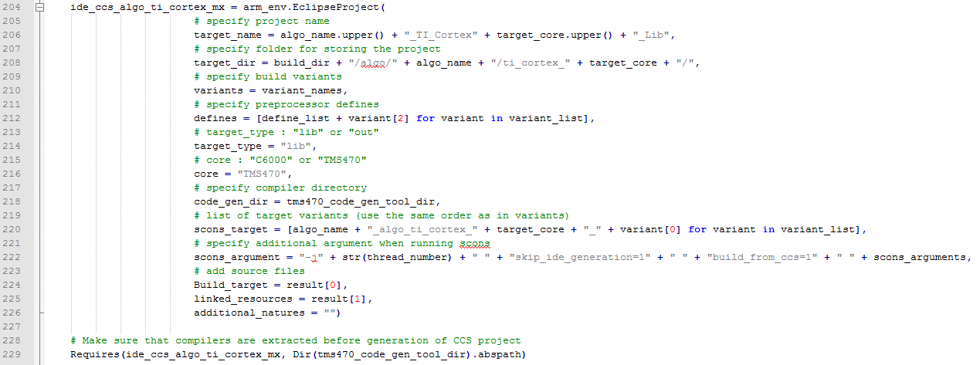
Generic Scons: Extraction of TI-Tools
Dependencies
Certain dependencies need to be provided in Scons extensions and/or Sconscript-files.
Following targets require certain dependencies:
CCS projects
ECU-Libraries
HIL-Targets
Realization for CCS prj,
see, e.g., line 229 of
scons_common_scripts\
algo\lib\
lib_env_ti_cortex_mx\
Sconscript.py:

Slide 8
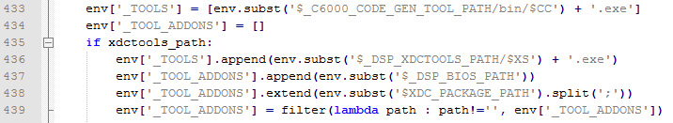
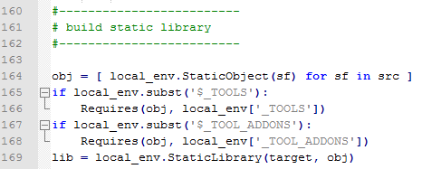
Generic Scons: Extraction of TI-Tools
Dependencies
For ECU- and HIL-Targets this is realized in a similar fashion:
In compiler-relevant Scons-extension, define the environmental keys „_TOOLS“ and „_TOOL_ADDONS“.
„_TOOLS“ is a list of programs required.
„_TOOL_ADDONS“ is a list of directories required.
Sconscript gets a „Requires“-command for relevant build step, see ,e.g., implementation for C6000-Library:
scons_adas_extensions\tms320dm6000.py:
scons_common_scripts\algo\lib\Sconscript.py:

