Slide 1

Generic Scons: QAC - Integration
Dr. André Fischer
ITK Engineering AG

Slide 2
Overview
Using QAC with GenericScons
Via Command line
Via Visual Studio
Remarks

Slide 3
Generic Scons: QAC - Integration
Overview
Valid from GenericScons Release ≥ AL_ETK_SCT_01.05.00
Goal: Generation of QAC-compliance reports for the code for
DSP with C674x-compiler
DSP with C66xx-compiler
EVE with ARP32-compiler
ARM Cortex A8 with TI-compiler/GCC
ARM Cortex A15 with GCC
Aliases in GenericScons:
xxx_qac -> generate all compliance reports
xxx_qac_<arch> -> generate compl. report for <arch>
xxx_qac_<arch>_proj -> generate QAC project for <arch>
where xxx stands for the component resp. algo and <arch> = „ti_c674x“, „ti_c66xx“, „ti_arp32“, „ti_cortex_a8“, „ti_cortex_a15“

Slide 4
Generic Scons: QAC - Integration
Using QAC with GenericScons – Via command line
Important: Please make sure that all prerequisites for using QAC in GenericScons are met, see 02_Development_Tools\scons_tools\docs\QAC_manual.docx
„scons.bat xxx_qac_<arch>“ from 03_Workspace\algo\xxx:
Generates the QAC project files for in 05_Testing\05_Test_Environment\algo\modtests\qac(pp)_tests\xxx
Source code analysis for <arch> with corresponding compiler settings; analysis results stored in 05_Testing\05_Test_Environment\algo\modtests\qac(pp)_tests\xxx\output
Generates the Compliance Report based on the analysis results; stored in 05_Testing\02_Reports\algo\modtests\qac(pp)_tests\
During analysis all QAC warnings are displayed on command line
Compliance report is opened automatically after generation

Slide 5
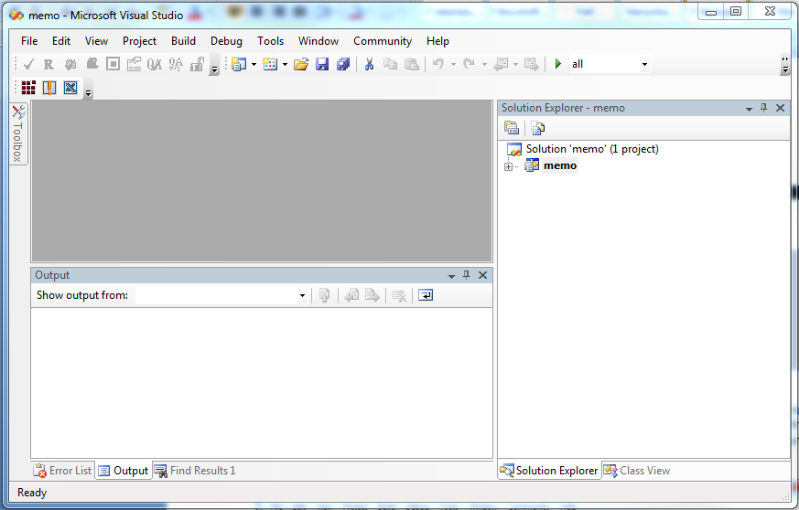
Generic Scons: QAC - Integration
Using QAC with GenericScons – Via Visual Studio
Idea: Deal with QAC warnings in a comfortable way in IDE
Requirements:
Generation of compliance report possible without QAC errors
Generation of Visual Studio solution xxx.sln as introduced by AL_ETK_SCT_01.03.01 (see 02_Development_Tools\scons_tools\docs\release_notes\)
→ Alias to choose from configuration manager
→ One project per component

Slide 6
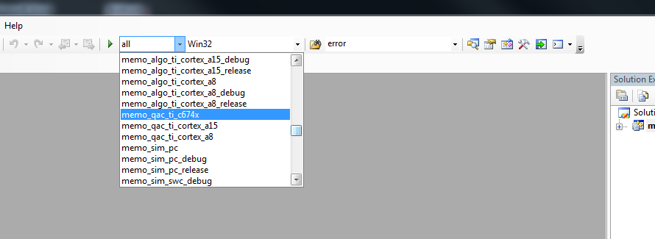
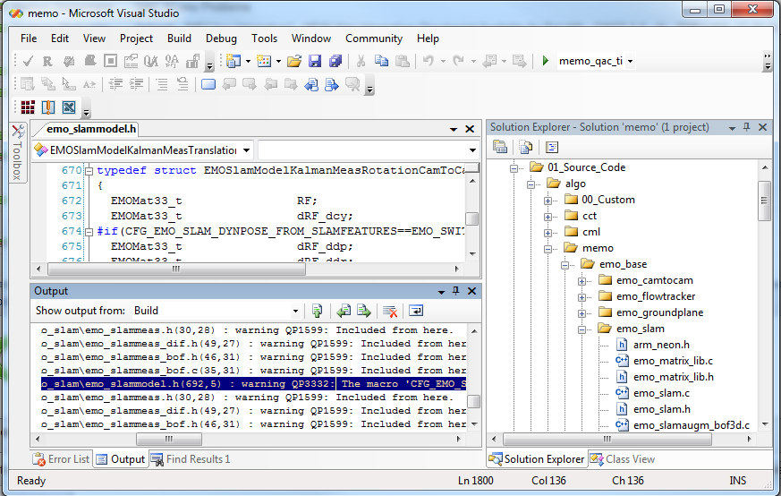
Generic Scons: QAC - Integration
Using QAC with GenericScons – Via Visual Studio
Choose desired QAC-Alias
Build the solution
-> „scons.bat <qac-target>“ is executed
Double-Click on warning messages opens source file

Slide 7
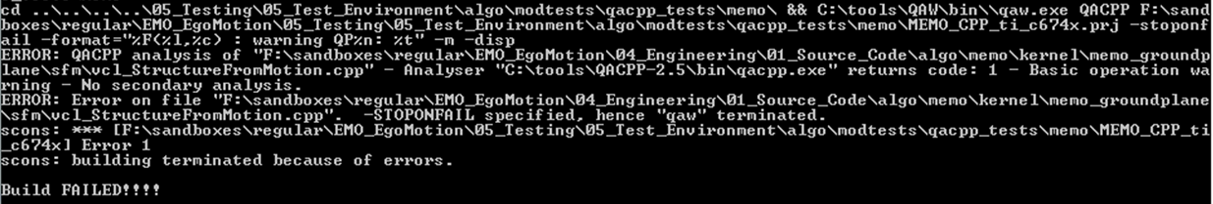
Generic Scons: QAC - Integration
Remarks
Only compliance report for DSP-code with C674x-compiler is reliable at the moment.
Reason: QAC-Environment is not completely set yet.
C-Code: Generating compliance reports generally works well.
C++-Code: Generally causes trouble because of parsing errors during analysis.
Possible resolution: Analyze source code „by hand“ in QACPP GUI, open message explorer and
Create a component-specific .p_a-template QACPP_p_a_template.txt in
05_Testing\05_Test_Environment\algo\modtests\qacpp_tests\xxx\
modifying set of makros/rules, etc. and/or
Modify/Correct compiler includes being read by QACPP in 05_Testing\05_Test_Environment\algo\modtests\qacpp_tests\common\CompilerInclude
For more details please refer to 02_Development_Tools\scons_tools\docs\QAC_manual.docx

Slide 8
Generic Scons: QAC - Integration
Remarks
Only compliance report for DSP-code with C674x-compiler is reliable at the moment.
Reason: QAC-Environment is not completely set yet.
C-Code: Generating compliance reports generally works well.
C++-Code: Generally causes trouble because of parsing errors during analysis.
Possible resolution: Analyze source code „by hand“ in QACPP GUI, open message explorer and
Create a component-specific .p_a-template QACPP_p_a_template.txt in
05_Testing\05_Test_Environment\algo\modtests\qacpp_tests\xxx\
modifying set of makros/rules, etc. and/or
Modify/Correct compiler includes being read by QACPP in 05_Testing\05_Test_Environment\algo\modtests\qacpp_tests\common\CompilerInclude
For more details please refer to 02_Development_Tools\scons_tools\docs\QAC_manual.docx
Thank you!

