Slide 1

Generic Scons – Development
Dr. André Fischer
ITK Engineering AG

Slide 2
GenericScons: Developer‘s point of view
Goals:
Workflow in MKS
External dependencies of GenericScons
Efficient development setup for GenericScons
Test environment for GenericScons
Usage of Build server lud4b3dg
Usage of Jenkins server

Slide 3
Generic Scons
Agenda
Workflow in MKS
External Dependencies
Testing

Slide 4
GenericScons –
Workflow in MKS

Slide 5
Generic Scons
GenericScons – Release Issues
Release cycles of about ca. 4 weeks, usually at the end of the month
Releases are issued in MKS under Project = „/ETK“
For each release issue a certain set of Issues (Change- or Feature-Requests, Problem Reports) is assigned
Those issues need to be fixed/closed until release date.
Distribution/Notification to Medhat Hussain – he will take care of distribution
Check list for Release:
Please refer to
nfs/projekte1/REPOSITORY/Base%5fDevelopment/05%5fAlgorithm/ETK%5fEngineeringToolKit/04%5fEngineering/SCT%5fSconstools/docs/processes/project.pj&selection=GenericSCons%5fRelease%5fProcess.docx
nfs/projekte1/REPOSITORY/Base%5fDevelopment/05%5fAlgorithm/ETK%5fEngineeringToolKit/04%5fEngineering/SCT%5fSconstools/docs/release%5fnotes/checklists/project.pj&selection=Release%5fChecklist.xlsx

Slide 6
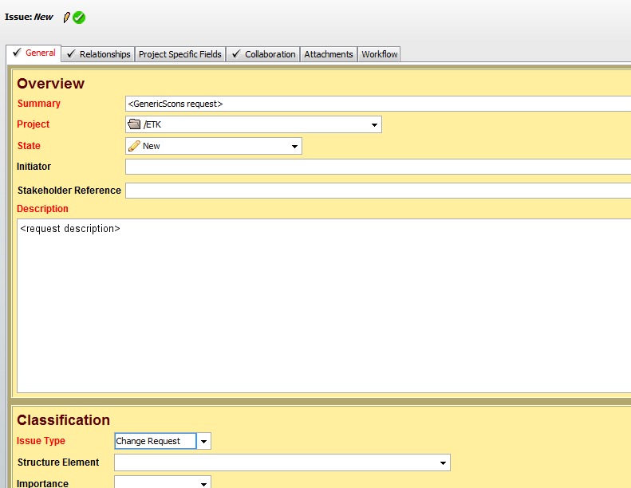
Generic Scons
GenericScons – Issues
Everybody can create Issues in MKS for any Change/Feature requests or Problem reports.
In MKS Integrity View go to Item -> Create… and choose Issue.
Submit the form like this (In particular, you can
leave „Structure Element“ empty.):
Subsequent workflow:
Issue will be attached to one
of the following releases.
Initiator will be notified when
issue has been realized.
Subsequent GenericScons
Release contains
corresponding solution.
Checklist for Issues:
Please refer to
http://mks-psad:7001/si/viewrevision?projectName=/nfs/projekte1/REPOSITORY/Base%5fDevelopment/05%5fAlgorithm/ETK%5fEngineeringToolKit/04%5fEngineering/SCT%5fSconstools/docs/release%5fnotes/checklists/project.pj&selection=Issue%5fChecklists.xlsx
http://mks-psad:7001/si/viewrevision?projectName=/nfs/projekte1/REPOSITORY/Base%5fDevelopment/05%5fAlgorithm/ETK%5fEngineeringToolKit/04%5fEngineering/SCT%5fSconstools/docs/processes/project.pj&selection=GenericSCons%5fRelease%5fProcess.docx

Slide 7
GenericScons –
External dependencies

Slide 8
Generic Scons
External dependencies
Projects: several components put together
Motivation of CM: Easy execution of Build software via .cmd files, e.g.: 03_Workspace\algo\make_all_<target>.cmd
Those .cmd-files need to work!
Build farm:
All delivery targets of all components of projects
SRLCam4T0 /nfs/projekte1/PROJECTS/SRLCam/06%5fAlgorithm/project.pj&developmentPath=SRLCam4T0
SMFC4B0 nfs/projekte1/PROJECTS/MFC400/06%5fAlgorithm/project.pj&developmentPath=SMFC4B0
MFC4T0
nfs/projekte1/PROJECTS/MFC400/06%5fAlgorithm/project.pj&developmentPath=MFC4T0
are built on a regular base, responsible: Wolfgang Sinnwell
Motivation: Identify build failures before release dates
Build failures caused by compiler errors → email to developers
Build failures caused by scons scripting errors → email to GenericScons team
Those errors should be dealt with quickly!
In the past the most scons scripting errors occurred because of wrong / missing shares under 05_Testing
Remarks:
A build for component xxx within project yyy is “almost the same” as if you build component xxx directly, (“utilities” of SR and TSA, as well as “blockage_sim” for CB are not included in yyy)
Key interest lies in build of targets which are delivered by components:
ECU Libraries
PC Simulation targets
SDL- and CDL-files

Slide 9
GenericScons –
Testing

Slide 10
Generic Scons
Efficient Testing
Any modifications within GenericScons may affect ALL components using GenericScons
Requirements:
Every modification shall be tested for the component / feature it refers to
Every modification shall be tested with every component that uses Generic Scons
Every modification shall be tested with projects which comprise several components, e.g. SMFC4B0, SRLCam4T0, etc. – this includes external dependencies!
Checking every modification with every component locally is not feasible for a developer on personal computer
Build Server lud4b3dg (Owner: Yavuz Isik)
Computer located in Lindau at our disposal for testing/building
Easy operability via Jenkins Server

Slide 11
Generic Scons
Efficient Testing: lud4b3dg
How to connect:
Start → remote desktop connection → type in “lud4b3dg”
Sign in with you user ID and computer password
Lud4b3dg is a standard computer which can be designed for corresponding needs
So far:
Installation of tools: Visual Studio 2005, QAC, Cantata.
Missing: Code Composer Studio
Sandboxes (build and regular) of all components
Batch-files for
Setting up development tools versions (setup_sanboxes.bat)
Resynchronising sandboxes with MKS (resync.bat)
Building (build.bat)

Slide 12
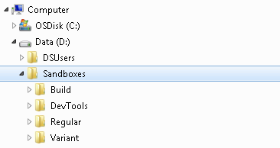
Generic Scons
Efficient Testing: lud4b3dg
Overview:
Build:
Build-sandboxes for all components running on GenericScons
Software releases to be shared under 02_Development_Tools and 05_Testing
Regular:
Regular sandboxes for all components running on GenericScons
Variant:
Variant sandboxes for Projects comprising several components running on GenericScons, at the moment:
SMFC4B0
MFC4T0
SRLCam4T0
DevTools:
Different versions of 02_Development_Tools

Slide 13
Generic Scons
Efficient Testing: lud4b3dg
Idea of DevTools:
Desirable to easily switch between different versions of 02_Development_Tools, e.g. in terms on the version of GenericScons being used:
Build failures: We should have a version of 02_Development_Tools with the GenericScons release in use to reconstruct problems
Development: We should have a version of 02_Development_Tools with the trunk version of GenericScons
Naïve approach:
Collect all relevant versions of 02_Development_Tools in terms of the GenericScons version used, e.g. 02_Development_Tools_1_49 contains copies of relevant build tools like ti_tools and GenericScons CP 1.49
Whenever required, just copy the corresponding 02_Development_Tools-folder to the sandbox in question
Obvious disadvantages:
Require a lot of storage
Copy takes quite some time
Confusion

Slide 14
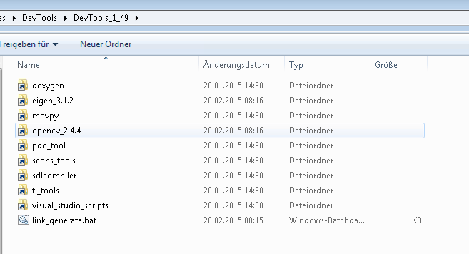
Generic Scons
Efficient Testing: lud4b3dg
Smart approach:
Collect all relevant versions of build tools on hard drive
Create empty folder DevTools_1_xx
Create symbolic links to required build tools with “mklink”, e.g.
mklink /D H:\sandboxes\DevTools_1_49\ti_tools H:\sandboxes\build\ti_tools_1_15
This step has been automated by link_generate.bat
mklink resp. link_generate.bat needs to be executed with administrator rights!
Result:
This folder then again can be linked with “mklink” to specific component sandboxes, e.g.
mklink /D 02_Development_Tools D:\sandboxes\DevTools\DevTools_1_49
This step has been automated by setup_sandboxes.bat

Slide 15
Generic Scons
Efficient Testing: lud4b3dg
So far:
Setup of sandboxes
Setup of Development_Tools
Still required:
Easy operability of builds
→ Jenkins Server and build.bat and generic (!) scons.bat
Address accessible from Conti network:
https://lud4b3dg:8443/
Person of contact: Yavuz Isik
Introduction to Jenkins
General advice to Jenkins: Wolfgang Sinnwell

