Slide 1

Generic Scons
Dr. André Fischer
ITK Engineering AG

Slide 2
Generic Scons
Agenda
GenericScons – an overview
Using GenericScons
Shared Scripts
Global Build settings
Local Build Settings
Folder Structure
scons_adas_extensions
Configuration for new component
GenericScons flags
Particularities with some components

Slide 3
GenericScons – an overview

Slide 4
GenericScons
What is SCons?
Scons is an Open Source python-based construction tool.
Build scripts and configuration files are python scripts.
→ Use real programming language to solve (complicated) build problems
Allows integration of ALL build targets to one build environment.
Provides reliable, automatic dependency analysis.
Reliable detection of build changes through MD5 signatures.
Allows global view of ALL dependencies and build targets.

Slide 5
Generic Scons
What is GenericScons?
Scons is a python-based construction tool.
GenericScons is an ADC-internal build software based on Scons
Features:
Build of ECU-libraries for
C66xx
C674x
ARP32
ARM Cortex A8
ARM Cortex A15
ARM Cortex M3
ARM Cortex M4
Build of PC Simulation Targets
Build of sdl- and cdl-files
Build of Visual Studio and CCS IDEs
QAC-analysis for all ECU-libraries
Cantata unittests
GScons supports Visual Studio 2005 and Code Composer Studio 5.x
Build of HiL-Outfiles for Evalboard
C66xx
C674x
ARP32
ARM Cortex A8
ARM Cortex A15
ARM Cortex M3
ARM Cortex M4
Ram/Rom allocation

Slide 6
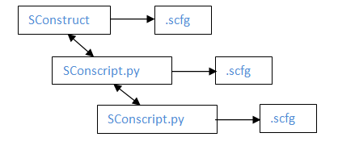
Generic Scons
Concept
GenericScons build environment contains:
Windows batch file (scons.bat)
Python scripts:
SConstruct (shared)
SConscript.py scripts (shared),
.scfg files (not shared)
configuration and setting
list of source files and include paths.
Before every build all shared files are automatically copied from 02_Development_Tools\scons_tools to the correct locations in the project.
Only non-shared files need to be created in the project and maintained by the component’s team.
Required build targets are found under 04_Build, 05_Deliverables and 05_Testing

Slide 7
Using GenericScons

Slide 8
GenericScons: User‘s point of view
Goals:
Purpose of all shared scripts
Purpose of all configuration files
Folder structure
Overview of adas extensions
Detailed coverage of selected adas extensions
Guide how to generate a GenericScons environment for a new component
Overview of GenericScons flags
Particularities of components already running on GenericScons

Slide 9
GenericScons – Shared Scripts

Slide 10
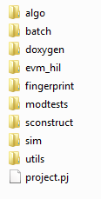
Generic Scons
Shared Scripts – overview
All shared scripts of GenericScons are located under scons_tools\scons_common_scripts
Organisation:
‘algo’: SConscripts for building ECU libraries, some sdl-files, and QAC testing
‘batch’: aux. batch files for QAC and scons.bat
‘doxygen’: aux. python script for doxygen documentation
‘evm_hil’: SConscripts related to Evm-Hil targets
‘fingerprint’: SConscript for Fingerprint mechanism (exclusively used by LD)
‘modtests’: SConscripts for Cantata testing
‘sim’: SConscripts for pc simulation targets (mostly dll’s)
‘utils’: SConscript for Autorelease feature.

Slide 11
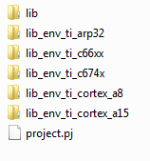
Generic Scons
Shared Scripts – algo
Each subfolder contains exactly one SConscript
Organisation:
‘lib’:
Copied to project as 01_Source_Code\algo\xxx\Sconscript.py
Actual build of ECU libraries, PC libraries, sdl- and cdl files, execution of QAC tests
‘lib_env_ti_<core>’:
Copied to project as 03_Workspace\algo\xxx\ti_<core>\SConscript.py
Reading 03_Workspace\algo\xxx\ti_<core>\ti_<core>_lib_config.scfg for build settings of variants
Setup of corresponding build environment
Call 01_Source_Code\algo\xxx\Sconscript.py
Generate CCS projects for ECU Libraries

Slide 12
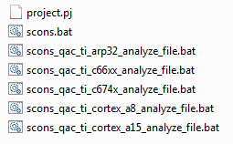
Generic Scons
Shared Scripts – batch
Organisation:
‘scons.bat’:
Shared and improved version of scons.bat
Advantages:
Up-to-date help menu
Correct handling of errorlevel → reliable reports of failed / succeeded builds
In MKS, components are supposed to share this file to 03_Workspace\algo\xxx
‘scons_qac_ti_<core>_analyze_file.bat’:
Can be linked into VS solution in order to analyze single source files with QAC
For more details see scons_tools\docs\qac\QAC_Manual.docx

Slide 13

Generic Scons
Shared Scripts – doxygen
Auxiliary python script for generation of doxygen documentation
Please refer to https://cws1.conti.de/content/00012669/Team%20Documents/03_General/06_Process/01_ModuleTests/Cantata/CKP%20Resources%20(meeting%20minutes,%20slides,%20etc)/DOORS_L3_Design_Spec_Creation/ExportSoftwareDesignFromDoxygenXMLtoDOORS.docx or Sophie Rony

Slide 14
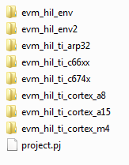
Generic Scons
Shared Scripts – evm_hil
Organisation:
‘evm_hil_env’:
Sconscript.py:
Copied to 03_Workspace\algo\xxx_sim\xxx_evm_hil\<vme | vh28>\evm_hil_projects
Master Sconscript.py for building Hil-targets for VME and VH28
Generate_DebugServerScripting.py
‘evm_hil_env2’: specific version of Sconscript.py from ‘evm_hil_env’, which does not contain build commands for DSP-Hil-outfile (required exclusively by SR)

Slide 15
Generic Scons
Shared Scripts – evm_hil
Organisation:
‘evm_hil_ti_<core>’:
Copied to 03_Workspace\algo\xxx_sim\xxx_evm_hil\<vme | vh28>\evm_hil_projects\<core>
The following applies for <core> ≠ Cortex A8
Contains two Sconscript.py’s respectively
Sconscript_<core>env.py:
Reads hil_env_config.scfg (located in the same folder) for build settings
Sets up build environment
Calls following Sconscript.py
Sconscript.py:
Executes build commands

Slide 16
Generic Scons
Shared Scripts – evm_hil
Organisation:
‘evm_hil_ti_cortex_a8’:
Three Sconscripts for setting up the build environment (with analogue steps as compared to <core> ≠ cortex a8
Sconscript_cortexa8env.py: used if
The component does not have a Cortex A8 library, i.e. the algo runs on DSP and possibly on EVE.
The outfile shall be generated with TI compiler
Sconscript_cortexa8onlyenv.py: used if
The component does have a Cortex A8 library.
The outfile shall be generated with TI compiler.
Sconscript_cortexa8gccenv.py: used if
The component does have a Cortex A8 library.
The outfile shall be generated with with GCC.
Currently not in use
Sconscript.py:
Executes build commands

Slide 17

Generic Scons
Shared Scripts – fingerprint
Sconscript_fingerprint.py:
Copied to 03_Workspace\algo\xxx
Reads 03_Workspace\algo\xxx\xxx_algo_ver_history.scfg and possibly also
03_Workspace\algo\xxx\xxx_arp_ver_history.scfg
Generates XXXAlgoFingerprint.h and possibly also XXXAlgoArpFingerprint.h
This feature will be covered below.

Slide 18
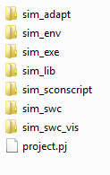
Generic Scons
Shared Scripts – sim
There are 5 different sorts of PC simulation targets
SWC-Plugin: dll, sdl, cdl, res-file → sim_swc
Visualization Plugin: dll, res-file → sim_swc_vis
Adapter Plugin: dll → sim_adapt
Static library: lib → sim_lib
Executable: exe → sim_exe
Every folder contains one Sconscript.py
Organisation:
‘sim_sconscript’:
Sconscript_sim.py is copied to 03_Workspace\algo\xxx_sim
Reads Key information from 03_Workspace\algo\xxx\sconstruct_config.scfg
Calls all other Sconscripts related to PC simulation targets
Builds Visual studio IDE

Slide 19
Generic Scons
Shared Scripts – sim
Organisation:
‘sim_env’:
Copied to 03_Workspace\algo\xxx_sim\<plugin>
Reads simenv_config.scfg for build settings for different variants
If configured like that, it builds a PC library
Executes corresponding Sconscript.py
‘sim_adapt’, ‘sim_lib’, etc.:
Copied to 03_Workspace\algo\xxx_sim\<plugin>
Reads sim_swc_config.scfg and sim_swc_xxx_file_list.scfg
Builds simulation target

Slide 20

Generic Scons
Shared Scripts – utils
Sconscript.py fürs Autorelease Feature
Please refer to the information located in scons_tools\docs\auto_release or to Roland Stark.

Slide 21

Generic Scons
Shared Scripts – modtests
Sconscript.py’s are copied to 05_Testing\05_Test_Environment\algo\modtests\cantata_tests\xxx.
Sconscript.py calls Sconscript_unittests.py.
Please refer to scons_tools\docs\cantata\ETK_SCT_SCons_Cantata_Integration.docx

Slide 22
Generic Scons
Tool Requirements
Recommended shares for 02_Development_Tools:
Doxygen
E.g. REPOSITORY\Base_Development\05_Algorithm\STP_SharedToolProjects\04_Engineering\doxygen
CP 1.28
movpy
E.g. Repository\Base_Development\05_Algorithm\STP_SharedToolProjects\04_Engineering\movpy
CP 1.17
pdo_tool
Repository\tools\custom\pdo\distribution
CP 1.37
scons_tools
Repository\Base_Development\05_Algorithm\ETK_EngineeringToolKit\04_Engineering\SCT_Sconstools
CP 1.53 (latest release)
sdlcompiler
Repository\Base_Development\05_Algorithm\STP_SharedToolProjects\sdl
CP 1.27
ti_tools
Repository\Tools\ti_tools
CP 1.16
visual_studio_scripts
Repository\Base_Development\05_Algorithm\ETK_EngineeringToolKit\04_Engineering\CMD_Tools\visual_studio_scripts
CP 1.13
Recommended shares for 05_Testing\05_Test_Environment\algo\modtests\qac_tests:
common
Repository\Tools\QAC
CP 1.39
Recommended shares for 05_Testing\05_Test_Environment\algo\modtests\qacpp_tests:
Common
Repository\Tools\QACPP
CP 1.25

Slide 23
GenericScons –
global build settings

Slide 24

Generic Scons
Global Build Settings
common_config.scfg contains:
Path definitions
Default settings for
ECU Libraries
PC Simulation targets
QAC test settings
Default settings comprise:
Compiler flags (only place, where default compiler flags are defined)
Linker flags (there might be additional one in corresponding adas extension scripts.)
Desirable in future: common_config.scfg contains all such default build setting.
When setting up a build environment, the corresponding build settings from common_config.scfg are set and complemented by component-specific needs
Remark: optimization level für c674x- and c66xx-ECU Libraries is per default set to “-o3”, but this can be overwritten by component-specific .scfg-file.

Slide 25
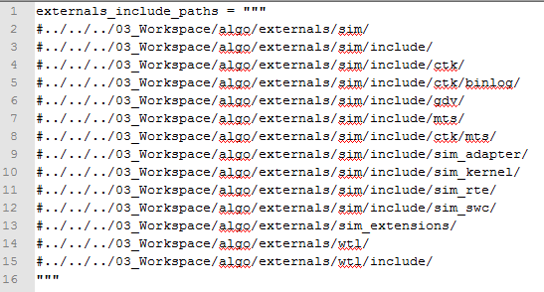
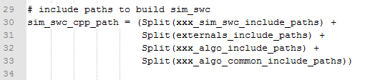
Generic Scons
Global Build Settings
External_include_file_list.scfg:
Contains frequently used include path sets
Typically used, e.g., in sim_swc_config.scfg as

Slide 26
GenericScons –
Local Build Settings

Slide 27
Generic Scons
Local Build Settings: Templates – overview
Motivation: Generic Scons needs build information, settings, and input from component (=local build settings).
Most of this information is stored in .scfg-files, which need to be
Created when moving to GenericScons (typically done by Generic Scons team)
Maintained by the component’s team, possibly supported by Generic Scons team
For some components feature implementation of Generic Scons is not sufficient → component-specific Sconscript.py’s
For autorelease, there is a build target (a .txt file) which requires a template to be provided.
Scons.bat
Conclusion: Templates (in scons_tools\scons_templates) contain examples for
Component-specific .scfg files
Component-specific Sconscript.py’s
Component-specific .txt-file template for auto_release
Component-specific scons.bat
Folder structure reflects the one required for components.

Slide 28
Generic Scons
Templates: .scfg-files
Essentially two kinds of .scfg-files:
Component-specific Settings
Copy Action: 03_Workspace\algo\xxx\sconscript_setup_config.scfg: Copy shared scripts to correct location in project.
Target Organisation: 03_Workspace\algo\xxx\sconstruct_config.scfg: e.g., c674x_used , ca8_used, gcc_used, include_unittests, etc.
Target-specific settings :
Algo Configs:
01_Source_Code\algo\xxx\algo_config.scfg: general settings on sources for different libs, pdo setting, fingerprint, qac, etc.
01_Source_Code\algo\xxx\algo_lib_file_list.scfg: source and include lists.
ECU Library Configs:
03_Workspace\algo\xxx\<core>\ti_<core>_lib_config.scfg: Compiler flags, defines, …
Fingerprint Configs:
03_Workspace\algo\xxx\xxx_algo_ver_history.scfg
03_Workspace\algo\xxx\xxx_arp_ver_history.scfg
We will cover their usage below

Slide 29
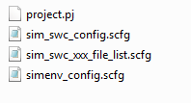
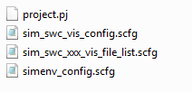

Generic Scons
Templates: .scfg-files
Essentially two kinds of .scfg-files:
Target-specific settings :
PC Simulation:
For each plugin there are three .scfg-files
SWC-Plugin:
Visualization plugin:
Adapter plugin:
Static Library:
Executable:

Slide 30
Generic Scons
Templates: .scfg-files
Essentially two kinds of .scfg-files:
Target-specific settings :
PC Simulation:
_config.scfg: (called by plugin’s Sconscript.py)
Organisation of source files and include paths to be used
External libraries and external libpaths
Flag if sdl/cdl-file is generated
etc.
_file_list.scfg: (called by plugin’s Sconscript.py and _config.scfg)
Definition of python variables with source file names and include paths → to be put together in _config.scfg
simenv_config.scfg: (called by Sconscript_simenv.py)
Definition of build variants and corresponding build settings, e.g. compiler flags, macros, libs to be linked, etc.

Slide 31
Generic Scons
Templates: .scfg-files
Essentially two kinds of .scfg-files:
Target-specific settings :
Hil Simulation:
Essentially the same concept as for PC simulation:
Three .scfg files with analogue information
For the details please refer to the corresponding .scfg-files.
Cantata unittests:
05_Testing\05_Test_Environment\algo\modtests\cantata_tests\xxx\unit_test.scfg, please refer to template

Slide 32
Generic Scons
Templates: Sconscript.py-files
PC simulation: 03_Workspace\algo\xxx_sim\Sconscript.py
Exists until GenericScons release AL_ETK_SCT_01.08.01.
Has been replaced by “Master Sconscript” for PC simulation: scons_common_scripts\sim\sim_sconscript\SConscript_sim.py
However: Not all components have switched to using shared Sconscript_sim.py
Still: Both Sconscripts are supported:
Sconstruct:
if exists xxx_sim\Sconscript_sim.py:
call Sconscript_sim
else:
call Sconscript.py
Advantages of shared Sconscript_sim.py:
Easier Generic Scons development
More advanced Visual studio solution:
Essentially all build targets of GenericScons environment are buildable per VS
Usage of QAC
Advantages of non-shared Sconscript.py:
Components can use own builders (e.g necessary for GEN, but the corresponding command was shifted to a certain .scfg-file, please refer to Christian Exner)
Disadvantages of non-shared Sconscript.py: Visual studio projects
Only PC simulation projects, i.e. no ECU Libraries available
No QAC usage
Wrong intellisense settings (e.g. macros are displayed in a wrong way)

Slide 33
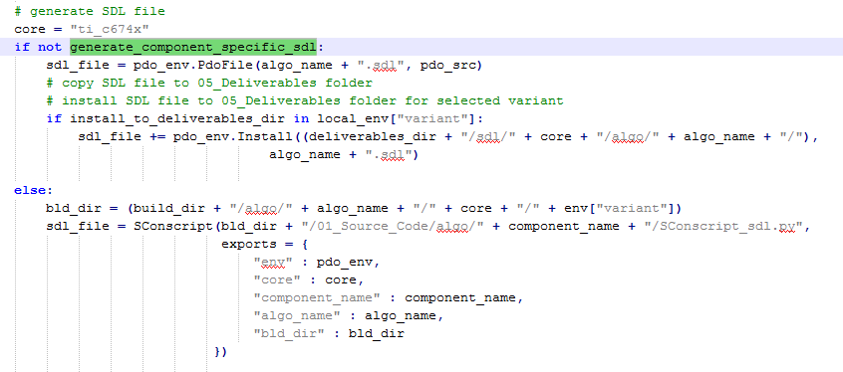
Generic Scons
Templates: Sconscript.py-files
SDL-generation: 01_Source_Code\algo\xxx\Sconscript_sdl.py
Generic Scons, per default builds sdl-/cdl-files from 01_Source_Code\algo\xxx\Sconscript.py or from 03_Workspace\algo\xxx_sim\sim_swc_xxx\Sconscript.py.
It happens that the needs of some components cannot be met with this method: e.g. SR
GenericScons provides the build of a “xxx.sdl”, but SR requires “sr_a.sdl” and “sr_b.sdl”
The default pdo-tool-integration is unsuited for generating sdl-files for ARM Libraries
Flag “generate_component_specific_sdl” (set in 01_Source_Code\algo\xxx\algo_config.scfg) controls which Sconscript.py to use for sdl-generation

Slide 34
Generic Scons
Templates: Rest
Auto-release-feature:
03_Workspace\algo\xxx\autorelease\autorel_handover_template.scfg
03_Workspace\algo\xxx\autorelease\Algorithm_Component_Handover_Template.txt
Please refer to the documents provided in scons_tools\docs\auto_release or to Roland Stark.
Scons.bat
Exists until GenericScons release AL_ETK_SCT_01.08.01.
There is a generic version of scons.bat which applies to all components.
Only few components have switched to the generic version of scons.bat
Advantages of generic version:
Always up-to-date help menu
Correct errorlevel report for Visual Studio, CCS projects, and Jenkins
Easier Generic Scons development
Components should switch to generic version! ☺

Slide 35
GenericScons – scons_adas_extensions

Slide 36
Generic Scons
scons_adas_extensions – Fingerprint
Build target: A header file which contains an algo fingerprint based on the hashsums of the source files being used.
Motivation:
After Algo delivery it should be possible to track the version of source files in use
In including this header file into the code, bug hunts can be facilitated
For more details please refer to Wladimir Klein (LD)
This feature is exclusively used by LD (LaneDetection)
During development the exact shape of the generated header files does not matter, as long as they can be included and the variables of this header files are defined → building libraries is possible
For a release, the “correct” fingerprint has to be generated, see below

Slide 37
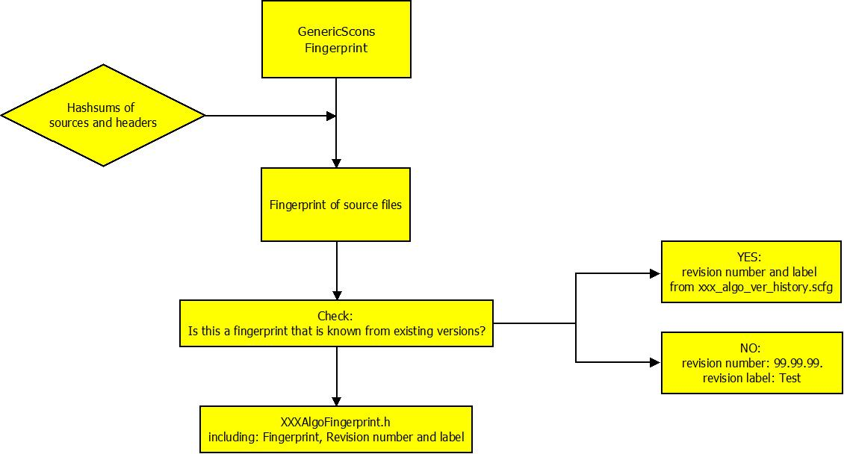
Generic Scons
scons_adas_extensions – Fingerprint

Slide 38
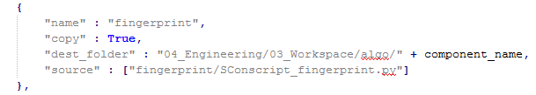
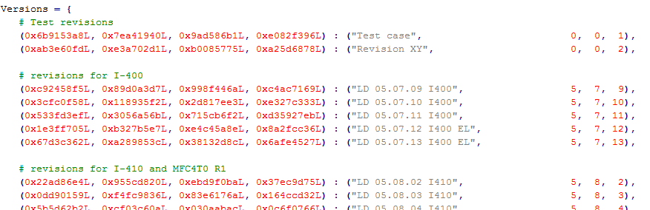
Generic Scons
scons_adas_extensions – Fingerprint
Relevant configurations:
03_Workspace\algo\xxx\sconstruct_config.scfg:
03_Workspace\algo\xxx\sconstruct_setup_config.scfg:
03_Workspace\algo\xxx\xxx_algo_version_history.scfg:
This file contains the fingerprints of previous releases
03\Workspace\algo\xxx\xxx_arp_ver_history.scfg
In principle the same as for xxx_algo_ver_history.scfg

Slide 39
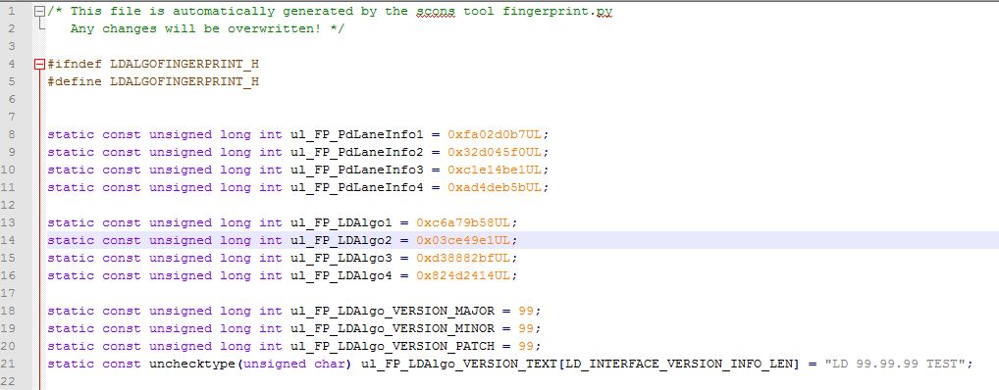
Generic Scons
scons_adas_extensions – Fingerprint – Usage for Release
Step 1: scons xxx_fingerprint → Header files are installed to 04_Build\algo\xxx\fingerprint

Slide 40
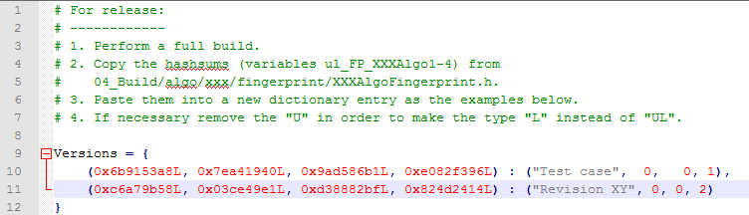
Generic Scons
scons_adas_extensions – Fingerprint – Usage for Release
Step 2: Insert the red encircled hash sums into “Versions” in xxx_algo_ver_history.scfg

Slide 41
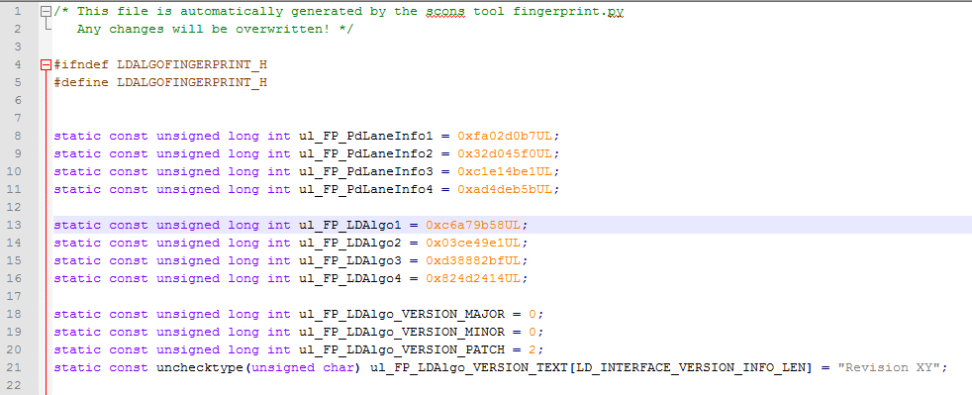
Generic Scons
scons_adas_extensions – Fingerprint – Usage for Release
Step 3: Rebuild scons xxx_fingerprint
The header file contains the correct version number.
Remark: Instead of Step 3 one could also directly build the required library or ‘all’ – Scons realizes that it has to generate the fingerprint first.

Slide 42
Generic Scons
scons_adas_extensions – pdo
Build targets: sdl- and cdl-files
Goal:
Read certain addresses from special PDO-comments in the code and generate .sdl-files (xml-format) based on that information
In connection with PC Simulation targets, those (and only those!) sdl-files are compiled to .cdl-files which serve as a wrapper for reading algo signals in MTS
Related Sconscript’s:
scons_tools\scons_common_scripts\algo\lib\Sconscript.py
scons_tools\sim\sim_swc\Sconscript.py
scons_tools\scons_templates\01_Source_Code\algo\xxx\Sconscript_sdl.py
There are three different ways to build those targets:
Env.PdoFile (default and preferred)
Env.Pdo
Env.PdoFileCustom
PDO-Tools developer’s contact: Gregory Ungvary

Slide 43
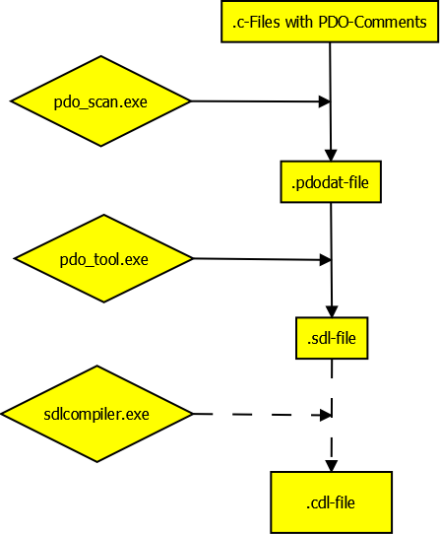
Generic Scons
scons_adas_extensions – pdo
Env.PdoFile()
Pdo_scan.exe
serves a preprocessor mimicking the complier preprocessor in use
Accomplished by .cfg-files under 02_Development_Tools\pdo_tool
Pdo_tools.exe
Parses the .pdodat-file and generates the .sdl-file
Sdlcompiler.exe
When generating an sdl-file for PC simulation targets, also a cdl-file is required
Compiling the sdl-file yields the cdl-file

Slide 44
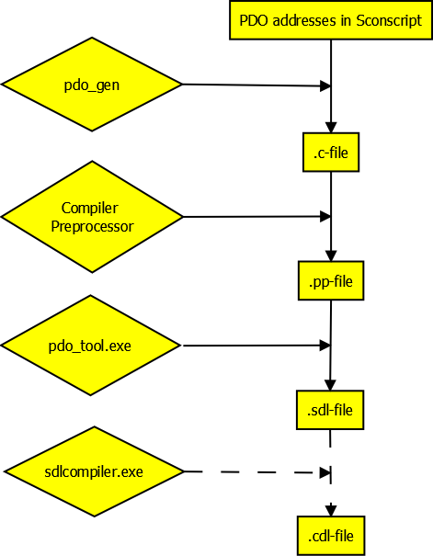
Generic Scons
scons_adas_extensions – pdo
Env.Pdo()
Pdo_gen: Script that parses information provided in Sconscript and writes it into a .c-file
Compiler Preprocessor compiles .c-file into a .pp-file
Pdo_tool.exe compiles .pp-file into a .sdl-file
Sdlcompiler.exe
When generating an sdl-file for PC simulation targets, also a cdl-file is required
Compiling the sdl-file yields the cdl-file

Slide 45
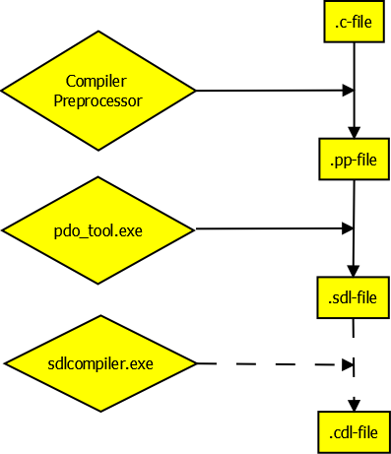
Generic Scons
scons_adas_extensions – pdo
Env.PdoFileCustom()
Same workflow as for Env.PdoFile(), but pdo_scan.exe replaced by corresponding compiler preprocessor
Motivation:
Pdo_scan.exe only mimicks the compiler preprocessor, but sometimes can’t generate the same results.
E.g.: pdo_scan.exe does not know the gcc-specific command “#include_next”
→ for gcc-compiled code it may be necessary to work with this sdl-generation (as it is the case for SR)

Slide 46
Generic Scons
scons_adas_extensions – help_menu
Motivation:
Provide an up-to-date help menu containing all important aliases.
GenericScons gathers all aliases that are configured in a specific way, see below, and writes them into 03_Workspace\algo\xxx\aliases.txt.
This file is updated during every build!
Important functions:
generate_alias(<alias>, <build node>, <hierarchy position>*, <info text>*):
This will generate an alias that will be displayed in aliases.txt
Hierarchy position is of the form hierarchy_level_0:hierarchy_level_1:…
If you neglect the *-ed arguments, you generate an alias that does not appear in aliases.txt, i.e. has the same effect as Alias (<alias>, <build node>)
create_help_menu():
Sorts all aliases configured in this way according to their hierarchy and writes them to aliases.txt
This is done at the end of Sconstruct.

Slide 47
Generic Scons
scons_adas_extensions – qac
Motivation:
For ECU libraries clients of Continental require static code tests with QAC
For such a static code test source files plus all build information serve as input
This build information is present in GenericScons and varies over different component (e.g. macro definitions)
→ It is natural to integrate this task into the build software
Goal: Generate a compliance report for individual cores for each component library for C and C++ respectively
Prerequisites:
Valid QAC(PP) installation according to scons_tools\docs\qac\QAC_Manual.docx
Shares:
C-Code: http://mks-psad:7001/si/viewproject?projectName=/nfs/projekte1/REPOSITORY/Tools/QAC/project.pj as 05_Testing\05_Test_Environment\algo\modtests\qac_tests\common
C++-Code: http://mks-psad:7001/si/viewproject?projectName=/nfs/projekte1/REPOSITORY/Tools/QACPP/project.pj as 05_Testing\05_Test_Environment\algo\modtests\qacpp_tests\common
Remarks:
QAC build targets are not included in build target “all”, they are called with “scons xxx_qac”.
Until AL_ETK_SCT_01.06.00 the QAC integration is enabled per default (before there was the flag generate_qac, but this is not evaluated any more).

Slide 48
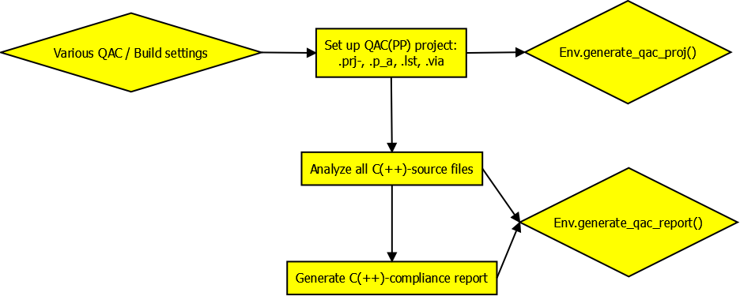
Generic Scons
scons_adas_extensions – qac
Workflow

Slide 49
Generic Scons
scons_adas_extensions – qac
Relevant GenericScons files:
01_Source_Code\algo\xxx\SConscript.py (shared script):
Gather necessary QAC configurations
Generate QAC(PP)-projects (including source file lists and macros in use)
Generate QAC(PP) compliance report (in .html-format)
01_Source_Code\algo\xxx\algo_config.scfg:
QAC(PP) analysis options for command line and Visual Studio, e.g. display/suppressing warnings
QAC(PP) report generation options
For more detailed information, refer to Section 5a or to scons_tools\docs\qac\QAC_Manual.docx
Analyzing single source files:
Use e.g. “scons xxx_qac_ti_c674x qac_source=<file1>,<file2>”

Slide 50
Generic Scons
scons_adas_extensions – further scripts
arm_gcc.py: This extension is used to setup ARM build environment using gcc.
autorel_function.py, autorel_main.py, autorel_mks_util.py, autorel_word_util.py: Builder scripts for Auto release feature.
doxygen.py: This extension is used to generate HTML documentation from doxygen doxyfile.
eclipse_cdt.py: This extension is used to generate Eclipse project for unit test.
eclipse_cdt_ccs5.py: This extension is used to generate CCS 5 Eclipse project for ECU Libraries and Hil Targets.
generate_DebugServerScripting.py: This extension is used to create _CopyDSScriptLoadCmdToClipboard.bat and DebugServerScripting.js which are used to run the debugger and load out files to one or more processor cores.
msvc-addon.py, msvs-patched.py: These scripts contain extensions and modifications to the Microsoft Visual Studio builder which is already supplied by SCons.
profile.py: Allows using a profiling mode for GenericScons, see Section 5.1.7 of scons_tools\docs\Scons_build_environment.docx.

Slide 51
Generic Scons
scons_adas_extensions – further scripts
ram_rom_algo_libsize.py, areas.py, libs_obj.py, maps.py: These extensions are used for Ram/Rom allocation of Libraries
sconscript_setup.py: This extension is used to copy shared SConscripts from 02_Development_Tools to 04_Engineering and 05_Testing.
sconstruct_helpers.py: This extension contains python functions used by SCons build environment.
ti_eve_arp32.py: This extension is used to setup ARP32 build environment. It specifies the TI compiler used, include directories and library directories.
tms320dm6000: This extension is used to setup DSP build environment. It specifies the TI DSP compiler used, include directories and library directories.
tms470r1x.py: This extension is used to setup ARM build environment using TI compiler. It specifies the ARM TI compiler used, include directories and library directories.
unittest.py: SCons extension for unit test
vsscript.py: Additional builder to patch Visual Studio rc file.

Slide 52
GenericScons –
Configuration for new component

Slide 53
Generic Scons
Configuration for New Component - Overview
Check out a recent build version of component
Identify build targets
Identify so far build method(s)
Identify necessary structural modifications for Generic Scons in line with CM, see https://processcenter.auto.contiwan.com/pkit/process/viewElement.do?id=1041272&type=artifact
Set up a Generic Scons environment on local sandbox
Perform necessary structural modification
Add shared subprojects of 02_Development_Tools
Set up an empty GenericScons environment
Add GenericScons features according to needs
Get in touch with function owner for
Presentation and explanation of Generic Scons environment
Performing structural modification in MKS together (including 02_Development_Tools)
Check in component-specific files of Generic Scons environment
If desired, How-To-Training session with component’s team

Slide 54
Generic Scons
Configuration for New Component - Overview
Check out a recent build version of component
Identify build targets
Identify so far build method(s)
Identify necessary structural modifications for Generic Scons in line with CM see https://processcenter.auto.contiwan.com/pkit/process/viewElement.do?id=1041272&type=artifact
Set up a Generic Scons environment on local sandbox
Perform necessary structural modification
Add shared subprojects of 02_Development_Tools
Set up an empty GenericScons environment
Add GenericScons features according to needs
Get in touch with function owner in order to
Presentation and explanation of Generic Scons environment
Performing structural modification in MKS together (including 02_Development_Tools)
Check in component-specific files of Generic Scons environment
If desired, How-To-Training session with component’s team

Slide 55
Generic Scons
Step 1: Empty GenericScons environment
Generate the following .scfg-files within the sandbox (use the templates from scons_tools\scons_templates and/or refer to print-outs of templates):
03_Workspace\algo\xxx\sconstruct_config.scfg
Set all supported feature flags to False
03_Workspace\algo\xxx\sconscript_setup_config.scfg
Set the copy action of all Sconscripts to False except for
03_Workspace\algo\xxx\Sconstruct
03_Workspace\algo\xxx_sim\Sconscript_sim.py
Copy scons_tools\scons_templates\03_Workspace\algo\xxx\scons.bat to 03_Workspace\algo\xxx
Open command line at 03_Workspace\algo\xxx and execute
“scons.bat no_target”
If “Build succeeded.” is reported, the empty GenericScons environment has been set up.

Slide 56
Generic Scons
Step 2: Add GenericScons features
Goal: Get the collection of necessary files for each supported build feature
We will discuss the exactly required content / modifications of the .scfg files directly.
So let’s consider all individual component-specific Generic Scons templates in detail
common_config.scfg
Component-specific .scfg-files
ECU Library-specific .scfg files
PC Simulation-specific .scfg files
HIL Simulation-specific .scfg files

Slide 57
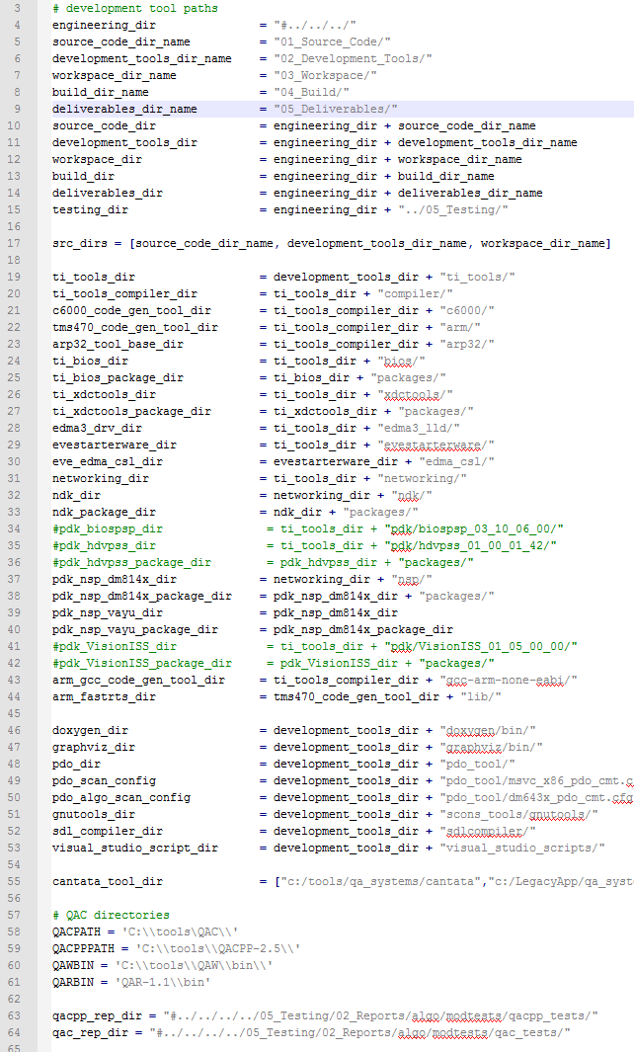
Generic Scons
scons_tools\scons_common_config\common_config.scfg
Provided by Generic Scons, nothing to be done here!!!!
Definition of common directroy paths:
Project subdirectory structure
ti_tools subdirectory structure
Further relevant subfolders in 02_Development_Tools
Cantata installation paths (several possibibilities)
QAC installation folders
Install directories for QAC reports

Slide 58
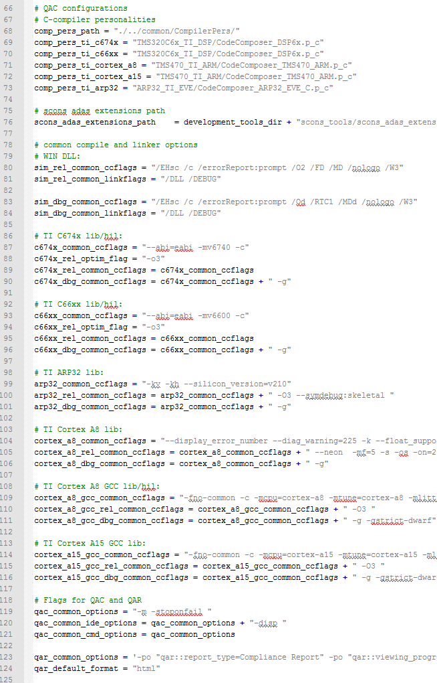
Generic Scons
scons_tools\scons_common_config\common_config.scfg
Relevant QAC files
Path to scons adas extensions
Global compiler setting for release and debug (Those are set per default in GenericScons):
Visual Studio compiler
C674x
C66xx
Arp32
Cortex A8
Cortex A15
QAC, QAR
Those compiler settings need not be set by the components for the respective variants.

Slide 59
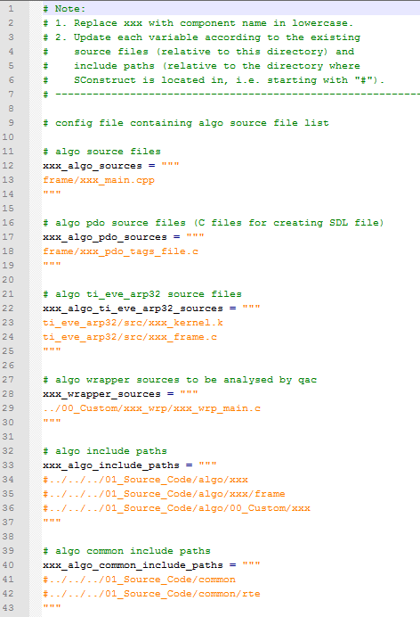
Generic Scons
01_Source_Code\algo\xxx\algo_lib_file_list.scfg
The following information is required for individual variables:
xxx_algo_sources:
Sources required for algo libraries
Specify relatively to current folder
xxx_algo_pdo_sources:
Specify .c-file(s) which is/are relevant for sdl-generation
Get info from makesdl-file which is generated by visual studio project (typically sim_swc_xxx)
xxx_algo_ti_eve_arp32_sources:
Specify first .k-files, then .c-files
If the there .c- and .k-files with the same, only write the .k-file (.c-files are generated by the compiler)

Slide 60
Generic Scons
01_Source_Code\algo\xxx\algo_lib_file_list.scfg
The following information is required for individual variables:
xxx_wrapper_sources:
C(++)-sources which are utilized by the frame software, but which are not compiled for libraries
Those sources are to be analyzed by QAC
Advice: Leave it empty at first!
xxx_algo_include_paths:
Include paths for compiling xxx_algo_sources
Specify relative to Sconstruct directory, i.e. staring with “#”, since for Scons “#” specifies the directoy, the Sconstruct lies in. (This holds for any include paths specified for GenericScons!!!!)
xxx_algo_common_include_paths:
Include paths which are common to all/some components, but which are not maintained by the component in question.

Slide 61
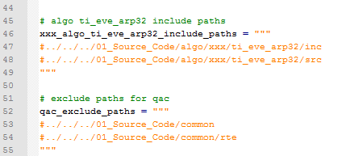
Generic Scons
01_Source_Code\algo\xxx\algo_lib_file_list.scfg
The following information is required for individual variables:
xxx_algo_ti_eve_arp32_include_paths:
Include paths for xxx_algo_ti_eve_arp32_sources
Specify relative to Sconstruct directory
qac_exclude_paths:
QAC, per default analyzes all header files included by the source code under test
For QAC report only those header files are relevant which are maintained by the component’s team
Specify include directories which do not contain headers from component’s team
Generic Scons per default already excludes compiler headers.

Slide 62
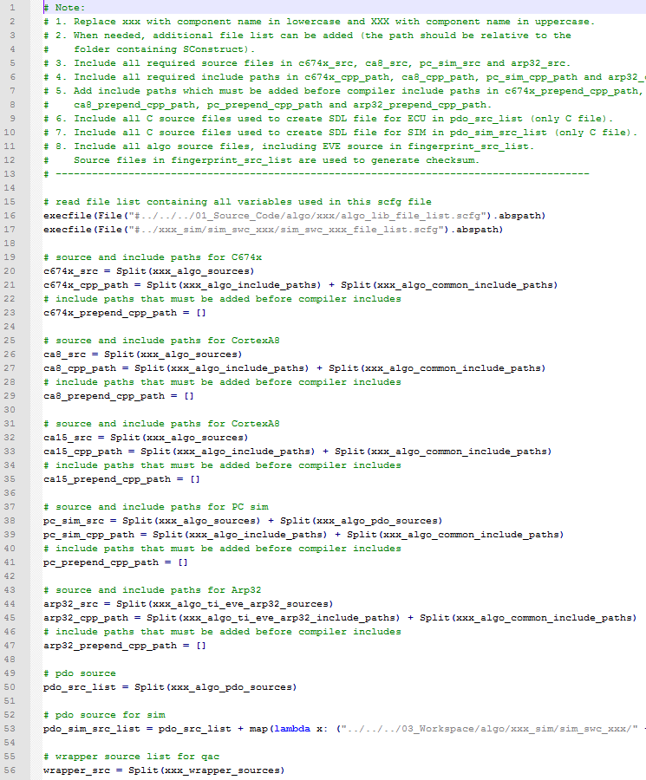
Generic Scons
01_Source_Code\algo\xxx\algo_config.scfg
The following information is filled in for indiviual variables:
c674x_src:
Sources used for c674x and c66xx ECU library
c674x_cpp_path:
Include paths for c674x and c66xx ECU library
ca8_src:
Sources used for Cortex A8 ECU library
ca8_cpp_path:
Include paths for Cortex A8 ECU library
Accordingly for ca15_src, pc_sim_src, arp32_src.
pdo_src_list:
C-sources for sdl-file dedicated for ECU libraries
pdo_sim_src_list:
C-sources for cdl-file(s) dedicated for PC simulation targets
wrapper_src:
Additionally analyzed source code for QAC

Slide 63
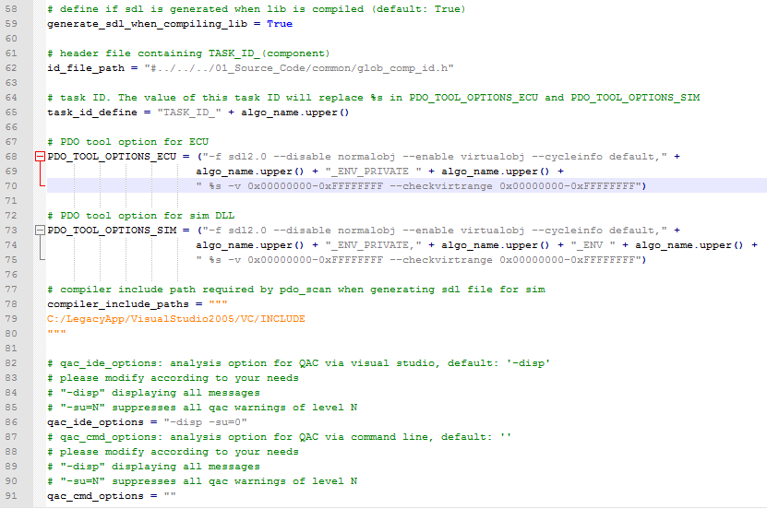
Generic Scons
01_Source_Code\algo\xxx\algo_config.scfg
The following information is filled in for indiviual variables:
generate_sdl_when_compiling_lib:
Obvious
id_file_path:
It should be assured that this file is really to be used
It contains IDs for individual components
That ID is written to %s in PDO_TOOL_OPTIONS_ECU and PDO_TOOL_OPTIONS_SIM
PDO_TOOL_OPTIONS_ECU
Command line options for pdo tool
Need to be extracted from makesdl-file generated by Visual Studio Project (see below)
PDO_TOOL_OPTIONS_SIM
Correspondingly
Remark on pdo options:
_ENV_PRIVATE from example needs to be the same for ECU and SIM, possibly needs to be replaced by _ENV_PVT
Refer to function owner or .c-pdo files in doubt
We will deal with QAC options in Section 5a

Slide 64
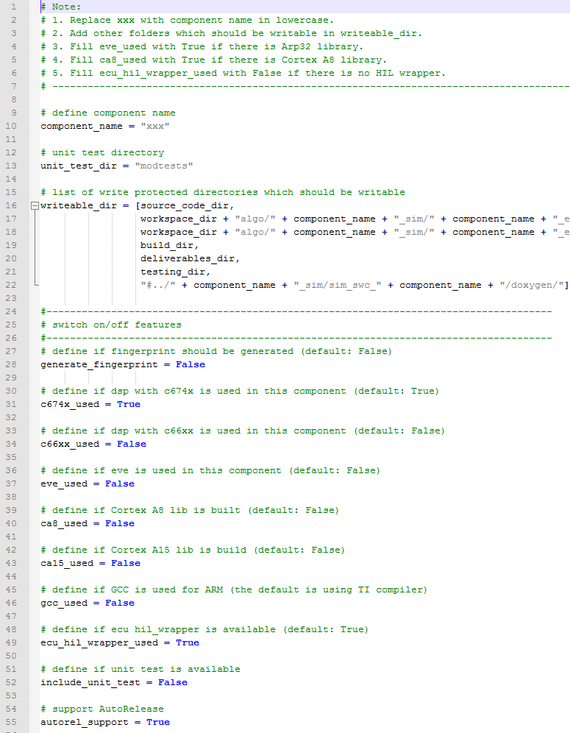
Generic Scons
03_Workspace\algo\xxx\sconstruct_config.scfg
The following information is filled in for indiviual variables:
unit_test_dir:
Directory under 05_Testing\05_Test_Environment\algo where qac- and cantata tests are stored
writable_dir:
Directories where write-protection needs to be removed
Flags to activate corresponding features:
generate_fingerprint (only LD used this)
c674x_used
c66xx_used
ca8_used
ca15_used
gcc_used: Cortex A8 library is compiled either with TI Compiler (TMS470) or GCC
ecu_hil_wrapper_used: Build of Hil out files
include_unit_test: Activate Cantata unittests
autorel_support: Activate Auto release feature

Slide 65
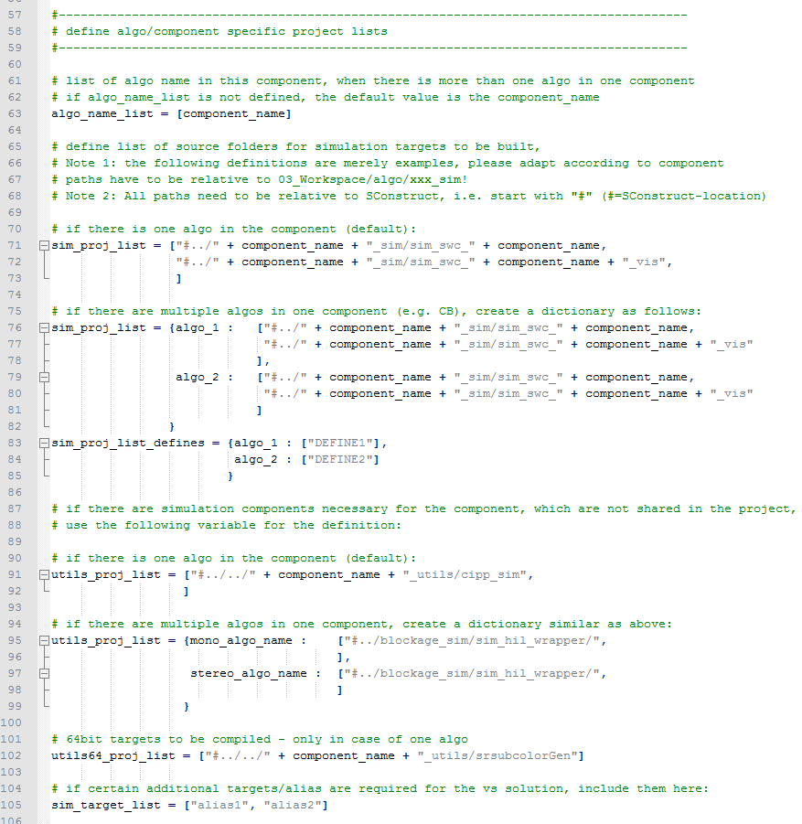
Generic Scons
03_Workspace\algo\xxx\sconstruct_config.scfg
The following information is filled in for indiviual variables:
algo_name_list:
Typically a component has one algo → as in example
For an example with multiple algos see below
sim_proj_list:
Specify the PC simulation plugin folders which are shared to the projects (like SMFC4B0)
utils_proj_list:
Specify PC simulation plugins which are NOT shared to the projects (like SMFC4B0)
utils64_proj_list:
Specify 64bit PC simulation plugins which are NOT shared to the projects (like SMFC4B0)
sim_target_list:
Visual Studio provides a certain list of build targets to be built
Aliases specified here are added to that list such that those can also be built from Visual Studio.
Remarks:
If only one algo is there, lines 71-73 are used instead of 75-85.
If there are no “utilities”, variables utils_proj_list, utils64_proj_list shall be removed.

Slide 66
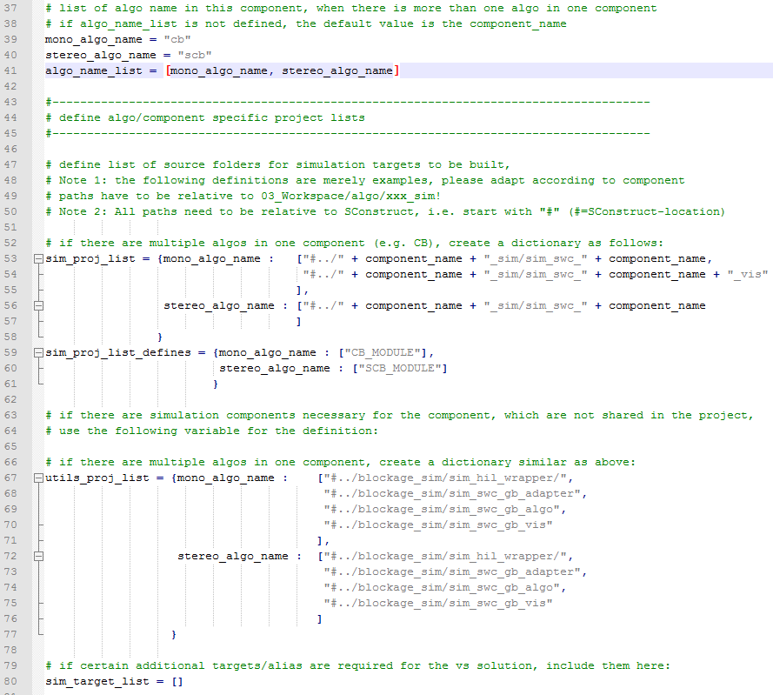
Generic Scons
CB\04_Engineering\03_Workspace\algo\gb\sconstruct_config.scfg
Example for a component with two algos (CB and SR use this “subalgo feature”)
Algos differ in the respective sets of defines
algo_name_list:
List with algo names
Function owner defines the names
sim_proj_list:
Dictionary with PC simulation targets dedicated to respective algos
sim_proj_list_defines:
Dictionary with differing macros
Similar for utils_proj_list

Slide 67
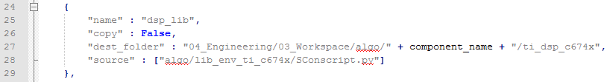
Generic Scons
03_Workspace\algo\xxx\sconscript_setup_config.scfg
File consists of blocks of the following form:
“name”: name of the feature, only for documentation, not read by Generic Scons
“copy”: flag to copy the files given under “source” to “dest_folder”
Possibly additional blocks necessary, e.g., for PC simulation plugins
Relation to scons.bat:
First execute sonscript_setup.py: copy Sconstruct-, Sconscript-files to sandbox
Then execute scons.py

Slide 68
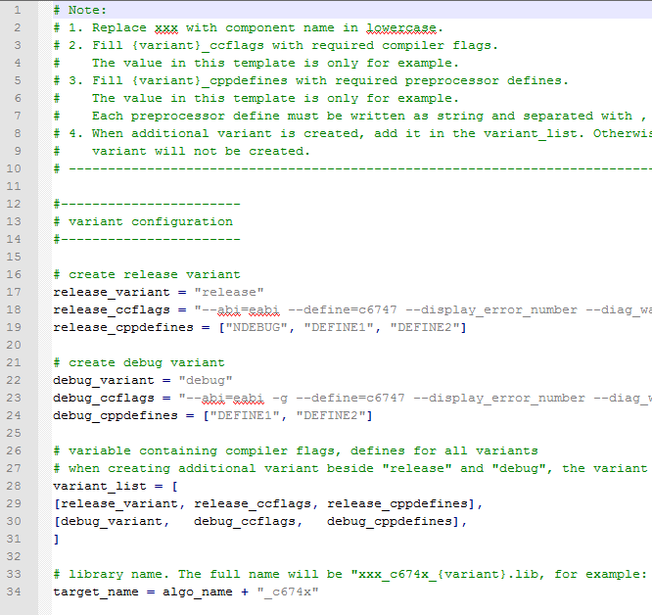
Generic Scons
ECU Libraries
The following structure applies also to the following .scfg-files:
03_Workspace\algo\xxx\ti_eve_arp32\ti_arp32_lib_config.scfg
03_Workspace\algo\xxx\ti_arm_cortex_a8\ti_arm_cortex_a8_lib_config.scfg
03_Workspace\algo\xxx\ti_arm_cortex_a15\ti_arm_cortex_a15_lib_config.scfg
Purpose: Definition of variants of ECU library for c674x, fill in:
Name of variant (=_variant)
Compiler Flags (=_ccflags)
Macros (=_cppdefines)
Typically: release and debug
Further variants maybe required
“target_name” indicates the file name of the library
Please refer to makefiles or the information that is provided by funtion owner

Slide 69
Generic Scons
PC Simulation Plugins
Plugin folder which are shared to projects are located in 03_Workspace\algo\xxx_sim
Plugin folder which are NOT shared to projects are NOT located in 03_Workspace\algo\xxx_sim, e.g.
SR: 03_Workspace\sr_utils
TSA: 03_Workspace\tsa_utils
CB: 03_Workspace\algo\blockage_sim
Three different kinds of plugins:
SWC
→ Sconscripts from scons_common_scripts\sim\sim_swc (to be set in sconscript_setup_config.scfg)
→ Templates from 03_Workspace\algo\xxx_sim\sim_swc_xxx
Visualization
→ Sconscripts from scons_common_scripts\sim\sim_swc_vis (to be set in sconscript_setup_config.scfg)
→ Templates from 03_Workspace\algo\xxx_sim\sim_swc_xxx_vis
Adapter
→ Sconscripts from
scons_common_scripts\sim\sim_adapt or
scons_common_scripts\sim\sim_lib or
scons_common_scripts\sim\sim_exe,
depending on the type (to be set in sconscript_setup_config.scfg)
→ Templates from 03_Workspace\algo\xxx_sim\xxx_adapter

Slide 70
Generic Scons
PC Simulation Plugins
How to distinguish those different kinds?
In the component’s Visual Studio project (not the one generated by Generic Scons!): Press right-click on the project -> Configuration Properties -> Build Events
Open Pre-Build-Event.
If command line contains “mk_pdo_sdl.vbs” → SWC
If it’s not an SWC-plugin, open Pre-Link-Event.
If command line contains res_patch.vbs → Visualization
Else → Adapter.
Identify the type to be built (.dll (most likely), .lib, or .exe)
Activation of a PC Simulation plugin in GenericScons:
Add copy command for corresponding Sconscript in 03_Workspace\algo\xxx\sconscript_setup_config.scfg
Add the plugin’s folder in 03_Workspace\algo\xxx\sconstruct_config.scfg
Add templates and modify according to individual steps in the templates and the following more detailed explanations
All related templates not covered in following can be used in the same way as for an SWC-plugin

Slide 71
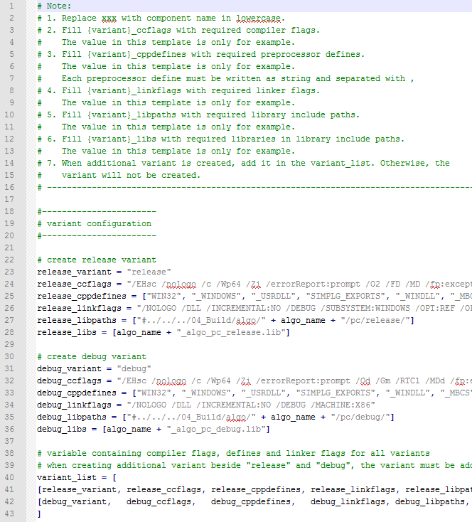
Generic Scons
03_Workspace\algo\xxx_sim\sim_swc_xxx\simenv_config.scfg
simenv_config.scfg has essentially the same structure for all kinds of plugins
Variant configuration (typically release and debug), fill in:
Name of variant (=_variant)
Compiler flags (=_ccflags)
Macros (=_cppdefines)
Linker flags (=_linkflags)
(Component) Libraries to be linked in (=_libs)
Paths to those libraries (=_libpaths)
Required build settings can be extracted from component’s Visual Studio project, Right click on properties
More variants can be added
Those need to be added in lines 40-43 in template.

Slide 72
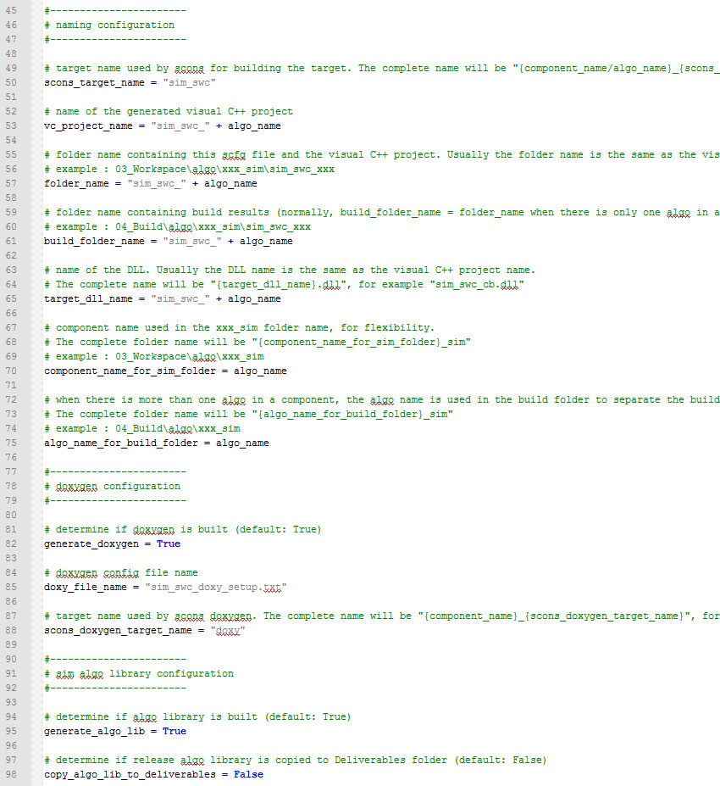
Generic Scons
03_Workspace\algo\xxx_sim\sim_swc_xxx\simenv_config.scfg
The following information is filled in for indiviual variables:
Naming configurations
“scons_target_name” needs to be unique (in case there are several PC simulation plugins
“vc_project_name” is not used any more
For the other variables, please refer to comments in template
Doxygen configuration
En-/Disabled by “generate_doxygen”
If this shall be enabled a doxy input file need to be checked into the plugin’s folder
For the path to corresponding sources please refer to Doxygen documentation, https://cws1.conti.de/content/00012669/Team%20Documents/03_General/06_Process/01_ModuleTests/Cantata/CKP%20Resources%20(meeting%20minutes,%20slides,%20etc)/DOORS_L3_Design_Spec_Creation/ExportSoftwareDesignFromDoxygenXMLtoDOORS.docx
A plugin specific doxy alias can be defined by „scons_doxygen_target_name“
Algo Library configuration
PC library may be generated for the PC simulation plugin
For every variant this can only be done once, since otherwise, Scons reports an error
For activating „copy_algo_lib_to_deliverables“ ask function owner.

Slide 73
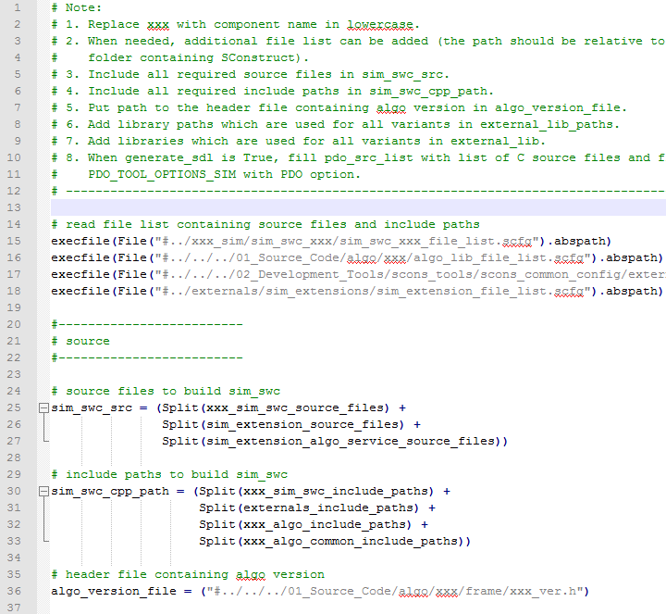
Generic Scons
03_Workspace\algo\xxx_sim\sim_swc_xxx\sim_swc_config.scfg
Reading other relevant .scfg-files mainly for definition of python variables which contain source list and/or include lists
The following information is filled in for indiviual variables:
“sim_swc_src”: Definition of source list for PC simulation plugin
“sim_swc_cpp_path”: Definition of include paths
“algo_version_file”:
This file contains the algo version number (XX.YY.ZZ)
Only required if “patch_rc_file = True”, see next slide.
If this file is not found, refer to funtion owner

Slide 74
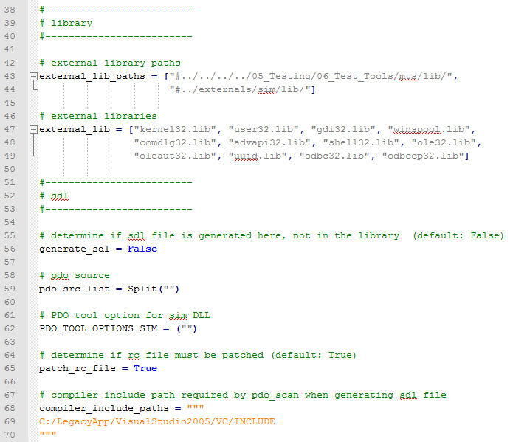
Generic Scons
03_Workspace\algo\xxx_sim\sim_swc_xxx\sim_swc_config.scfg
The following information is filled in for indiviual variables:
“external_lib”:
External libraries to be linked in plugin
Verify with component’s Visual Studio in Linker command
“external_lib_paths”:
Adapt if necessary

Slide 75
Generic Scons
03_Workspace\algo\xxx_sim\sim_swc_xxx\sim_swc_config.scfg
The following information is filled in for indiviual variables:
sdl-flags:
Some plugins require an sdl- and a resulting cdl-file
Check Visual Studio if an sdl is generated, if yes, please refer to makesdl for the pdo tool configurations
“patch_rc_file”:
For a SWC-plugin a .res-file is generated from an .rc-file
This may be patch with the algo version number from “algo_version_file”
If “patch_rc_file = False”, “algo_version_file” need not be specified
“compiler_include_paths”:
Here Visual Studio 2005 is declared
A future move to a more recent version of Visual Studio requires a change here.

Slide 76
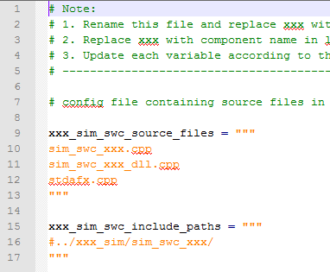
Generic Scons
03_Workspace\algo\xxx_sim\sim_swc_xxx\sim_swc_file_list.scfg
Specify:
File lists
Include paths

Slide 77
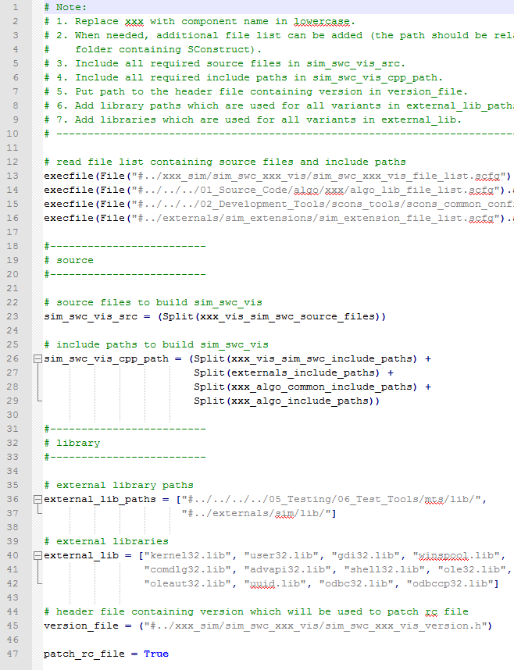
Generic Scons
03_Workspace\algo\xx_sim\sim_swc_xxx_vis\sim_swc_config.scfg
Essentially the same as for the SWC-plugin
“patch_pc_file”:
instead of “algo_version_file” the variable “version_file” is used
Possibly refer to funtion owner or Visual Studio project

Slide 78
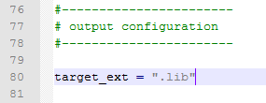
Generic Scons
03_Workspace\algo\xxx_sim\xxx_adapter\simenv_config.scfg
This file has the same structure as in the case of an SWC-plugin
BUT: Additional block “output configuration”:
Definition of target type in “target_ext”
If this variable is not set, it is per default set to “.dll”
Only SR generates PC simulation plugins which are not dll’s

Slide 79
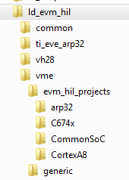
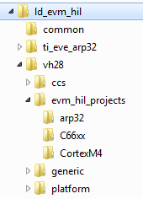
Generic Scons
HIL simulation targets
Folder structure (example from LD)
Folder vme contains sources for
outfiles for VISION MID EVE
C674x, if a C674x Lib is built
ARP32, if an ARP32 Lib is built
CortexA8
CortexA8Only, if a CortexA8
Lib is built
Folder vh28 contains sources for
outfiles for VISION HIGH 28
C66xx, if a C66xx Lib is built
ARP32, if an ARP32 Lib is built
CortexA15, if a Cortex A15 Lib is built
(e.g. SR)
CortexM4
Common: sources used for both vme
and v28

Slide 80
Generic Scons
HIL simulation targets – Activation
In 03_Workspace\algo\xxx\sconstruct_config.scfg set
ecu_hil_wrapper_used = True
In 03_Workspace\algo\xxx\sconscript_setup_config.scfg activate copy of related Sconscripts
Copy templates to individual folders and adapt accordingly
Remark: Apart from source lists and include lists, almost nothing is expected to have to be changed
There are only templates for VME targets
For appropriate examples for VH28 configurations please refer to the ones from LD and SR
ToDo: Create suitable templates for VH28.

Slide 81
Generic Scons
HIL simulation targets – organisation
Each folder requires
hil_env_config.scfg
→ corresponds to simenv_config.scfg from PC Simulation plugins
ti_<core>_sim_hil_file_list.scfg
→ corresponds to sim_swc_xxx_file_list.scfg from PC Simulation plugins
ti_<core>_sim_hil_config.scfg
→ corresponds to sim_swc_xxx_scfg from PC Simulation plugins
Since HIL-Sim .scfg’s are very similar to PC -Sim.scfg, we will only cover particularities.

Slide 82
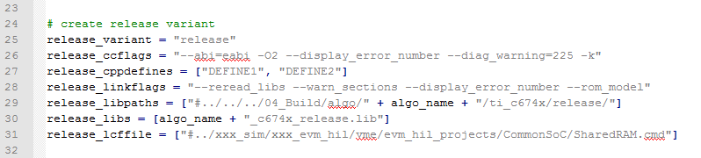
Generic Scons
evm_hil_projects\<core>\hil_env_config.scfg
Excerpt:
<variant>_libs must contain related ECU Library, excluding:
Cortex A8, since then no Cortex A8 Library is used built
Cortex M4.
Possibly further libraries (e.g. from TI) need to be taken into account

Slide 83
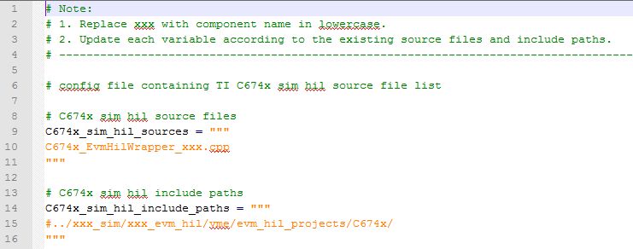
Generic Scons
evm_hil_projects\<core>\ti_<core>_sim_hil_file_list.scfg
Example from C674x:
“<core>_sim_hil_sources” requires only one file.

Slide 84
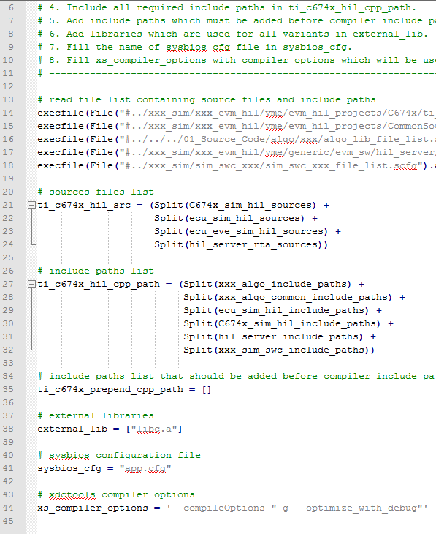
Generic Scons
evm_hil_projects\<core>\ti_<core>_sim_hil_config.scfg
“sysbios_cfg”:
For some HIL targets it is necessary to generate a sysbios (TI operating system)
A configuration file is necessary here
Generated with XDC-tools
“xs_compiler_options” contain flags for the sysbios generation

Slide 85
GenericScons –
GenericScons flags

Slide 86
GenericScons flags
verbose=< 0 | 1 >:
If activated, full commands are displayed on command line
skip_ide_generation=< 0 | 1>:
If activated all build commands for IDE generation are ignored
When Building from DIE, this flag is always set
build_from_ide=< 0 | 1 >:
(De)Activate certain mode of installing build targets to 05_Testing
Please refer to scons_tools\docs\Scons_build_environment.docx
build_from_vs=< 0 | 1 >:
Build commands for Hil targets are ignored
Always set when building from Visual Studio
Motivation: Optimization of Reading Sconscript files
build_from_ccs=< 0 | 1 >:
Build commands for PC Simulation targets are ignored
Always set when building from CCS
Motivation: Optimization of Reading Sconscript files

Slide 87
GenericScons flags
custom_sim_copy=< 0 | 1 >:
Custom way of installing PC Simulation targets to 05_Testing
Only used by SR
profile=< 0 | 1 >:
Measure reading time for Sconscript files
Written to 03_Workspace\algo\xxx\profile.txt
-h:
Display help menu including list of aliases
install_to_deliverables_dir=<variant>
Per default, when building from command line, only release variants are installed to 05_Deliverables
With this flag also other variants may be selected for that
-j N:
Use multi-thread build with N cores

Slide 88
GenericScons – Particularities with some components

Slide 89
Generic Scons
Particularities with some components
SR:
Maintain so-called „utilities“ (03_Workspace\sr_utils)
= PC simulation plugins, which are not shared to projects
Specified in 03_Workspace\algo\sr\sconsctruct_config.scfg
Use shared SConscripts
Further SR-specific SConscript‘s:
03_Workspace\sr_utils\SConscript_utils.py – called from 03_Workspace\algo\sr_sim\Sconscript_sim.py – which calls
01_Source_Code\algo\00_Custom\sr_wrp\SConscript_priv.py
Three sub-algos: sr, sr_mid, sr_entry
TSA:
Also Maintain so-called „utilities“ (03_Workspace\tsa_utils)
Built from 03_Workspace\tsa_utils\SConscript_utils.py
Use TSA-specific Sconscripts
→ ToDo: Move to 03_Workspace\algo\tsa\sconstruct_config.scfg with shared Sconscripts as with SR

Slide 90
Generic Scons
Particularities with some components
CB:
Also maintains „utilities“ under 03_Workspace\algo\blockage_sim
Use some shared and some component-specific Sconscripts
Two sub-algos: CB and SCB (=Mono, Stereo)
EMO:
Contains two components: MEMO, SEMO, so NOT two subalgos, but two „sub-components“ with individual GenericScons environments
When building MEMO needs to be built first for certain build targets
Note: All those „utilities“ are not shared to projects, they can only be built from base development!
Master Sconscript for PC simulation plugins
Earlier: 03_Workspace\algo\xxx_sim\Sconscript.py (component-specific)
Recent: 03_Workspace\algo\xxx_sim\Sconscript_sim.py (shared)
Roughly 50% of components use shared version
→ ToDo: Move components to new version!

