Slide 1

Generic Scons – Test Tools integration
Dr. André Fischer
ITK Engineering AG

Slide 2
GenericScons: Developer‘s point of view
Goals:
Understand configurations of QAC
GenericSCons workflow for QAC
Performing QAC tests via
Command line
Visual Studio
Basic information about Cantata

Slide 3
Generic Scons
Agenda
QAC
Cantata

Slide 4
GenericScons –
QAC

Slide 5
Generic Scons
Crash course on QAC
QAC performs static code analysis
Goal: Code is required to meet certain standards, e.g. MISRA rules
QAC needs to read the code in exactly the same way as the corresponding compiler does (ideally!)
Usage:
GUI
Command line -> interface for GenericScons
Configuration:
“Compiler Personality”: options that reflect the configuration of your compiler
“Analysis Personality”: analysis options that are associated with project, e.g., macros in use, include/exclude paths, etc.
“Message Personality”: messages are enabled and how output is displayed

Slide 6
Generic Scons
Crash course on QAC
Include/Exclude options
Analysis of one component needs to be based on the component’s source code only
BUT: Components generally use also code that
Is shared by other components/projects
Is provided by the compiler
This code needs to be excluded from analysis! → exclude paths.
Compiler includes
QAC generally does not understand compiler headers
Instead of compiler headers, artificial substitute headers are used which
Allow to understand the code,
Do not differ too much from the actual compiler includes.

Slide 7
Generic Scons
QAC input
Required QAC-relevant shares are configured under 05_Testing\05_Test_Environment\algo\modtests\qac_tests\common resp.
05_Testing\05_Test_Environment\algo\modtests\qacpp_tests\common
Please refer to 02_Development_Tools\scons_tools\docs\qac\QAC_manual.docx

Slide 8
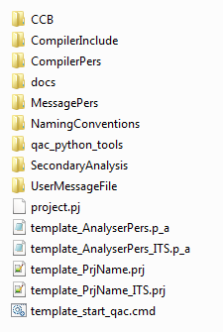
Generic Scons
The common – folder
Relevant for GenericScons:
CompilerInclude contains header files which serve as a substitute for actual compiler headers
CompilerPers contains compiler personalities for required compilers
MessagePers contains message personality
qac_python_tools contains a template for the analysis personality and relicts from earlier
SecondaryAnalysis contains a batch file triggering a secondary analysis
UserMessageFile contains file with MISRA rules.
For more information on contents of this folder, please refer to Gurucharan Kulkarni

Slide 9
Generic Scons
Using QAC with GenericScons
Possible with GenericScons Release ≥ AL_ETK_SCT_01.05.00
Goal: Generation of QAC-compliance reports for the code for
DSP-library with C674x-compiler
DSP-library with C66xx-compiler
(EVE-library with ARP32-compiler)
ARM Cortex A8-library with TI-compiler/GCC
ARM Cortex A15-library with GCC
Not all components deliver reports for all libraries they build
Aliases in GenericScons:
xxx_qac -> generate all compliance reports
xxx_qac_<core> -> generate compl. report for <core >
xxx_qac_<core >_proj -> generate QAC project for <core >
where xxx stands for the component resp. algo and <core> = „ti_c674x“, „ti_c66xx“, „ti_arp32“, „ti_cortex_a8“, „ti_cortex_a15“

Slide 10
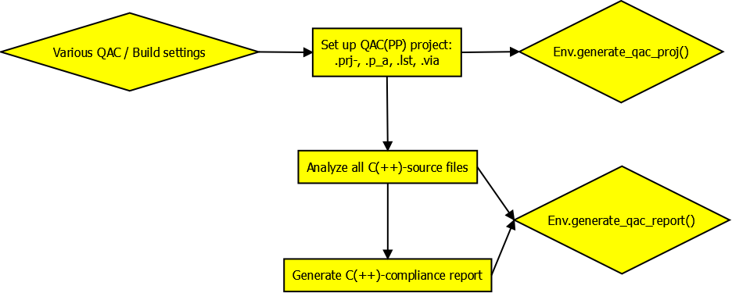
Generic Scons
Using QAC with GenericScons

Slide 11
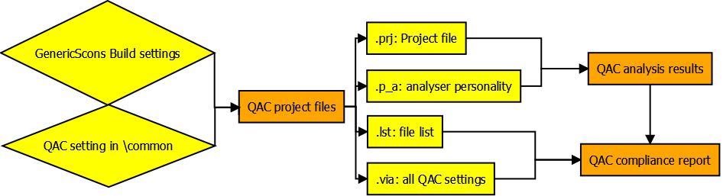
Generic Scons
Using QAC with GenericScons

Slide 12
Generic Scons
Using QAC with GenericScons
Remarks
Generation of .prj-file:
Based on template 05_Testing\05_Test_Environment\algo\modtests\qac_tests\common\qac_python_tools\QAC_prj_template.txt
Generation of .p_a-file:
Default: Based on 05_Testing\05_Test_Environment\algo\modtests\qac_tests\xxx\QAC_p_a_template.txt
If it does not exist, based on 05_Testing\05_Test_Environment\algo\modtests\qac_tests\common\qac_python_tools\QAC_p_a_template.txt
.lst- and .via-file are generated from scratch
Output directories for results:
QAC project files: 05_Testing\05_Test_Environment\algo\modtests\qac(pp)_tests\xxx
Source code analysis: 05_Testing\05_Test_Environment\algo\modtests\qac(pp)_tests\xxx\output
Compliance Report: 05_Testing\02_Reports\algo\modtests\qac(pp)_tests\

Slide 13
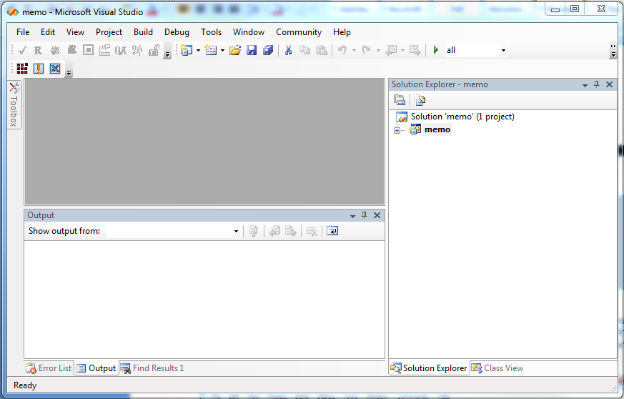
Generic Scons
Using QAC with GenericScons – Via Visual Studio
Idea: Deal with QAC warnings in a comfortable way in IDE
Requirements:
Generation of compliance report possible without QAC errors
Generation of Visual Studio solution xxx.sln as introduced by AL_ETK_SCT_01.03.01 (see 02_Development_Tools\scons_tools\docs\release_notes\)
→ Alias to choose from configuration manager
→ One project per component

Slide 14
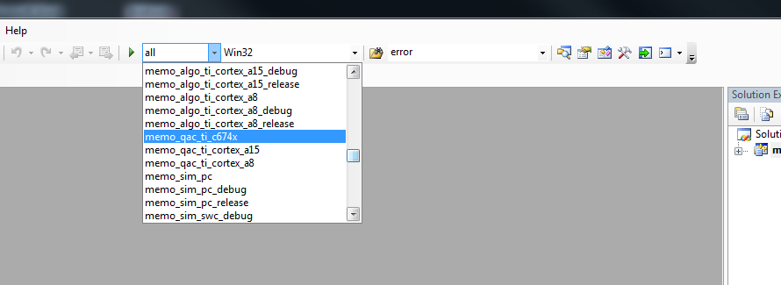
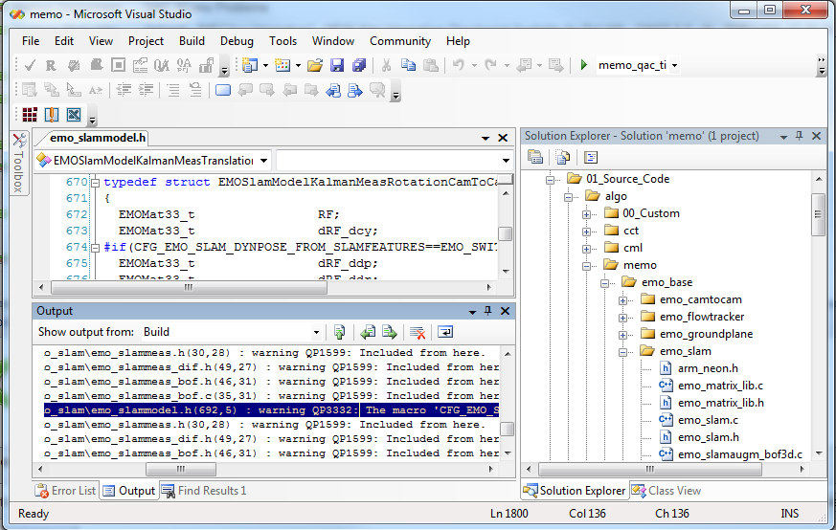
Generic Scons
Using QAC with GenericScons – Via Visual Studio
Choose desired QAC-Alias
Build the solution
-> „scons.bat <qac-target>“ is executed
Double-Click on warning messages opens source file

Slide 15
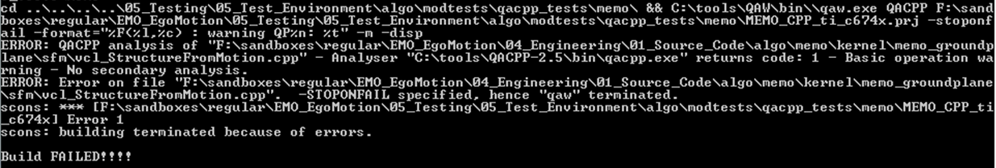
Generic Scons
Remarks
C-Code: Generating compliance reports generally works well.
C++-Code: Generally causes trouble because of parsing errors during analysis.
Possible resolution: Analyze source code „by hand“ in QACPP GUI, open message explorer and
Create a component-specific .p_a-template QACPP_p_a_template.txt in
05_Testing\05_Test_Environment\algo\modtests\qacpp_tests\xxx\
modifying set of makros/rules, etc. and/or
Modify/Correct compiler includes being read by QACPP in 05_Testing\05_Test_Environment\algo\modtests\qacpp_tests\common\CompilerInclude
It is possible to analyze also single files instead of all source files for ECU library
For more details please refer to 02_Development_Tools\scons_tools\docs\generic_scons_features\QAC_manual.docx

Slide 16
GenericScons –
Cantata

Slide 17
Generic Scons
Cantata
Activation of Cantata (overview):
Set up folder 05_Testing\05_Test_Environment\algo\modtests\cantata_tests\xxx according to scons_tools\docs\cantata\ETK_SCT_SCons_Cantata_Integration.docx
03_Workspace\algo\xxx\sconstruct_config.scfg:
include_unit_test=True
03_Workspace\algo\xxx\sconscript_config.scfg:
Activate copy of unittest-Sconscripts
Generate and modify 05_Testing\05_Test_Environment\algo\modtests\cantata_tests\xxx\unit_test.scfg
according to needs

Slide 18
Generic Scons
Cantata
Remarks
Installation of Cantata affects installation of Visual Studio 2005:
Cantata C-Compiler is named „cl.exe“ and replaces the Visual Studio compiler in C:\LegacyApp\VisualStudio2005\VC\bin
Visual Studio compiler is renamed to „ms_cl.exe“
Consequences:
If GenericScons detects a Cantata installation, the build environment for PC simulation requires „ms_cl“ instead of „cl“ for „CC“
This is done in scons_tools\scons_common_scripts\sim_sconscript\Sconscript_sim.py
Typical error:
For execution of a unit test, ipg.cop of that unittest is copied to 03_Workspace\algo\xxx
If this unit test succeeds, this file is deleted again.
If not, it remains there
→ This causes builds for any PC targets to fail!!
Resolution: Remove ipg.cop.
For further support, please refer to Andreas Jahnke

