Slide 1
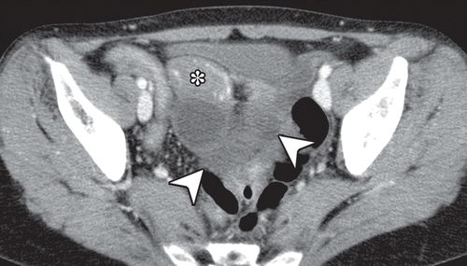
Intended question type:
Anki card
Generated question:
A 58-year-old woman presents with a 1-day history of intermittent abdominal pain and vomiting. She has a history of three normal pregnancies. The figure shows her contrast-enhanced CT and intraoperative images. What abnormality is indicated by the cluster of small bowel loops and the deviation of the uterus?
Generated answer:
Broad ligament hernia

