Slide 1







Yale Department of Radiology Policy Chatbot
Database
Engine
User Interface
Users
Backend
Tool Access
Clarity Interface
(Existing UI)
Chats
RAG
MCP Server
Chat Agent API
------------
OpenAI API (o4-mini) +
OpenAI Agentic SDK +
FastAPI
Messages
Tool Usage
Tool
Access
Question
Web Application
(internal or public URL)
Question
Policies
Policy Lookup
Policy Chunks
Answer
Chunk Vectors
Policy Updates
Data Collection
Look for relevant URLs
Answer
Scraper
Crawler
Populate
Chat Snippet
(Pop-up Window)
Answer
Manage
Extract and save policy content (uses OpenAI’s o3-mini)
Provides a single Policy URL or a rot URL to begin tree-based search
RAG: Retrieval Augmented Generation
MCP: Model Context Protocol

Slide 2
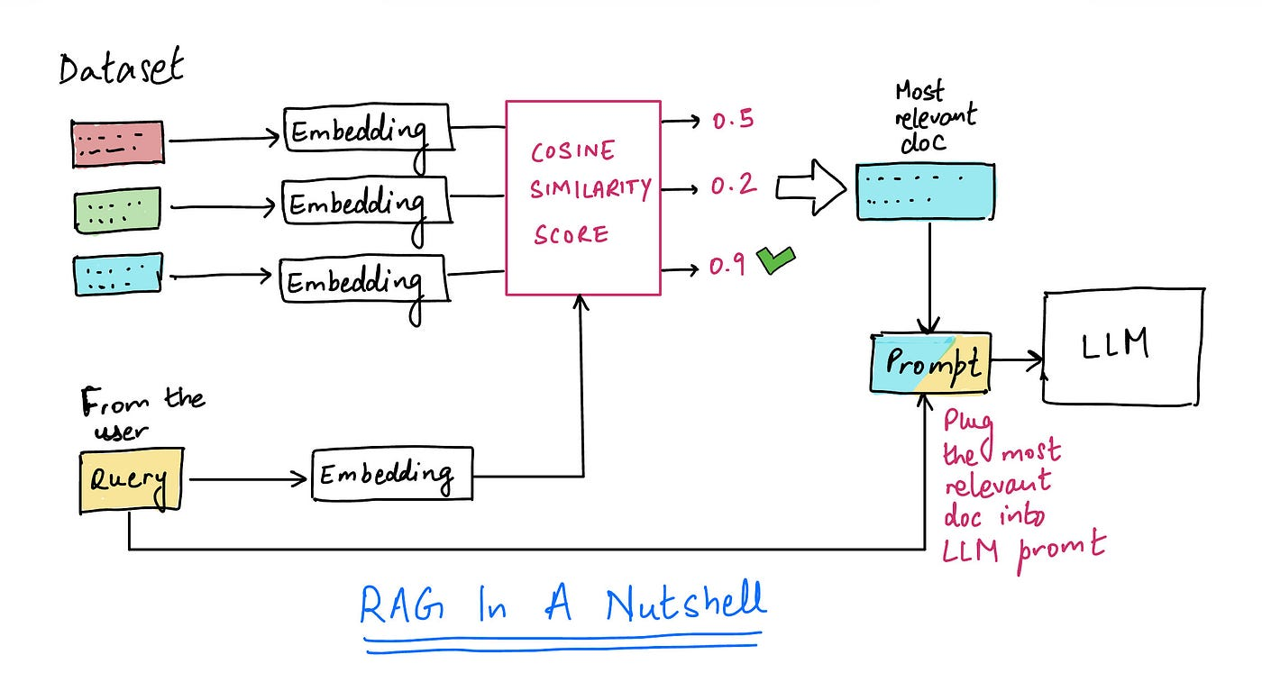
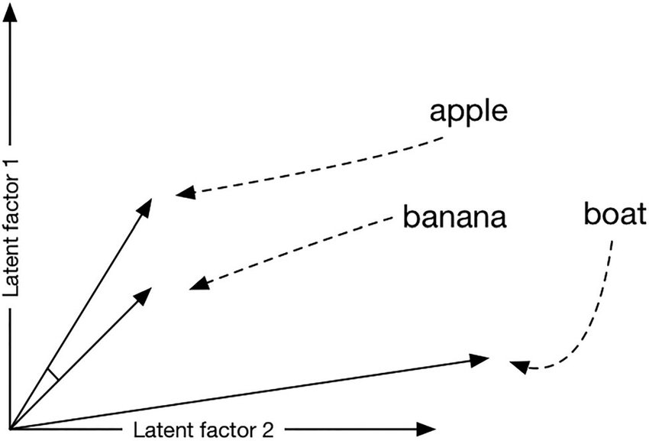
Retrieval Augmented Generation

Slide 3
Technology Stack
Backend
Frontend
Core Language: Python 3.10+
Framework: FastAPI
Server: Uvicorn (ASGI)
AI Provider: OpenAI API
Agent Framework: OpenAI /Agentic SDK
Tool Protocol: Model Context Protocol
Async Runtime: Asyncio
Data Validation: Pydantic
Authentication: JWT (python-jose) + passlib
CLI Interface: Typer
Framework: Next.js 15.3 (App Router)
Language: TypeScript
Styling: Tailwind CSS 4
UI Components: shadcn/ui and Radix UI
State Management: React Context API
Form Handling: React Hook Form with Zod validation
Animations: Framer Motion
HTTP Client: Native Fetch API
Streaming: Server-Sent Events via Microsoft's fetch-event-source
DNS Management: Cloudflare
Additional Libraries: date-fns - Date formatting and manipulation react-markdown - Markdown rendering sonner - Toast notifications lucide-react - Icon system next-themes - Theme management js-cookie - Cookie management
Data Collection
Web Automation: Selenium + Requests
Document Processing: Markdownify (for markdown generation) + Mistral API (for OCR)
Database: PostgreSQL + pgvector + SQLAlchemy

Slide 4
Cost Structures
Current chat (agent) model: OpenAI O4-mini
1.1$ / million input tokens
4.4$ / million output tokens
Currently using my personal API.
Current embedding model: OpenAI text-embedding-3-small
0.02$ / million tokens
Currently using my personal API.
Current domain: https://ydrp.chat
purchased at 5$ for first year.
Renews at 26$ / year in April 2026.
Easy to change to another domain.
DNS management, tunneling, and SSL certificates by Cloudflare is free.

Slide 5
Policy Sources
There are currently around 90 policies indexed in the chatbot:
These are automatically scraped from the Yale Intranet.
Scraping happened up to 6 levels of branching from: https://medicine.yale.edu/diagnosticradiology/facintranet/policies
Not sure if above the URL is still active or if it has been changed to: https://medicine.yale.edu/radiology-biomedical-imaging/intranet/division-of-bioimaging-sciences-policies-sops-and-forms/
If the URL has changed and all target policies can now be downloaded as a zipped PDF file, we would need to rewrite the code for data collection and database building. However, the overall logic would ultimately be more straightforward.

Slide 6
Additional Considerations
The current version of the chatbot is not HIPPA safe.
Both embedding model and the chat model send data to OpenAI servers.
The current “ydrp.chat” domain is password-protected, but public.
The source codes for the chatbot (but not the policy data) are also available publicly on my GitHub (here and here).
The database, MCP, agent backend, and frontend are all currently running on the neurodl server (on separate tmux sessions).
The website will become unavailable if the server restarts or the tmux sessions shut down.
We can separate the servers for each of these.
The current setup is production-ready and modular, so that:
We can share ydrp.chat (or another domain) with the users, or replace the UI, agent, etc. with internal URLs, Clarity, etc.
The current login mechanism for ydrp.chat is basic.
The admin should define users and their passwords for now.
This can be easily replaced with an advanced login mechanism later on.

