Slide 1
Improving Full Stack Web Application Performance: A Study on Rendering and API Response Strategies using React and Java Spring Boot
Pourna devi ak
2023tm93602

Slide 2
Current Application
Performance is key in modern web apps.
Unoptimized React + Spring Boot application fetches all 50,000+ records in a single call.
Baseline implementation shows slow rendering, high API response time, and poor scalability.
Future optimization plans: database indexing, pagination, caching, frontend rendering strategies.

Slide 3
Application Overview
Frontend: ReactJS 18
Backend: Spring Boot 3.2.5
Database: PostgreSQL
Core Modules:
Product Listing
Cart Management
Checkout Operations

Slide 4
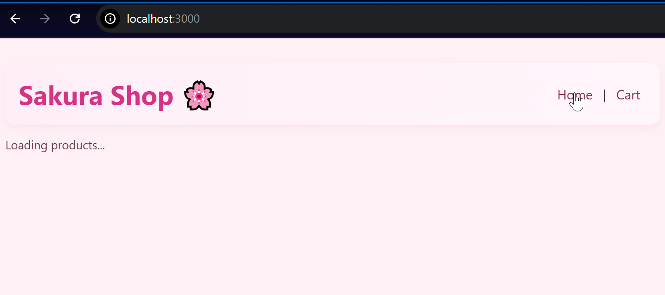
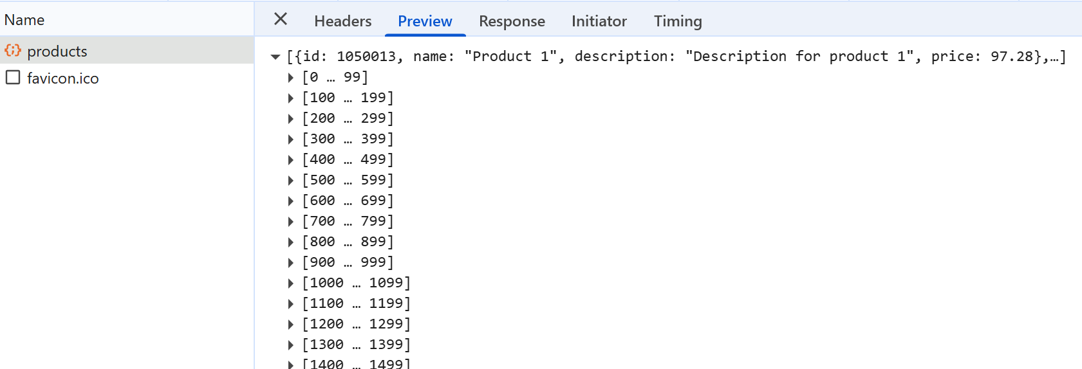
Unoptimized Design
Frontend Rendering:
Renders all 50,000+ products at once without pagination or lazy loading.
Sluggish scrolling and high memory usage.
Backend API Structure:
/api/products fetches full dataset; cart APIs use multiple sequential queries (N+1 problem).
Large JSON payloads.
Database:
No indexes; full table scans; slow queries.

Slide 5
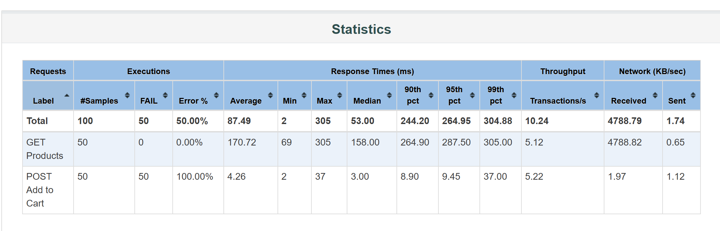
Baseline Performance Testing Setup
Tools: Apache JMeter 5.6.3, Postman
JMeter Test Plan:50, 100, 200 concurrent usersEndpoints: /api/products, /cart/add
Objectives: Measure response time, throughput, error %

Slide 6
Response Payload & UI Impact
Large payloads (several MB) for /api/products.
Frontend rendering impacted: slow loading and DOM-heavy UI.
Cart API suffers from N+1 query problem, causing delays in displaying cart items.
Observed Bottlenecks
Fetching entire dataset at once → high network payload.
Frontend renders all data → DOM overload and memory spikes.
Cart API executes multiple sequential queries → N+1 problem.
Database has no indexes → queries take longer.
JMeter metrics: high response time, low throughput under concurrent load.

Slide 7
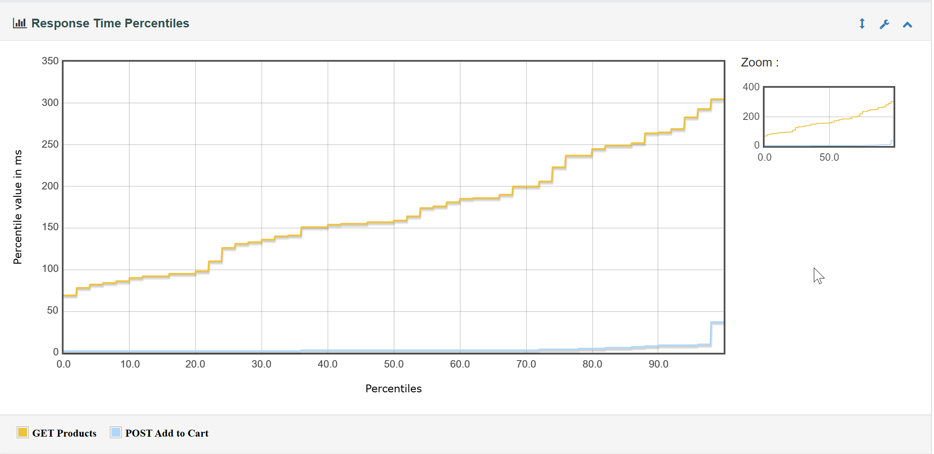
Summary of Baseline Findings
GET Products is slower: Because it fetches all 50,000+ products without pagination → some requests take much longer.
POST Add to Cart is fast: Smaller payload, simpler operation.
Variation in GET Products: The gradual rise indicates some requests take significantly longer — this shows performance bottleneck for bulk data fetch.

Slide 8
Next Steps / Planned Optimizations
Frontend: Pagination, lazy loading, memoization, code-splitting.
Backend: Pageable APIs, DTOs, GZIP compression, optimized cart queries.
Database: Indexes, query optimization, caching.
Performance Testing: Benchmark optimized system for comparison.

