Slide 1
Sales Performance: Data Story & Statistical Validation
ApexPlanet Data Analytics Internship — Task 4
Based on the cleaned sales dataset and Task 2–3 analysis
ApexPlanet Data Analytics Internship • Task 4 • 1

Slide 2
Executive Summary
Dataset contains 1,000 sales transactions and 947 unique customers.
Total sales are ₹139.40M, with average sales of ₹139.4K per transaction.
Electronics is the largest category at ₹50.78M.
Patna leads the cities at ₹20.83M.
Monthly sales peak in March and are lowest in September.
The statistical test does not provide evidence that average transaction sales differ by gender.
ApexPlanet Data Analytics Internship • Task 4 • 2

Slide 3
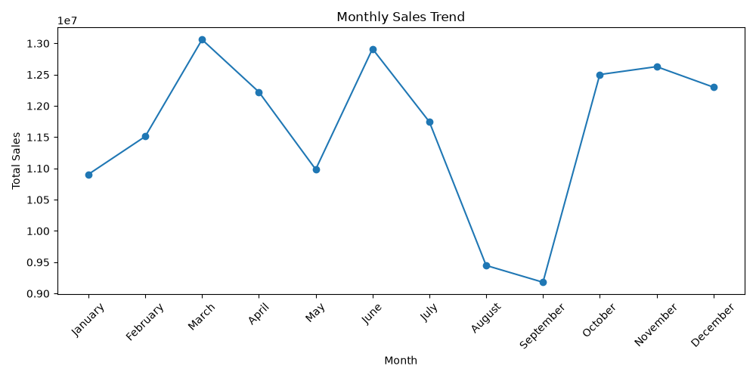
The Business Story
What the analysis says about where sales are coming from
Category concentration: Electronics contributes ₹50.8M, clearly ahead of the other categories.
Geographic opportunity: Patna leads at ₹20.8M, while Pune and Gaya are the lowest among the eight cities shown.
Product strength: Laptop and Mobile are the top two products, each above ₹25M in sales.
Seasonality is visible: sales rise into March/June, fall sharply in August–September, then recover in Q4.
Management implication: protect high-performing categories/products while investigating the causes of the late-summer dip.
ApexPlanet Data Analytics Internship • Task 4 • 3

Slide 4
Key Performance Indicators
₹139.40M
Total Sales
1,000
Transactions
947
Customers
₹139.4K
Avg. Sales / Transaction
5.43
Avg. Quantity
These KPIs connect the EDA findings to the interactive dashboard created in Task 3.
They provide a compact view of scale, customer reach, transaction value and purchase quantity.
ApexPlanet Data Analytics Internship • Task 4 • 4

Slide 5
Business Hypothesis
Question: Do male and female customers generate different average sales per transaction?
H₀ (null): Mean Total_Sales is the same for male and female transactions.
H₁ (alternative): Mean Total_Sales is different between male and female transactions.
Significance level: α = 0.05.
Test selected: Welch's independent two-sample t-test, appropriate for comparing two group means without assuming equal variances.
ApexPlanet Data Analytics Internship • Task 4 • 5

Slide 6
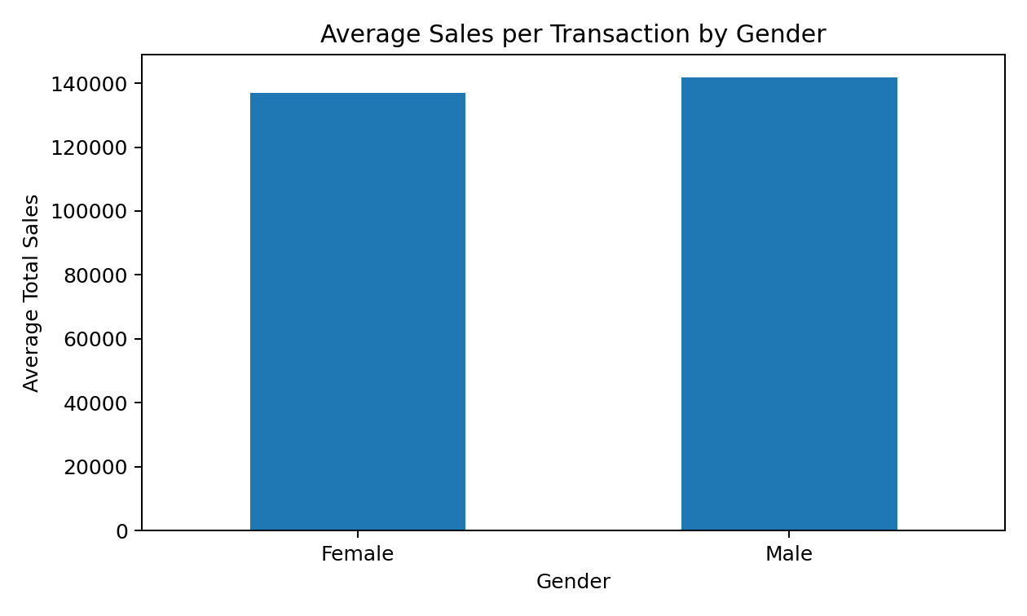
Hypothesis Test Results
Female mean: ₹136,883
Male mean: ₹141,807
Mean difference (Male − Female): ₹4,924
t-statistic: 0.683
p-value: 0.495
95% CI for the difference: ₹-9,232 to ₹19,080
ApexPlanet Data Analytics Internship • Task 4 • 6

Slide 7
Statistical Conclusion & Business Meaning
Decision: Fail to reject H₀ because p = 0.495 > 0.05.
The observed difference in average sales is not statistically significant at the 5% level.
The confidence interval crosses zero, so the data are consistent with no true difference in average transaction sales by gender.
Business takeaway: gender should not be treated as a proven driver of transaction value from this dataset alone.
Recommended next step: investigate category, product, city and time-period effects, which show stronger visible variation in the analysis.
ApexPlanet Data Analytics Internship • Task 4 • 7

Slide 8
Recommendations & Call to Action
Prioritize Electronics, Laptop and Mobile performance because they account for the strongest sales contribution.
Study Patna's success and test whether its customer/product mix can be replicated in lower-performing cities.
Investigate the August–September sales decline with campaign, inventory and demand data.
Use the Task 3 dashboard to monitor sales, customers, average transaction value and quantity over time.
For future testing, evaluate specific interventions such as promotions or pricing changes with a clear control group.
ApexPlanet Data Analytics Internship • Task 4 • 8

Slide 9
Methodology & Data Basis
Source: Cleaned_Sales_Dataset.xlsx used for the internship analysis.
EDA covered descriptive statistics, category/city/product analysis, monthly trends and correlations.
Task 3 added an interactive Power BI dashboard with core KPIs and visual analysis.
Task 4 uses the cleaned transaction-level data for hypothesis testing.
Statistical test: Welch's independent two-sample t-test; two-sided α = 0.05.
Results are descriptive of this dataset and should not be interpreted as causal evidence.
ApexPlanet Data Analytics Internship • Task 4 • 9

