Slide 1
EMOSENSE
Guide: Pournami Prasad
Smt. Chinchu M Pillai CHN22MCA-2043

Slide 2
INTRODUCTION
Depression is a serious mental health issue for people world-wide irrelevant of their ages, genders and races.
In this age of modern communication and technology, people feel more comfortable sharing their thoughts in social networking sites (SNS) almost every day.
The objective of this paper is to propose a data-analytic based model to detect depression of any human being.
Depression level of a user has been detected based on his posts in social media.
These methods need a huge amount of data from the person.

Slide 3
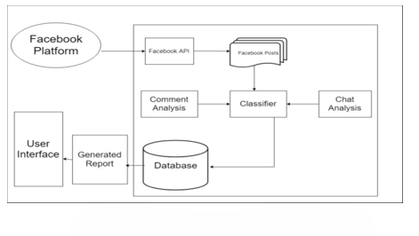
SYSTEM ARCHITECTURE

Slide 4
TECHNIQUES /ALGORITHMS
Algorithms
Support Vector Machine(SVM)
Naïve Bayes Algorithm
Random Forest
Techniques
Text analysis
Natural Language Processing(NLP)
Sentiment analysis
Social network analysis

Slide 5
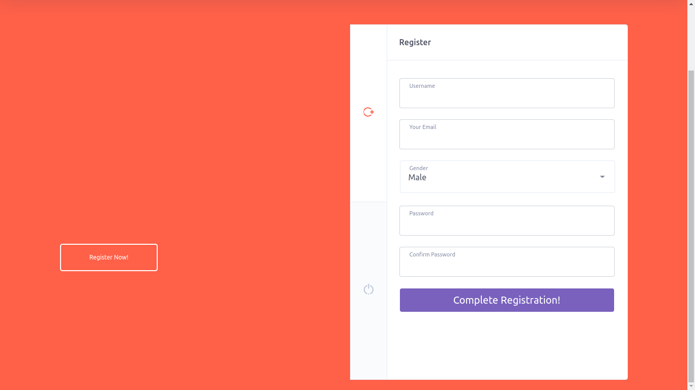
WORK DONE

Slide 6
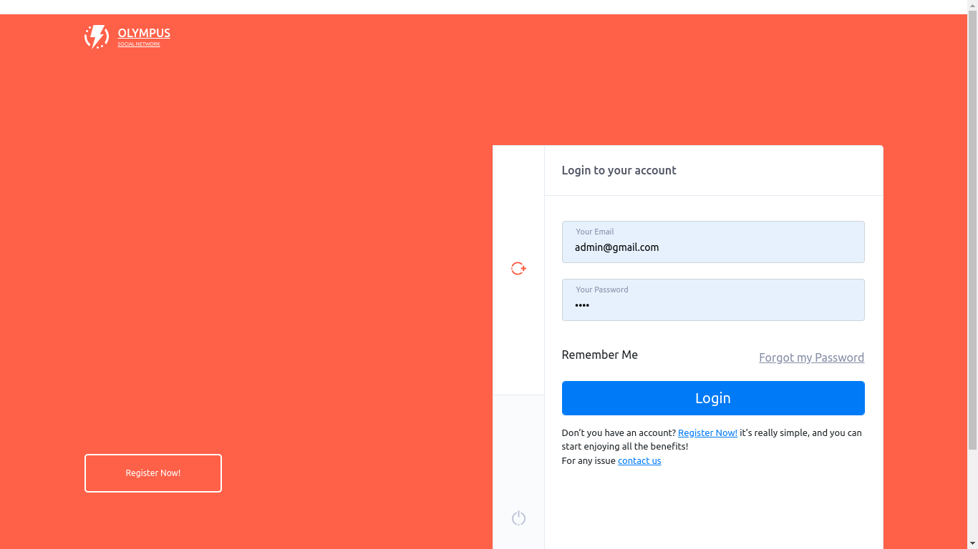

Slide 7
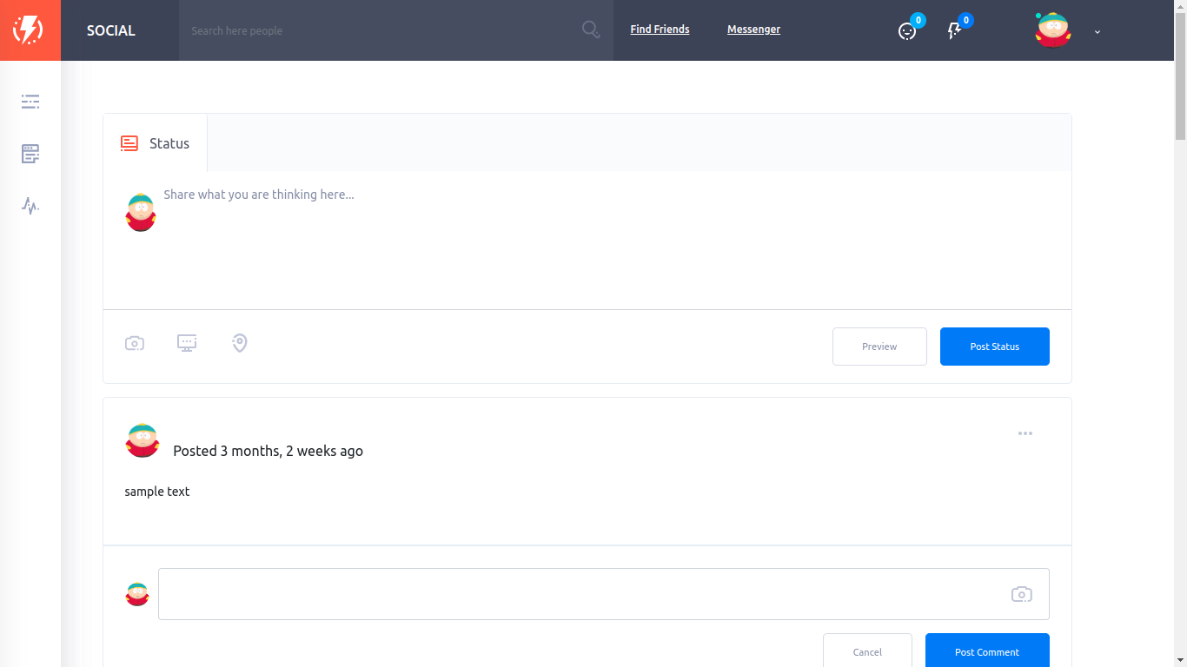

Slide 8
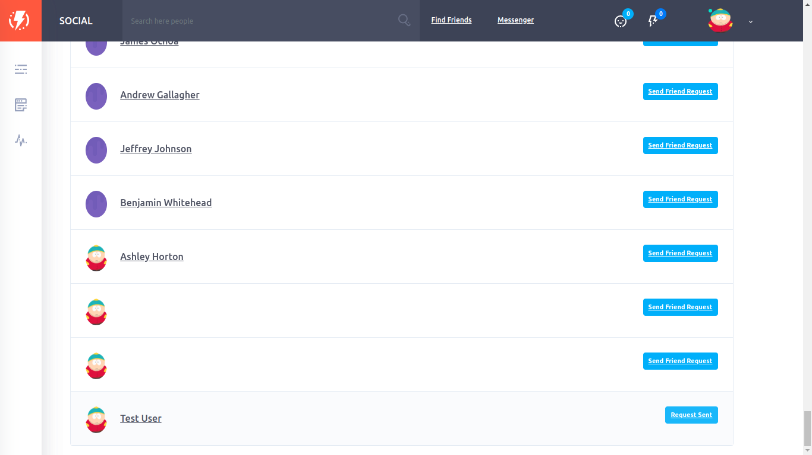

Slide 9
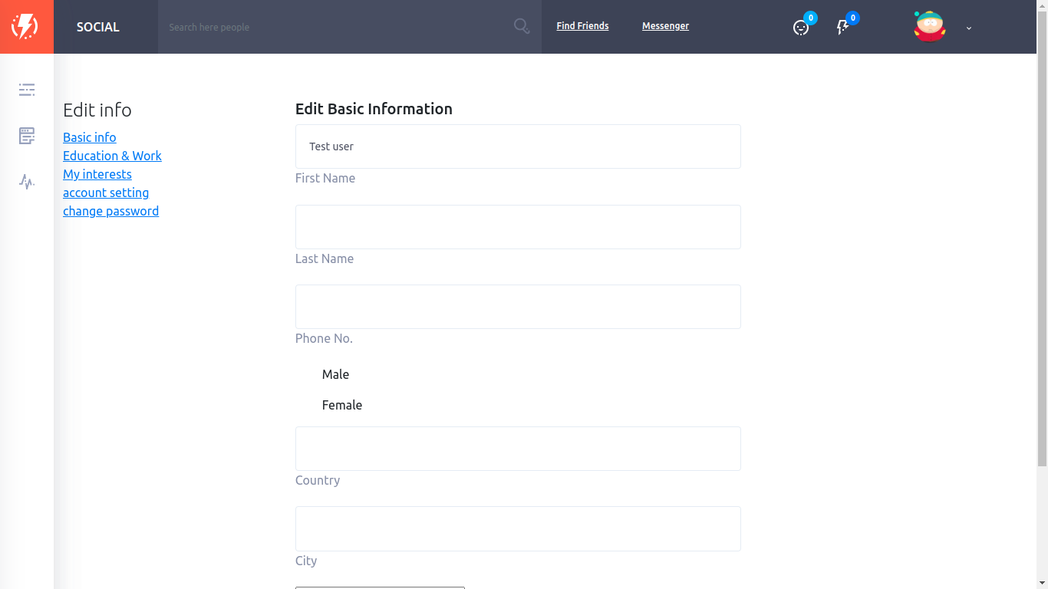

Slide 10
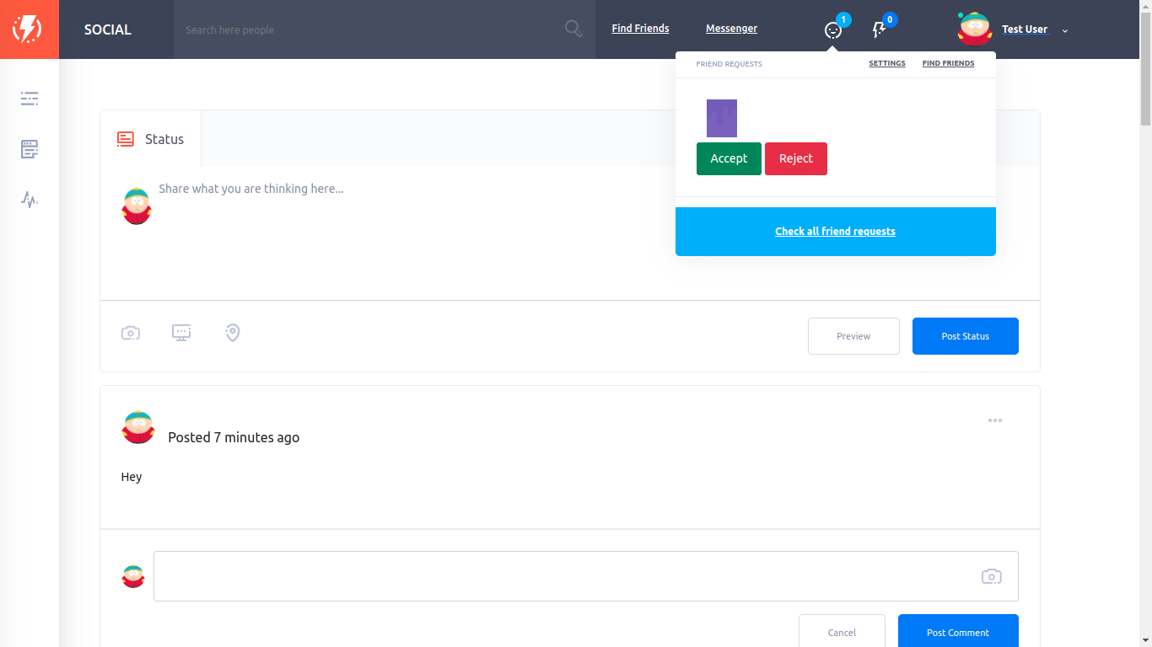

Slide 11
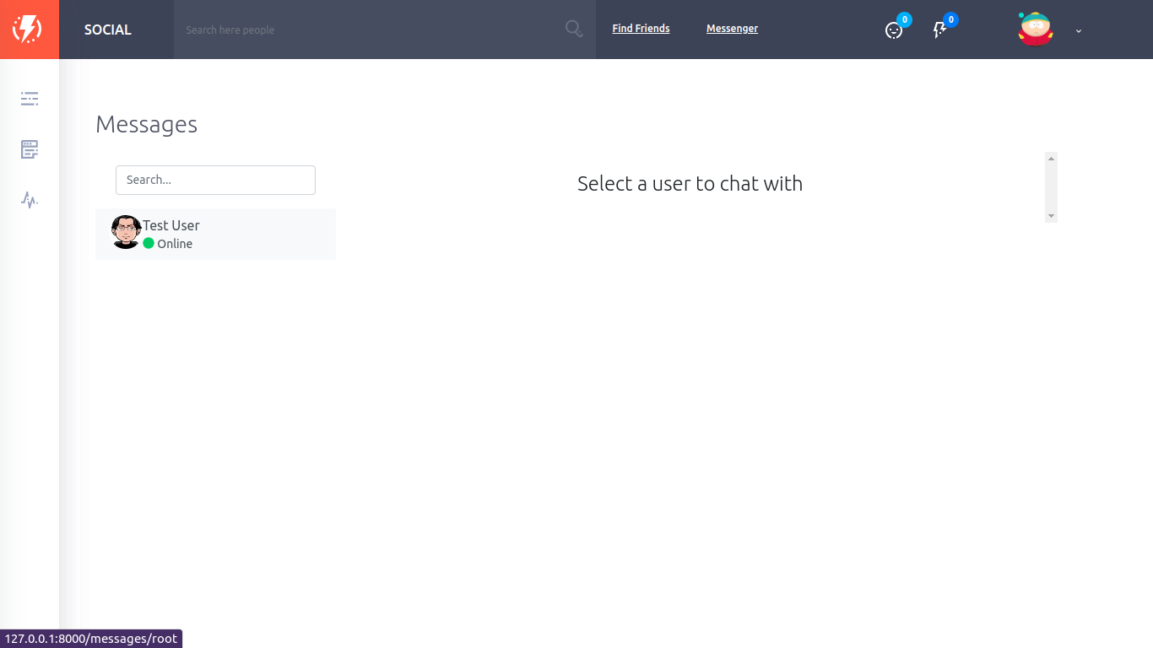

Slide 13
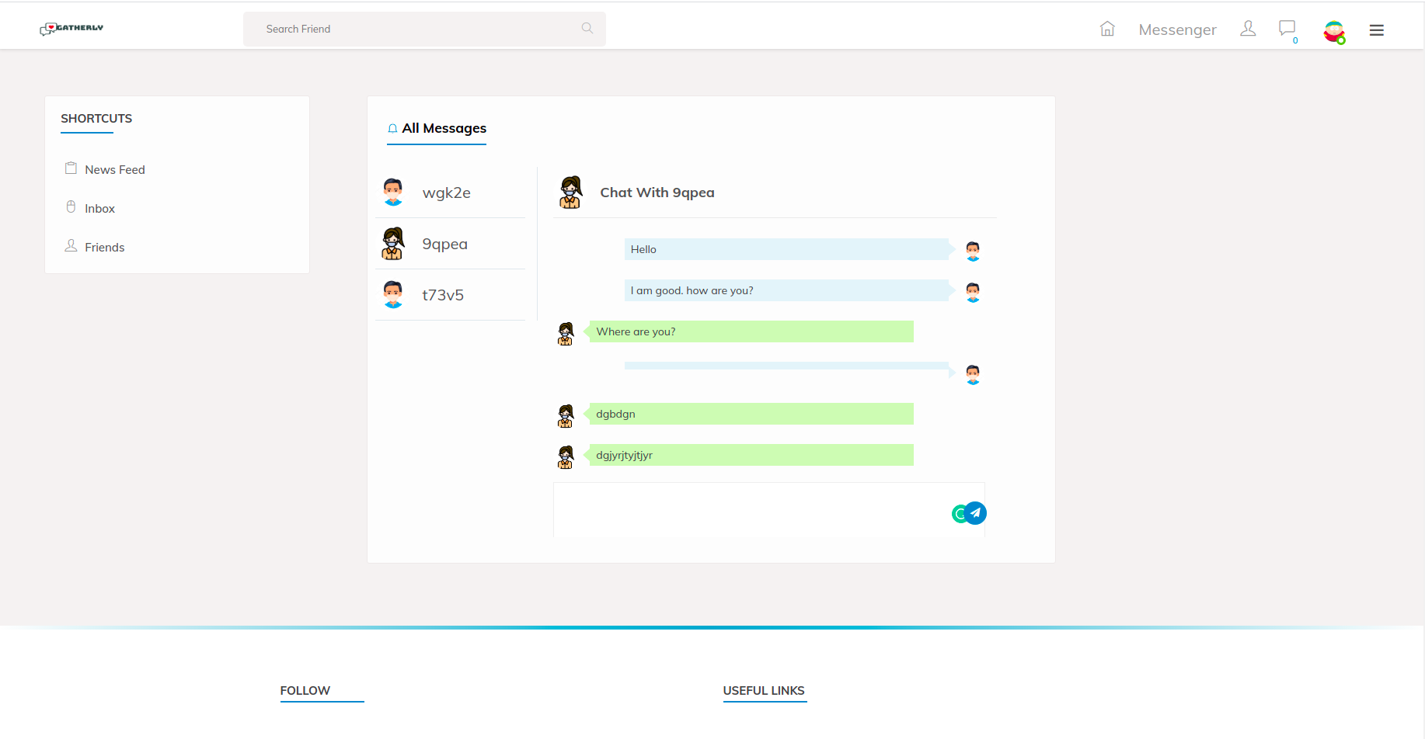

Slide 14
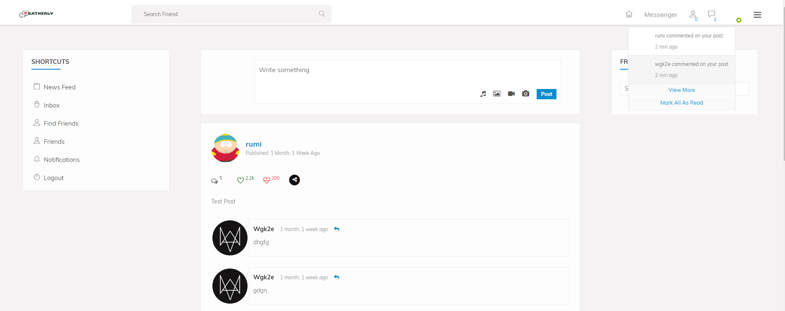

Slide 15
WORK PROGRESS
Data collection and data preprocessing were completed
Feature extraction and training completed
User interface for application is created.
Social Media created

Slide 16
WORK SCHEDULE
Start Date | Task Description | End Date | Status
2024-03-08 | Preprocess dataset (clean, tokenize, etc.) | 2024-03-10 | Completed
2024-03-11 | Train initial machine learning model | 2024-03-14 | Completed
2024-03-15 | Develop user interface for application | 2024-03-20 | Completed
2024-03-18 | Test and evaluate model | 2024-03-24 | In progress
2024-03-25 | Refine model based on test results | 2024-03-28 | In progress
2024-04-29 | Integrate model with user interface | 2024-04-01 | Not Completed
2024-04-03 | Conduct beta testing with sample users | 2024-04-05 | Not Completed
2024-04-03 | Analyze feedback and make improvements | 2024-04-05 | Not Completed
2024-03-29 | Finalize application for release | 2024-03-31 | Not Completed

Slide 17
CONCLUSION
The Emosense project on social media has shown promising results in identifying signs of depression and offering early intervention, it highlighting the importance of using technology for mental health support.

Slide 18
THANKYOU

