Slide 1

Session 2
Front-end | CSS
Introduction
Selectors
How to
Example
by Mohammad Amin H.B. Tehrani
www.maktabsharif.ir

Slide 2
Introduction

Slide 3
Intro
What is CSS?
CSS is the language we use to style a Web page.
CSS stands for Cascading Style Sheets
CSS describes how HTML elements are to be displayed on screen, paper, or in other media
CSS saves a lot of work. It can control the layout of multiple web pages all at once
External stylesheets are stored in CSS files
<head>
<meta charset="UTF-8">
<title>Title</title>
<style>
body {
background-color: rgb(150,150,250);
}
h1{
color: #000086;
}
p {
color: rebeccapurple;
}
</style>
</head>
<body>

Slide 4
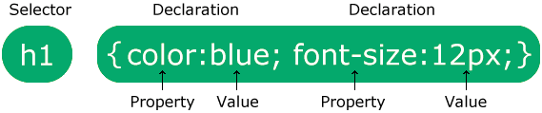
Intro
Syntax
A CSS rule consists of a selector and a declaration block.
The selector points to the HTML element you want to style.
The declaration block contains one or more declarations separated by semicolons.
Each declaration includes a CSS property name and a value, separated by a colon.
Multiple CSS declarations are separated with semicolons, and declaration blocks are surrounded by curly braces.

Slide 5
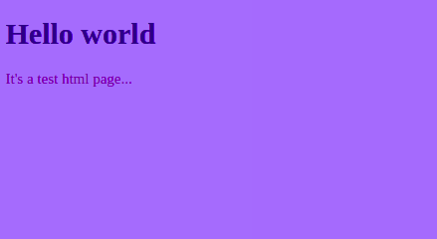
Intro
Example
<!DOCTYPE html>
<html lang="en">
<head>
<title>HTML/CSS Test</title>
<style>
body {background-color: rgb(150,150,250);}
h1 {color: #000086;}
p {color: rebeccapurple;}
</style>
</head>
<body>
<h1>Hello world</h1>
<p>It's a test html page...</p>
</body>
</html>

Slide 6
Selectors

Slide 7
Selectors
Intro
CSS Selectors
CSS selectors are used to "find" (or select) the HTML elements you want to style.
We can divide CSS selectors into five categories:
Simple selectors (select elements based on name, id, class)
Combinator selectors (select elements based on a specific relationship between them)
Pseudo-class selectors (select elements based on a certain state)
Pseudo-elements selectors (select and style a part of an element)
Attribute selectors (select elements based on an attribute or attribute value)

Slide 8
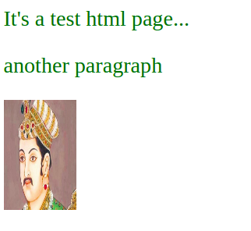
Selectors
Element Selector
The element selector selects HTML elements based on the element name.
tag_name { declaration }
p {
font-size: 40px;
color: darkgreen;
}
img {
width: 100px;
height: 150px;
}
<p>It's a test html page...</p>
<p>another paragraph</p>
<img src="/akbar.jpg">

Slide 9
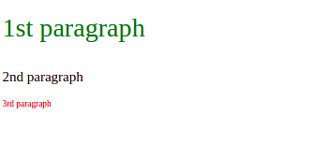
Selectors
id Selector
The id selector uses the id attribute of an HTML element to select a specific element.
The id of an element is unique within a page, so the id selector is used to select one unique element!
To select an element with a specific id, write a hash (#) character, followed by the id of the element.
#id { declarations; }
#p1 {
font-size: 30px;
color: darkgreen;
}
#p3 {
font-size: 10px;
color: red;
}
<p id="p1">1st paragraph</p>
<p>2nd paragraph</p>
<p id="p3">3rd paragraph</p>

Slide 10

Selectors
Class selector
The class selector selects HTML elements with a specific class attribute.
To select elements with a specific class, write a period (.) character, followed by the class name.
.class { declarations; }
.my-class {
font-size: 30px;
color: darkgreen;
}
<p class="my-class">1st paragraph</p>
<p>2nd paragraph</p>
<p class="my-class">3rd paragraph</p>

Slide 11
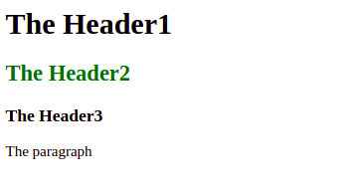
Selectors
Element.Class selector
You can also specify that only specific HTML elements should be affected by a class.
tag_name.class { declarations; }
h2.my-class {
color: darkgreen;
}
<h1 class="my-class">The Header1</h1>
<h2 class="my-class">The Header2</h2>
<h3 class="my-class">The Header3</h3>
<p class="my-class">The paragraph</p>

Slide 12
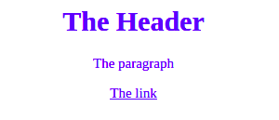
Selectors
Universal selector (*)
The universal selector (*) selects all HTML elements on the page.
* { declarations; }
* {
text-align: center;
color: blue;
}
<h1>The Header</h1>
<p>The paragraph</p>
<a href="#">The link</a>

Slide 13
Selectors
Grouping Selector
The grouping selector selects all the HTML elements with the same style definitions.
selector1, selector2, selector3, … { declarations; }
h1 {
text-align: center;
color: red;
}
h2 {
text-align: center;
color: red;
}
p {
text-align: center;
color: red;
}
h1, h2, p {
text-align: center;
color: red;
}

Slide 14
How to

Slide 15
How to
Intro
When a browser reads a style sheet, it will format the HTML document according to the information in the style sheet.
Three Ways to Insert CSS
There are three ways of inserting a style sheet:
External CSS
Internal CSS
Inline CSS

Slide 16
How to
External css
With an external style sheet, you can change the look of an entire website by changing just one file!
Each HTML page must include a reference to the external style sheet file inside the <link> element, inside the head section.
<!DOCTYPE html>
<html lang="en">
<head>
<link rel="stylesheet" href="mystyle.css">
<title>Test html</title>
</head>
<body>
<h1>This is a heading</h1>
<p>This is a paragraph.</p>
</body>
</html>
/* mystyle.css */
* {
text-align: center;
color: blue;
}
An external style sheet can be written in any text editor, and must be saved with a .css extension.
The external .css file should not contain any HTML tags.

Slide 17
How to
Internal CSS
An internal style sheet may be used if one single HTML page has a unique style.
The internal style is defined inside the <style> element, inside the head section.
<!DOCTYPE html>
<html>
<head>
<style>
body {
background-color: linen;
}
h1 {
color: maroon;
margin-left: 40px;
}
</style>
</head>
<body>
<h1>This is a heading</h1>
<p>This is a paragraph.</p>
</body>
</html>

Slide 18
How to
InLine CSS
An inline style may be used to apply a unique style for a single element.
To use inline styles, add the style attribute to the relevant element. The style attribute can contain any CSS property.
<!DOCTYPE html>
<html>
<body>
<h1 style="color:blue;text-align:center;">This is a heading</h1>
<p style="color:red;">This is a paragraph.</p>
</body>
</html>

Slide 19
How to
Cascading?
The name cascading comes from the specified priority scheme to determine which style rule applies if more than one rule matches a particular element. This cascading priority scheme is predictable.
/* cards.css */
.card-container {
display: flex;
flex-direction: row;
}
.card {
background-color: white;
box-shadow: 0 3px 5px 2px gray ;
border-radius: 10px;
}
/* Update .card style */
.card {
width: 150px;
height: 250px;
margin: 5px;
}
#primary_card {
background-color: #0d0d5c;
}
<head>
<link rel="stylesheet" href="cards.css">
<style>
.card {
text-align: center;
padding: 10px;
}
#primary_card {
color: white;
}
p{
opacity: 0.8;
font-size: 12px;
}
</style>
</head>
<body style="background-color: rgba(64,86,141,0.57)">
1
2
3

Slide 20
How to
Cascading?
The name cascading comes from the specified priority scheme to determine which style rule applies if more than one rule matches a particular element. This cascading priority scheme is predictable.
/* cards.css */
.card-container {
display: flex;
flex-direction: row;
}
.card {
background-color: white;
box-shadow: 0 3px 5px 2px gray ;
border-radius: 10px;
}
/* Update .card style */
.card {
width: 150px;
height: 250px;
margin: 5px;
}
#primary_card {
background-color: #0d0d5c;
}
<head>
<link rel="stylesheet" href="cards.css">
<style>
.card {
text-align: center;
padding: 10px;
}
#primary_card {
color: white;
}
p{
opacity: 0.8;
font-size: 12px;
}
</style>
</head>
<body style="background-color: rgba(64,86,141,0.57)">
1
2
3

Slide 21
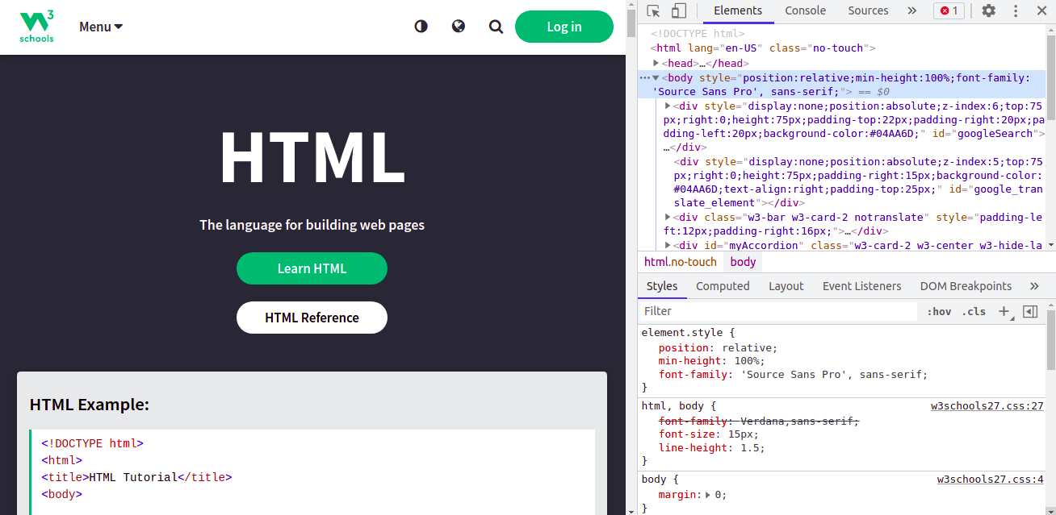
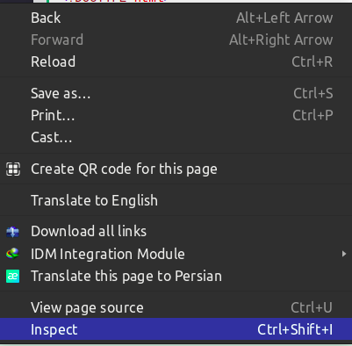
How to
Browser inspector
Every modern web browser includes a powerful suite of developer tools. These tools do a range of things, from inspecting currently-loaded HTML, CSS and JavaScript to showing which assets the page has requested and how long they took to load. This article explains how to use the basic functions of your browser's devtools.

Slide 22
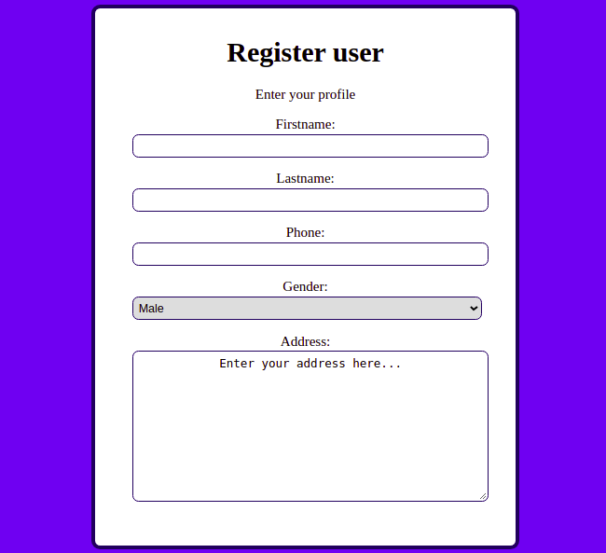
How to
Practice: Registration form
Create a html page like the following sample :
Do it individually

Slide 23
Example

Slide 24
Pre-reading
Responsive web page
Bootstrap
CSS properties

