Slide 1

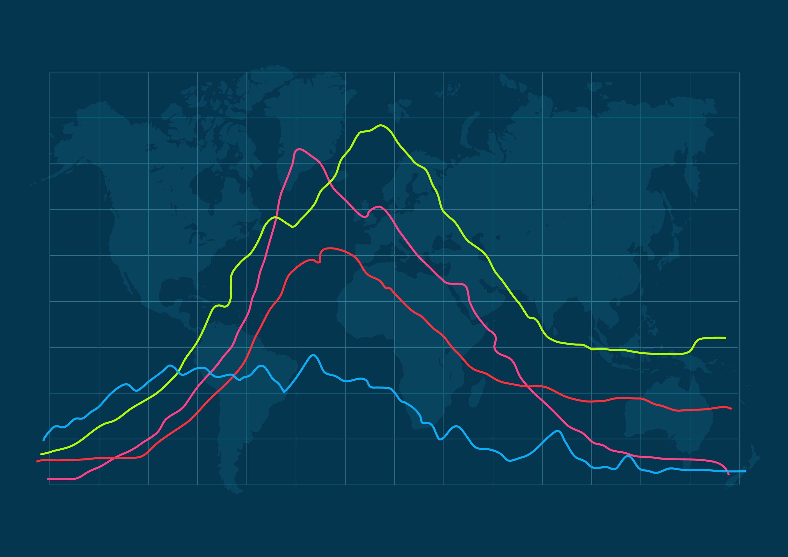
TIME-SERIES ANALYSIS AND FORECASTING OF MONTHLY FEDERAL RESERVE BOARD PRODUCTION INDEX
NAME- POUSHALI DUTTA

Slide 2
METHODOLOGY
Data
Description
SARIMA
Model
Data
Analysis
Objective
Model
Fitting
Forecasting
Future
Scope
Of study

Slide 3
WhY Do we need to study production index?
The FRB’s Industrial Production Index (IPI) is considered to be an important indicator that measures the original output of the manufacturing, mining, and utilities sectors. It is used by policymakers, businessmen, and investors to gauge the economic health and predict future trends.

Slide 4
Objective of the study
To observe the time series plot of the production data recorded month-wise and understanding the underlying pattern, components in the data.
To fit appropriate model to the residual series after removing the deterministic components from the data.
To forecast production index for future timepoints and checking whether the forecasts generated are aligned with the original data i.e. checking the accuracy of the forecast values.

Slide 5
Data Description
I have used monthly production dataset ‘prodn’ over the period from 1948 to 1978 which belongs to the ‘astsa’ library in R. The dataset contains 372 datapoints on the production index from January 1948 to December 1978.
This entire time series has further been divided into two separate time series. Data for the period January 1948 to September 1969 is used to carry out the following analysis, build a model and forecast future values, i.e., we treat it as our training set. Data for the remaining period, October 1969 to December 1978 is used to see how well the model based on the training set works, i.e., we use it as our testing set.

Slide 6


Brief Description on SARIMA Model
The multiplicative seasonal autoregressive integrated moving average model, or SARIMA model is given by ,
$Φ$_{p} (B^{s}) $φ$(B)$∇$_{s}^{D} $∇$^{d} x_{t} = $δ$ + $Θ$_{Q} (B^{s})$θ$(B) w_{t}
where w_{t} = usual Gaussian white noise process. The general model is denoted as ARIMA(p,d,q)×(P,D,Q)_{s}. δ represents a deterministic trend or mean level in the time series.
$φ$(B) = Ordinary autoregressive process of order p,
$θ$(B) = Moving average components of order q
$Φ$_{P}(B^{s}) = Seasonal autoregressive process of order P
$Θ$_{Q}(B^{s}) = Moving average components of order Q
$∇$^{d} =(1- B)^{d} = Ordinary difference component
$∇$_{s}^{D} =(1- B^{s})^{D} = Seasonal differencing
x_{t} = Value of the process at timepoint t
B= backshift operator

Slide 7
ADF Test
To check the stationarity, we will use ADF test. The test involves estimating a regression model of the form:
Δx_{t} = α + βt + γx_{t-1}+ θ₁Δx_{t-1} + θ₂Δx_{t-2} + … + θ_{p} Δx_{t-p} + w_{t}
where Δx_{t} = the first difference of the time series,
t = a linear trend term,
x_{t-1} = the lagged value of the time series,
and θ₁, θ₂, …, θ_{p} are the AR coefficients.
Null hypothesis of the testing claims presence of a unit root in the time series, indicating that the time series is nonstationary. The alternative hypothesis says that series is stationary.

Slide 8

Ljung-Box test
Ljung–Box test is a type of statistical test for checking whether series is random or they are correlated. Ljung-Box test is widely used in econometrics and time series data.
Here we are to test,
H₀: The series is random vs. H₁: The series is not random
The test statistic is given by,
Q = n (n+2) $\sum_{k=1}^{h}{\frac{r⌃2}{n−k}}$
Where n = the sample size,
r = the sample autocorrelation at lag k and
h = the number of lags being tested.
Under H₀ the statistic Q asymptotically follows Chi-sq. distribution with degrees of freedom h.

Slide 9
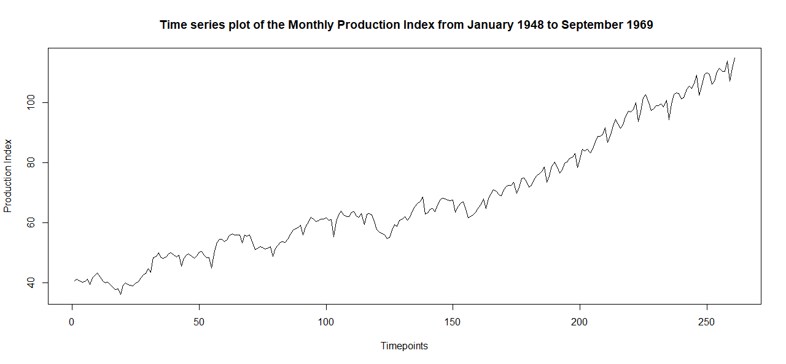
Analysis of the data
First, 70% of the dataset has been taken for analysis purpose and remaining 30% of data is kept for testing purpose. To analyse the data, I first plot the data to have an idea about the deterministic components present in the dataset.
From the above plot we note the following observations
There is an increasing upward trend.
Seasonal variation appears since it is recorded month-wise.
No cycle of period more than a year is present indicating that there is no cyclical variation in the data.

Slide 10
Checking for stationarity of the series
Also, I will apply Augmented Dickey-Fuller Test of the data to check whether it is stationary or not.
Here, we can observe that the p-value is 0.9523 ,which is greater than 0.05 (l.o.s). From the above result we can conclude that we will accept H₀ which is indicating the data is not stationary.
Augmented Dickey-Fuller Test data: data Dickey-Fuller = -0.89485, Lag order = 6, p-value = 0.9523 Alternative hypothesis: stationary

Slide 11
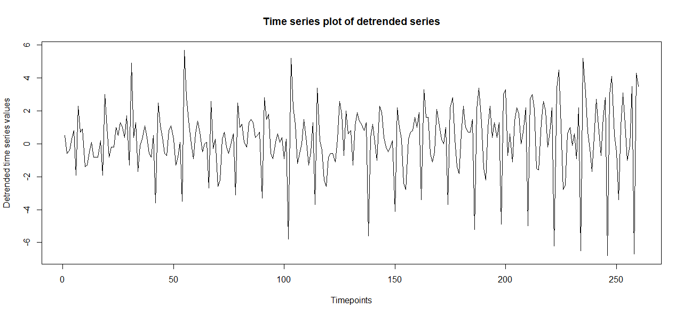
we first difference the data at lag 1 to eliminate the trend component from the data.
Optimal choice for d: 1

Slide 12
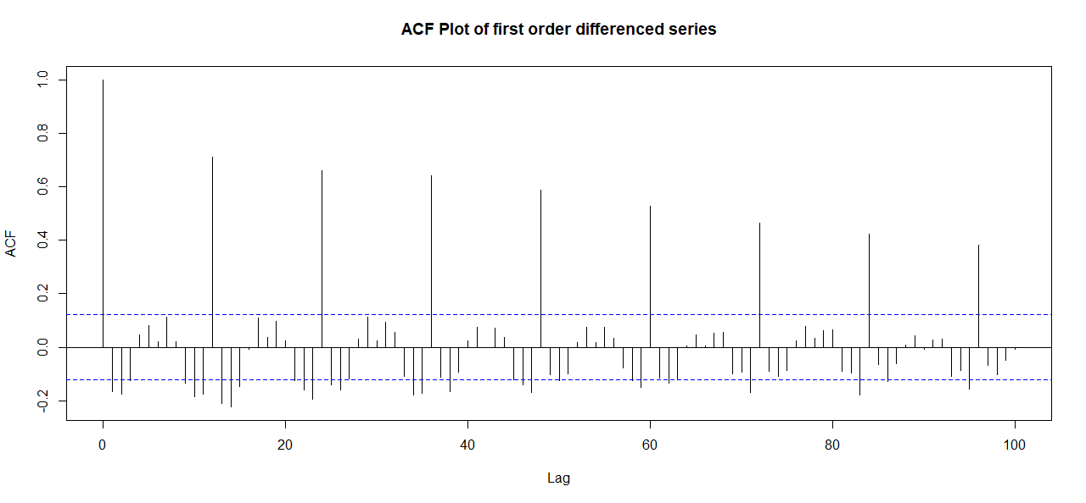
Now we will plot the ACF of the detrended series.

Slide 13
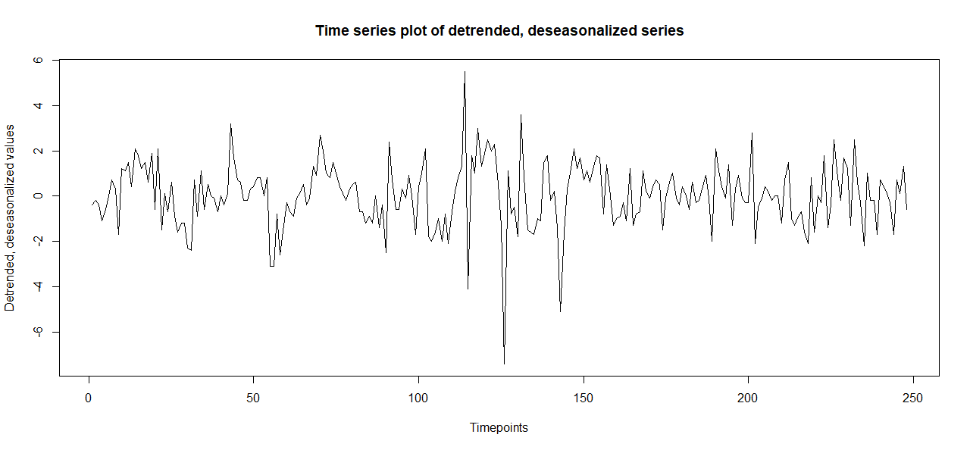
We take the first order seasonal difference to remove the seasonal fluctuation from the data. Finally, we plot the detrended, de-seasonalized series.
Optimal choice for D: 1

Slide 14
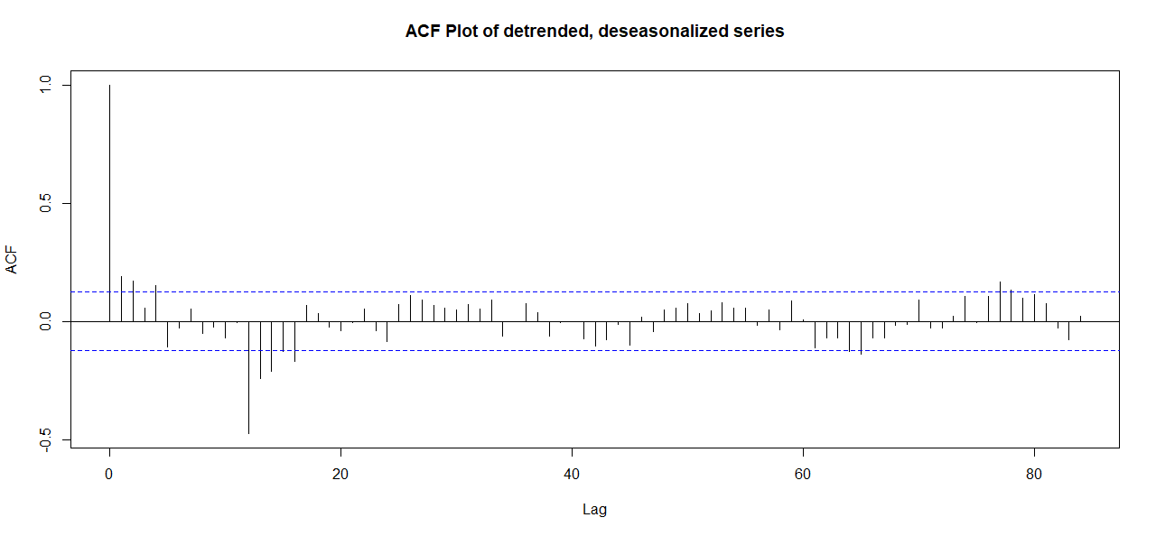
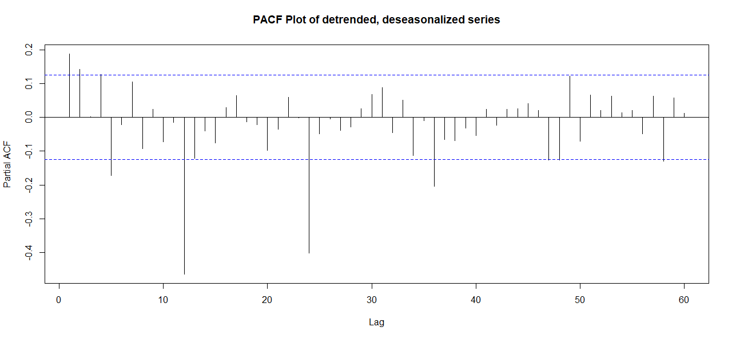
I plot ACF of the detrended, de-seasonalized data.
Optimal choice of q: 0,1,2
Optimal choice of Q : 1
Now, I plot the PACF of the detrended and de-seasonalized series.
Optimal choice for p: 0,1,2
Optimal choice for P: 1,2,3

Slide 15
Fitting of appropriate model
Then we fit SARIMA (Seasonal Auto-Regressive Integrated Moving Average) models of different order combinations to the data and finally we will check for which model the aic (Akaike information criterion) value is minimum.
Model | aic value
ARIMA (0,1,0)×(1,1,1)₁₂ | 765.3372
ARIMA (1,1,0)×(1,1,1)₁₂ | 763.8883
ARIMA (0,1,1)×(0,1,1)₁₂ | 764.0646
ARIMA (1,1,1)×(1,1,1)₁₂ | 765.2669
ARIMA (1,1,2)×(1,1,1)₁₂ | 765.3800
ARIMA (1,1,2)×(2,1,1)₁₂ | 757.6896
ARIMA (1,1,2)×(0,1,1)₁₂ | 764.9509
ARIMA (0,1,2)×(0,1,1)₁₂ | 764.6481
ARIMA (0,1,2)×(3,1,1)₁₂ | 757.2819
ARIMA (0,1,2)×(1,1,1)₁₂ | 765.1054
ARIMA (0,1,1)×(3,1,1)₁₂ | 756.9207
ARIMA (2,1,2)×(2,1,1)₁₂ | 748.4358
ARIMA (2,1,1) × (2,1,1)₁₂ | 758.0181
ARIMA (2,1,2) × (3,1,1)₁₂ | 759.7821
ARIMA (2,1,1)×(1,1,1)₁₂ | 765.7656
ARIMA (2,1,1)×(0,1,1)₁₂ | 765.3081
ARIMA (2,1,2)×(1,1,1)₁₂ | 755.2867
ARIMA (2,1,2)×(0,1,1)₁₂ | 756.6868

Slide 16

We see that, the aic value corresponding to ARIMA(2,1,2)×(2,1,1)₁₂ is minimum among all above suggested models. Hence, we fit ARIMA(2,1,2)×(2,1,1)₁₂ model to the above data. The root means square error corresponding to this model is 13.7981.
Then the model becomes as follows,
(1-$Φ$₁B¹²-$Φ$₂B²⁴) (1-$φ$₁B-$φ$₂B²) (1-B) (1-B¹²) x_{t} = (1+$Θ$₁B¹²) (1+$θ$₁B+$θ$₂B²) w_{t}
Where x_{t} = value of the process at timepoint t,
w_{t} = value of the random walk process at t^{th} timepoint
B = backshift operator i.e. B(x_{t}) = x_{t-1}
And $Φ$_{1,} $Φ$_{2,} $φ$_{1,} $φ_{2}, Θ_{1},θ_{1},θ_{2}$ are the model parameters.
Hence the fitted model is given by,
(1-$\hat{Φ_{1}}$B¹²- $\hat{Φ_{2}}$ B²⁴) (1- $\hat{φ_{1} }$B-$\hat{φ_{2}}$B²) (1-B) (1- B¹²) x_{t} = (1+ $\hat{Θ_{1}}$B¹²) (1+ $\hat{θ_{1}}$B+$\hat{θ_{2}}$B²) w_{t}
$\hat{Φ_{1}}$ = -0.3317 , $\hat{Φ_{2}}$= -0.2535 , $\hat{φ_{1}}$= -1.3285 , $\hat{φ_{2}}$ = -0.8260 , $\hat{Θ_{1}}$ = -0.5115
$\hat{θ_{1}}$= 1.4546 , $\hat{θ_{2}}$ = 1.000

Slide 17
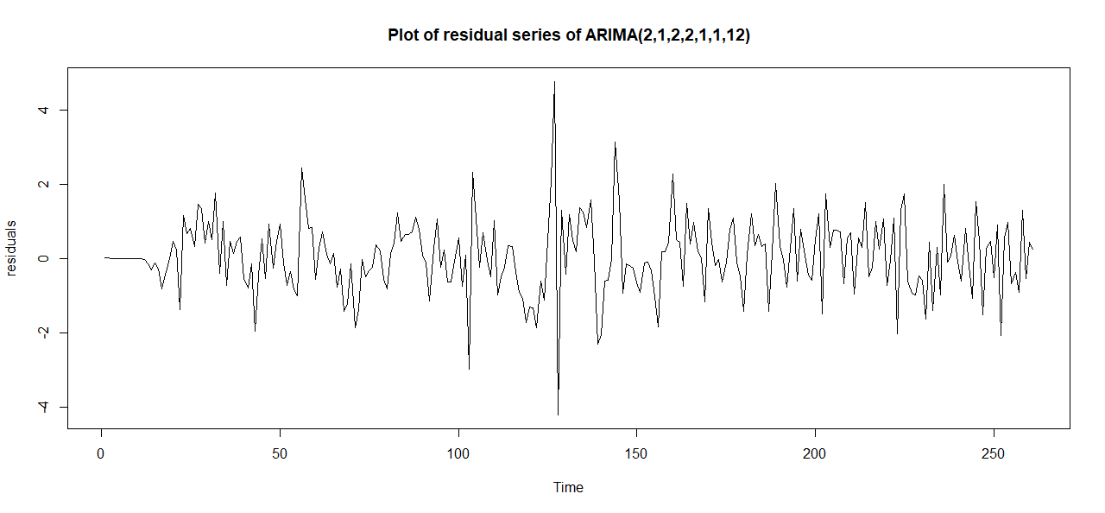
Testing of goodness of fit
We plot the residuals obtained due to this fit, i.e., the model residual series.
On visual inspection the residual series seems to be random.
To confirm our finding, we check for randomness of model residual series using the Ljung-Box test. We take α = 0.05. The results of the test are given by,
As the p-value = 0.1148, which is greater than 0.05, we accept H₀ at 5% level of significance indicating the residual series is random.
Box-Ljung test data: model$residuals X-squared = 28.968, df = 21, p-value = 0.1148

Slide 18
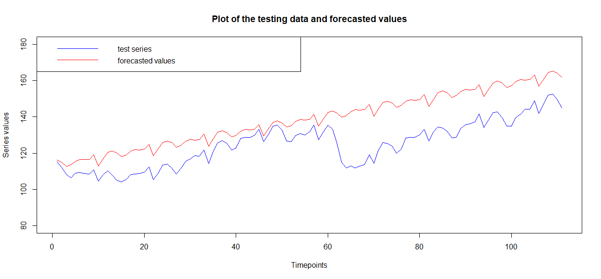
Forecasting
We use the ARIMA(2,1,2)×(2,1,1)₁₂ model fitted above to forecast the values corresponding to the testing set comprising of data from October 1969 to December 1978. We plot the test data and the corresponding forecasts for monthly production index on the same graph.
The forecasts appear to be quite close to the original data and hence by using this model we can easily forecast the production index for future timepoints.
This also indicates that there is an increasing trend in the production index if proper business planning is undertaken. Thus, a study of a long-term production data helps us to forecast the production for future timepoints.

Slide 19
Future scope of study
The further scope of study in fitting SARIMA models to industrial production data includes several advanced areas for research and improvement.
We can also incorporate the idea of Machine Learning for better prediction performance.
We may combine SARIMA with GARCH to model volatility in production and SARIMA with Neural Networks for capturing nonlinear patterns.
We may also check the points where the shift in trend is detected.

Slide 20
References
https://www.machinelearningplus.com/time-series/augmented-dickey-fuller-test/
https://medium.com/@ritusantra/introduction-to-sarima-model-cbb885ceabe8
https://people.stat.sc.edu/hitchcock/stat520ch6slides.pdf
https://rucore.libraries.rutgers.edu/rutgers-lib/34211/PDF/1/play/
https://online.stat.psu.edu/stat510/lesson/3/3.2

Slide 21
THANK YOU!

