Slide 1

PouliVet
AI-powered satellite intelligence protecting 4.2 million smallholder farmers
from poultry disease losses worth UGX 350 billion annually.
Team: Iyundhu Kennedy Kisame, Yiga Isaac Marvin
Mukisa Rachel Jovia Nsubuga Jeremiah
1 / 10

Slide 2
THE PROBLEM
Uganda's poultry farmers are flying blind.
73%
UGX 350B
20km+
of poultry deaths happen with
zero prior warning to farmers
lost to preventable disease
every year nationally
to nearest veterinary officer
for 61% of farmers
Today, a smallholder farmer learns of disease only when their flock starts dying by then, treatment is too late.
PouliVet
2 / 10

Slide 3
THE SOLUTION
PouliVet closes the information gap with satellites and AI.
PREDICT
DIAGNOSE
Satellite Intelligence
On-Device AI
Sentinel-2 and MODIS satellites track vegetation, moisture, temperature, and water bodies across 134 Uganda districts every week.
YOLOv8n model analyses chicken dropping photos in under 5 seconds — detecting Newcastle, Coccidiosis, and Salmonella.
Warns farmers BEFORE outbreaks happen.
94% accuracy on field-captured images.
PouliVet
3 / 10

Slide 4

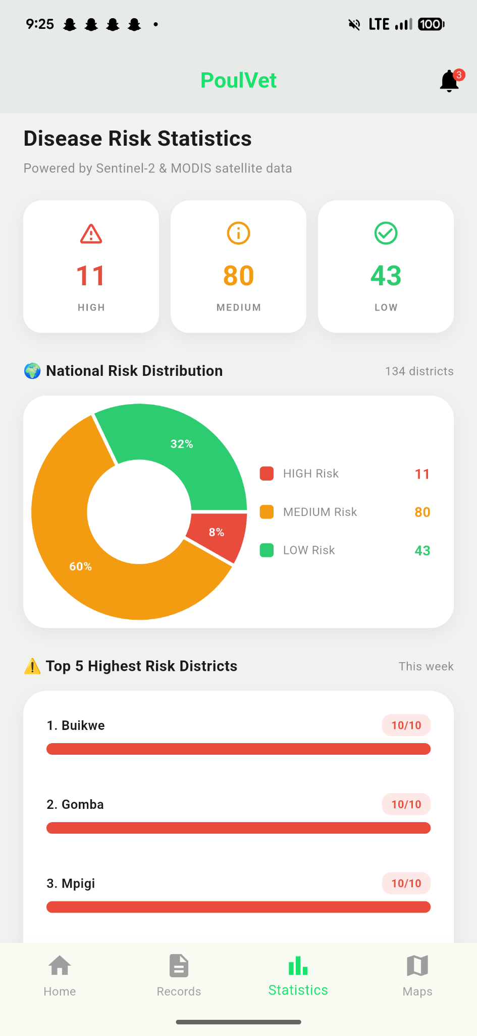
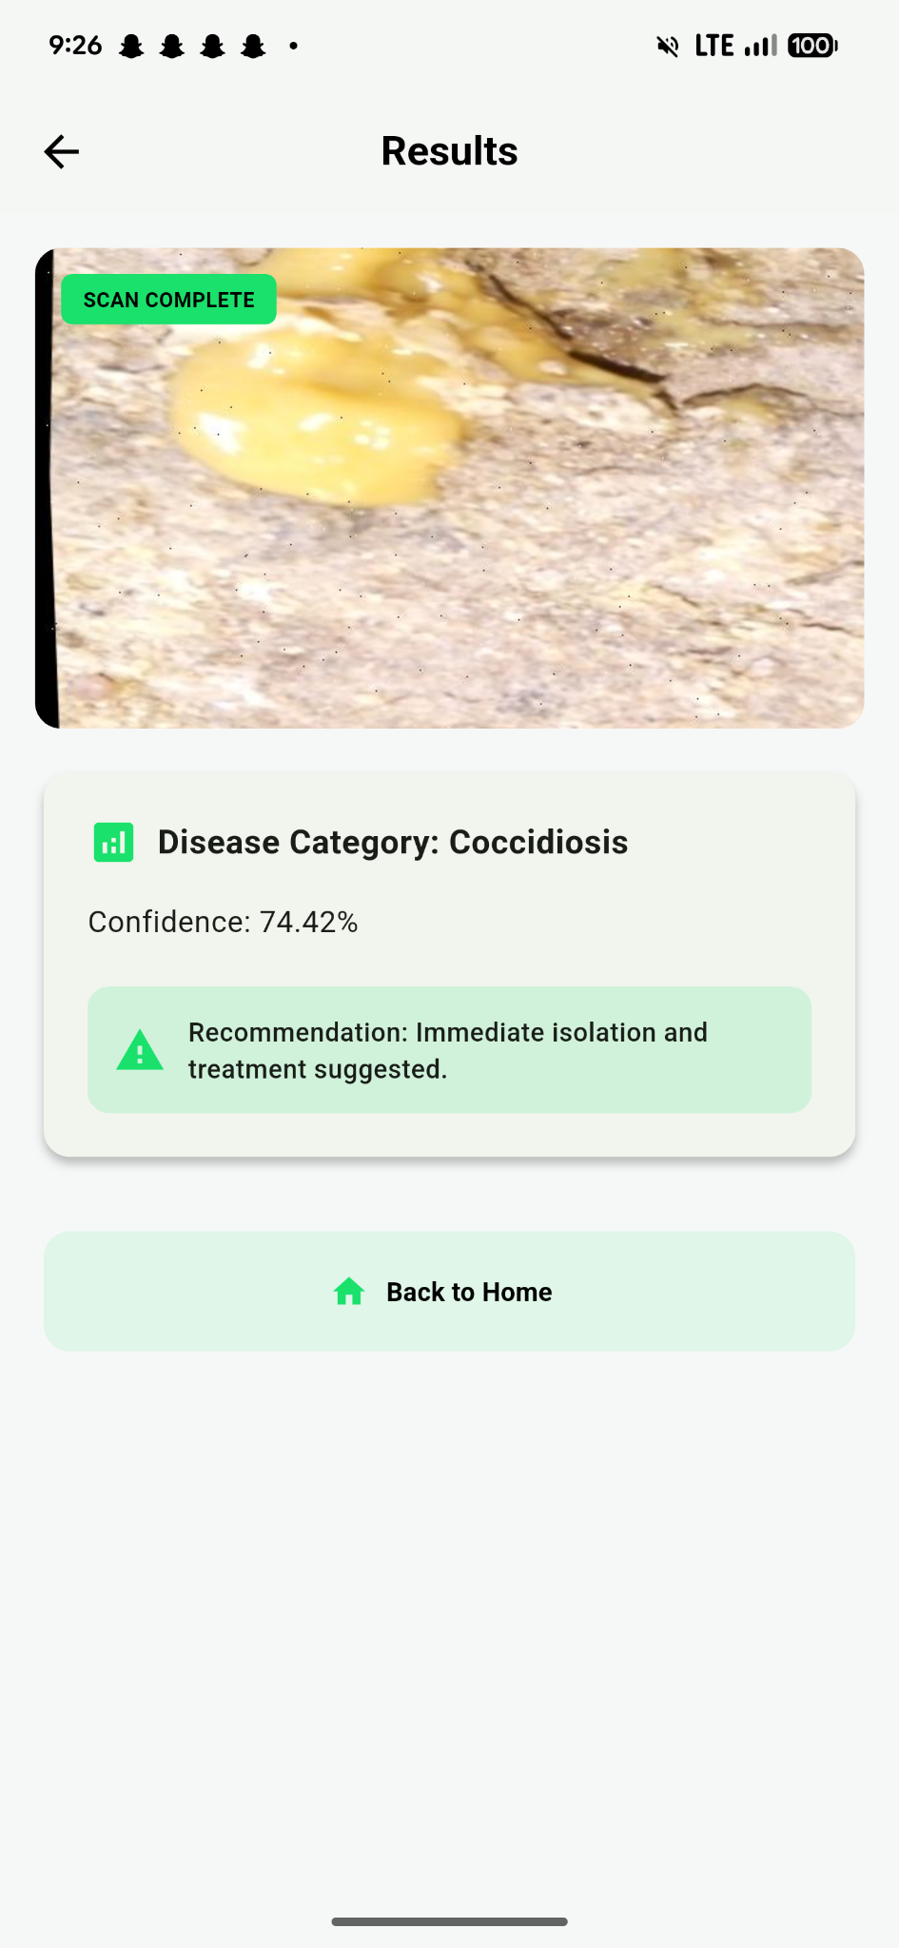

LIVE PRODUCT
Watch the demo: https://www.youtube.com/watch?v=Pf2xE6BRTmA
PouliVet
4 / 10

Slide 5

VALUE PROPOSITION
Value across three layers of the ecosystem.
FOR SMALLHOLDER FARMERS
FOR VETERINARY OFFICERS
FOR GOVERNMENT & NGOs
Save flocks. Save income.
Target the right districts.
First real-time surveillance.
Disease warnings BEFORE outbreaks happen
Saves up to UGX 200,000 per production cycle
Works on basic Android phones
Free to use, no subscription required
National disease risk dashboard
Targets visits to HIGH-risk areas
10x more efficient field resource allocation
Data-driven supervision of livestock health
Real-time disease surveillance for MAAIF
Data-driven policy interventions
Reduces national poultry losses
Supports food security objectives
PouliVet
5 / 10

Slide 6



MARKET SIZE
A massive, underserved, growing opportunity.
TAM Sub-Saharan Africa
80%+
of rural households across SSA keep poultry as a primary livelihood
MDPI Pathogens 2024
SAM East Africa
70M+
smallholder households across Uganda, Kenya, Tanzania, Rwanda — urban demand growing 4.5% annually
East Africa Poultry Report 2025
SOM Uganda · Years 1-3
$1.5B
annual meat & poultry market · 2.9M households rear chickens · 47M chickens nationally · 78.6% of livestock households
UBOS Census 2024 · FAO 2024 · IndexBox 2024
PouliVet
6 / 10

Slide 7
BUSINESS MODEL
1
B2G — Government & NGOs
2
B2B — Agribusiness Data API
Annual surveillance contracts with MAAIF, FAO, ILRI, USAID, GIZ for national disease intelligence dashboards.
Subscription access for feed manufacturers, vaccine distributors, livestock insurers, commercial hatcheries.
10M – 15M per agency / year
UGX 100,000 monthly
3
Premium Commercial Farms
4
Telco SMS Partnerships
Revenue share with MTN and Airtel for vernacular SMS disease alerts to farmers without smartphones.
UGX 50,000 monthly
Per-message revenue share
YEAR 3 TARGET $500K ARR · 50,000 active monthly users
7 / 10

Slide 8
COMPETITIVE LANDSCAPE
Solution | Satellite Risk Prediction | AI Disease Diagnosis | Uganda Local Deployment
PouliVet | ✓ | ✓ | ✓
Traditional Veterinary Services (MAAIF officers) | ✗ | ✗ | ✓
EzyAgric / M-Omulimisa (general agritech apps) | ✗ | ✗ | ✓
Global Poultry Apps (Poultry Plus, Farm IQ) | ✗ | Partial | ✗
Cowtribe (Ghana) vet booking platform | ✗ | ✗ | ✗
OUR MOAT: satellite intelligence + AI diagnosis + local trust. No competitor offers all three.
8 / 10

Slide 9
THE TEAM
Mukisa Racheal Jovia
Iyundhu Kennedy Kisame
System architect
Operations lead
Yiga Marvin Isaac
ML lead
Nsubuga Jeremiah
Research and Innovation lead

