Slide 1
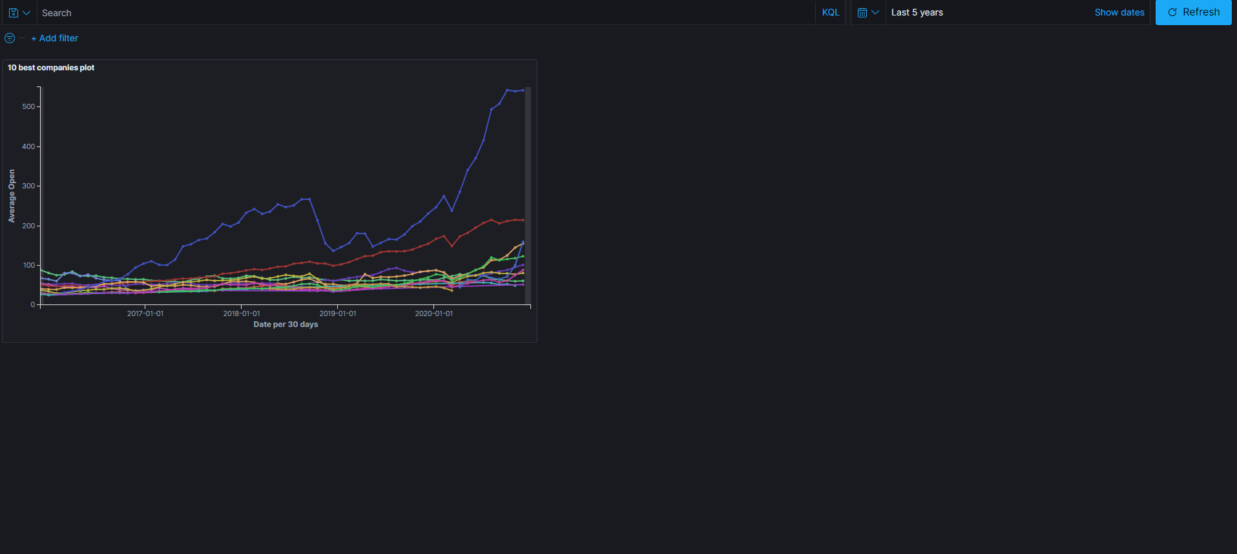
Portfolio Total, in hand, cash bank, value + variatio
Portfolio Total, in hand, cash, bank, variation over a period
Symbol Last values + variation (& Buy/Sell)
Portfolio Total, in hand, cash bank, variation over a period
Portfolio Total, in hand, cash bank, variation over a period
Porfoltio composition (in values)
Portfolio Total over time
Cash over time
Bank over time

