Slide 1
A guide to power calculations for RCTs

Slide 2
Outline
Reinforce intuition (with some theoretical grounding)
Work through basic examples in Optimal Design and Stata 15 Power command
Monte Carlo simulations to calculate power

Slide 3
Why bother with Power Calcs
Conducted ex-ante to determine the necessary sample to obtain a given power. Many funding agencies consider 80% to 90% an appropriate target.
However, sample size is often determined in large part by budget or implementation constraints. In this case, power calculations can help evaluate the power of a specific design, and thus help the researcher decide whether to embark on the project at all.
Power calculations help make decisions about how to design the experiment to achieve the maximum power within a given budget. For example, is it worth conducting a baseline?
Doing Power calculations before the start of a study is really important!

Slide 4
Power calculations are hard
Disclaimer: I am *not* an expert
Isabel Onate quoting Andrew Dillon: “Power calculations are witchcraft”
Perhaps a basic calculation is a close enough approximation
Isabel Onate quoting Dean Karlan responding to a question about power calculations: “You’re thinking too hard about this”

Slide 5
Terminology of Hypothesis Testing
Null Hypothesis (H0): no significant difference between two populations (in RCTs: treatment effect = 0)
Alternative hypothesis (Ha): there is a difference (in RCTs: treatment effect != 0)
Type I error: False positive, reject null when it is true
α: Type I error rate
Type II error: False negative, fail to reject null when it is false
β: Type II error rate
Mnemonic: The villagers in “The Boy Who Cried Wolf” commit Type I and then Type II error, in that order
Vincent J. Armentano Jr’s idea:

Slide 6
What is power?
rejecting the null when it is false
not committing a Type II error
1 - β
The probability of

Slide 7
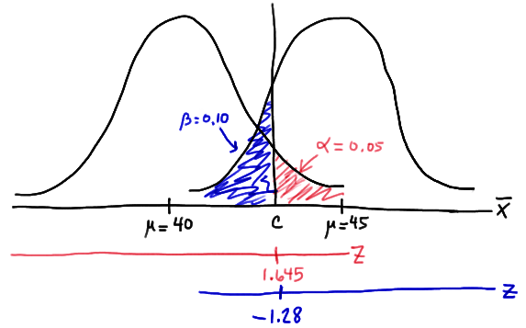
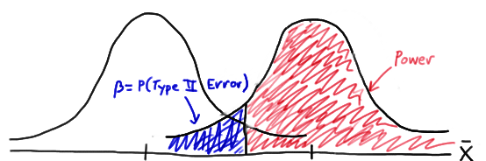
Graphically:
Find cutoff c such that red area equals desired α/2 (for a two tailed test)
This cutoff will determine β, depending on the extent of overlap between the null and alternate distributions

Slide 8
Note on normality
We are not assuming that the data is normally distributed. The sample mean is normally distributed because of the Central Limit Theorem.

Slide 9
Moving parts
Power analysis is specific to a particular design
- For individual-level randomization:
Power = 1 - β = f(α, MDES, SD, N, R² explained by covariates)
- For cluster-level randomization:
Power = 1 - β = f(α, MDES, SD, Nk, Nc, ICC, R² explained by covariates)
Hold everything except two parts constant to produce a twoway plot
(Of the outcome)
number of clusters
number of individuals per cluster

Slide 10
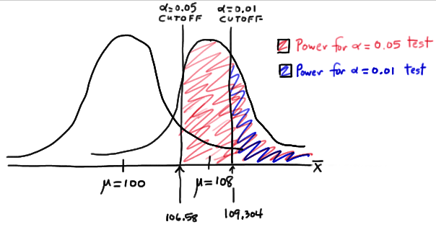
How does α affect power?

Slide 11
What is Minimum Detectable Effect Size (MDES)?
The smallest effect size that can be detected at a specific level of power for any given sample size.
That is, if power is 0.8 and the distribution of the mean effect under the null and alternate hypothesis is as in the diagram below, then the smallest distance x can get while the area in red is greater than 0.8 is the MDES at power 0.8.
x

Slide 12
What is MDES?
It is useful to specify MDES in SD units when we don’t have data available on means and standard deviations
0.2 standard deviation described as a “small” effect, 0.5 as “medium” and 0.8 as “large.”
Not clear if this distinction has practical meaning without a sense of what the standard deviation is

Slide 13
How does the MDES affect power?
Greater MDES => Distributions are further apart => less overlap in distributions => smaller β
0 1
0 2

Slide 14
How does standard deviation of outcome affect power?
Smaller SD => Smaller standard error (as $SE=\frac{SD}{\sqrt{N}}$) => narrower distribution => less overlap => smaller β
0 1
0 1

Slide 15
How does N affect power?
Greater N => Smaller standard error (as $SE=\frac{SD}{\sqrt{N}}$) => narrower distribution => less overlap => smaller β
0 1
0 1

Slide 16
How does explained R² affect power?
We include covariates measured pre-treatment (or static covariates measured post-treatment) to “increase precision,” i.e. have a smaller standard errors on our estimate of the treatment effect
The covariates explain some portion of the variation in the outcome of interest that is unrelated to the treatment assignment in an RCT
Controlling for these covariates will reduce the variation in the outcome variable that is uncorrelated with treatment
Higher R² explained by covariates => Smaller SD => smaller β

Slide 17
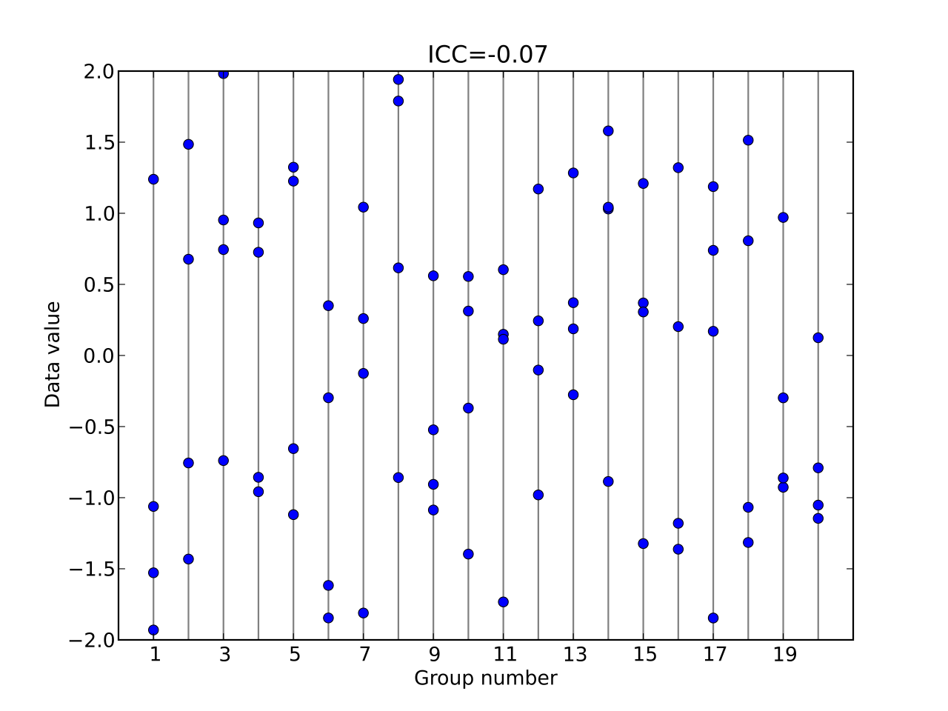
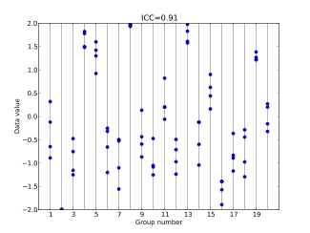
What is Intraclass Correlation (ICC)?
Some portion of the outcome’s variation will be explained by the cluster an individual belongs to, and we need to consider that for a clustered randomization design
Higher ICC => Observations from one group more clustered

Slide 18

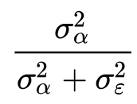
What is ICC?
Consider the model:
Overall mean
Noise
Outcome value for person i in cluster j
Effect of being in cluster j
SD of α_{j} is denoted by σ_{α} and the SD of ε_{ij} is denoted σ_{ε}
The total variance of Y_{ij} is σ_{α}² + σ_{ε}², and the within group variance is σ_{α}²
ICC measures the proportion of the overall variance in the outcome which is explained by within group variance:
ICC =

Slide 19
How does ICC affect power?
Consider the extremes:
ICC = 0, equivalent to a person-level randomization design, clusters irrelevant
ICC = 1, no marginal benefit to having more than one person per cluster
All else equal, higher ICC => lower power
But rate of change depends on specific Nc and Nk being tested; in the toy example where Nk = 1, changes to ICC will not affect power

Slide 20
How do Nc and Nk affect power?
N = Nc*Nk , so the effect is in the same direction as N
But with non-zero ICC, the effect of increasing N by adding more clusters will be different from the effect of increasing N by the same amount while keeping Nc constant
Generally, it is cheaper to increase Nk than Nc, but the returns to increasing Nk while holding Nc constant can be rapidly diminishing with non-zero ICC

Slide 21
Power calculations in practice
Goal: present PIs with a menu of options and associated tradeoffs, under various assumptions
Power = f(α, MDES, SD, Nk, Nc, ICC, R² explained by covariates)
We can produce two way plots using Optimal Design/Stata 15’s power command to show the relationship between two variables holding everything else fixed. Two broad approaches:
Power determination approach: make assumptions about the effect size the intervention produces, compute the power you will have to detect that effect with a given sample size
Effect size approach: begin with a desired level of power, compute the minimum effect size that can be detected at that level of power for any given sample size

Slide 22
Power calculations in practice
By convention: power = 0.8, α = 0.05
Look at past studies for a reasonable MDES, get PI input on what effect they would like to be able to detect
Use data from a similar context (or baseline data if available) to calculate ICC (“icc” command in stata) and check with PIs
Similarly for R² explained by covariates (at least 0.2 is a good rule of thumb if data not available)
If there are logistical or budgetary constraints on N/Nk/Nc, take those into account

Slide 23
Power calculations: example
Study design: lottery for admission to a charter school
Applicants to a charter school are randomly assigned to be enrolled in the school (treatment) or rejected (control, will presumably enroll in the local public school).
Based on pilot, we expect that treated students will score 0.25 standard deviation units greater than control students on a test. Suppose the PIs are considering administering a pre-test to all students prior to the study. Based on past literature, we expect the pre-test to explain 64% of the variation in the post-test scores. We want to be able to detect 0.25SD size treatment effect with power = 0.80.
How many students are required for the study? How many students would be required if the pre-test is not included in the The researchers want to be able to detect this size treatment effect with power = 0.80. and analysis plan?

Slide 24

Power calculations: example
Optimal design:
Design -> Person randomized trials -> single level trials -> Power on y-axis -> power vs. total number of people (N).
Click on δ. Set delta(1) = 0.25
Click on <x< and set the maximum = 600
Click on R² . Set r2(2) = 0.64
Stata 15:
power twomeans 0 .25, p(.2(.02).98) sd(1) graph
power twomeans 0 .25, p(.2(.02).98) sd(`=sqrt(1-.64)') graph
Conducting the baseline test reduces the total sample size by 324. We can now make the budgetary comparison to see which option is preferable.
$$=√{(1−R}^{2})$$

Slide 25
Power calculations: exercise
Charter school example continued:
Suppose 200 students apply to the charter school. 100 people will be assigned to the treatment and 100 people will be assigned to the control. What is the minimum detectable effect size (MDES) the we can find with power = 0.80?
Suppose the PIs are considering administering a pre-test to all kids prior to the study. Based on past literature, we expect the pre-test to explain 64% of the variation in the post-test scores. What is the MDES with power = 0.80?

Slide 26
Power calculations: exercise
Optimal design:
Design -> Person randomized trials -> single level trials -> MDES on y-axis -> MDES vs. number of people (N).
Click on P. Set P(1) = 0.8
Click on R² . Set r2(2) = 0.64
Stata 15:
power twomeans 0, p(.2(.02).98) n1(100) n2(100) sd1(1) sd2(1) graph
power twomeans 0, p(.2(.02).98) n1(100) n2(100) sd1(`=sqrt(1-.64)') sd2(`=sqrt(1-.64)') graph
Conducting the baseline test changes the MDES from 0.4 to 0.24 for N=200. So it will be necessary to do so if we want an MDES of 0.25.

Slide 27
Power calculations: example
Study design: School level randomization of new curriculum
Schools are randomly assigned to teach students using a new curriculum for 3rd graders (treatment) or the old one (control).
We have access to last years 3rd grade average reading test scores for each school. Past data reveals that last years scores explain 49% of the variation in test scores.
Based on past studies, the researchers expect about 20 percent of the variation to lie between schools and are interested in detecting an effect size of at least 0.25 with adequate power. Assuming that 20 students are willing to participate in the study from each school, how many schools (clusters) are necessary to achieve power = 0.80? How many clusters are required after including the cluster-level covariate which explains 49% of the variation in test scores?

Slide 28
Power calculations: example
Optimal design:
Design -> Cluster randomized trials with person level outcomes -> Cluster randomized trials -> Treatment at level 2 -> Power on y-axis (continuous outcome) -> Power vs. number of clusters (J)
Click on n. Set n(1) = 20
Click on δ. Set delta(1) = 0.25 and delete delta (2)
Click on ρ. Set rho (1) = 0.20 and delete rho (2)
Click on <x<. Set the maximum to 150
Click on R² . Set r2(2) = 0.49
Stata 15:
power twomeans 0 .25, cluster power(.2(.02).98) rho(.2) sd(1) m1(20) m2(20) graph
power twomeans 0 .25, cluster power(.2(.02).98) rho(.2) sd(`=sqrt(1-.49)') m1(20) m2(20) graph

Slide 29
Power calculations: exercise
New curriculum example continued:
We are limited to 60 schools, 30 in the treatment and 30 in the control group with 20 students per school. Based on past studies, we expect about 20 percent of the variation to lie between schools. What is the MDES we can find with power = 0.80? Assuming the cluster-level covariate explains 49% of the variation in test scores, what is the MDES?

Slide 30
Power calculations: exercise
Optimal design:
Design -> Cluster randomized trials with person level outcomes -> Cluster randomized trials -> Treatment at level 2 -> MDES on y-axis (continuous outcome) -> MDES vs. number of clusters (J)
Click on n. Set n(1) = 20
Click on P. Set J (1) = 0.80.
Click on ρ. Set rho (1) = 0.20 and delete rho (2)
Click on R² . Set r2(2) = 0.49
Stata 15:
power twomeans 0, cluster power(.2(.02).98) k1(30) k2(30) m1(20) m2(20) rho(.2) sd(1) graph
power twomeans 0, cluster power(.2(.02).98) k1(30) k2(30) m1(20) m2(20) rho(.2) sd(`=sqrt(1-.49)') graph

Slide 31
Optimal Design/Stata limitations
OD assumes that all designs are balanced, i.e. treat and control groups are equal in size. Use Stata for unbalanced designs.
OD can only do MDES in SD units. Stata 15 allows non standardized units if needed
Continuous variables only, use Stata power “two proportions” for binary
Note that the R² explained by covariates option in OD is for covariates at the level of randomization
Optimal design manual is straightforward and helpful if you’re interested in learning about the other features I did not go over
Stata 15 power command does not have a straightforward option for explained R², but we can adjust SD accordingly

Slide 32
Monte Carlo (MC) simulations
OD/Stata commands cannot account for all sort of designs and tests you may want to calculate power for, and considerations you want to make
It can be very difficult to think through all the details theoretically and be certain you’re not making a major error (and mistakes at this stage can be very costly!)
For ultimate flexibility, you can code a Monte Carlo simulation in Stata

Slide 33
How to calculate power empirically?
Recall: Power is the probability of rejecting the null when it is false
Procedure:
Generate data assuming the alternate hypothesis is true (i.e. the null is false)
Test the null hypothesis using this data
Repeat this S times
Count up number of times the null hypothesis in rejected, call this R
Now R/S is the probability of rejecting the null when it is false

Slide 34
Monte Carlo simulation example
Back to the school curriculum example from before:
R² explained by covariates = 0.49
ICC = 0.2
MDES = 0.25
Nk = 20
Goal: plot power against Nc

Slide 35
Monte Carlo simulation: Generating data
R² explained by covariates = 0.49
=> Remaining variation on Y_{ij} is 0.51

Slide 36
Monte Carlo simulation: Generating data
ICC = 0.2
Recall: if data is generated by , then
Total variance of Y_{ij} is σ_{α}² + σ_{ε}² = 1 - 0.49 = 0.51
=> σ_{α}² = 0.2*0.51 and σ_{ε}² = 0.8*0.51
ICC =

Slide 37
Monte Carlo simulation: Generating data
Steps:
Set Nc to integer x
Create x schools, and randomly assign to treatment and control
For each school, generate α_{j} from a distribution with mean 0 and variance 0.2*0.51
For each school, generate 20 random numbers (ε_{ij}) from a distribution with mean 0 and variance 0.8*0.51
Generate Y_{ij} = α_{j} + ε_{ij}
Add 0.25 to Y_{ij} for individual i if cluster j is assigned to treatment

Slide 38
Monte Carlo simulation example
Next steps:
Test hypothesis on data
Repeat S times
Calculate power for Nc = x
Repeat for different values of Nc to produce a plot

Slide 39
Monte Carlo simulation example

Slide 40
Monte Carlo simulation in practice
What is the right S?
As high as you need to go to get a stable result.
(Analytically, power is 0.6970)

Slide 41
Monte Carlo simulation in practice
What distribution to assume on the outcome variable?
It shouldn’t matter too much with large enough S, because central limit theorem
Outcome distribution
Normal
Uniform

Slide 42
Monte Carlo simulation
Stata blog posts on MC simulations are very useful:
https://blog.stata.com/2019/01/10/calculating-power-using-monte-carlo-simulations-part-1-the-basics/
https://blog.stata.com/2019/01/29/calculating-power-using-monte-carlo-simulations-part-2-running-your-simulation-using-power/

Slide 43
Citations/Resources
Using Randomization In Development Economics Research: A Toolkit (Esther Duflo, Rachel Glennerster and Michael Kremer)
Optimal design manual
Stata blog posts on Monte Carlo Simulations
Previous slides and documents by Isabel Onate

Slide 44
