Slide 1
Diabetes Prediction
Using Feature Grouping
24/April/2026

Slide 2
Original Dataset: 21 Features
HighBP
HighChol
CholCheck
Smoker
Stroke
HeartDiseaseorAttack
PhysActivity
Fruits
Veggies
HvyAlcoholConsump
AnyHealthcare
NoDocbcCost
DiffWalk
GenHlth (1–5)
Age (1–13)
Education (1–6)
Income (1–8)
BMI
MentHlth (0–30 days)
PhysHlth (0–30 days)
Diabetes_binary (0/1)
Target Variable
Target: Diabetes_binary → 0 = No Diabetes / Pre-Diabetes | 1 = Diabetes

Slide 3
Three Big Groups
Demographic
HEALTH STATUS
Lifestyle & Healthcare Access
Age · Gender · Education · Income
Blood pressure · Cholesterol · Stroke · Heart disease · General health · Physical & Mental health
Smoking · Drinking · Exercise · Diet · Insurance · Cost issue · Doctor check

Slide 4
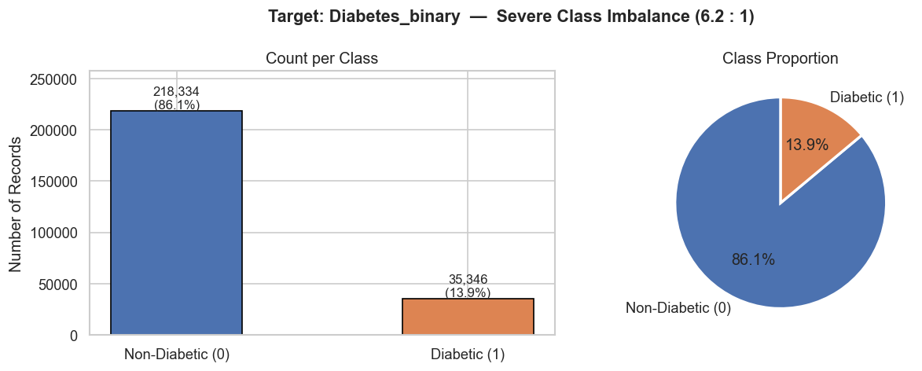
EDA — Class Imbalance
Data Overview (Imbalance)
The dataset is imbalance Use SMOTE to balance training data

Slide 5
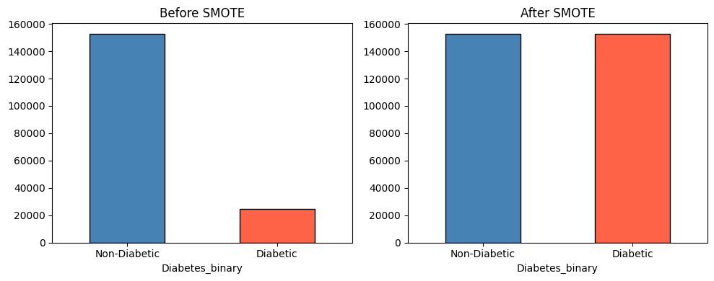
EDA — Class Imbalance
Data Overview (Imbalance)

Slide 6
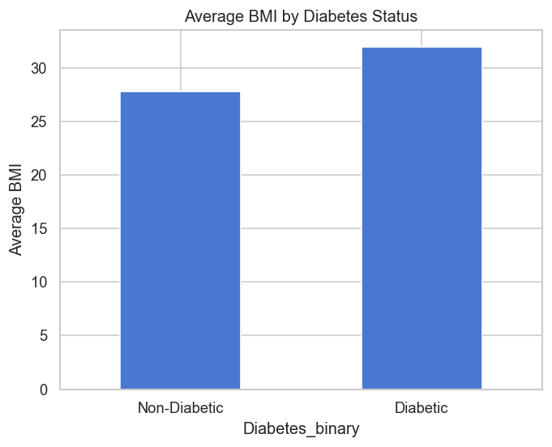
EDA – Key Risk Factors
BMI vs Diabetes
# average BMI
avg_bmi = df.groupby('Diabetes_binary')['BMI'].mean()
# plot
avg_bmi.plot(kind='bar')
plt.xticks([0,1], ['Non-Diabetic', 'Diabetic'], rotation=0)
plt.ylabel("Average BMI")
plt.title("Average BMI by Diabetes Status")
plt.show()

Slide 7
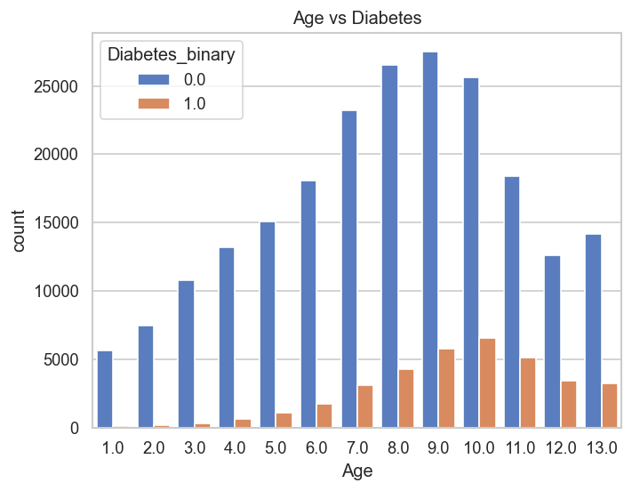
EDA – Key Risk Factors
Age VS Diabetes
plt.figure()
sns.countplot(x='Age', hue='Diabetes_binary', data=df)
plt.title("Age vs Diabetes")
plt.show()

Slide 8
THANK YOU
AI-Powered Diabetes Risk Prediction

Slide 9
Royal University of Phnom Penh
Faculty of Engineering
Department of Data Science and Engineering
Explainable AI for Diabetes Risk Prediction and Actionable Insights
78% Risk
Extended Output Design
1 / 0
Risk Level
Why?
Advisor: Prof. Khim Chamrouen
Presenter: NHOR Povketya
What to improve
06/May/2026

Slide 10
Output 1: Probability + Risk Level
Convert model probability into human-readable risk categories
Low
Medium
High
0%
30%
70%
100%
Example A: 20%
Example B: 78%
Risk level: Low
Risk level: High
Notes:
Explain that probability is the model confidence of diabetes risk. Risk levels are a communication layer, not a medical diagnosis.

Slide 11
Output 2: Feature Contribution
Patient risk explanation
BMI
biggest reason ↑
Simple explanation
Age
second reason ↑
“This patient is high risk mainly because BMI and Age push the prediction upward. Physical activity helps reduce the risk.”
High BP
pushes risk ↑
Exercise
reduces risk ↓
Fruits
reduces risk ↓
lower risk
higher risk
Notes:
Mention BMI, age, and physical activity because the paper identifies BMI, general health, age, and physical activity as important contributors.

Slide 12
Output 3: Group Insight
Demographic
1
Who the patient is
Age, Sex, Education, Income
Health Status
2
Current health condition
BMI, HighBP, HighChol, GenHlth, Heart disease
Lifestyle & Healthcare Access
3
Daily behavior and access
Physical activity, fruits, veggies, smoking, healthcare access
Example insight: “Health Status is the strongest driver because BMI and high blood pressure increase the prediction.”
Notes:
Explain that grouping reduces complexity. Instead of showing many columns, we summarize the reason into three understandable categories.

Slide 13
Output 4: Explain + Suggest Improvement
Model Output
Why
Improve
78% High Risk
BMI + Age increase risk
Exercise reduces risk
More activity
Weight management
Regular check-up
Important: the system supports prevention and education. It should not claim to replace doctors or diagnose the patient.
Notes:
Tell the audience that recommendations should be safe and general, such as exercise, healthy diet, and check-up. It should not be a final medical diagnosis.

Slide 14
Complete Extended Output Design
Patient Risk Report
78% High Risk
Probability
Risk score = 78% → High
Feature Contribution
BMI and Age increase risk; Physical Activity reduces risk
Group Insight
Health Status is the main driver; Lifestyle is modifiable
Recommendation
Increase activity, monitor BMI, check blood pressure / cholesterol
This output is easier for users because it answers: How risky? Why? Which group? What can be improved?
Notes:
This slide summarizes the final report format. It is the most important slide for explaining the extended output.

Slide 15
Actionable Recommendation: What does Gemini receive?
System Output
Structured Input Sent to Gemini
Gemini Output
Prediction result
{
"risk_probability": 0.78,
"risk_level": "High",
"patient_profile": {
"Age": "58",
"BMI": 34.7,
"HighBP": 1,
"HighChol": 1,
"PhysActivity": 0
},
"top_risk_factors": ["BMI", "Age", "HighBP"],
"protective_factors": ["Physical Activity"],
"instruction": "Provide simple lifestyle education only. Do not diagnose."
}
Simple explanation: why risk is high
78% · High Risk
1
2
3–5 actions: exercise, diet, BMI tracking
Patient profile
Age, BMI, BP, activity
3
Safe reminder: consult health professional
SHAP explanation
Top factors: BMI, Age
4
Friendly wording for patient/user
Safety rule
Education only, not diagnosis
Important: Gemini explains and recommends. The ML model already made the prediction.
“The AI recommendation uses three inputs: the risk score, patient health data, and SHAP reasons. Gemini only translates them into understandable lifestyle advice.”

Slide 16
Final Output Example
👤
Patient Result
📊
Main Reasons
◔
Group Insight
🛡️
Actionable
Recommendation
1
BMI – biggest reason
increasing risk
1
Increase regular physical activity
Health Status:
65%
78%
2
Age – second strongest
factor
Lifestyle &
Healthcare Access:
25%
2
Monitor and reduce BMI
High Risk
3
High blood pressure –
increases risk
Demographic:
10%
3
Check blood pressure regularly
4
Consult a healthcare professional
4
Physical activity –
helps reduce risk
Predicted diabetes risk probability
Health Status is the main category
driving this patient’s risk
i
For education and early awareness
only not a medical diagnosis
📄
This final output extends binary prediction into probability, risk level, explanation, and action

Slide 17
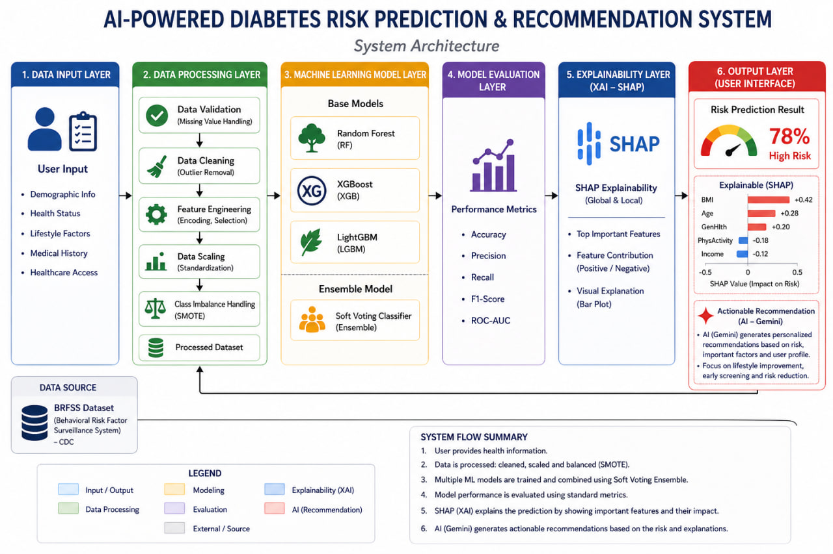
System Architecture
Notes:
This slide summarizes the final report format. It is the most important slide for explaining the extended output.

Slide 18
2015 → 2017 → 2019
Adding 2017 & 2019 BRFSS Data
Combined data
769K rows

Slide 19
Diabetes Target Mapping
Raw value
Meaning
Action
1
Yes, diabetes
1 = Positive risk class
Final target definition
4
Prediabetes / borderline diabetes
1 = Positive risk class
0 = No diabetes
1 = Diabetes-related risk group
including prediabetes and diabetes
3
No diabetes
0 = Negative class
2
Diabetes only during pregnancy
Remove
7 / 9 / Missing
Don’t know / Refused / Missing
Remove

Slide 20
From Raw BRFSS Data to Clean Binary Data
Data Source
Cleaning Pipeline
CDC BRFSS Annual Survey Data
1
Download .XPT
CDC raw annual file
2
Convert to CSV
read_sas → to_csv
3
Select features
match 2015 indicators
4
Rename columns
same names as 2015
Download original yearly survey data as SAS Transport (.XPT) files.
Example years used:
Clean values
remove invalid codes
Binary target
0/1 diabetes label
Save clean CSV
ready for modeling
2017 BRFSS raw file
2019 BRFSS raw file
2015 Kaggle clean reference
5
6
7
Source:
CDC BRFSS Annual Data
2017 2017 BRFSS Data (SAS Transport Format) [ZIP – 101 MB]
2019 2019 BRFSS Data (SAS Transport Format) [ZIP – 101 MB]
Kaggle Diabetes Health Indicators dataset
Feature Match
Column Names
Binary Target
Keep only columns that also exist in the 2015 diabetes dataset.
Rename raw BRFSS codes to clear ML names such as BMI, Age, HighBP.
Group the diabetes column into only 2 classes: 0 and 1.

Slide 21
From Raw BRFSS Data to Clean Binary Data
Why rows decrease after cleaning?
Raw BRFSS has more answer categories and many survey variables. We keep only records with a clear diabetes status and the same selected 21 features used by the 2015 dataset.
253K
275K
240K
Clean 2015
Clean 2017
Clean 2019
Clean binary data = ready structure for model training

Slide 22
Combined Dataset and Class Imbalance
84.55%
Total combined rows
769,919
Class 0 = 650,997
No diabetes
Most records are class 0. If we train directly without care, the model may become good at predicting “no diabetes” but weaker at finding real risk cases.
15.45%
Class 1 = 119,922
Prediabetes or diabetes
Next: use stratified split + class balancing such as SMOTE

