Slide 1
POWELL · BUI
A DECISION BRIEF
Health Account
Charges.
What is associated with the bill, and how we would price the next customer.
Aaron Powell and Thuan-Andy Bui
26 September 2026
HEALTH-ACCOUNT CHARGES
01 / 15
Notes:
0:00 to 0:40. Which customer facts are associated with health-account charges, and does that association depend on region? Separately, if the job is to price the next account, which method is the best?

Slide 2
POWELL · BUI
THE BIG PICTURE
Insurance insights
3.8x
$1,461
$264
$512
Average smoker charges
Per BMI point among smokers
Per year of age
Per child
$32,050 average smoker annual charges.
$8,441 average non-smoker annual charges.
$22,833 gap between smokers and non-smokers at BMI 30.
Among non-smokers, BMI is not a predictor of charges.
2% of the average bill.
Same slope for smokers and non-smokers. Range $245 to $283.
Sex is not clearly associated with charges (p-value = .062).
Adjusted, southeast is $1,207 lower and southwest $1,228 lower than northeast region.
Analysis supports an association in these customers. It does not support a national rate or a causal effect.
Reported as contrasts – all other variables held constant.
HEALTH-ACCOUNT CHARGES
02 / 15
Notes:
0:40 to 3:00. Let’s talk about the big picture, and the insights we found given the sample.
Smoking dominates. At BMI 30, holding age, children, and region fixed, mean charges for a smoker are about $23,000 higher. 280% higher than a non-smoker at the same BMI. BMI among smokers is associated with about $1,461 increase charges per point. There isn’t a significant association among non-smokers.
Age is associated with a $264 a year increase both smokers and non-smokers. The ordinary 95 percent interval is $245 to $283 using a paired bootstrap method. That is about 2 percent of the average bill. Each child is added is associated with about $512 increase in charges.
Sex is not clearly associated once the other facts are held fixed.
The unadjusted southeast looks expensive because it has more smokers and a higher BMI. After those are held fixed, the southeast mean is $1,207 lower than the northeast, and the southwest is $1,228 lower. The northwest did not have a clear difference from the northeast.
These are associations in 1,337 accounts in the sample. Not a national rate, and not what the bill would do if a particular person stopped smoking.

Slide 3
POWELL · BUI
DATA SUMMARY
1,337 customer accounts
Group | Customers | Average | Median | SD
Non-smoker | 1,063 | $8,441 | $7,346 | $5,993
Smoker | 274 | $32,050 | $34,456 | $11,542
Age
Years, 18 to 64
Sex
675 male, 662 female
BMI
Slope differs by smoker
Mean bill $13,279. Median $9,386.
Children
$512 each. Thin past 3.
Fact | Mean | SD | Min | Median | Max
Charges ($) | $13,279 | $12,110 | $1,122 | $9,386 | $63,770
Age (years) | 39.2 | 14.0 | 18 | 39 | 64
BMI | 30.7 | 6.1 | 16.0 | 30.4 | 53.1
Children | 1.1 | 1.2 | 0 | 1 | 5
Smoker
20.5% of the book
Region
Adjusted level shift
Charges
Skewed. Median $9,386
HEALTH-ACCOUNT CHARGES
03 / 15
Notes:
3:00 to 4:10.
1,337 records were examined, after dropping one exact duplicate. Smokers are 20.5 percent. Their median charges are higher than the average so smokers are not right-skewed. The remaining non-smokers have higher average than median which presents a right skewed distribution for the sample. For this reason, we consider both mean and median in our analysis.
The right-hand list only names the facts. Forty-three people have four or five children, so the per-child slope is identified mostly from zero to three.

Slide 4
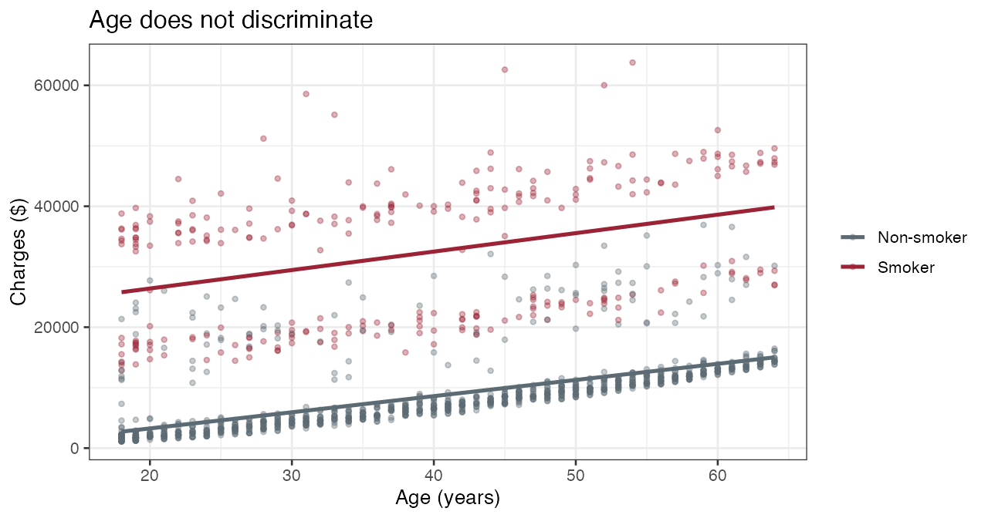
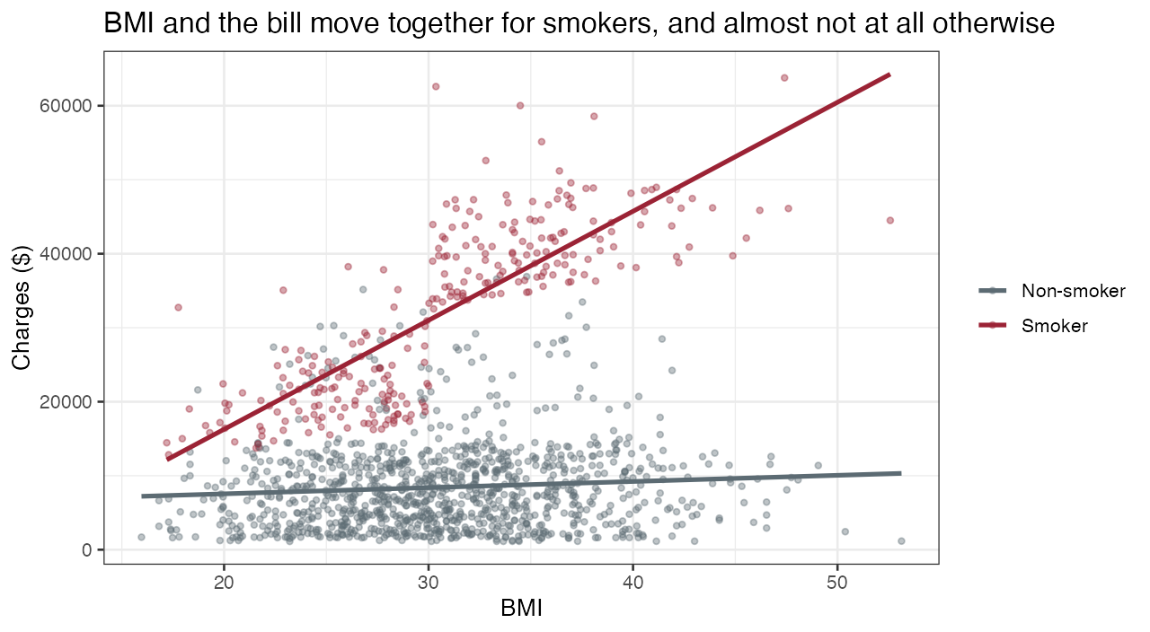
POWELL · BUI
DATA SUMMARY
Age lifts both groups. BMI lifts smokers.
Age correlation is 0.63 for non-smokers and 0.37 for smokers. The lines are roughly parallel. Smoking is a level shift of tens of thousands of dollars. Age is a few hundred a year.
BMI correlation is 0.81 for smokers and 0.08 for non-smokers. One smoker number would average a steep line and a flat line into a sentence that is true for neither group.
HEALTH-ACCOUNT CHARGES
04 / 15
Notes:
4:10 to 6:10. Since there is a clear delineation between smokers and non-smokers, we decided to view plots of other variables illustrating the difference.
We found age had different correlations among smokers compared to non-smokers, but when plotted against charges we did not find a significant difference to move the bill as illustrated on the left.
The right illustrates the opposite. using BMI to predict charges is highly dependent on if the customer is also a smoker. In short, Age is linearily correlated to the bill and BMI is only relevant among smokers.
We saw the same interaction among children, but overall children had a low correlation to charges (.07) and there’s not many instances greater than 3 children per account.

Slide 5
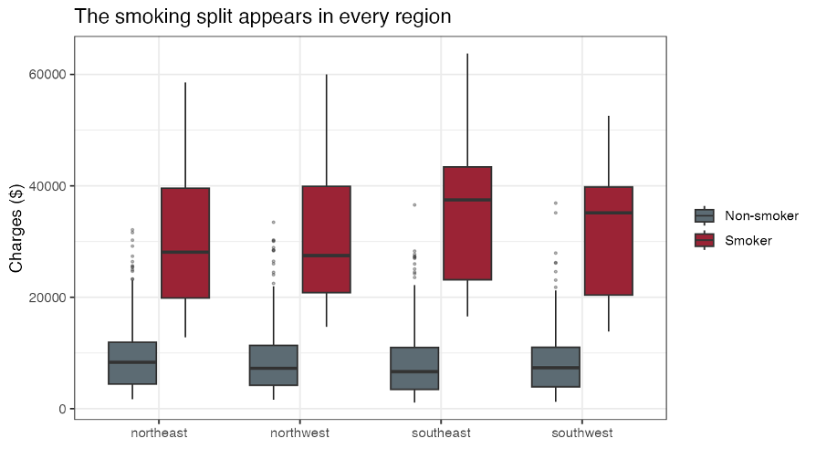
POWELL · BUI
DATA SUMMARY
Region shift
Region | Customers | Average BMI | Smoker share | Average bill
Northeast | 324 | 29.2 | 20.7% | $13,406
Northwest | 324 | 29.2 | 17.9% | $12,451
Southeast | 364 | 33.4 | 25.0% | $14,735
Southwest | 325 | 30.6 | 17.8% | $12,347
N
The smoker gap does not depend on region (p = 0.31). The age slope does not depend on region (p = 0.28), nor the smoker BMI slope (p = 0.20).
Southeast has the highest unadjusted average bill, lowest when holding age, children, BMI and smoking status fixed.
-$1,200
HEALTH-ACCOUNT CHARGES
05 / 15
Notes:
6:10 to 7:40. To answer your question if charges depends on region, yes but not as much as BMI, smoker or even age. Be careful when looking at the average bill by region. Southeast has the highest average BMI and Smoker share.
For regional comparison only, holding age, children, BMI, and smoking status fixed, the southeast average is associated with $1,207 lower average charge amount relative to the northeast (-$1,959 to -$455), about 9.1% of the average bill. The southwest contrast is -$1,228 (-$1,978 to -$477). The northwest range includes zero (-$1,327 to $170).

Slide 6
POWELL · BUI
THE EQUATION
The equation we would defend.
Charges = age + children + BMI + smoker + (BMI × smoker) + region
Non-smoker and northeast are the reference.
Kept
Age, one slope for both groups
Kept
Children, about $512 each
Kept
A BMI slope only where it exists: smokers
Kept
Region as a level shift
Left out
Sex. p = 0.062 after other facts
Left out
A different smoker gap by region. p = 0.31
Left out
A different age slope by region, or by smoker
HEALTH-ACCOUNT CHARGES
06 / 15
Notes:
7:40 to 9:10. This is the equation we would tell your customers.
* Read the equation once, slowly. Then what we kept and what we refused. *
Our final equation uses age, children, BMI, smoking status, region, and an interaction between BMI and smoking. That interaction means the effect of BMI changes depending on whether the customer smokes.
Non-smoker and northeast are the reference. We’re about to explain 84% of the variation in charges with this equation.
A common percent per year is too steep for smokers, and giving smokers their own age slope on the log scale makes the residual spreads unequal again.
Dollar scale. We fit the log of charges and did not adopt it.
This is the equation we would use to explain the charges.
Our final model includes age, children, BMI, smoking status, region, and an interaction between BMI and smoking. That interaction is important because the effect of BMI is different for smokers and nonsmokers.
Nonsmokers and the Northeast are our reference groups.
We kept age, children, the BMI-by-smoking interaction, and region because they contributed meaningful information to the model. We left out sex because, after controlling for the other variables, it was not clearly significant. We also did not find strong evidence that the smoker gap or the age slope needed to change by region.
This model explains about 84% of the variation in charges in this sample.
We also tested a log transformation. It improved some of the residual behavior, but it created other problems, especially with the age relationship and unequal spreads between smokers and nonsmokers. Because of that, we kept the model on the original dollar scale.

Slide 7
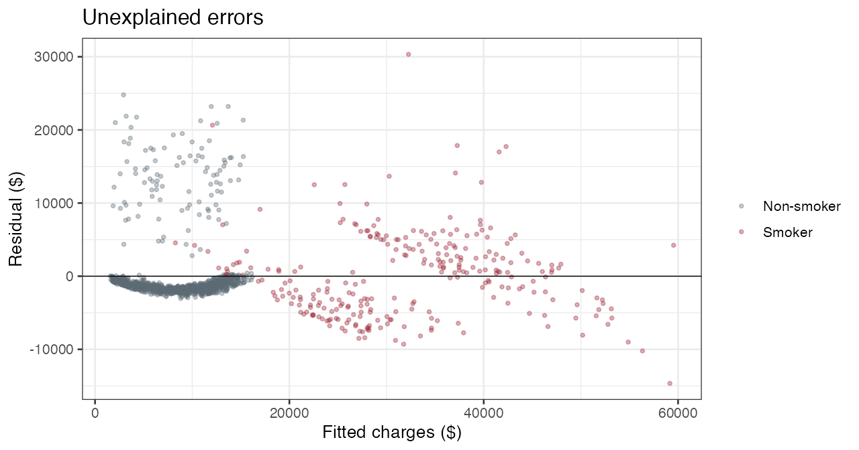
POWELL · BUI
THE EQUATION
Unique variation
$5,717
Smoker residual SD.
$4,588
Non-smoker residual SD.
48 people
Studentized residual beyond 3. Almost all are non-smokers. Nothing in the file explains them.
HEALTH-ACCOUNT CHARGES
07 / 15
Notes:
10:50 to 12:10.
We didn’t adopt a transformation because there’s a unique distribution of errors with any equation or transformation we use.
The main non-smoker band sits near zero. The smoker cloud is wider and sits at higher fitted bills. A third group of non-smokers lands in the smoker range. We did not delete them. The largest Cook's distance is 0.055. A screen of 4 over n is about 0.003 and flags 92 rows at this sample size. It is a screen, not a deletion rule. None over leverage the equation, only the combination is unexplained.
Forty-eight accounts have a studentized residual beyond 3. Almost all are non-smokers. A log scale looks calmer and we refused it, because the model becomes over simplified increasing errors. Adding the complexity for our original analysis and the variation looks like the plot on the left again. This is why we will not predict charges with this equation.
This slide shows the unexplained variation left over after fitting our regression equation.
Most nonsmokers sit near zero, meaning the model predicts them reasonably well. The smoker residuals are more spread out, with a residual standard deviation of about $5,717, compared with $4,588 for nonsmokers.
We also see a separate group of unusually high-cost nonsmokers. Forty-eight customers have studentized residuals greater than 3 in absolute value, and most of them are nonsmokers. We checked for influential observations, but the largest Cook’s distance was only about 0.055, so no single customer is dominating the model.
We did not remove these observations because there is no evidence that they are data errors. Instead, they suggest that there are important factors affecting charges that are not included in this dataset.
We also tested transformations such as the log scale. Although the residual pattern looked somewhat better, it created other problems with the age relationship and the residual spread. Because of that, we kept the model on the original dollar scale.

Slide 8
POWELL · BUI
PRICING THE NEXT CUSTOMER
Prediction models
Method | 10-fold CV RMSE | Holdout RMSE
Explanation equation | $4,816 | $4,714
All two-way products | $4,842 | $4,761
Term search | $4,836 | $4,781
Shrunk equation | $5,050 | $4,842
Nearest neighbors | $5,384 | $5,165
Averaged trees | $4,867 | $4,448
Random forest | $4,624 | $4,366
Term search wins on AIC and loses on RMSE. Averaged trees win the holdout and lose the CV. The forest wins both.
HEALTH-ACCOUNT CHARGES
08 / 15
Notes:
12:10 to 13:30. We tested 7 models using a 10-fold cross-validation, the same folds for every method, and one 80/20 holdout, recording root-mean-squared-error. The random forest is lowest on both tests. $4,624 cross-validated, $4,366 on the holdout. Against the explanatory equation two slides agao, cross-validated gap is $192. The forest's fold-to-fold standard deviation is $763, so that edge is inside the variation.
The term search has a better AIC, because that is the score it we used to optimize. Its cross-validated RMSE is $4,836, slightly worse. Averaged trees beat the equation on the holdout, and lose the cross-validation. We don’t view RMSE as a single source of truth.
We tested 7 models using 10-fold cross-validation, using the same folds for every method, along with a separate 80/20 holdout. We compared the models using RMSE, where lower is better.
The random forest had the lowest RMSE on both checks $4,624 in cross-validation and $4,366 on the holdout. Compared with our explanation equation, the cross-validated improvement is only about $192. The forest’s fold-to-fold standard deviation is about $763, so that difference is small relative to the variation across folds.
The term-search model had the lowest AIC among the linear models because AIC was the criterion used to select its terms. However, its cross-validated RMSE was $4,836, slightly worse than the explanation equation.
Averaged trees performed better than the explanation equation on the holdout, but worse in cross-validation. So we do not want to base the decision on a single split.
Overall, the random forest performs best on both validation checks, but its advantage over the explanation equation is modest. The next slides show where that advantage is coming from.

Slide 9
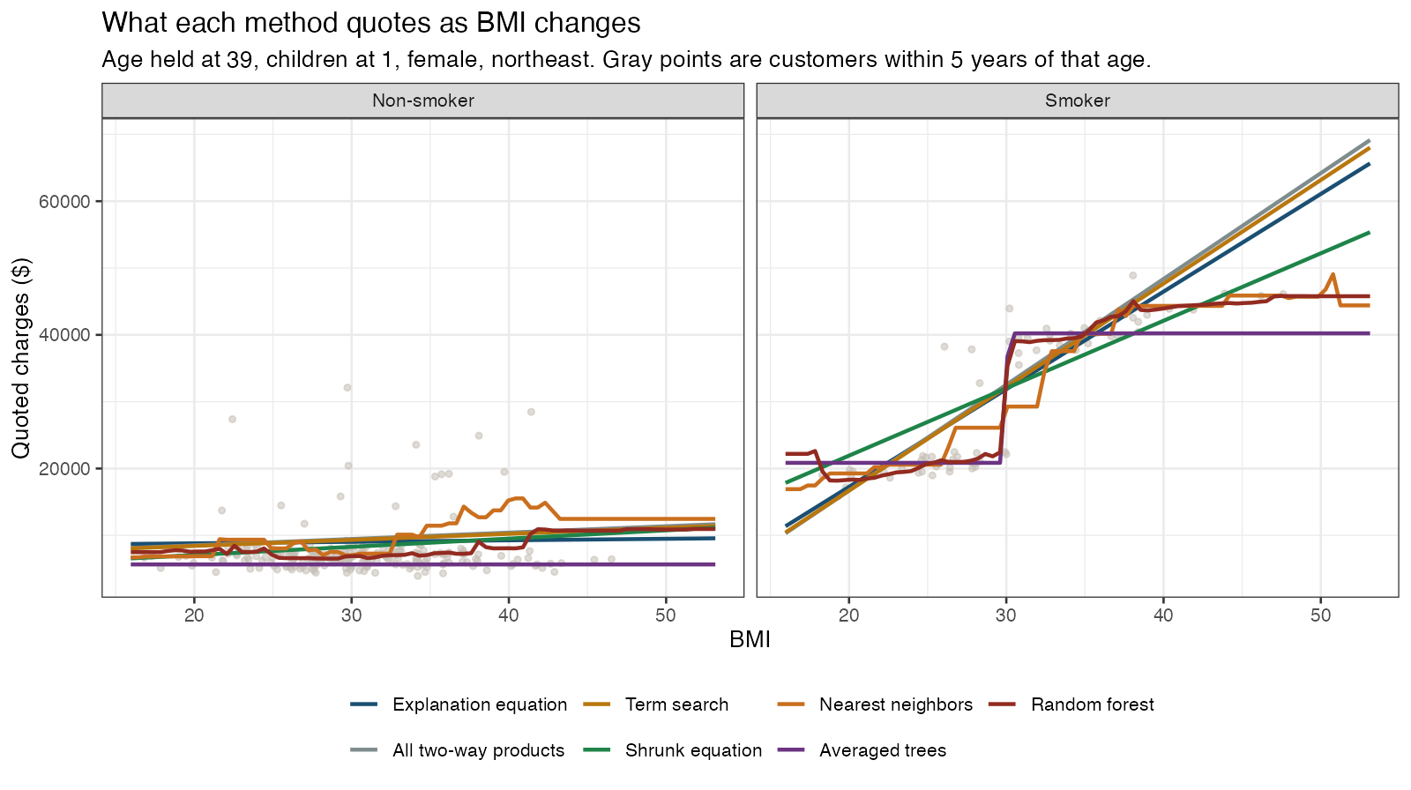
POWELL · BUI
PRICING THE NEXT CUSTOMER
Regression overfits – Trees split
HEALTH-ACCOUNT CHARGES
09 / 15
Notes:
13:30 to 15:00. To understand the trade-off between overfiting and underfitting a model, and to help select the most practical model, let’s take a look at the predictive power of each model to a typical customer.
Age is held at 39, children at one, female lives in northeast. The gray points are real accounts within five years of age 39. A line that sits off the cloud is bias (underfit). A line that jumps from one BMI to the next is variance (overfit).
Left, non-smoker. Every method sits in the lower cloud. None of them climbs to the accounts whose bills are far above that band. The orange neighbor line wiggles toward a few of those points and falls back. The wiggle does not explain the band.
Right, smokers. The straight lines keep climbing and pass $60,000 when The actual flattens out. Around a BMI of 30 the forest, the neighbors, and the averaged trees step up and then level off. The straight line is biased high once BMI is high. The forest is the calmest line that is allowed to bend. The nearest neighbors model still jump.
For the forest, 95 percent of left-out smoker bills fell within $9,800 of the quote, and 95 percent of non-smoker bills within $12,486.
This slide helps show the trade off between overfitting and underfitting, and why we prefer the random forest for prediction.
We hold age at 39, children at one, female, and Northeast. The gray points are actual customers within five years of age 39. A line that consistently sits away from the customer data shows bias, or underfitting. A line that jumps sharply from one BMI value to the next shows high variance, or overfitting.
On the left are nonsmokers. Most of the models stay within the lower band of charges. The nearest-neighbor model moves up and down more as BMI changes, showing higher variance. None of the models really explains the smaller group of nonsmokers with unusually high charges.
On the right are smokers. The straight regression lines continue to rise as BMI increases, eventually predicting charges above $60,000, while the actual smoker charges begin to level off. Around a BMI of 30, the forest, nearest neighbors, and averaged trees are able to step up and then flatten with the data.
The random forest gives us the most stable flexible prediction. It can adapt to the shape of the smoker data without jumping around as much as nearest neighbors.
For the random forest, 95% of the left-out smoker bills were within about $9,800 of the prediction, and 95% of nonsmoker bills were within about $12,486.

Slide 10
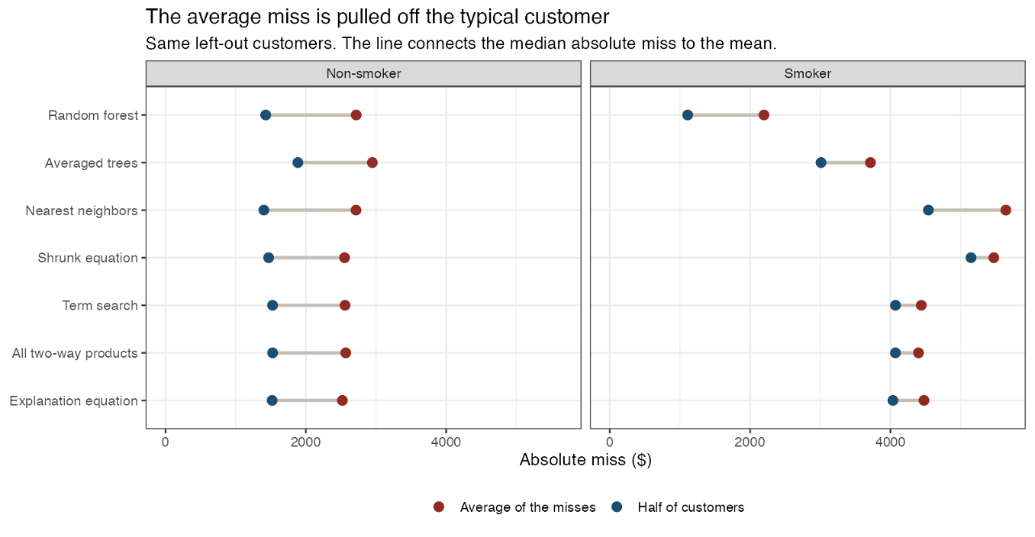
POWELL · BUI
PRICING THE NEXT CUSTOMER
Average vs typical error
HEALTH-ACCOUNT CHARGES
10 / 15
Notes:
15:00 to 16:20. So far random trees visually explains more of the unique variation in charges give the sample, and RMSE is the lowest.
before we lean on the RMSE ranking, let’s compare to the typical (or median) customer. Blue is the median absolute error. Half of the left-out accounts are closer to the quote. Red is the mean of the same absolute errors.
Non-smoking on the left, smoking on the right.
Right panel, The forest's median is $1,111. The equation's is $4,035. Averaged trees are about $3,011. For the typical smoker the forest is about $2,900 closer.
Left panel, non-smokers. The medians sit together, about $1,400 to $1,900. Neighbors are $1,402 and the forest is $1,428. On non-smokers the equation is slightly closer on RMSE, because again smokers dominate the formula in our sample. The random forest's win is the smoker book, but not on the most extreme cases. Not depicted on this graph: adjusting for 95 percent absolute error for smokers, so testing against the most extreme cases, the equation is about $9,500 and the forest is $9,800.

Slide 11
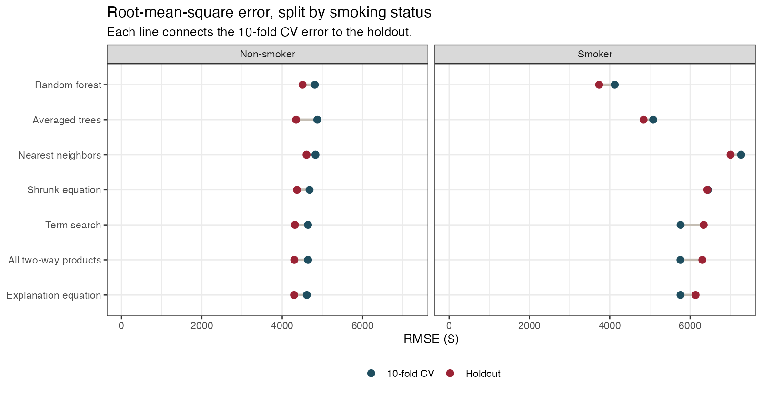
POWELL · BUI
PRICING THE NEXT CUSTOMER
Median & mean point to Random forest
HEALTH-ACCOUNT CHARGES
11 / 15
Notes:
Now with that additional context and looking back at RMSE, we still recommend the nonparameteric Random Forest model as the best trade-off between bias and variance given then sample. Among non-smokers the models performs about the same, but much better among smokers where it counts. On the holdout, 16 non-smokers have bills above $15,000. The equation misses that group by about $14,036 on average. The forest misses them by about $13,554. A more flexible scorer does not explain those accounts.
We still recommend the nonparametric random forest as the best overall trade-off between bias and variance for this sample. Among nonsmokers, the models perform fairly similarly. The larger advantage appears among smokers, where the random forest has lower prediction error than the linear models. On the holdout set, there were 16 nonsmokers with charges above $15,000. The explanation equation missed that group by about $14,036 on average, while the random forest missed them by about $13,554. So although the random forest is more flexible, it still does not fully explain or predict those unusually high-cost nonsmokers. That suggests there are important factors affecting those charges that are not included in this dataset. Random forest gives us the better prediction model, especially for smokers, while the unexplained high cost nonsmoker group remains a limitation.

Slide 12
POWELL · BUI
THE DECISION
Two jobs. Two tools.
EXPLAIN
PRICE
The equation.
The random forest.
Age, children, a smoker gap that depends on BMI, and a regional level shift. Quote at BMI 30. Do not quote the smoker coefficient at BMI 0. Do not call the southeast expensive.
Lowest RMSE on the 10-fold CV and the holdout. The CV edge is $192, inside a $763 fold SD. The gain is the typical smoker, about $1,111 versus $4,035.
HEALTH-ACCOUNT CHARGES
12 / 15
Notes:
17:20 to 18:30. To conclude, we’re giving two tools for two jobs.
Explain with the equation. Age, children, a smoker gap that depends on BMI, and a regional level shift. Quote at BMI 30 when no BMI reading is available . Do not quote the smoker coefficient. It is the gap at BMI 0. Do not call the southeast expensive.
Price with the forest. Lowest RMSE on both checks. Use it because the quote levels off with the smoker cloud instead of climbing past it, and because the typical smoker is about $2,900 closer. It does represents the unique variance better than the equation, but cannot say what a year of age is worth.
To conclude, we recommend two tools for two different jobs.
For explanation, we use the regression equation. It lets us describe the effects of age, children, the smoker gap that changes with BMI, and regional differences. When discussing the smoker effect, we use BMI 30 as a meaningful reference point rather than quoting the smoker coefficient by itself, because that coefficient represents the difference at BMI 0. We also would not describe the Southeast as more expensive after the other variables are held constant.
For prediction, we use the random forest. It had the lowest RMSE on both the 10-fold cross-validation and the holdout set. It also follows the smoker pattern better by leveling off at higher BMI values instead of continuing upward like the straight-line models.
For a typical smoker, the random forest prediction is about $2,900 closer than the explanation equation. The trade-off is that the forest is harder to interpret, it can give us a better prediction, but it cannot tell us something simple like how much one additional year of age changes the expected bill.
The main takeaway is: use the equation to explain the bill, and use the random forest to predict the next one.

Slide 13
POWELL · BUI
WHAT WE WILL NOT CLAIM
The sample supports an association.
Not a national rate, and not a cause.
Scope
Cause
Four region labels in this file. No household, plan, or year. Independence is an assumption, not a result.
Smoking was not assigned. $22,833 is a contrast in this file, not the effect of someone quitting.
A tight quote
More time
95% of left-out smoker bills fell within $9,800 of the forest quote. Non-smokers, within $12,486. The equation is $9,489 and $13,031 on that cut. Not a tighter smoker margin, and not a percent of the average bill.
What the sample does not contain: diagnosis, plan design, deductible, and whether the charge is one year.
HEALTH-ACCOUNT CHARGES
13 / 15
Notes:
18:30 to 20:00. Couple quick notes on Scope.
Four region labels in this file. No household, plan, or year, so independence is an assumption, not a result. Generalizing past these labels is a guess.
Cause. Smoking, BMI, and region were not assigned. $22,833 is a contrast in this file with age, children, and region held fixed. It is not an estimate of what the bill would do if a particular person stopped smoking.
The margin. Ninety-five percent of left-out smoker bills fell within $9,800 of the forest quote, and 95 percent of non-smoker bills within $12,486. That is a percentile of absolute errors, not a confidence interval, and not a percent of the average bill. The equation is as tight or tighter for smokers, at $9,489.
Mosti mportantly:
Diagnosis, plan design, deductible, and whether the charge is one year or many. Then a later book of accounts, not another split of this one, before treating a $192 edge as stable. Stop. The backup stays down unless someone asks how the penalty or the neighborhood behaved.
Any questions?
Here are a few important limits to keep in mind.
First, this sample supports associations, not national estimates. We only have four region labels, and the file does not include household, insurance plan, or year information. So we should be careful about generalizing these results beyond this sample.
Second, these results are not causal. Smoking was not assigned, so the $22,833 smoker gap at BMI 30 is an adjusted comparison within this dataset. It does not tell us what would happen to one person’s bill if they stopped smoking.
Third, there is still good amount prediction uncertainty. For the random forest, 95% of left-out smoker bills were within about $9,800 of the prediction, and nonsmokers were within about $12,486. The explanation equation was slightly tighter for smokers at about $9,489, so the forest does not improve every measure.
Finally, the biggest limitation may be what the dataset does not contain. We do not have diagnosis, plan design, deductible, or even confirmation that each charge represents one year. Those variables could help explain some of the unusually high-cost customers that our models currently miss.
So our conclusion is to use the regression equation to explain the relationships we can defend, use the random forest for prediction, and recognize that important information is still missing from the data.

Slide 14
POWELL · BUI
THE EQUATION
Detailed Insights
AGE
Holding BMI, smoking, children, and region fixed, one more year of age is associated with $264 higher mean charges. Ordinary 95% interval $245 to $283. The paired bootstrap interval is the same. About 2% of the average bill. Same slope in both groups.
SMOKER, AT BMI 30
Holding age, children, and region fixed, a smoker at BMI 30 has mean charges $22,833 higher than a non-smoker at the same BMI. The paired bootstrap interval is $22,045 to $23,566. At BMI 25 the gap is $15,643. At BMI 35 it is $30,024. This describes the file. It is not what the bill would do if a particular person stopped smoking.
HEALTH-ACCOUNT CHARGES
14 / 15
Notes:
9:10 to 10:50. Read both contrasts almost as written. Do not drop the holding-fixed clause. This is the interpretation.
Age. One more year, with BMI, smoking, children, and region held fixed, is associated with $264 higher mean charges. Ordinary 95 percent interval $245 to $283. The paired bootstrap, which redraws whole accounts and keeps each person with their own residual, gives the same interval. Same slope in both groups. About 2 percent of the average bill.
Smoker gap at BMI 30. Holding age, children, and region fixed, the contrast is $22,833. The paired bootstrap interval we would quote is $22,045 to $23,566. The ordinary interval is $22,182 to $23,484. They agree because the contrast is many standard errors from zero. The ordinary interval is still approximate, because residual spread is wider for smokers. At BMI 25 the gap is $15,643. At BMI 35 it is $30,024. This describes the file. It is not the effect of a person quitting.
If asked. Children are $512, ordinary interval $296 to $729. Northwest versus northeast is about minus $578, and that interval includes zero. Southeast minus $1,207, interval minus $1,959 to minus $455. Southwest minus $1,228, interval minus $1,978 to minus $477.

Slide 15
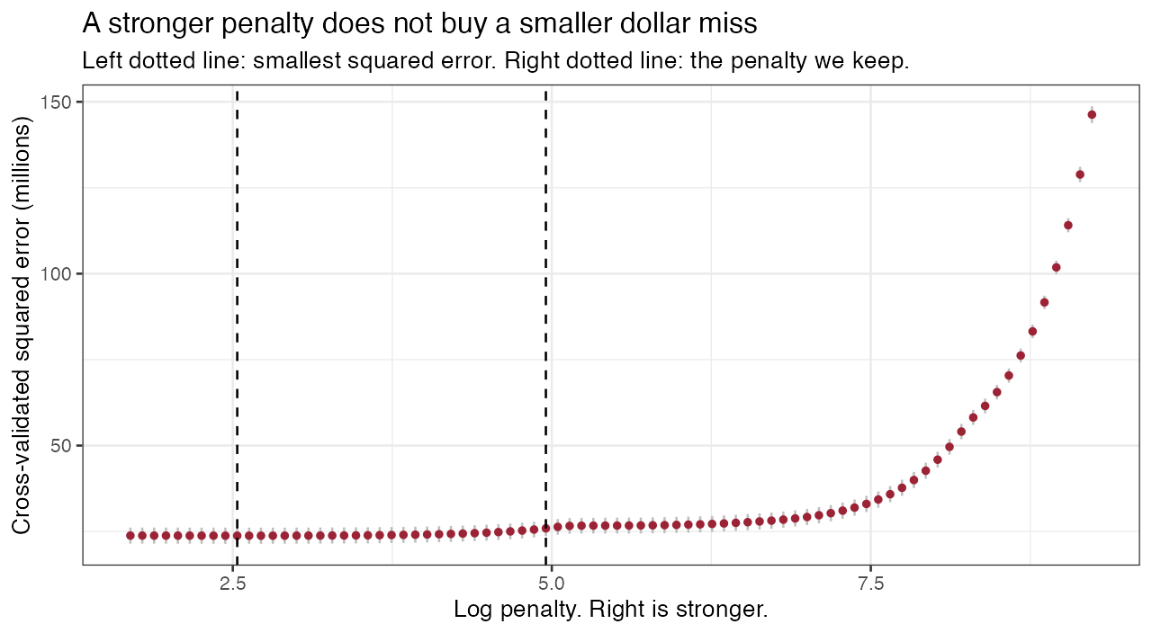
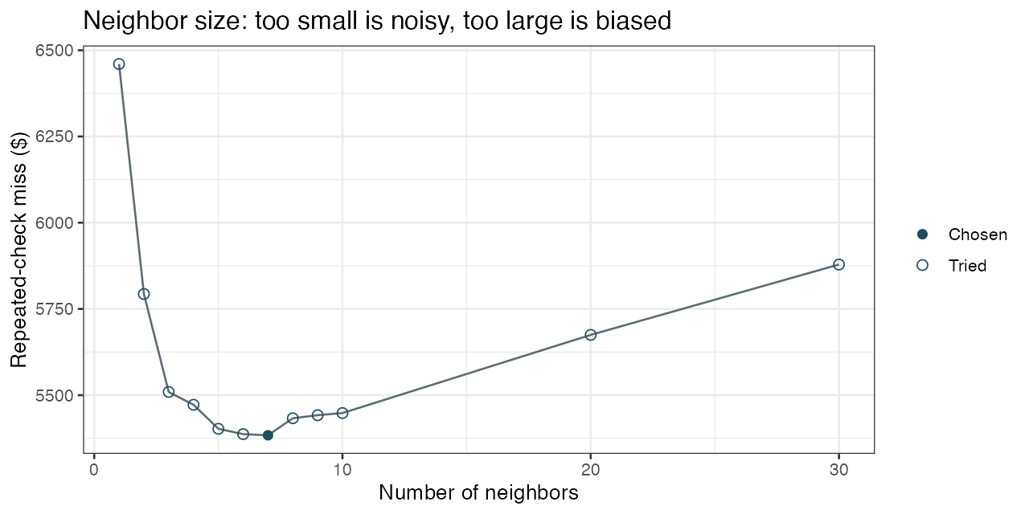
POWELL · BUI
IF ASKED
The penalty, and the neighborhood.
Between the smallest squared error and the penalty we keep, the error barely moves. Farther right, signal starts coming out. Neighbors of 1 and of 30 are both worse than 7, and 7 does not beat the equation.
HEALTH-ACCOUNT CHARGES
15 / 15
Notes:
Do not present this unless asked. It is the backup for two pictures in the brief.
Left, the penalty path. Cross-validated squared error stays flat between the minimum and the one-standard-error penalty we keep, then climbs once signal starts coming out. We keep 14 of 33 terms. There is no t-test on a term the penalty has already set to zero.
Right, neighborhood size. One neighbor is unstable, with a cross-validated RMSE of about $6,460. Thirty neighbors average people who are not alike, about $5,879. The size the cross-validation chose is k = 7, at $5,384, and it still loses to the explanation equation.
Full tables, the coefficient list, and the code are in the knitted brief.

