Slide 1
POWELL · BUI
A DECISION BRIEF
Health Account
Charges.
What is associated with the bill, and how we would price the next customer.
Aaron Powell and Thuan-Andy Bui
26 September 2026
HEALTH-ACCOUNT CHARGES
01 / 15
Notes:
0:00 to 0:40. Which customer facts are associated with health-account charges, and does that association depend on region? Separately, if the job is to price the next account, which method is the best?

Slide 2
POWELL · BUI
THE BIG PICTURE
Insurance insights
3.8x
$1,461
$264
$512
Average smoker charges
Per BMI point among smokers
Per year of age
Per child
$32,050 average smoker annual charges.
$8,441 average non-smoker annual charges.
$22,833 gap between smokers and non-smokers at BMI 30.
Among non-smokers, BMI is not a predictor of charges.
2% of the average bill.
Same slope for smokers and non-smokers. Range $245 to $283.
Sex is not clearly associated with charges (p-value = .062).
Adjusted, southeast is $1,207 lower and southwest $1,228 lower than northeast region.
Analysis supports an association in these customers. It does not support a national rate or a causal effect.
Reported as contrasts – all other variables held constant.
HEALTH-ACCOUNT CHARGES
02 / 15
Notes:
0:40 to 3:00. Let’s talk about the big picture, and the insights we found given the sample.
Smoking dominates. At BMI 30, holding age, children, and region fixed, mean charges for a smoker are about $23,000 higher. 280% higher than a non-smoker at the same BMI. BMI among smokers is associated with about $1,461 increase charges per point. There isn’t a significant association among non-smokers.
Age is associated with a $264 a year increase both smokers and non-smokers. The ordinary 95 percent interval is $245 to $283 using a paired bootstrap method. That is about 2 percent of the average bill. Each child is added is associated with about $512 increase in charges.
Sex is not clearly associated once the other facts are held fixed. The p-value is 0.062.
The unadjusted southeast looks expensive because it has more smokers and a higher BMI. After those are held fixed, the southeast mean is $1,207 lower than the northeast, and the southwest is $1,228 lower. The northwest did not have a clear difference from the northeast.
These are associations in 1,337 accounts in the sample. Not a national rate, and not what the bill would do if a particular person stopped smoking.

Slide 3
POWELL · BUI
DATA SUMMARY
1,337 customer accounts
Group | Customers | Average | Median | SD
Non-smoker | 1,063 | $8,441 | $7,346 | $5,993
Smoker | 274 | $32,050 | $34,456 | $11,542
Age
Years, 18 to 64
Sex
675 male, 662 female
BMI
Slope differs by smoker
Mean bill $13,279. Median $9,386.
Children
$512 each. Thin past 3.
Fact | Mean | SD | Min | Median | Max
Charges ($) | $13,279 | $12,110 | $1,122 | $9,386 | $63,770
Age (years) | 39.2 | 14.0 | 18 | 39 | 64
BMI | 30.7 | 6.1 | 16.0 | 30.4 | 53.1
Children | 1.1 | 1.2 | 0 | 1 | 5
Smoker
20.5% of the book
Region
Adjusted level shift
Charges
Skewed. Median $9,386
HEALTH-ACCOUNT CHARGES
03 / 15
Notes:
3:00 to 4:10.
1,337 records were examined, after dropping one exact duplicate. Smokers are 20.5 percent. Their average charges are higher than the median so smokers are not right-skewed. The remaining non-smokers have higher average than median which presents a right skewed distribution for the sample. For this reason, we consider both mean and median in our analysis.
The right-hand list only names the facts. Forty-three people have four or five children, so the per-child slope is identified mostly from zero to three. Do not define BMI. If the clock is behind, two sentences and move on.

Slide 4
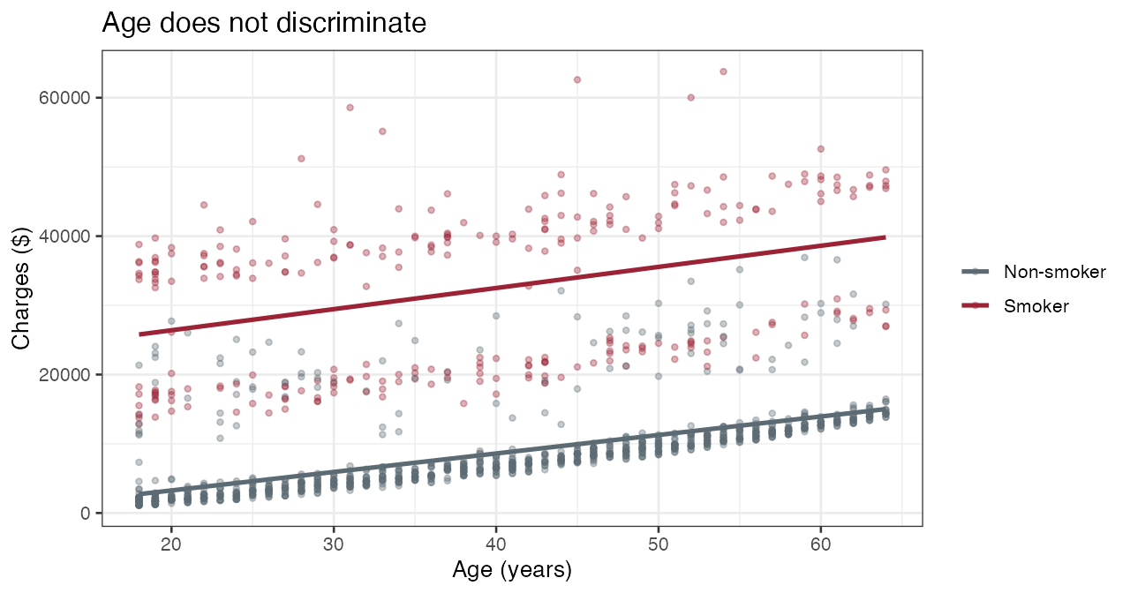
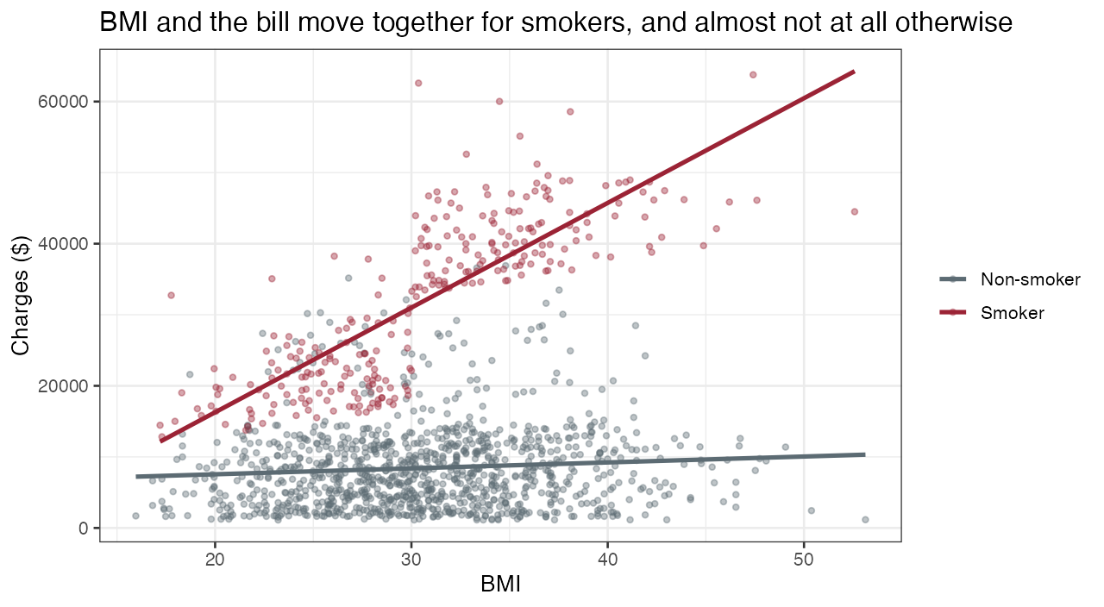
POWELL · BUI
DATA SUMMARY
Age lifts both groups. BMI lifts smokers.
Age correlation is 0.63 for non-smokers and 0.37 for smokers. The lines are roughly parallel. Smoking is a level shift of tens of thousands of dollars. Age is a few hundred a year.
BMI correlation is 0.81 for smokers and 0.08 for non-smokers. One smoker number would average a steep line and a flat line into a sentence that is true for neither group.
HEALTH-ACCOUNT CHARGES
04 / 15
Notes:
4:10 to 6:10. This slide is why the equation has an interaction and one age slope.
Left, age. Say the correlations before you point: 0.63 among non-smokers and 0.37 among smokers. The lines are roughly parallel. Letting the age slope differ by smoker does not improve the dollar equation. Smoking is a level shift of tens of thousands of dollars. Age is a few hundred a year.
Right, BMI. Correlation 0.81 for smokers and 0.08 for non-smokers. One smoker coefficient with a single BMI slope would average a steep line and a flat line into a number that is true of neither group. The smoker gap has to be stated at a BMI we actually see. BMI 0 is not an account. We quote 25, 30, and 35.
Children, if you have the second: correlation with charges is about 0.07. The nested test keeps a per-child amount. We do not pretend the line is well seen past three children.

Slide 5
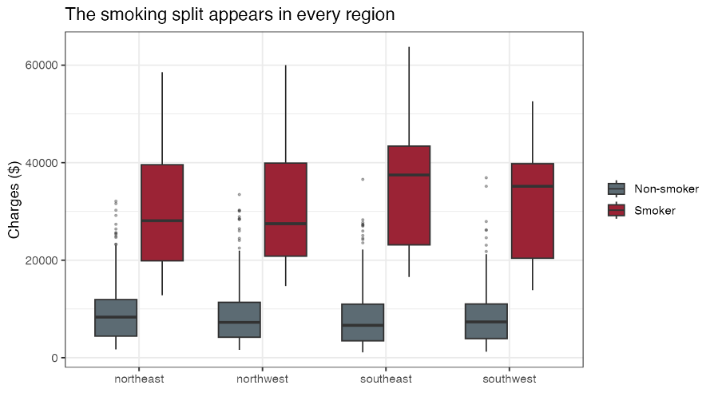
POWELL · BUI
DATA SUMMARY
Region shift
Region | Customers | Average BMI | Smoker share | Average bill
Northeast | 324 | 29.2 | 20.7% | $13,406
Northwest | 324 | 29.2 | 17.9% | $12,451
Southeast | 364 | 33.4 | 25.0% | $14,735
Southwest | 325 | 30.6 | 17.8% | $12,347
Southeast smokers average $34,845 before any adjustment. Northeast smokers average $29,674.
Region is mostly who is in the band, plus a level shift once smoking and BMI are held fixed.
The smoker gap does not depend on region (p = 0.31). The age slope does not (p = 0.28), nor the smoker BMI slope (p = 0.20).
Southeast has the highest unadjusted average bill, the highest average BMI, and the highest smoker share.
HEALTH-ACCOUNT CHARGES
05 / 15
Notes:
6:10 to 7:40. The picture and the table are the same sentence: a high smoker band and a low non-smoker band in every region.
Southeast smokers average $34,845 before any adjustment. Northeast smokers average $29,674. Southeast also has the highest average BMI, 33.4, and the highest smoker share, 25 percent. That is why the unadjusted southeast bill looks high.
Then the tests, slowly. The smoker gap does not depend on region, p = 0.31. The age slope does not, p = 0.28. The smoker BMI slope does not, p = 0.20. There is a smaller result that is not on this slide. The non-smoker BMI slope does differ by region, p = 0.011, and both of those slopes are tiny next to $1,461 a point for smokers. We report it and leave it out of the equation we would say out loud.

Slide 6
POWELL · BUI
THE EQUATION
The equation we would defend.
Charges = age + children + BMI + smoker + (BMI × smoker) + region
Non-smoker and northeast are the reference.
Kept
Age, one slope for both groups
Kept
Children, about $512 each
Kept
A BMI slope only where it exists: smokers
Kept
Region as a level shift
Left out
Sex. p = 0.062 after other facts
Left out
A different smoker gap by region. p = 0.31
Left out
A different age slope by region, or by smoker
HEALTH-ACCOUNT CHARGES
06 / 15
Notes:
7:40 to 9:10. Read the equation once, slowly. Then what we kept and what we refused.
Dollar scale. Non-smoker and northeast are the reference. Adjusted R-squared is 0.84. That is how much of this file the line tracks. It is not the dollar miss on a new account.
Sex stays out. p = 0.062, close to the 5 percent line we used, and not a clear association. Say that if someone pushes. A different smoker gap by region stays out, p = 0.31. A different age slope, by region or by smoker, stays out.
We also fit the log of charges and did not adopt it. Say this only if asked, or on the residual slide. A common percent per year is too steep for smokers, and giving smokers their own age slope on the log scale makes the residual spreads unequal again.

Slide 7
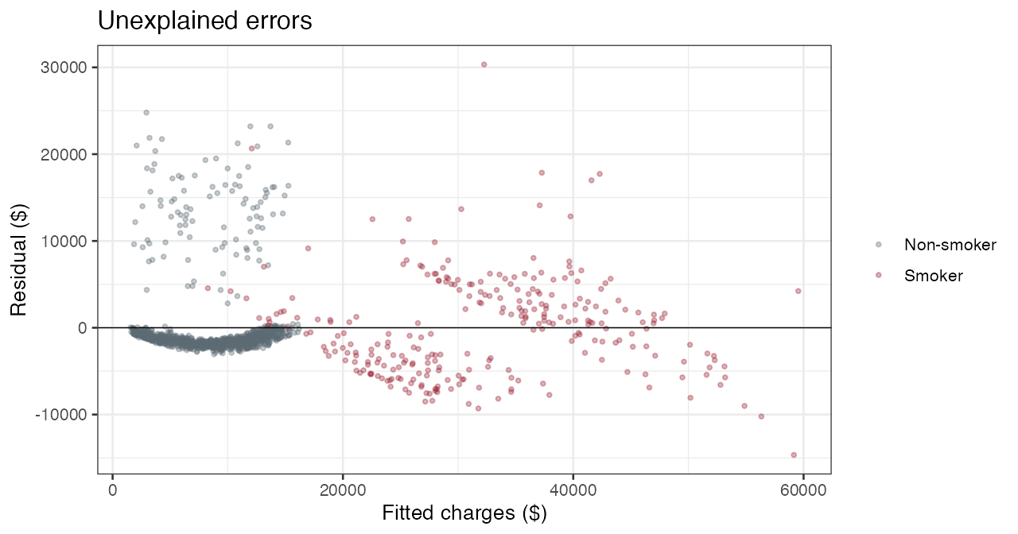
POWELL · BUI
THE EQUATION
Unique variation
$5,717
Smoker residual SD.
$4,588
Non-smoker residual SD.
48 people
Studentized residual beyond 3. Almost all are non-smokers. Nothing in the file explains them.
HEALTH-ACCOUNT CHARGES
08 / 15
Notes:
10:50 to 12:10. Three clouds, then the handoff.
The main non-smoker band sits near zero. The smoker cloud is wider and sits at higher fitted bills. A third group of non-smokers lands in the smoker range. We did not delete them. The largest Cook's distance is 0.055. A screen of 4 over n is about 0.003 and flags 92 rows at this sample size. It is a screen, not a deletion rule. Nothing dominates the fit.
Forty-eight accounts have a studentized residual beyond 3. Almost all are non-smokers. Nothing in the file explains them. Smoker residual SD is $5,717. Non-smoker residual SD is $4,588. The ratio is about 1.25.
A log scale looks calmer and we refused it. On the log, a common age slope is rejected. Putting in a different age slope for smokers makes the spreads unequal again. This is why we will not publish one linear error bar, even though this equation is what we would explain. Hand the pricing half to your partner.

Slide 8
POWELL · BUI
PRICING THE NEXT CUSTOMER
Prediction models
Method | 10-fold CV RMSE | Holdout RMSE
Explanation equation | $4,816 | $4,714
All two-way products | $4,842 | $4,761
Term search | $4,836 | $4,781
Shrunk equation | $5,050 | $4,842
Nearest neighbors | $5,384 | $5,165
Averaged trees | $4,867 | $4,448
Random forest | $4,624 | $4,366
Term search wins on AIC and loses on RMSE. Averaged trees win the holdout and lose the CV. The forest wins both.
HEALTH-ACCOUNT CHARGES
09 / 15
Notes:
12:10 to 13:30. Do not read every row. Point at the tan row, then at two failures.
The metric is root-mean-square error, in dollars. Say it once. The columns are a 10-fold cross-validation, the same folds for every method, and one 80/20 holdout: 1,072 accounts to fit, 265 to score. Seed 1234.
The forest is lowest on both: $4,624 cross-validated, $4,366 on the holdout. The explanation equation is $4,816 and $4,714. The cross-validated gap is $192. The forest's fold-to-fold standard deviation is $763, so that edge is inside the variation. Do not sell a transformation in accuracy.
The term search has a better AIC, about 21,258 against 21,267, because that is the score it was asked to optimize. Its cross-validated RMSE is $4,836, slightly worse. AIC does not price a new account. Averaged trees beat the equation on the holdout, at $4,448, and lose the cross-validation, at $4,867. One split is not the decision. The reason to score with the forest is the shape on the next slide, not the $192.

Slide 9
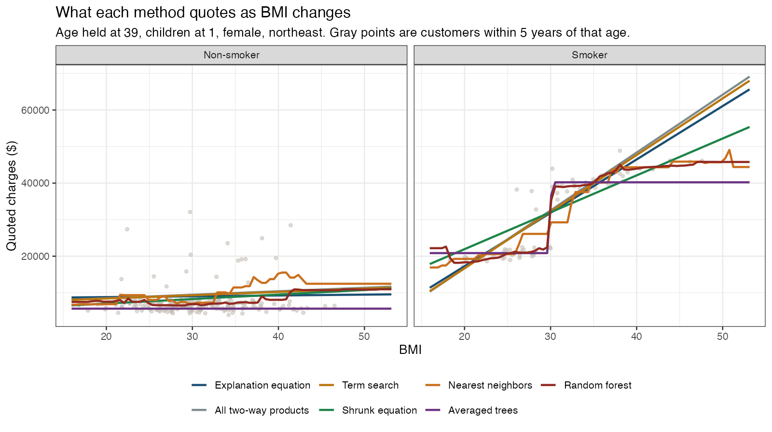
POWELL · BUI
PRICING THE NEXT CUSTOMER
Regression overfits – Trees split
HEALTH-ACCOUNT CHARGES
10 / 15
Notes:
13:30 to 15:00. This is the picture. Do not read the legend item by item.
Age is held at 39, children at one, female, northeast. The gray points are real accounts within five years of 39. A line that sits off the cloud is bias. A line that jumps from one BMI to the next is variance.
Left, non-smokers. Every method sits in the lower cloud. None of them climbs to the accounts whose bills are far above that band. The orange neighbor line wiggles toward a few of those points and falls back. The wiggle does not explain the band.
Right, smokers. The straight lines keep climbing and pass $60,000. The cloud flattens. Around a BMI of 30 the forest, the neighbors, and the averaged trees step up and then level off. The straight line is biased high once BMI is high. The forest is the calmest line that is allowed to bend. The neighbors still jump.
One sentence on the margin, then leave it for the close. For the forest, 95 percent of left-out smoker bills fell within $9,800 of the quote, and 95 percent of non-smoker bills within $12,486. The tail is a bill above the quote. Do not convert it to a percent of the average bill.

Slide 10
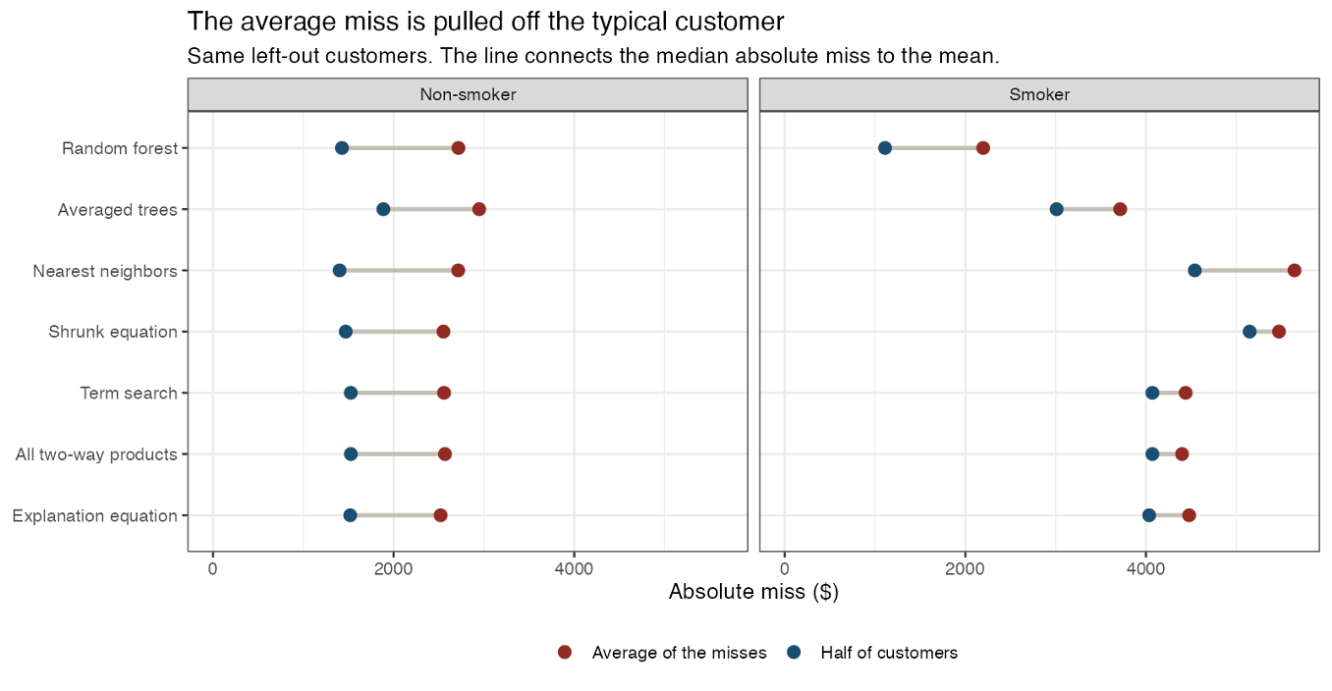
POWELL · BUI
PRICING THE NEXT CUSTOMER
Average vs typical error
HEALTH-ACCOUNT CHARGES
11 / 15
Notes:
15:00 to 16:20. Say this before you lean on the RMSE ranking. Blue is the median absolute error. Half of the left-out accounts are closer to the quote than that dot. Red is the mean of the same absolute errors, pulled right by a minority of bills.
Right panel, smokers. The forest's median is $1,111. The equation's is $4,035. Averaged trees are about $3,011. For the typical smoker the forest is about $2,900 closer. That is the gain. The $192 of cross-validated RMSE was never this story.
Left panel, non-smokers. The medians sit together, about $1,400 to $1,900. Neighbors are $1,402 and the forest is $1,428. Do not propose two scorers over $26. On non-smokers the equation is slightly closer on RMSE, about $4,612 against $4,811, and that gap is also inside the fold variation. The forest's win is the smoker book.
The outer margin has not gone away. It is the tail, not the typical account. And be straight about it: on the 95 percent absolute error for smokers, the equation is $9,489 and the forest is $9,800. The forest is not tighter there.

Slide 11
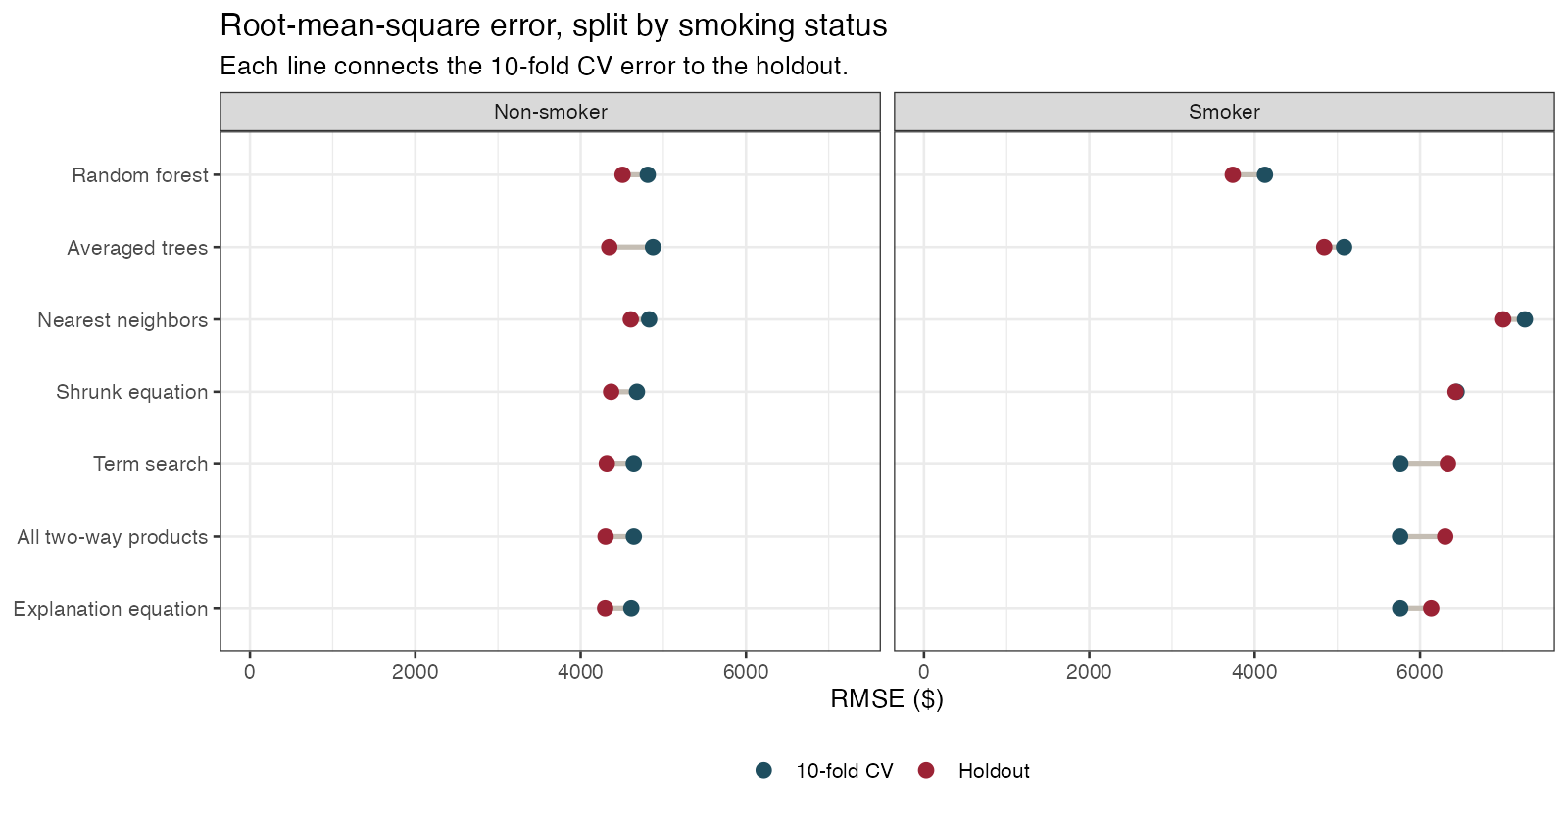
POWELL · BUI
PRICING THE NEXT CUSTOMER
Random forest's RMSE advantage comes from smokers
HEALTH-ACCOUNT CHARGES
11 / 15
Notes:
16:20 to 17:20. This slide breaks the prediction error down by smoking status so we can see where the random forest is actually helping.
Remember, lower RMSE is better.
For nonsmokers, the models are fairly close. In fact, on the 10-fold cross-validation, the explanation equation is slightly better than the random forest about $4,612 versus $4,811. That difference is also small relative to the amount of variation across the folds.
The bigger difference appears among smokers. The random forest performs much better there because it can follow the nonlinear pattern we saw earlier, where smoker charges rise with BMI and then begin to level off instead of continuing in a straight line.
So the random forest’s overall advantage is not coming equally from every customer. Most of the gain is coming from better predictions for smokers.
That’s why we still prefer the random forest for pricing, even though the regression remains very competitive for nonsmokers.
.

Slide 12
POWELL · BUI
THE DECISION
Two jobs. Two tools.
EXPLAIN
PRICE
The equation.
The random forest.
Age, children, a smoker gap that depends on BMI, and a regional level shift. Quote the paired bootstrap interval on age and on the smoker gap at BMI 30. Do not quote the smoker coefficient at BMI 0. Do not call the southeast expensive after smoking and BMI are held fixed.
Lowest RMSE on the 10-fold CV and the holdout. The CV edge is $192, inside a $763 fold SD. The gain is the typical smoker, about $1,111 versus $4,035. One residual spread does not fit both groups. This is not an explanation.
HEALTH-ACCOUNT CHARGES
13 / 15
Notes:
17:20 to 18:30. This is the decision. Two jobs, two tools. Say the $192 out loud so nobody leaves thinking the forest is a different business.
Explain with the equation. Age, children, a smoker gap that depends on BMI, and a regional level shift. Quote the paired bootstrap interval for the age slope and for the smoker gap at BMI 30. Do not quote the smoker coefficient. It is the gap at BMI 0. Do not call the southeast expensive after smoking and BMI are held fixed.
Price with the forest. Lowest RMSE on both checks. Use it because the quote levels off with the smoker cloud instead of climbing past it, and because the typical smoker is about $2,900 closer. It does not assume one residual spread. It also cannot say what a year of age is worth. Do not describe it as an explanation.
The limit, in one sentence. On the holdout, 16 non-smokers have bills above $15,000. The equation misses that group by about $14,036 on average. The forest misses them by about $13,554. A more flexible scorer does not explain those accounts.

Slide 13
POWELL · BUI
WHAT WE WILL NOT CLAIM
The sample supports an association.
Not a national rate, and not a cause.
Scope
Cause
Four region labels in this file. No household, plan, or year. Independence is an assumption, not a result.
Smoking was not assigned. $22,833 is a contrast in this file, not the effect of someone quitting.
95% prediction-error margin
More time
95% of left-out smoker bills fell within $9,800 of the forest quote. Non-smokers, within $12,486. The equation is $9,489 and $13,031 on that cut. Not a tighter smoker margin, and not a percent of the average bill.
What the sample does not contain: diagnosis, plan design, deductible, and whether the charge is one year.
HEALTH-ACCOUNT CHARGES
14 / 15
Notes:
18:30 to 20:00. Four limits, then stop. Do not add a method you did not run.
Scope. Four region labels in this file. No household, plan, or year, so independence is an assumption, not a result. Generalizing past these labels is a guess.
Cause. Smoking, BMI, and region were not assigned. $22,833 is a contrast in this file with age, children, and region held fixed. It is not an estimate of what the bill would do if a particular person stopped smoking.
The margin. Ninety-five percent of left-out smoker bills fell within $9,800 of the forest quote, and 95 percent of non-smoker bills within $12,486. That is a percentile of absolute errors, not a confidence interval, and not a percent of the average bill. The equation is as tight or tighter for smokers, at $9,489.
More time. Diagnosis, plan design, deductible, and whether the charge is one year or many. Then a later book of accounts, not another split of this one, before treating a $192 edge as stable. Stop. The backup stays down unless someone asks how the penalty or the neighborhood behaved.

Slide 14
POWELL · BUI
THE EQUATION
Detailed Insights
AGE
Holding BMI, smoking, children, and region fixed, one more year of age is associated with $264 higher mean charges. Ordinary 95% interval $245 to $283. The paired bootstrap interval is the same. About 2% of the average bill. Same slope in both groups.
SMOKER, AT BMI 30
Holding age, children, and region fixed, a smoker at BMI 30 has mean charges $22,833 higher than a non-smoker at the same BMI. The paired bootstrap interval is $22,045 to $23,566. At BMI 25 the gap is $15,643. At BMI 35 it is $30,024. This describes the file. It is not what the bill would do if a particular person stopped smoking.
HEALTH-ACCOUNT CHARGES
07 / 15
Notes:
9:10 to 10:50. Read both contrasts almost as written. Do not drop the holding-fixed clause. This is the interpretation.
Age. One more year, with BMI, smoking, children, and region held fixed, is associated with $264 higher mean charges. Ordinary 95 percent interval $245 to $283. The paired bootstrap, which redraws whole accounts and keeps each person with their own residual, gives the same interval. Same slope in both groups. About 2 percent of the average bill.
Smoker gap at BMI 30. Holding age, children, and region fixed, the contrast is $22,833. The paired bootstrap interval we would quote is $22,045 to $23,566. The ordinary interval is $22,182 to $23,484. They agree because the contrast is many standard errors from zero. The ordinary interval is still approximate, because residual spread is wider for smokers. At BMI 25 the gap is $15,643. At BMI 35 it is $30,024. This describes the file. It is not the effect of a person quitting.
If asked. Children are $512, ordinary interval $296 to $729. Northwest versus northeast is about minus $578, and that interval includes zero. Southeast minus $1,207, interval minus $1,959 to minus $455. Southwest minus $1,228, interval minus $1,978 to minus $477.

Slide 15
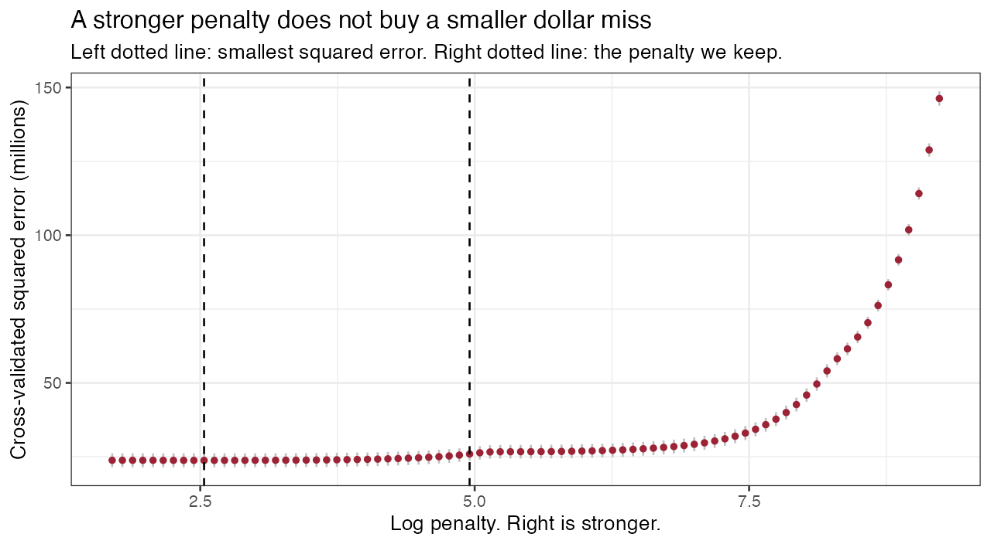
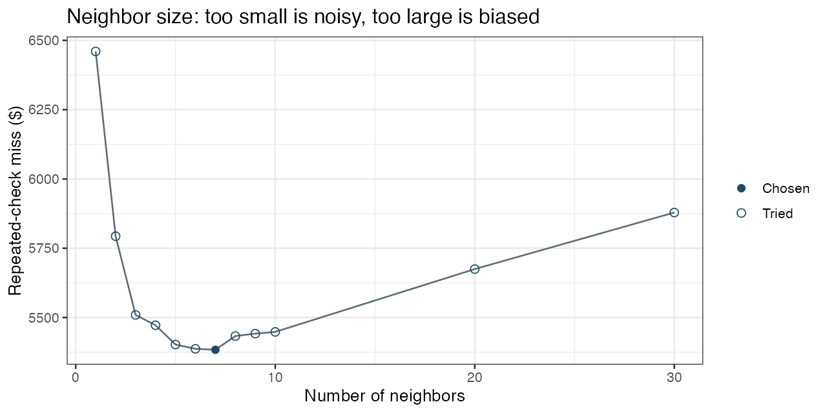
POWELL · BUI
IF ASKED
The penalty, and the neighborhood.
Between the smallest squared error and the penalty we keep, the error barely moves. Farther right, signal starts coming out. Neighbors of 1 and of 30 are both worse than 7, and 7 does not beat the equation.
HEALTH-ACCOUNT CHARGES
15 / 15
Notes:
Do not present this unless asked. It is the backup for two pictures in the brief.
Left, the penalty path. Cross-validated squared error stays flat between the minimum and the one-standard-error penalty we keep, then climbs once signal starts coming out. We keep 14 of 33 terms. There is no t-test on a term the penalty has already set to zero.
Right, neighborhood size. One neighbor is unstable, with a cross-validated RMSE of about $6,460. Thirty neighbors average people who are not alike, about $5,879. The size the cross-validation chose is k = 7, at $5,384, and it still loses to the explanation equation.
Full tables, the coefficient list, and the code are in the knitted brief.

